Slide 1

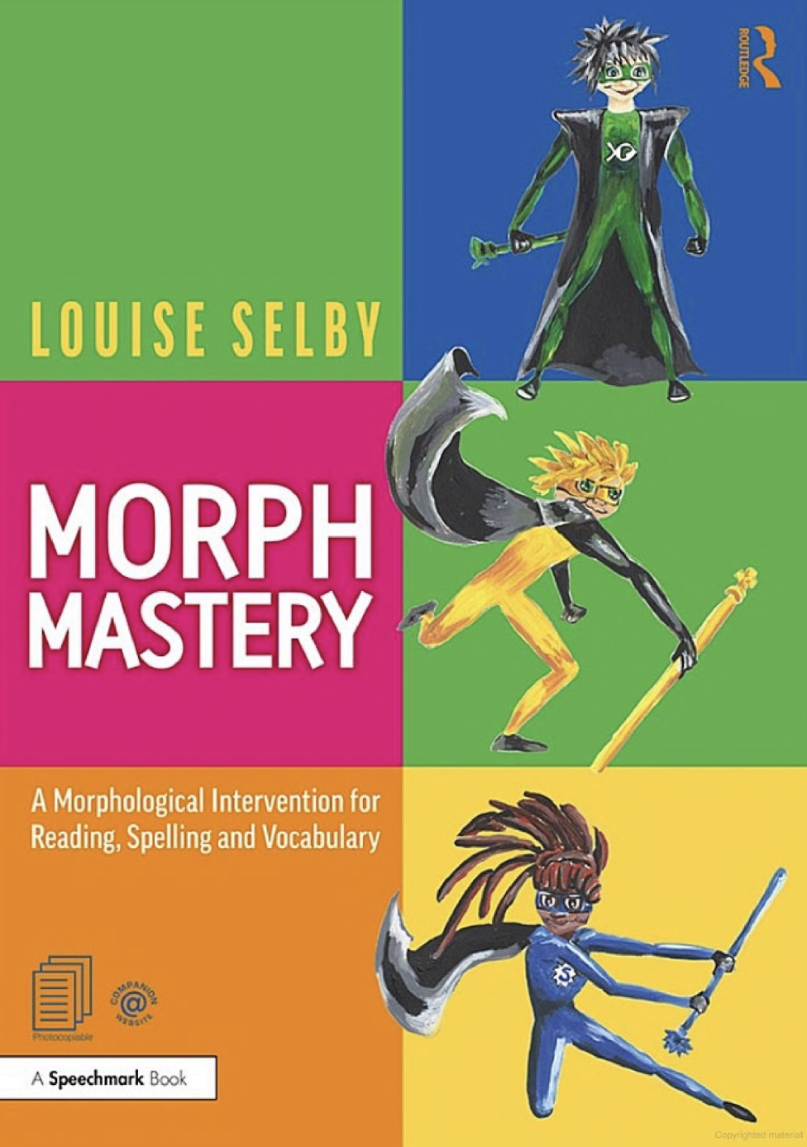
What we have found from using Morph mastery

Slide 2
How our journey started…
What next for those where phonics hasn’t worked?
Whole school training (2023)
Small group interventions
A year of research by English Lead
English lead led training to whole staff (2025)
Implemented whole school approach

Slide 3
Benefits:
Challenges:
Increased motivation
Enjoyment of words
Enhanced confidence
Expand word knowledge and vocabulary
Measurable progress
Staff development
Significant time and resource commitment
It can initially seem overwhelming

Slide 4
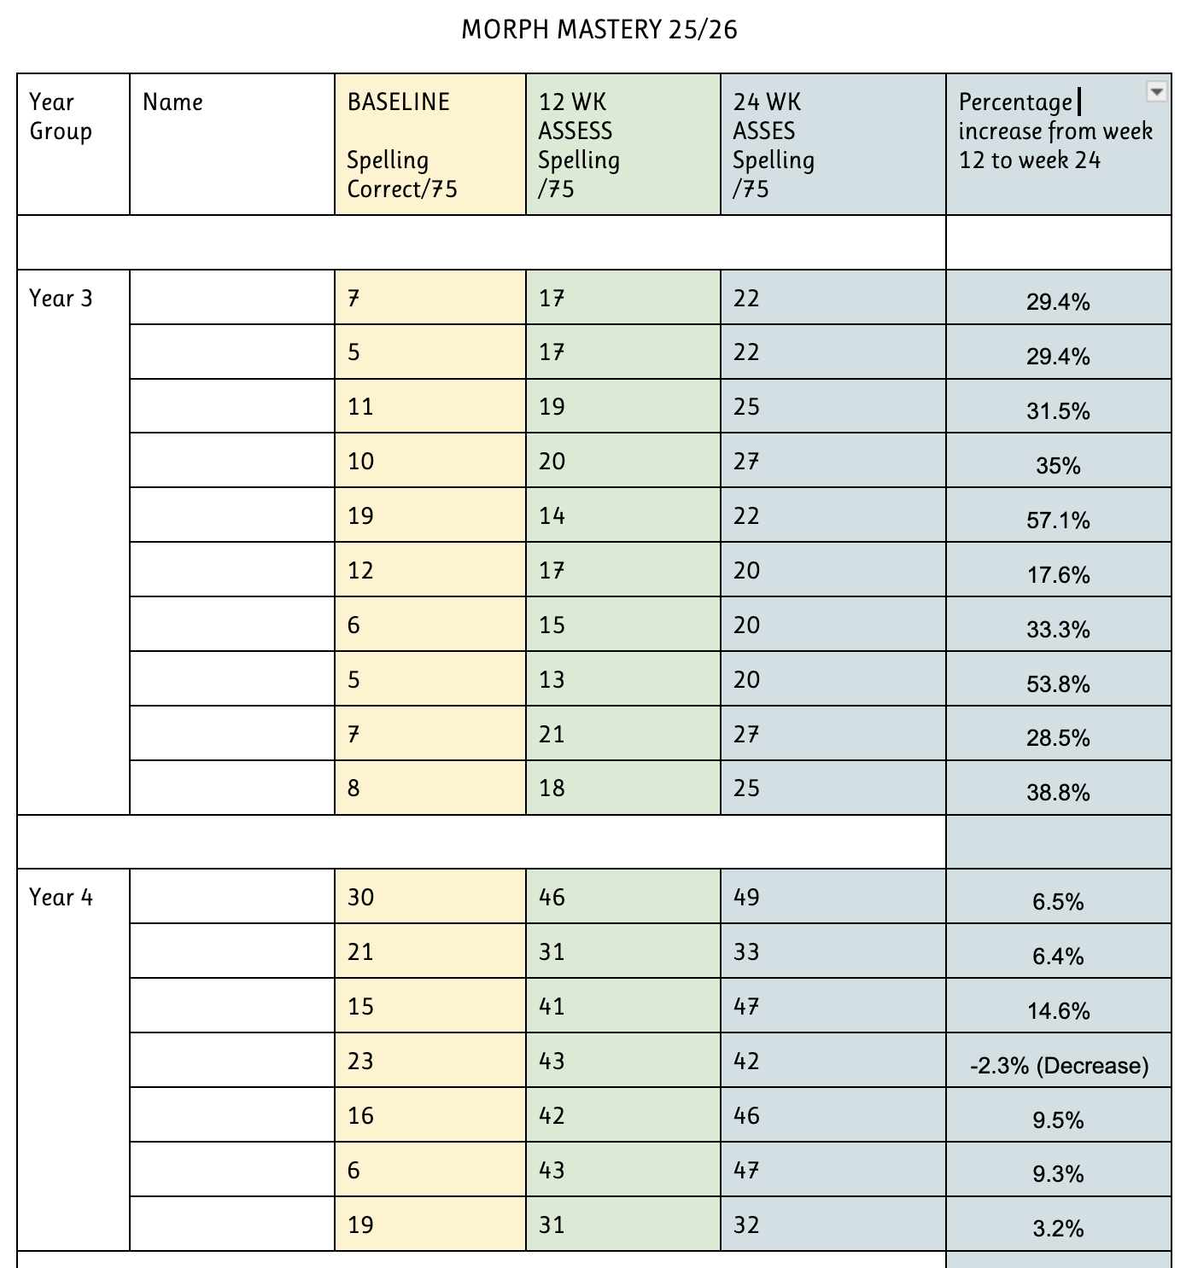
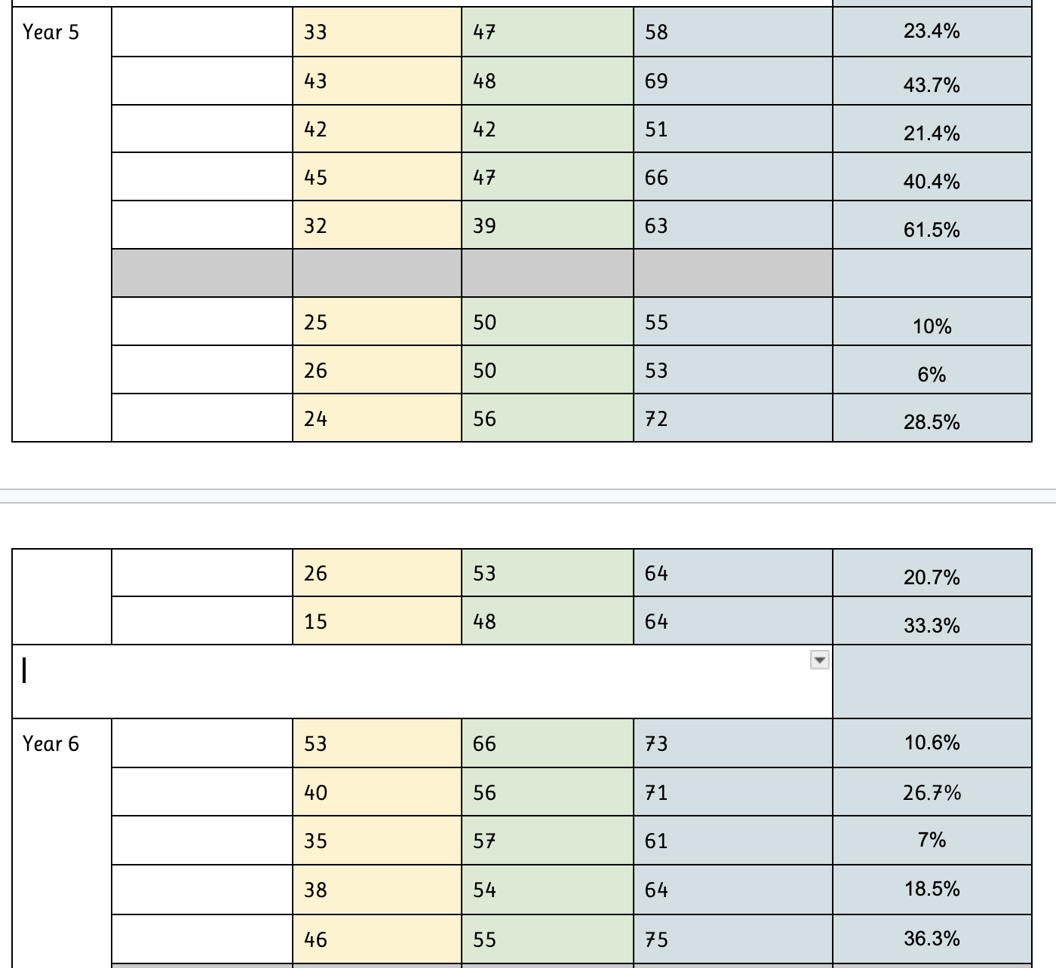
The evidence

Slide 5
What do group sessions look like?
3-5 children
3 times a week
15 minute sessions

Slide 6
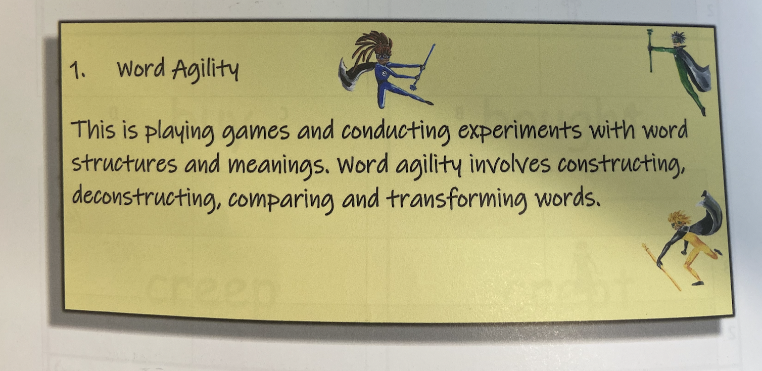
Day 1 - What does this look like whole school?
Picture taken from Morph Mastery handbook - Louise Selby

Slide 7
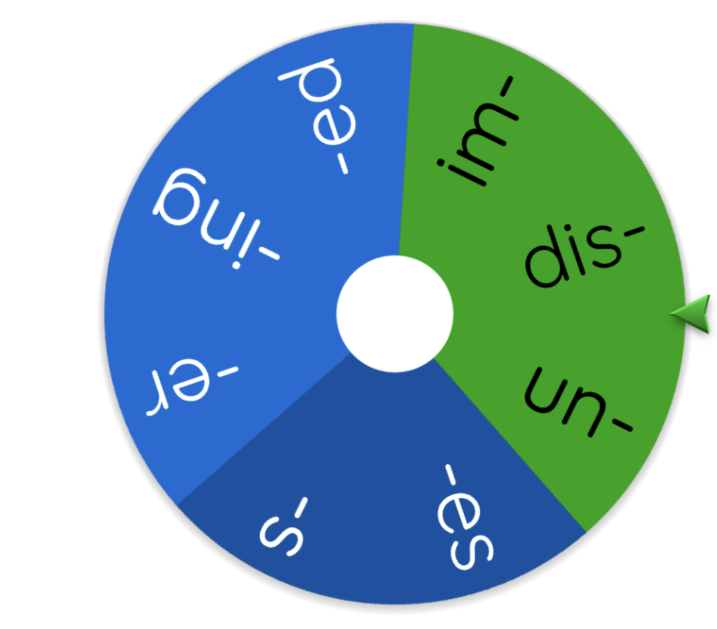
Spinner

Slide 8
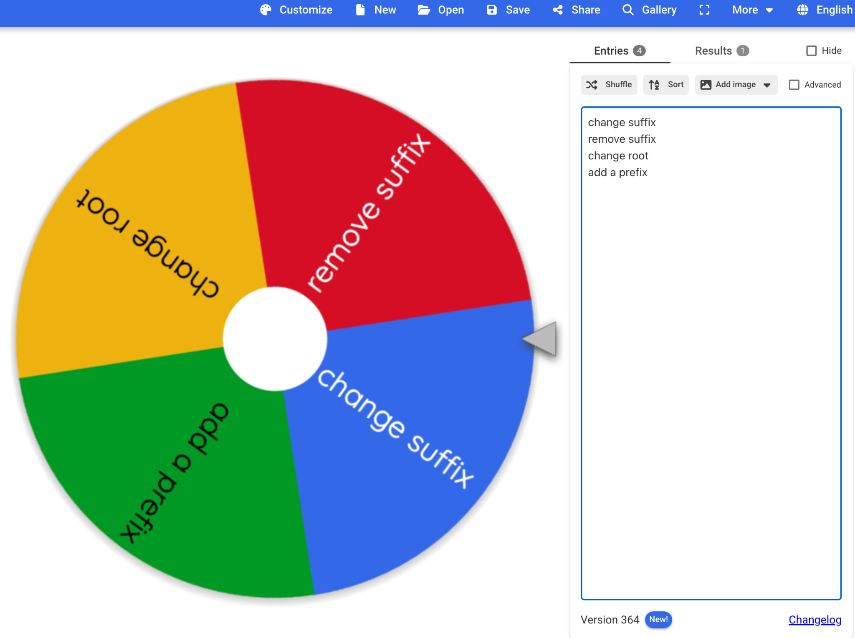
wordcraft

Slide 9
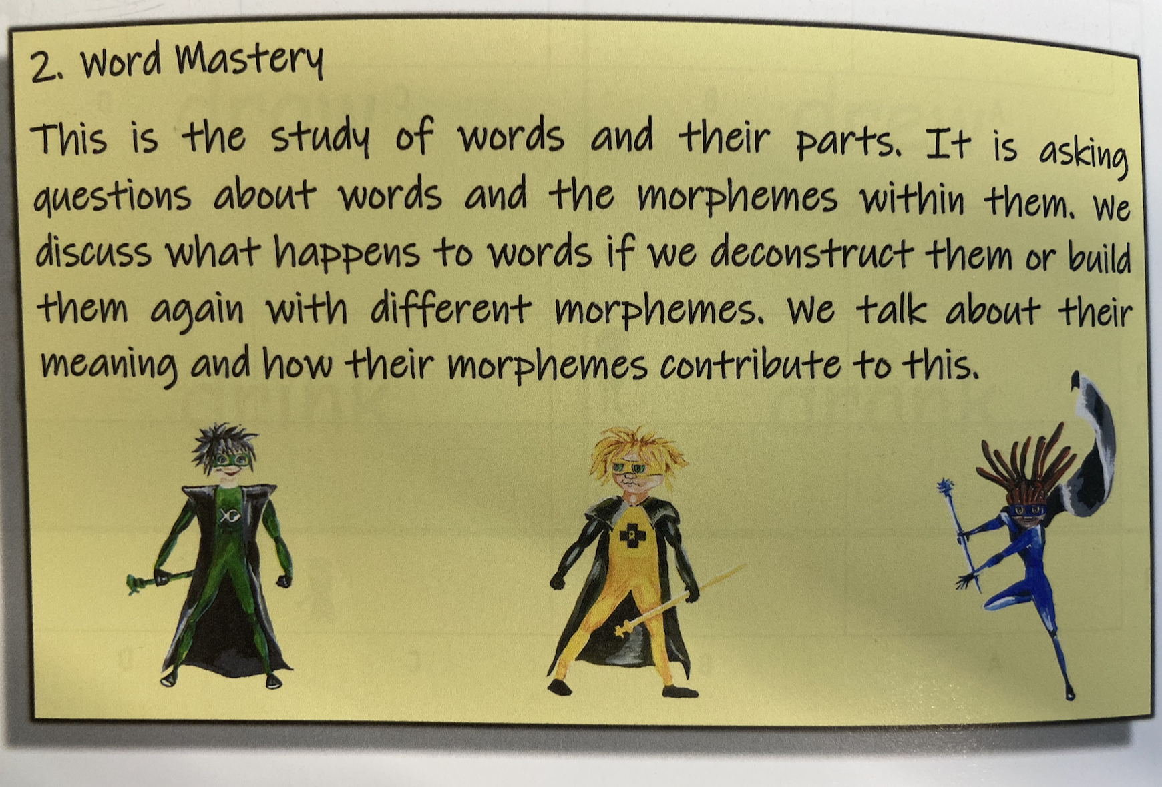
Day 2
Picture taken from Morph Mastery handbook - Louise Selby

Slide 10
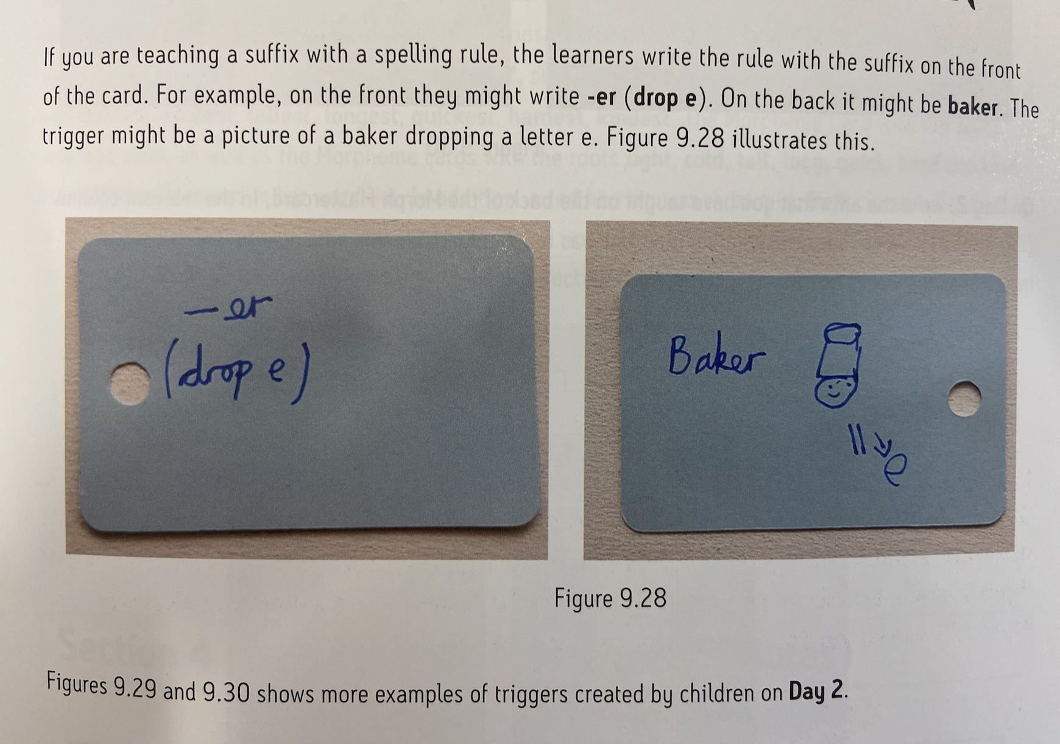
Trigger Cards
Picture taken from Morph Mastery handbook - Louise Selby

Slide 11
dislike
dismake
Word
Not a word

Slide 12
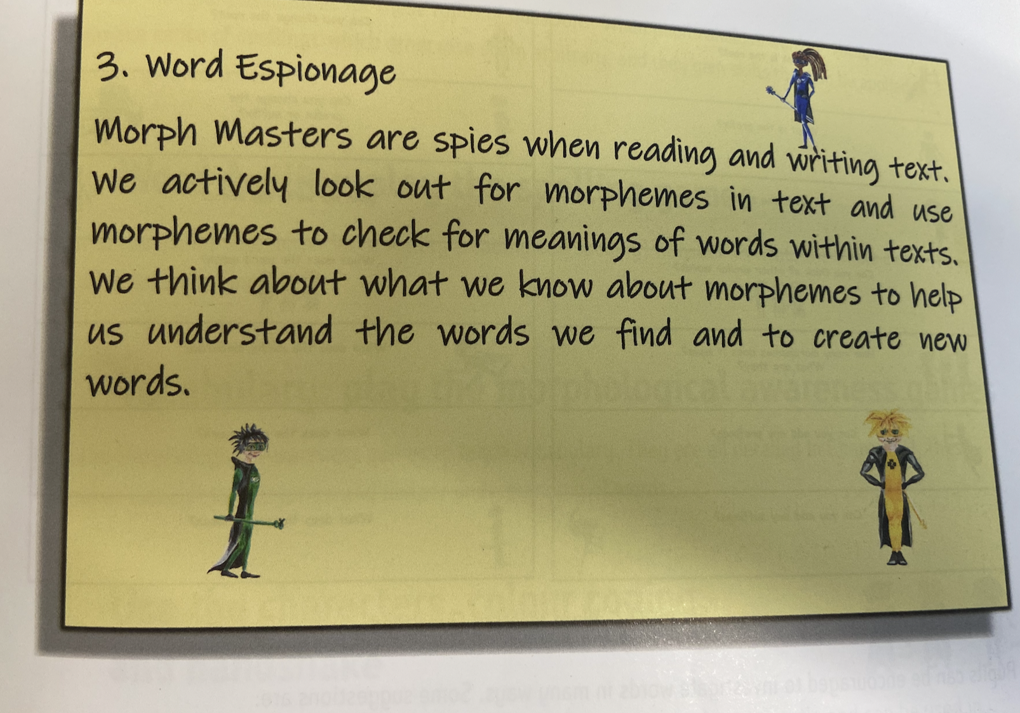
Picture taken from Morph Mastery handbook - Louise Selby

Slide 13
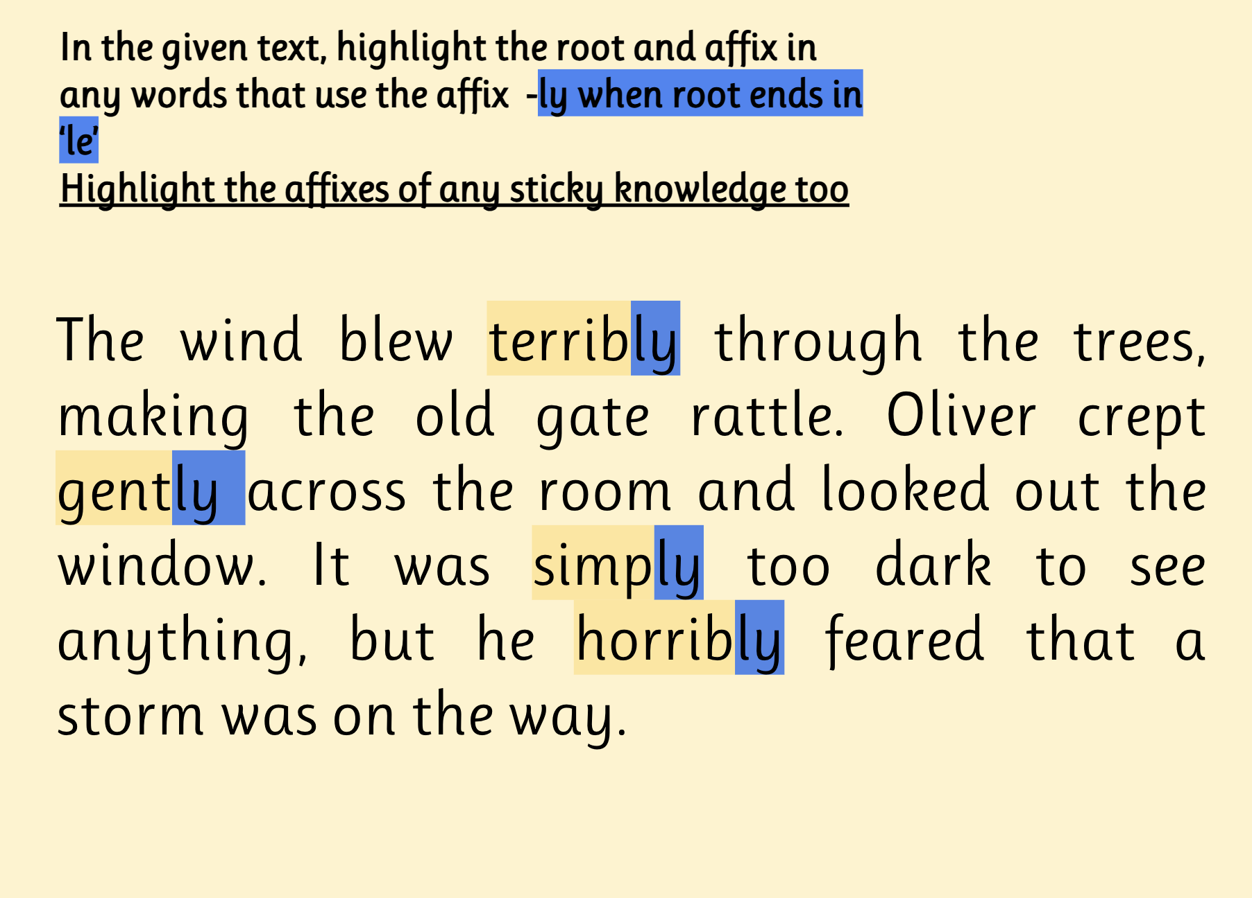
Notes:
Can you identify the root of each word?
Can you identify any words in your own writing?

