Slide 1

Graduated Approach Briefings
June/July 2026
Notices
Notes:
Welcome and remind that they can still complete the GAB survey from QR code

Slide 2
Graduated Approach Briefings
Run by the Inclusion Team:
James.Morris2@lincolnshire.gov.uk – Quality and Effectiveness Lead
Karen.Donnelly@lincolnshire.gov.uk – Specialist Teaching Teams
Karen.Richardson3@lincolnshire.gov.uk – PRT, AskSALL, Inclusion
The agenda is set following requests from SENCOs so please email with content suggestions.
We are very keen to have SENCOs share examples of good practice – what is working well in your school???
Please make sure BS-SEND has your up-to-date email address

Slide 3



More information on the role of the Virtual School can be
found at: Promoting the education of children with a social worker and children in kinship care arrangements: virtual school head role extension - GOV.UK (www.gov.uk)
Please don’t hesitate to contact us for any CiC, CWSW, PLAC and Kinship care guidance: VirtualSchool@Lincolnshire.gov.uk or contact your co-ordinator directly.
Notes:
Jen

Slide 4


Lincolnshire Virtual School Training Offer
All bookings are made through our 2025 – 2026 booklet. You do not have to have a child in care to attend our training.
If you require any further information or advice around our training offer, email us on: VirtualSchoolTraining@lincolnshire.gov.uk
Notes:
Link for training offer

Slide 5
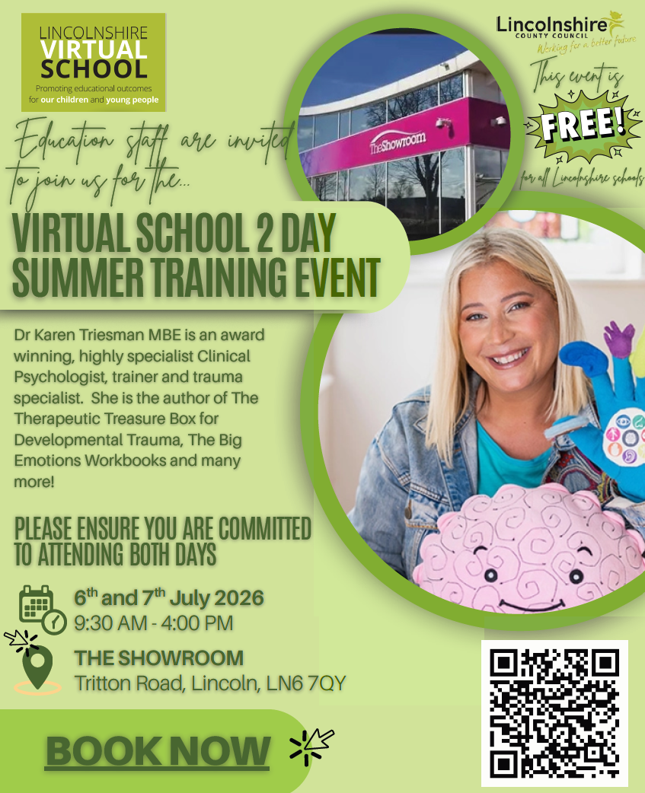

Slide 6


Virtual School Padlet
One stop shop for all things Virtual School
Training Pathway
PEP Guidance and Support
Conference/Training Event
Children with a Social Worker information
Post 16 information

Slide 7

Dyslexia Outreach 2026-2027
Who we are:
We are two specialist teachers, with a wealth of expert knowledge and experience in teaching and supporting students with Dyslexia and/or cognition and learning difficulties.
We offer a county-wide service provided by Lincolnshire County Council.
We provide free of charge advice and support, as well as a range of training options for schools and other organisations.
Contact details: NEW TEAM!!!!!
Jenny Murray covers the southern half of Lincolnshire; Helena Sharman covers the northern half of the county.
Jenny Murray: jenny.murray@lincolnshire.gov.uk Tel: 07825024084
Helena Sharman: helena.sharman@lincolnshire.gov.uk Tel: 07789926106
Dyslexiaoutreach@lincolnshire.gov.uk
Whole school training:
Twilight sessions are charged at £170
Dyslexia Awareness and Strategies
Dyslexia and Spelling
Memory and Metacognition
Using a Morphological Approach to Literacy
Dyscalculia & Maths Difficulties
Examination Access Arrangements
TA training:
TA training sessions that can be delivered during the school day are provided free of charge.
Precision Teaching
Morphology
Multisensory Strategies to Support Literacy and Maths
T.A. Discussions/Q&A Sessions
In addition, any of the whole school training packages can be adapted for TAs.
Supporting and advising parents/carers:
All support for parents/carers is free of charge.
Working with parents to enable them to provide the best support to their children and understand their needs is crucial to ensuring a successful whole team approach to SEND.
We can help schools to achieve this by offering the following:
Developing parents’ understanding of literacy and maths difficulties
Advice on strategies to support at home
Transition support
Drop-in advice sessions/attendance at coffee mornings
Parent workshops
Attendance at meetings
Mediation and liaison support
In addition to the above, we are happy to offer bespoke training packages for teachers and teaching assistants, based on a school’s individual needs. These are priced at £85 per hour with a minimum charge of £170.

Slide 8
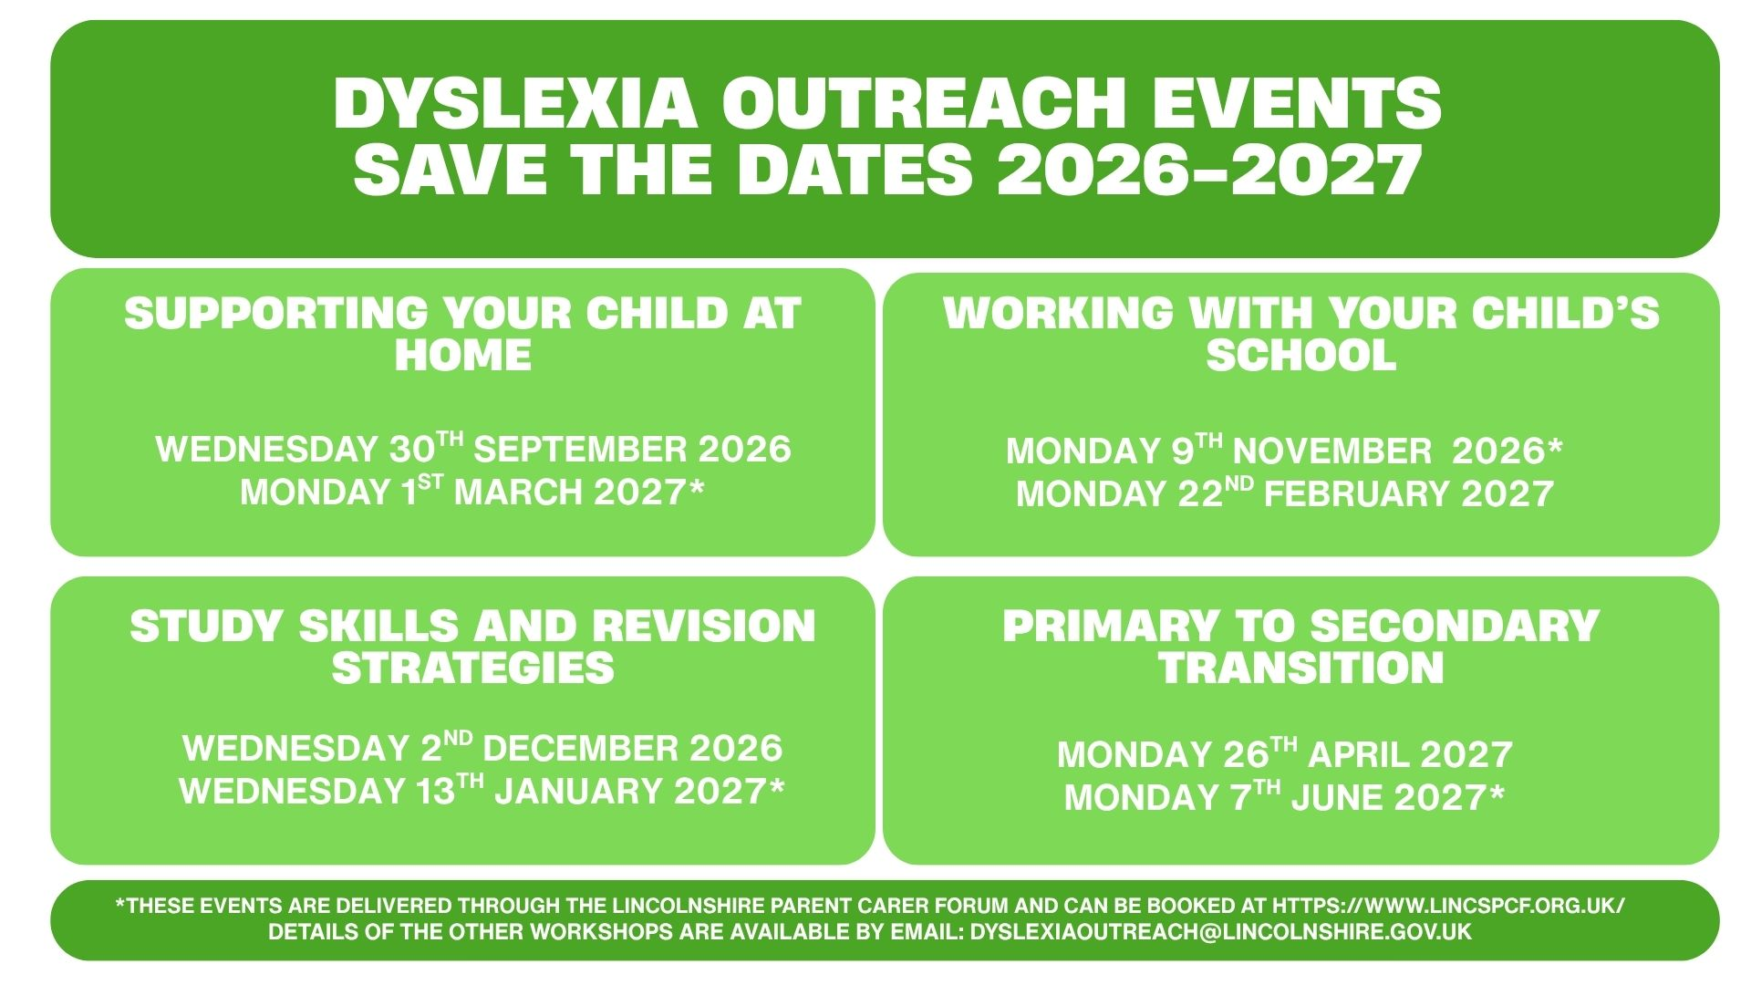

Slide 9
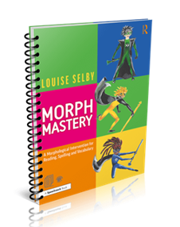

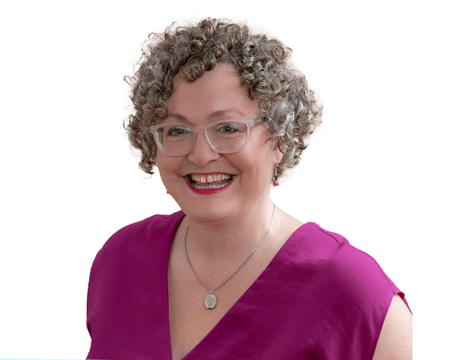

Specialist Teaching Team
Dyslexia Outreach
Inclusion Service
To register your interest or for further information please contact
jane.mcwatt@lincolnshire.gov.uk
Morph Mastery for Small Groups is a powerful new adaptation of the successful Morph Mastery 1:1 intervention – now reimagined to support small groups of learners aged 9 to 13 who are still struggling with spelling despite quality phonics teaching. This course equips school staff with the confidence and practical resources to deliver engaging, curriculum-aligned intervention sessions that make a real difference in spelling, vocabulary, and reading confidence.
Dyslexia Outreach are delighted to be able to offer schools in Lincolnshire the opportunity to access Morph Mastery for Small Groups training delivered through live online sessions via Zoom with author Louise Selby during Autumn term 2026 at a hugely reduced cost of £50.
Seven live sessions lasting 1.25 hours each will take you through the whole intervention, from understanding principles, assessing for planning, teaching each of the lessons, and reviewing. You’ll be set tasks between each session so that by the end of the course you are ready to go. You'll have the chance to ask questions of Louise and discuss progress with colleagues throughout the course. Sessions will be recorded with lifetime access.

Slide 10
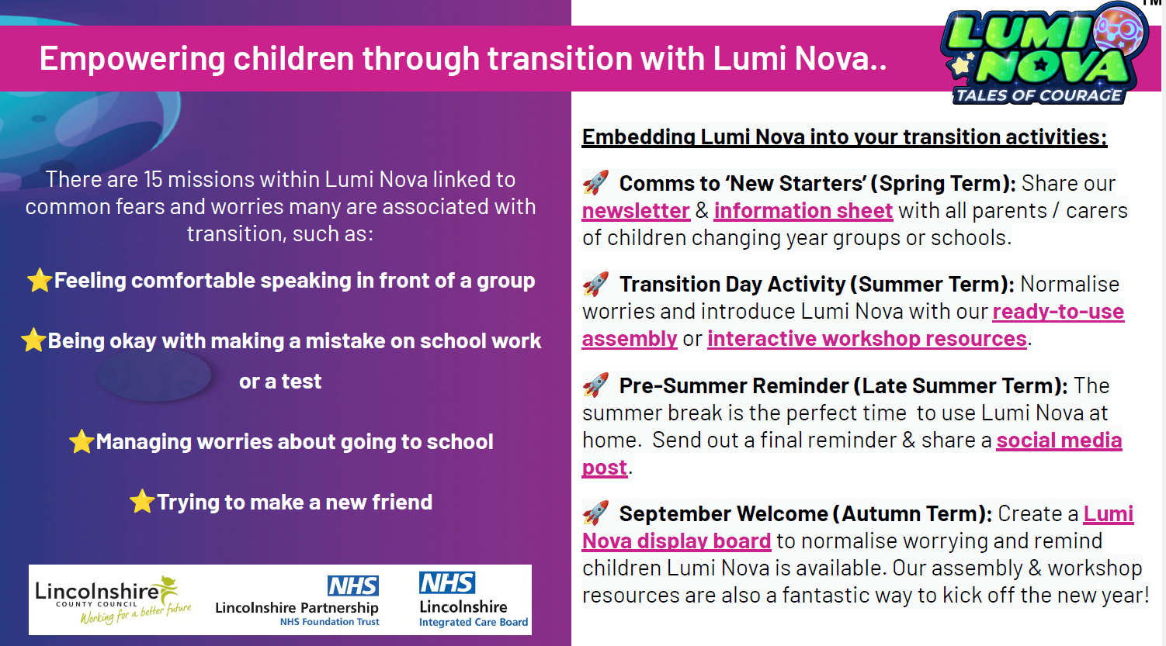

Slide 11
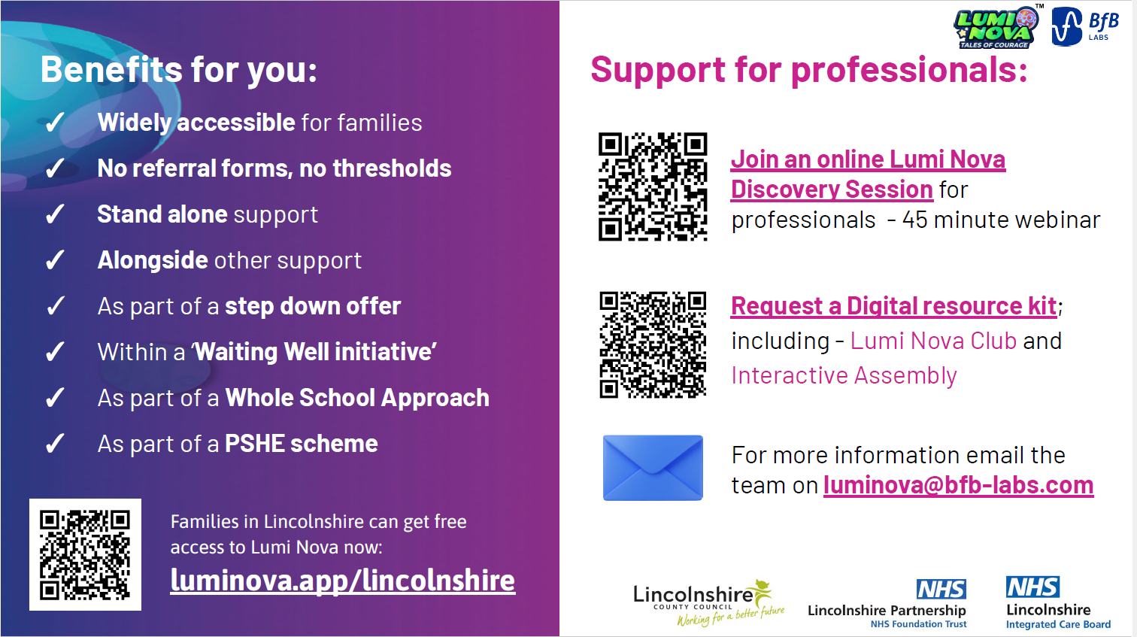

Slide 12

Presentations and Videos will be available from
20th July 2026
Remember to visit the Graduated Approach Briefings page on the Local Offer so that you can view the presentations and videos for this round of briefings and any from the previous academic year.
Graduated approach briefings – Professional resources (lincolnshire.gov.uk)

Slide 13

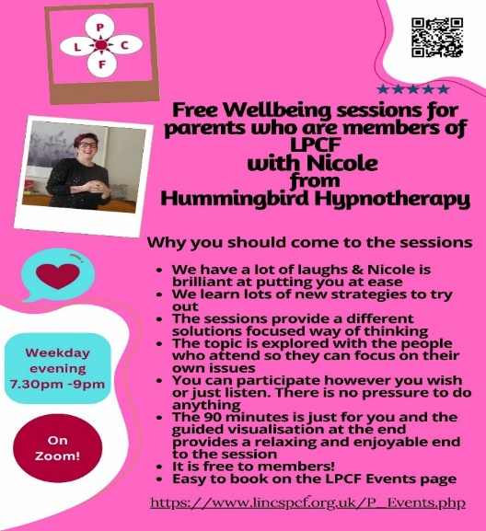
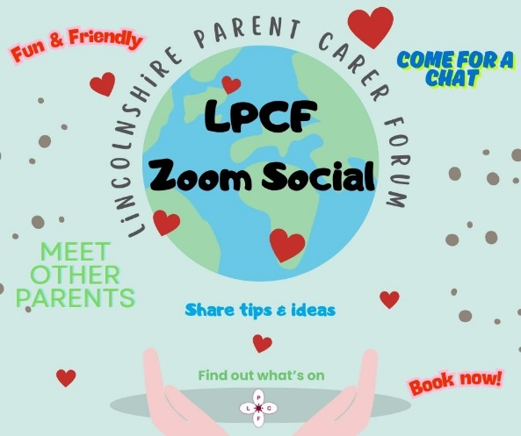
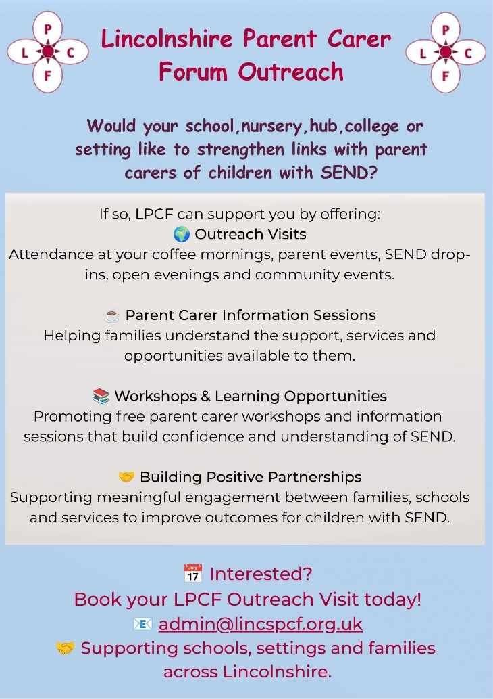
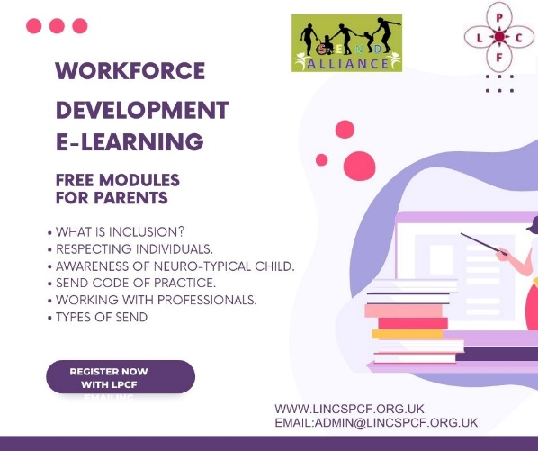
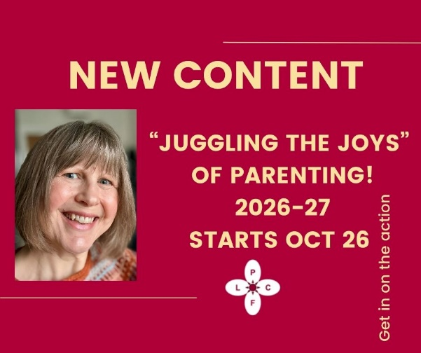
Lincolnshire Parent Carer Forum
Lincolnshire Parent Carer Forum

