Slide 1


SEND Workforce Development
Scan the QR code to register for FREE!
17,500+
Modules
completed
346
Lincs schools
engaged
99%
Satisfaction
rate
25
Average mins per module
chris.lincoln@learnsendhub.co.uk | sendworkforcedevelopment.my.canva.site
Notes:
The SEND Workforce Development project continues to be accessed by staff in schools across Lincolnshire.

Slide 2
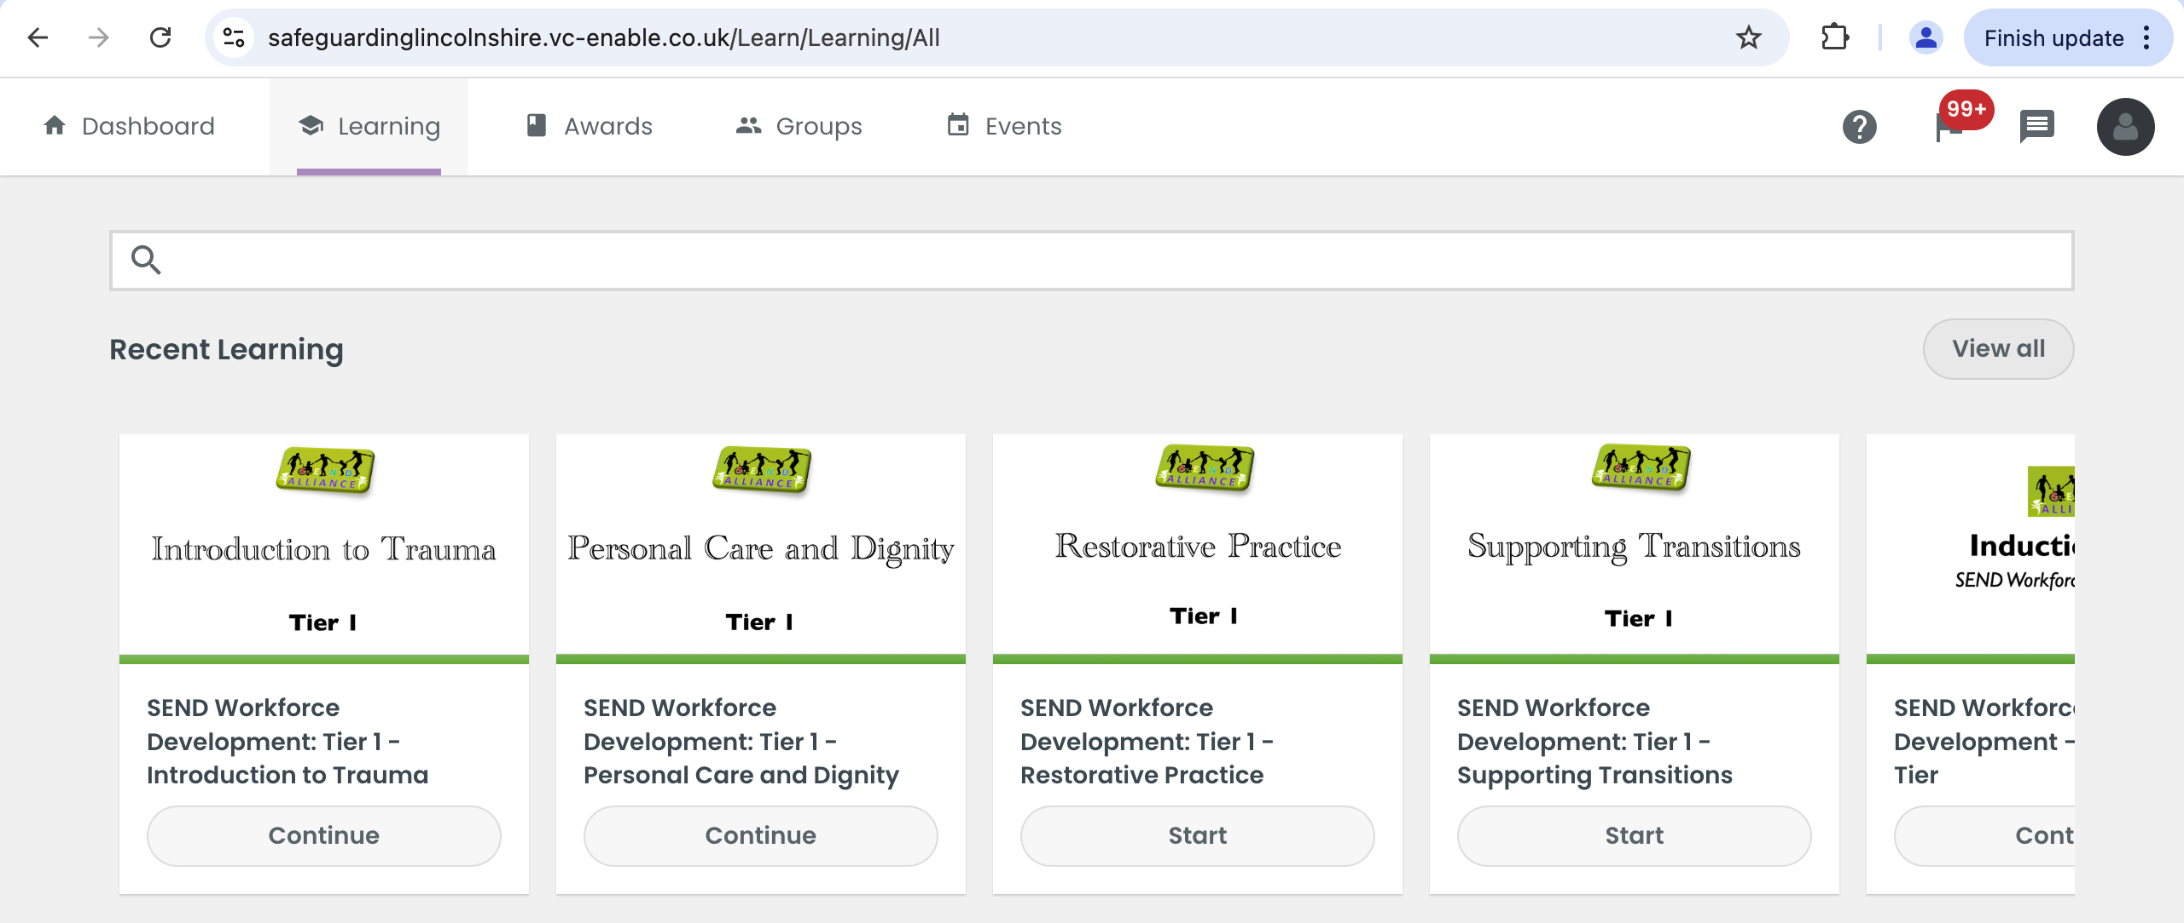
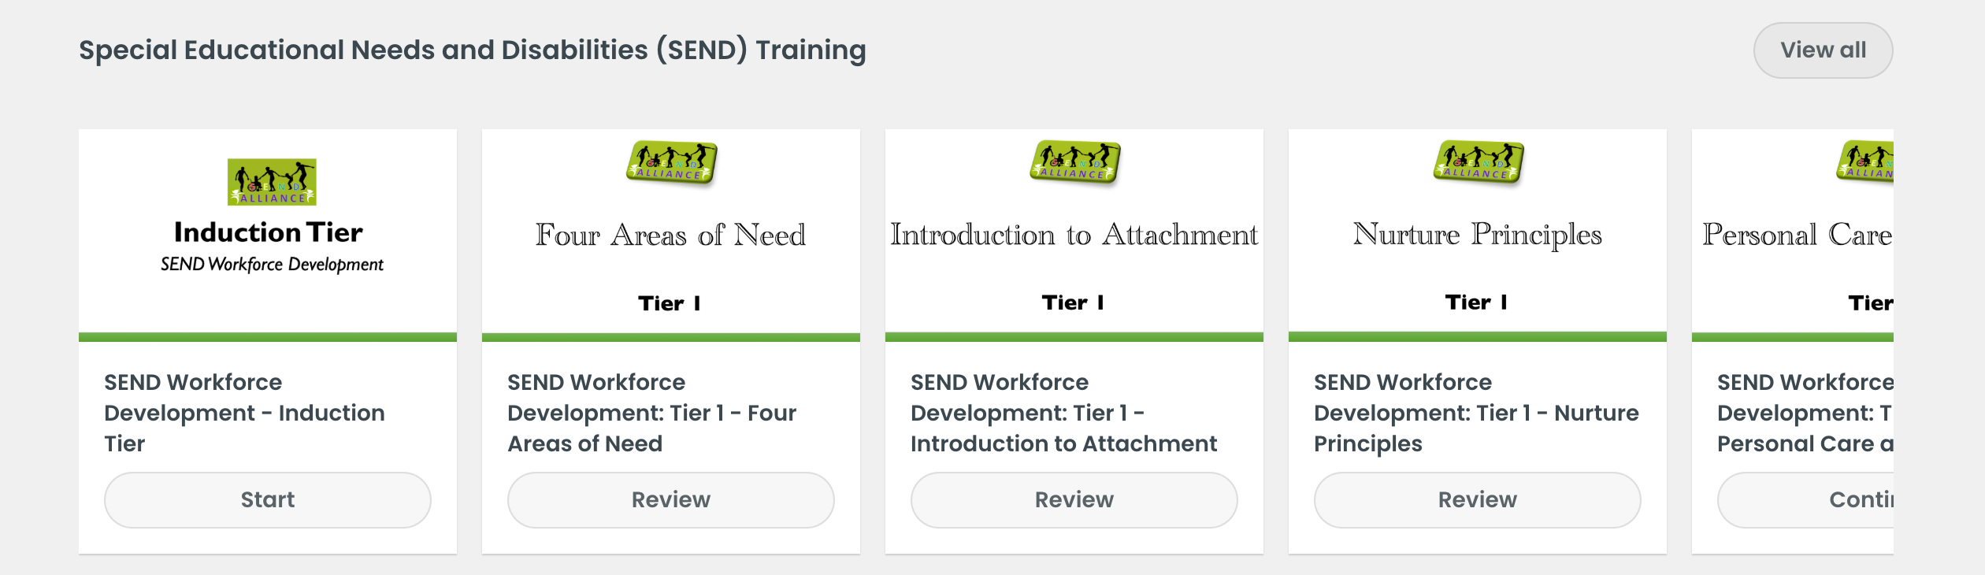
SEND Workforce Development
“A very clear and concise toolkit
of strategies. I enjoyed working through the scenarios and the downloadable content”
chris.lincoln@learnsendhub.co.uk | sendworkforcedevelopment.my.canva.site
Notes:
A reminder that any member of staff who has an account on the Lincolnshire Safeguarding Children Partnership platform, should be able to see and access all of the modules that have gone live when they sign into the platform.

Slide 3
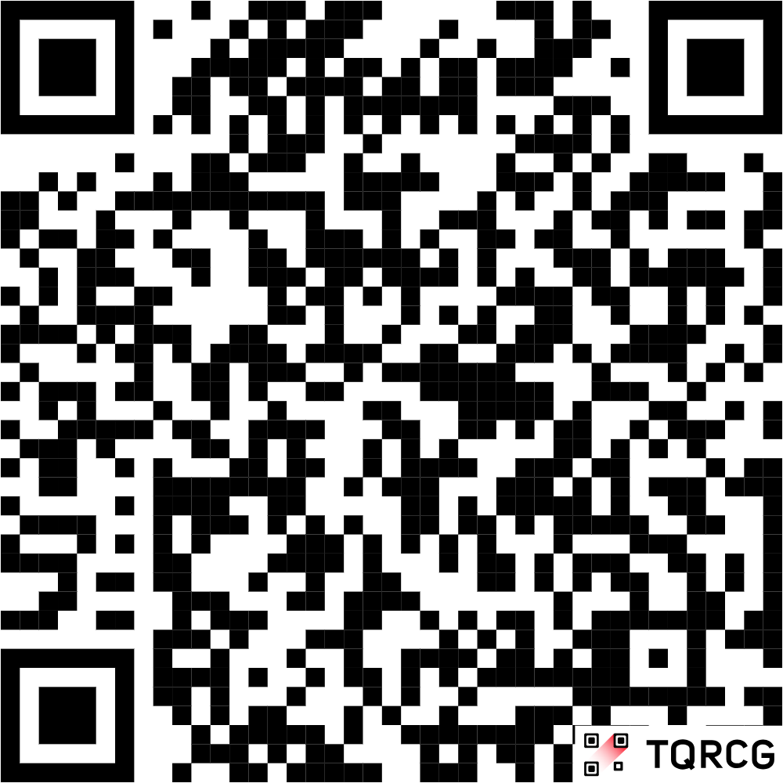
SEND Workforce Development
New modules available include:
Tier 1 Extension
Belonging in Your School
Parent/Carer Engagement
Every Teacher is a Teacher of SEND
Understanding Neurodiversity
Enabling and Inclusive Environments
Introduction to DLD
Behaviour as a form of Communication
De-Escalation
Dual Coding
Speech and Language and Behaviour
Regulation Strategies
Co-Regulation
Coming Soon…
Trauma (extension of Tier 1)
Relationships and Relational Practice
Interoception
Scan the QR code for our website:
@SENDworkforce
chris.lincoln@learnsendhub.co.uk | sendworkforcedevelopment.my.canva.site
Notes:
Next stage of the project

Slide 4
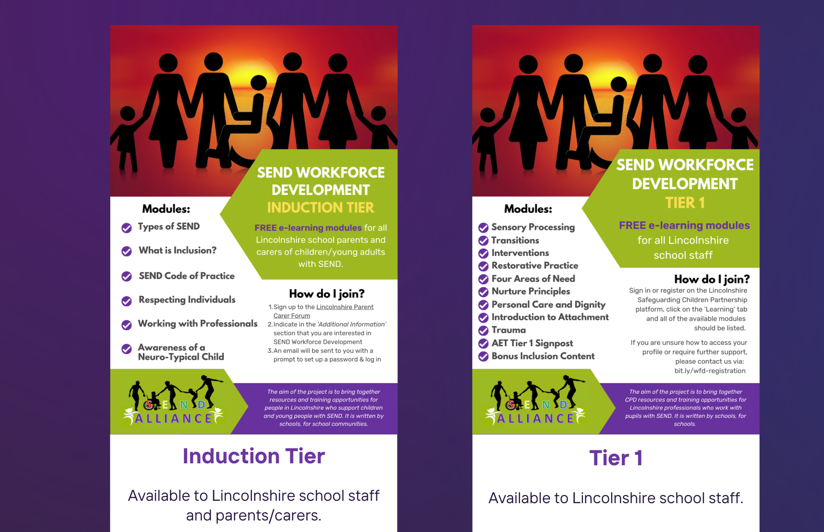
SEND Workforce Development
Scan the QR code for our website:
@SENDworkforce
chris.lincoln@learnsendhub.co.uk | sendworkforcedevelopment.my.canva.site
Notes:
Next stage of the project

Slide 5

SEND Workforce Development
What impact have the modules made?
Scan the QR code for our website:
@SENDworkforce
chris.lincoln@learnsendhub.co.uk | sendworkforcedevelopment.my.canva.site
Notes:
Induction Tier modules are available to parents for free. If you would like a flyer about the content that you can send to parents and carers, please contact Chris on the email address at the bottom of the slide. We are really looking to promote this content to as many parents as possible.

