Slide 1


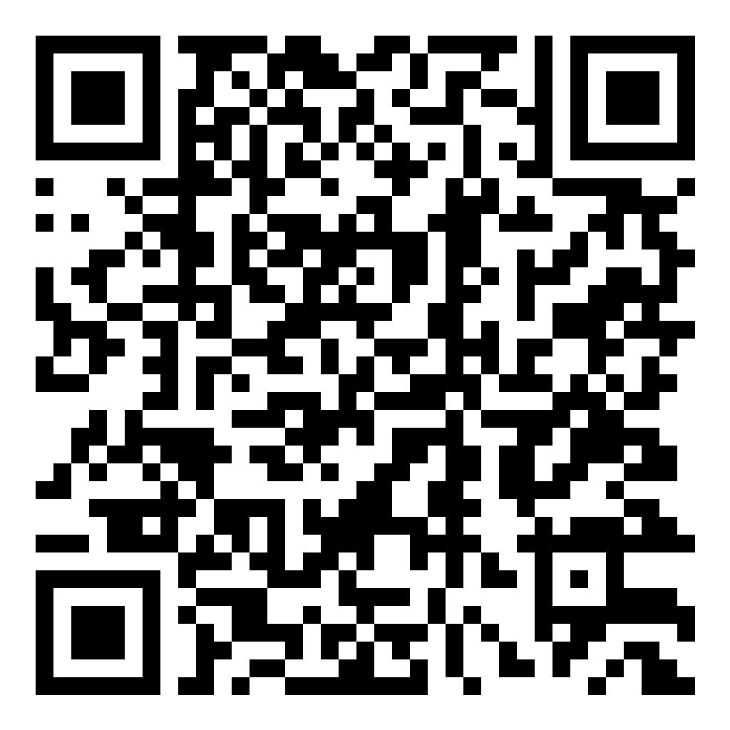

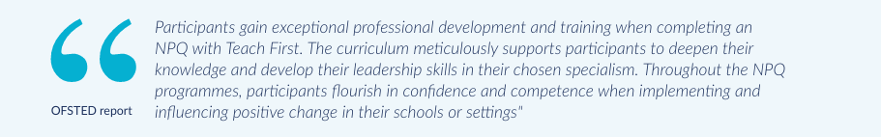
NPQ Announcement!
NPQ applications and registrations open23rd June.
NPQH, NPQSENCo, and NPQSL will be fully funded for teachers and leaders in publicly-funded schools (including maintained nursery schools) and 16 to 19 educational settings in England.
NPQ EYL is available for publicly funded early years settings and maintained nursery schools.
All other NPQs are available, funding for which is available for settings based on disadvantaged criteria. A list of these settings can be found here
Interested? Complete the EOI!
For a conversation or for any questions,
email Colette@leadtshub.co.uk

Slide 2
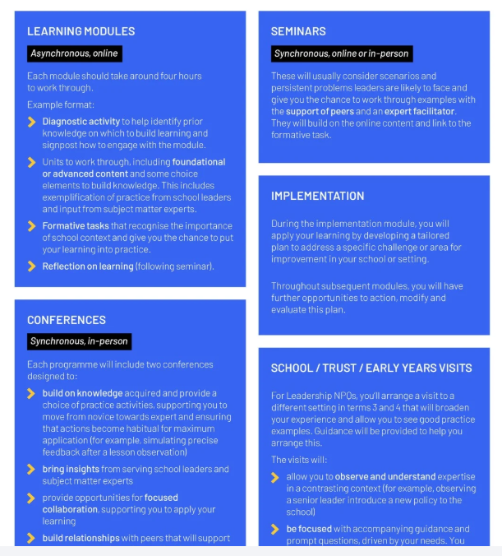
Leadership Programmes:
18 months
Specialist Programmes
12 months

Slide 3
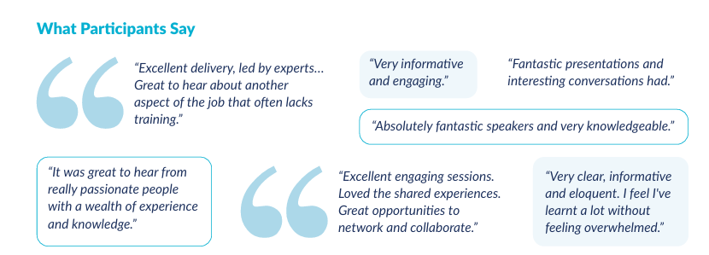
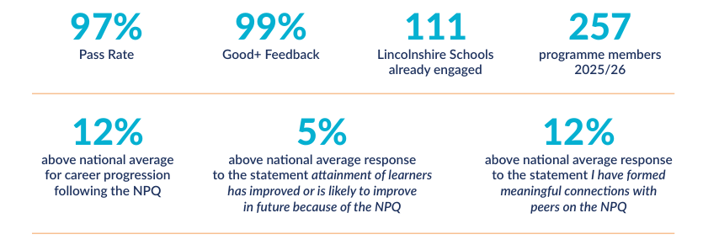

Slide 4
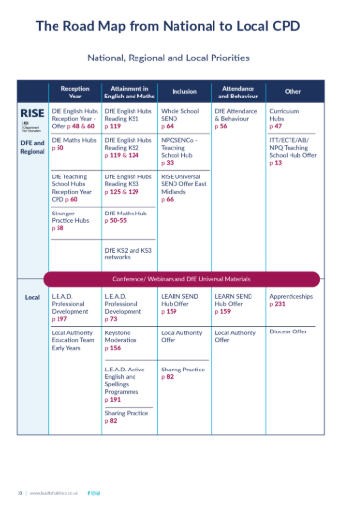

Brochure out now!

Slide 5
