Slide 1

Graduated Approach Briefings
April/May 2026
Notices
Notes:
Welcome and remind that they can still complete the GAB survey from QR code

Slide 2
Graduated Approach Briefings
Run by the Inclusion Team:
James.Morris2@lincolnshire.gov.uk – Quality and Effectiveness Lead
Karen.Donnelly@lincolnshire.gov.uk – Specialist Teaching Teams
Karen.Richardson3@lincolnshire.gov.uk – PRT, AskSALL, Inclusion
The agenda is set following requests from SENCOs so please email with content suggestions.
We are very keen to have SENCOs share examples of good practice – what is working well in your school???
Please make sure BS-SEND has your up-to-date email address

Slide 3
Remember to book your places for each briefing throughout the year on the Local Offer
Month | Meeting 1 | Meeting 2 | Meeting 3
September 2025 | NO meetings
November /December 2025 | TEAMS: Thurs 27th November 13:00 – 15:30 | TEAMS: Tues 2nd December: 09:30 – 12:00 | N/A
February 2026 | TEAMS: Thurs 5th February 13.00 – 15.30 | TEAMS: Tuesday 10th February 09.30 – 12.00 | N/A
April/May 2026 | F2F: Thursday 23rd April 09.30 – 14.30 (Including 9.30 – 10.00 networking; 30 mins lunch; and 14.00 – 14.30 networking opportunities) Venue: LEAD Teaching School Hub, The Regatta, Henley Way, Lincoln. LN6 3QR Maximum 50 attendees Please bring own lunch | F2F: Tues 28th April 09.30 – 14.30 (Including 9.30 – 10.00 networking; 30 mins lunch; and 14.00 – 14.30 networking opportunities) Venue: LEARN Teaching Centre, Warwick House, Long Bennington Business Park. NG23 5JR Maximum 50 attendees Please bring own lunch | TEAMS: Tuesday 5th May: 09.00 – 12.30
June/July 2026 | TEAMS: Tuesday 23rd June 13.00 – 15.30 | TEAMS: Thursday 2nd July 09.30 – 12.00 | N/A
Graduated approach briefings – Professional resources (lincolnshire.gov.uk)
Notes:
Reminder of signing up for the April/May and June/July briefings

Slide 4



More information on the role of the Virtual School can be
found at: Promoting the education of children with a social worker and children in kinship care arrangements: virtual school head role extension - GOV.UK (www.gov.uk)
Please don’t hesitate to contact us for any CiC, CWSW, PLAC and Kinship care guidance: VirtualSchool@Lincolnshire.gov.uk or contact your co-ordinator directly.
Notes:
Jen

Slide 5


Lincolnshire Virtual School Training Offer
All bookings are made through our 2025 – 2026 booklet. You do not have to have a child in care to attend our training.
If you require any further information or advice around our training offer, email us on: VirtualSchoolTraining@lincolnshire.gov.uk
Notes:
Link for training offer

Slide 6


Slide 7

Dyslexia Outreach 2026-2027
Who we are:
We are two specialist teachers, with a wealth of expert knowledge and experience in teaching and supporting students with Dyslexia and/or cognition and learning difficulties.
We offer a county-wide service provided by Lincolnshire County Council.
We provide free of charge advice and support, as well as a range of training options for schools and other organisations.
Contact details: NEW TEAM!!!!!
Jenny Murray covers the southern half of Lincolnshire; Helena Sharman covers the northern half of the county.
Jenny Murray: jenny.murray@lincolnshire.gov.uk Tel: 07825024084
Helena Sharman: helena.sharman@lincolnshire.gov.uk Tel: 07789926106
Dyslexiaoutreach@lincolnshire.gov.uk
Whole school training:
Twilight sessions are charged at £170
Dyslexia Awareness and Strategies
Dyslexia and Spelling
Memory and Metacognition
Using a Morphological Approach to Literacy
Dyscalculia & Maths Difficulties
Examination Access Arrangements
TA training:
TA training sessions that can be delivered during the school day are provided free of charge.
Precision Teaching
Morphology
Multisensory Strategies to Support Literacy and Maths
T.A. Discussions/Q&A Sessions
In addition, any of the whole school training packages can be adapted for TAs.
Supporting and advising parents/carers:
All support for parents/carers is free of charge.
Working with parents to enable them to provide the best support to their children and understand their needs is crucial to ensuring a successful whole team approach to SEND.
We can help schools to achieve this by offering the following:
Developing parents’ understanding of literacy and maths difficulties
Advice on strategies to support at home
Transition support
Drop-in advice sessions/attendance at coffee mornings
Parent workshops
Attendance at meetings
Mediation and liaison support
In addition to the above, we are happy to offer bespoke training packages for teachers and teaching assistants, based on a school’s individual needs. These are priced at £85 per hour with a minimum charge of £170.

Slide 8







Dyslexia Outreach Support - EduLincs – Lincolnshire County Council
Notes:
Dates still available for supporting child at home and primary/secondary transition

Slide 9


Slide 10
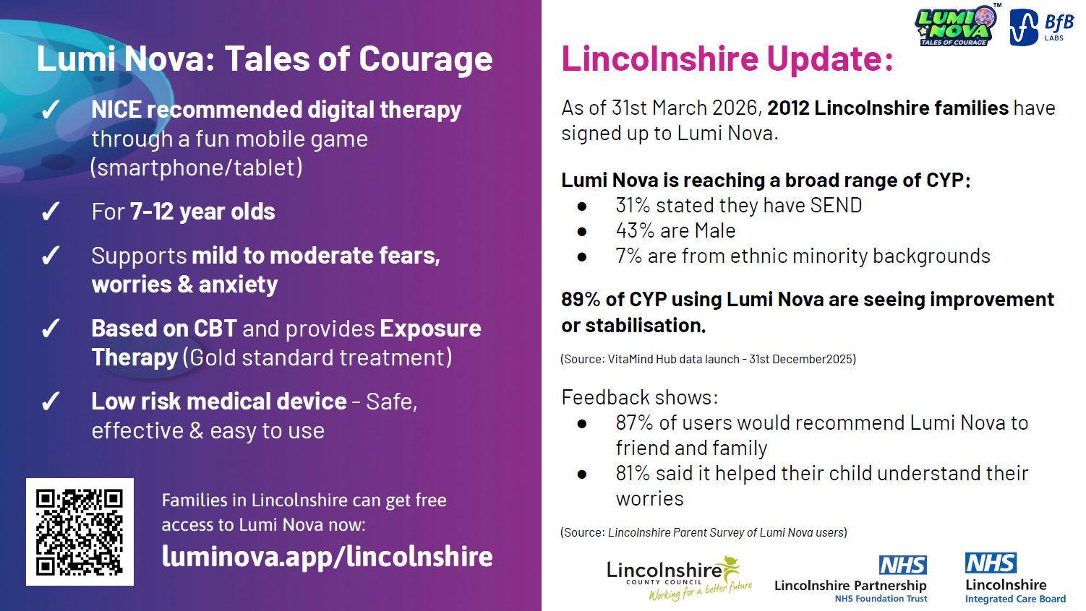

Slide 11
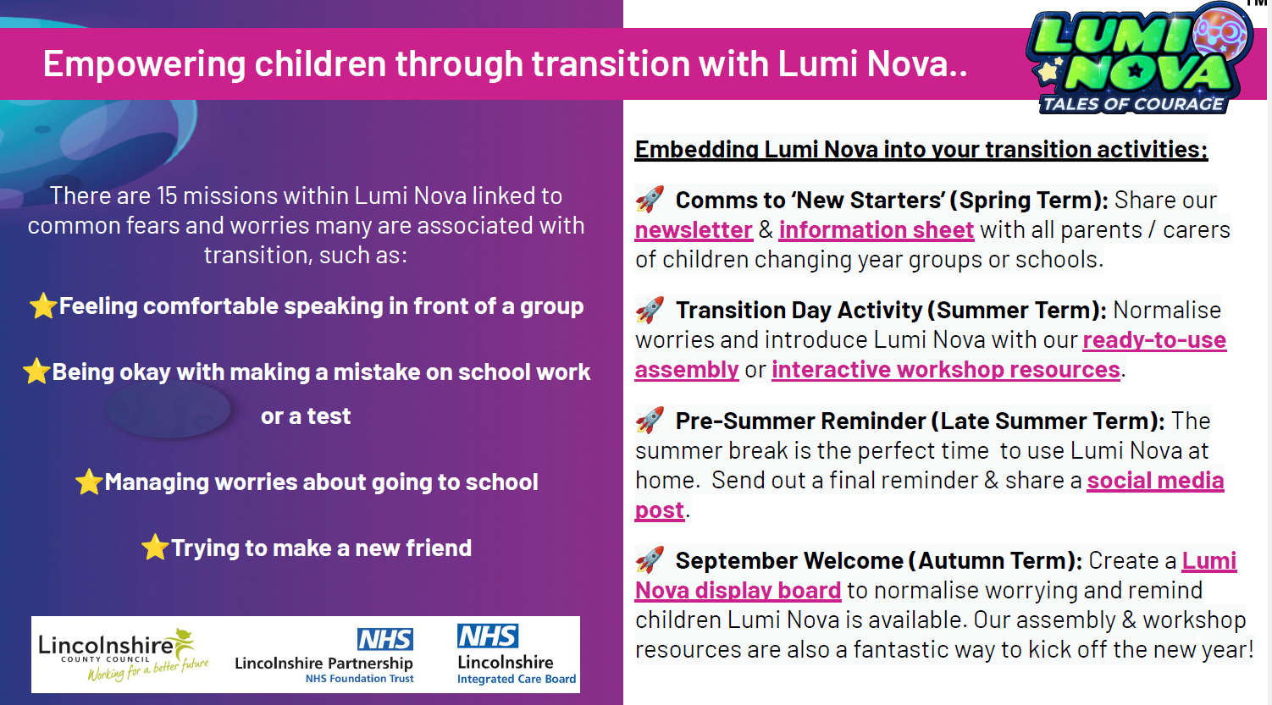

Slide 12
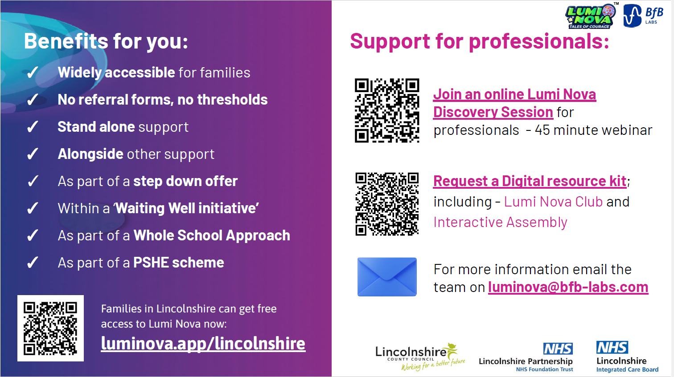

Slide 13

Presentations and Videos will be available from 20th May 2026
Remember to visit the Graduated Approach Briefings page on the Local Offer so that you can view the presentations and videos for this round of briefings and any from the previous academic year.
Graduated approach briefings – Professional resources (lincolnshire.gov.uk)

