Slide 1
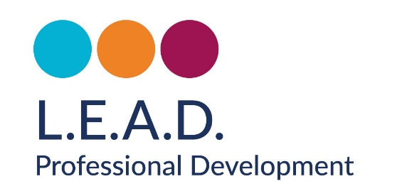
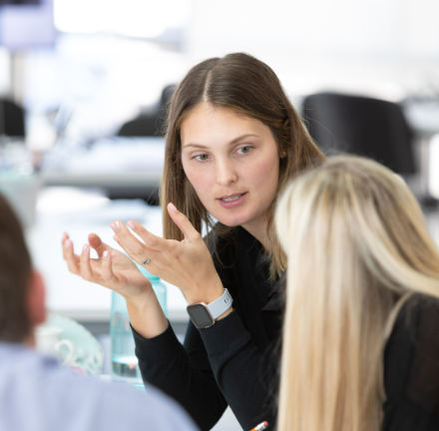

Making Sense of the Landscape
‘Working in Partnership, Achieving the Highest Outcomes for All’
Working in partnership, achieving the highest outcomes for all.
Notes:
Print ofsted
Print Strat plan – sept
Email strat plan to all
Print overview of plan

Slide 2
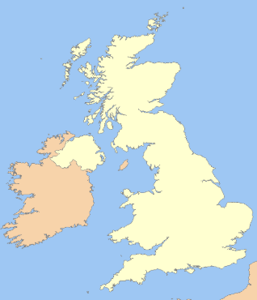
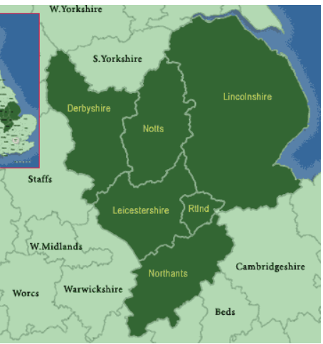
RISE National Priorities
Regional Plan
Attendance
Attainment
Inclusive Mainstream
Reception Year Quality
National
Regional Plan
Working in partnership, achieving the highest outcomes for all.

Slide 3
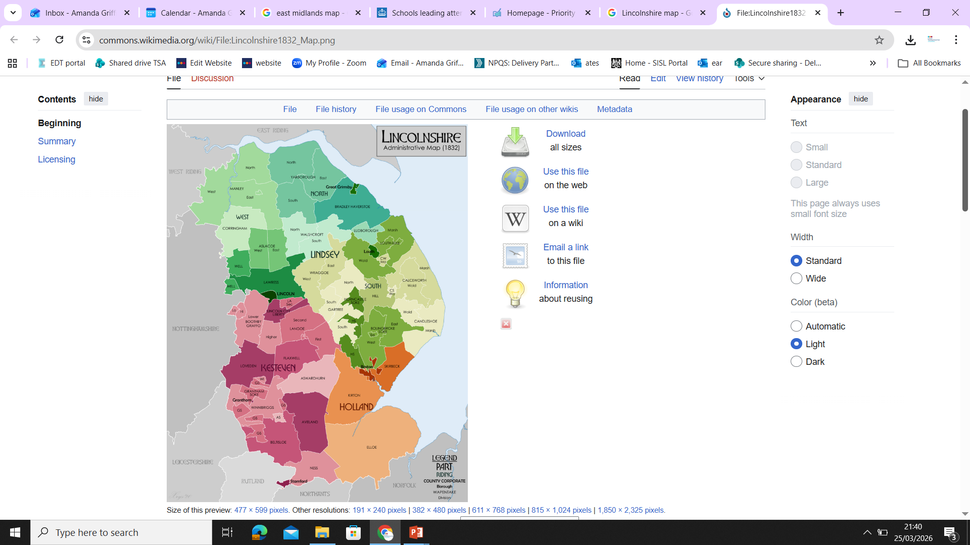
Connection Regional to Local
National
Regional
Local

Slide 4
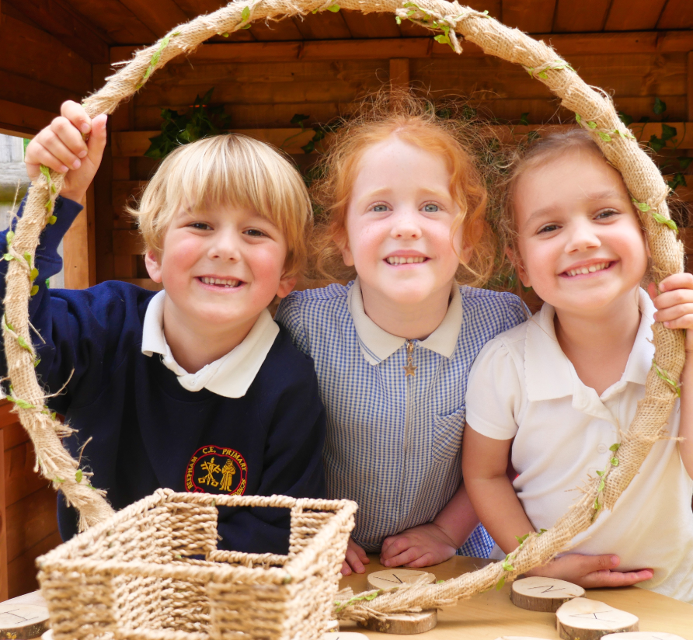
Reception Year

Slide 5
Reception Year Support
RISE Reception Networks 5 in the East Midlands 2x Lincolnshire
Open Days Network Meetings Resources
RISE Teaching School Hubs 2026
Reception Year Training for teachers in their third year + Wider CPD for Early Years
RISE English Hubs 2026
Reception Audits and Specialist support in early English
Local Authority
Moderation Support Training Pre Reception
RISE Maths Hubs 2026
Specialist Support in Reception Resources Training pathways
DfE Stronger Practice Hubs 2026 Pen Green & Flying High
Specialist Support in Reception Resources Pre Reception Year support

Slide 6
Reception Year
Attendance and Behaviour

Slide 7
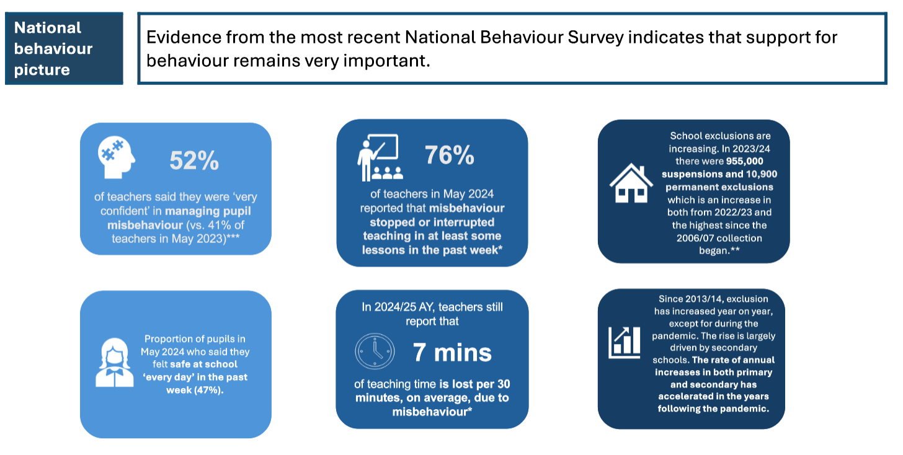
Working in partnership, achieving the highest outcomes for all.

Slide 8
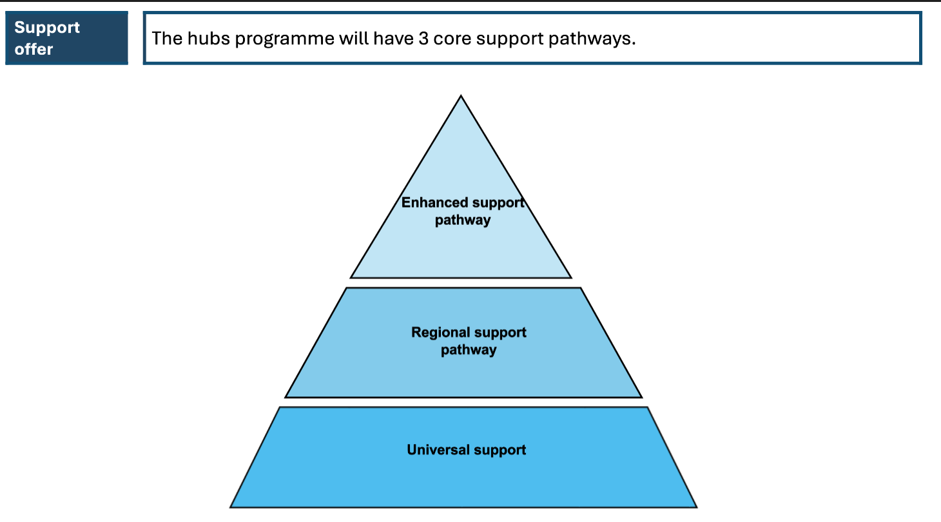
93 schools awarded
3 in Lincolnshire/NE Lincs
Working in partnership, achieving the highest outcomes for all.

Slide 9
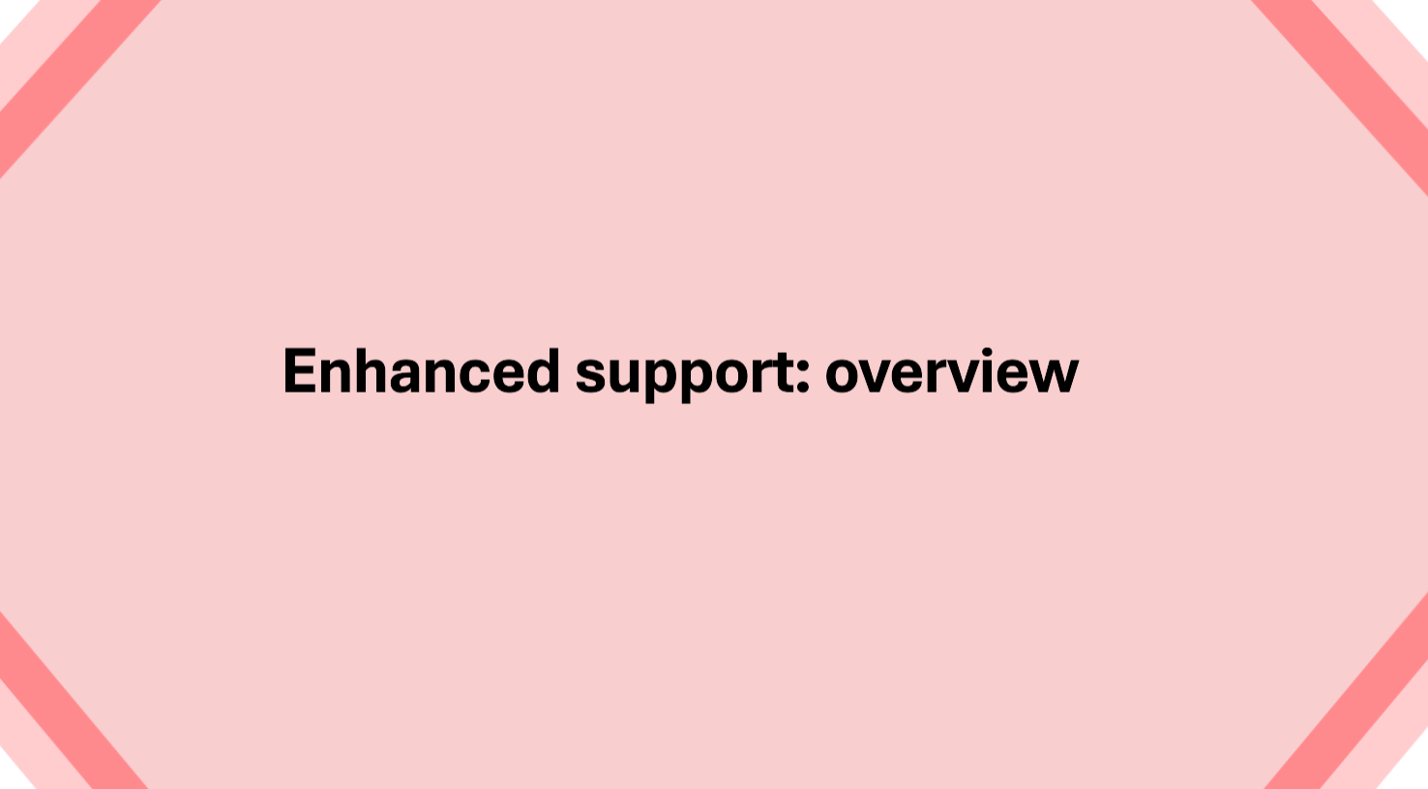
Working in partnership, achieving the highest outcomes for all.

Slide 10
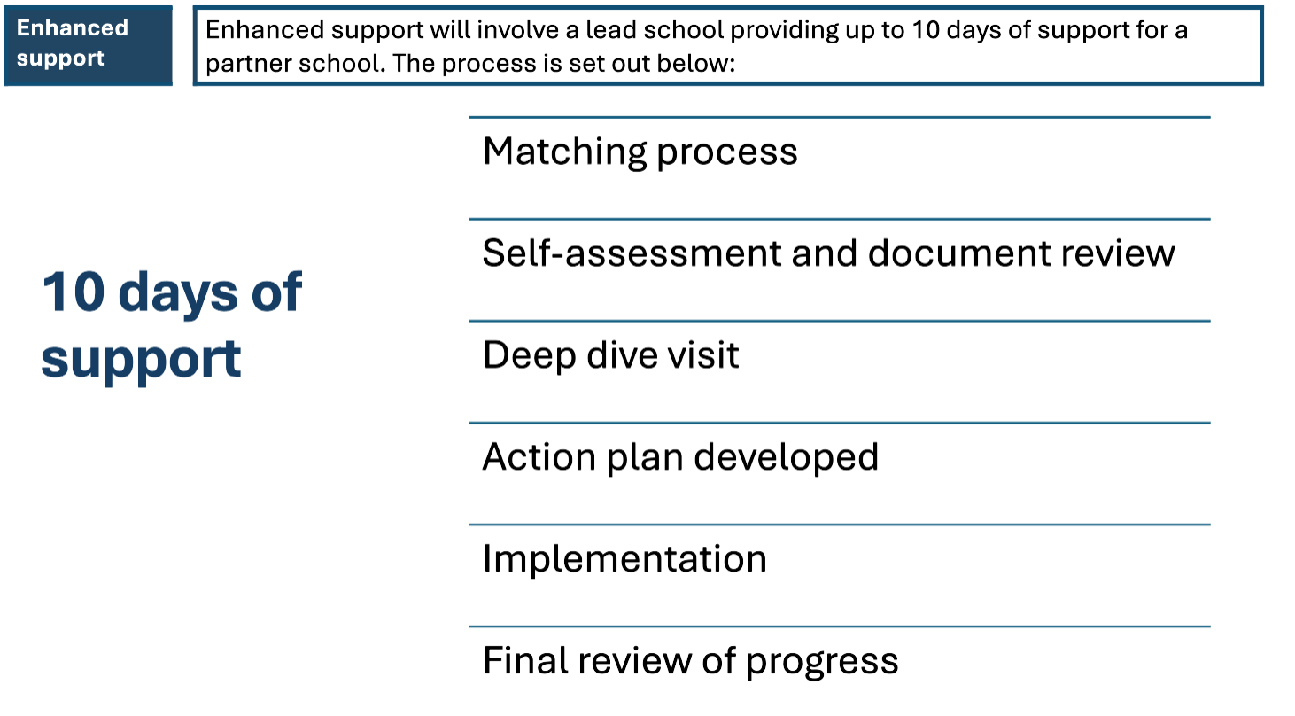
Enhanced Support Pathway
Working in partnership, achieving the highest outcomes for all.

Slide 11
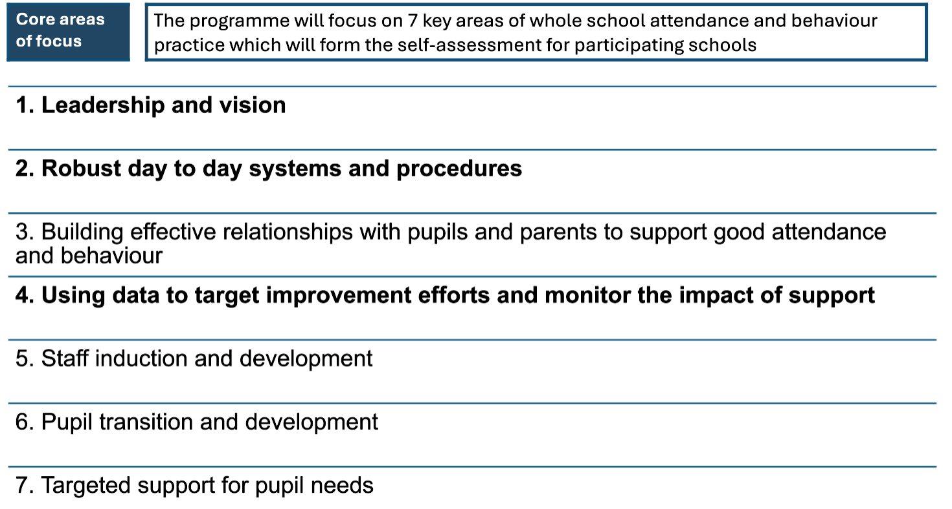
Working in partnership, achieving the highest outcomes for all.

Slide 12
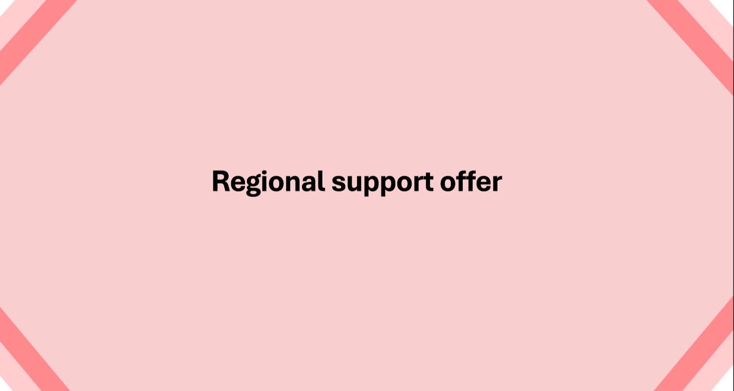
Working in partnership, achieving the highest outcomes for all.

Slide 13
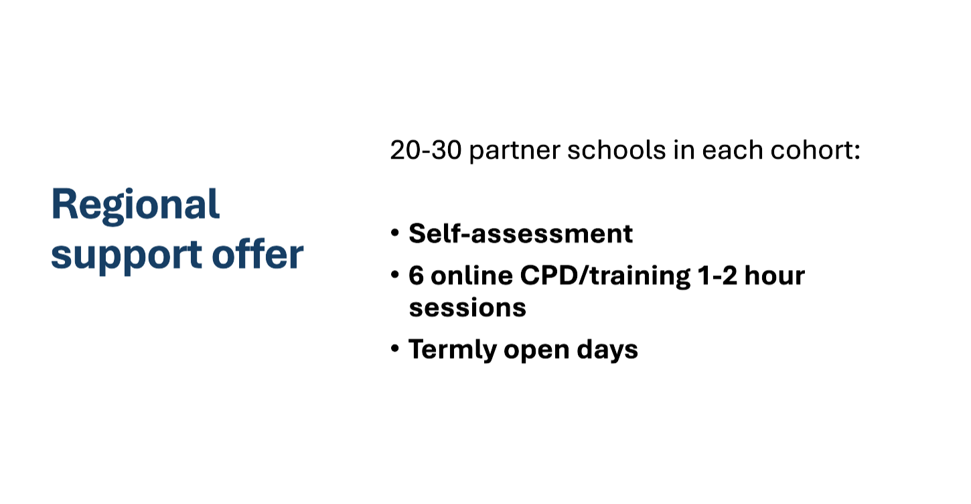
Working in partnership, achieving the highest outcomes for all.

Slide 14
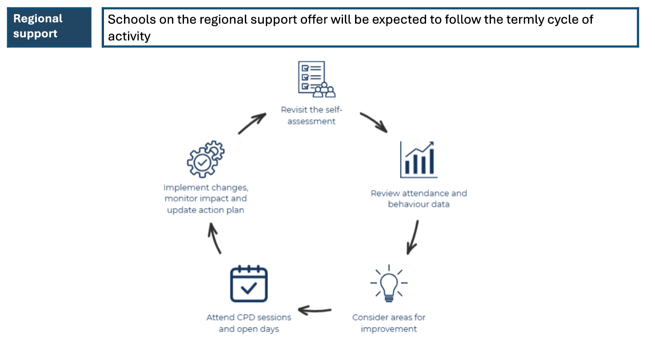
Working in partnership, achieving the highest outcomes for all.

Slide 15
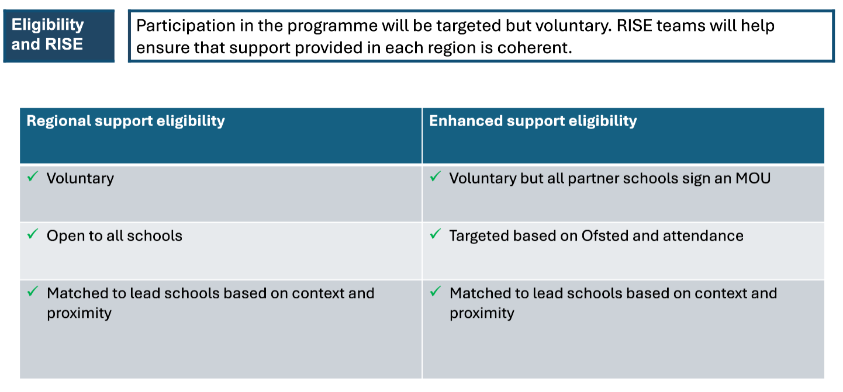
Working in partnership, achieving the highest outcomes for all.

Slide 16
Reception Year
Attainment in English and Maths

Slide 17
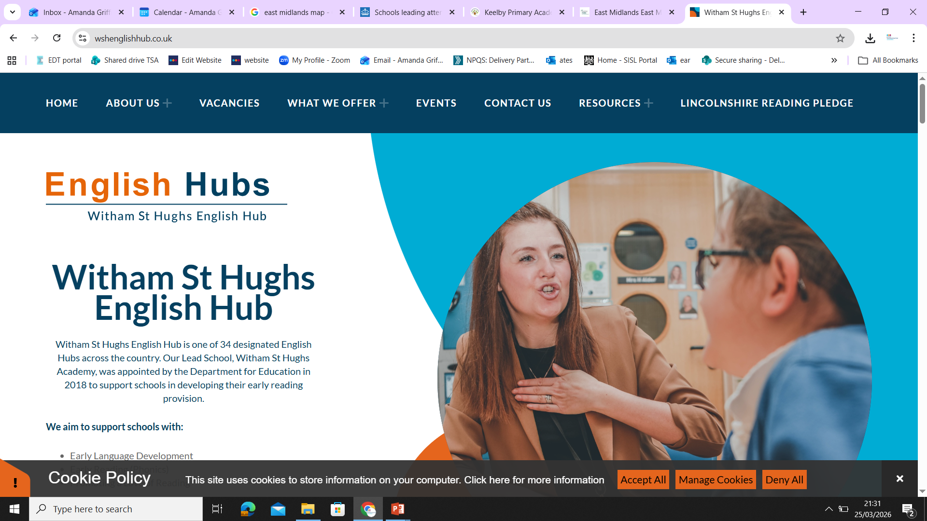
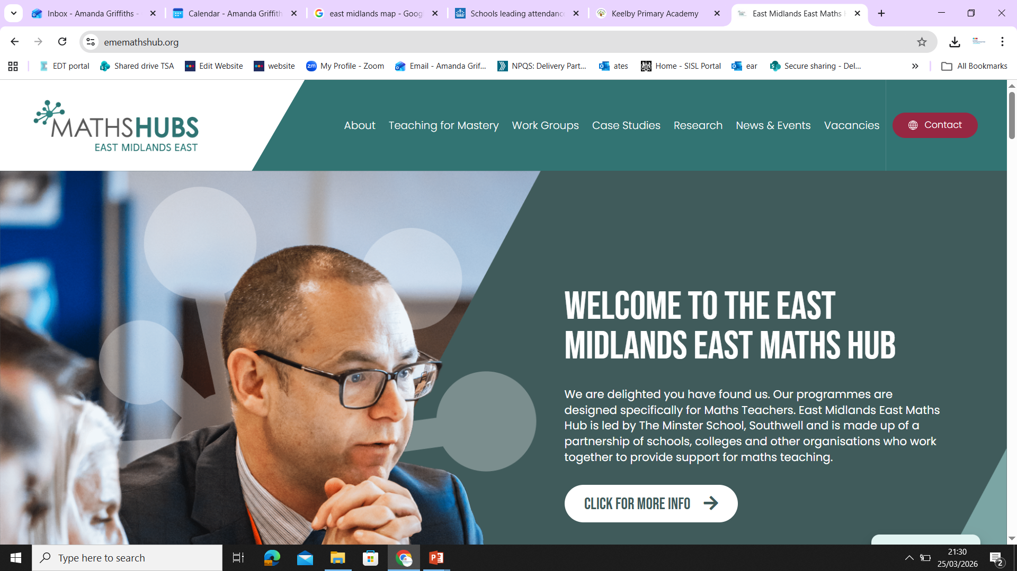
KS2
KS3
Reception Year
Phonics
Work Groups
Training
MAT model
Rec to FE
Working in partnership, achieving the highest outcomes for all.

Slide 18
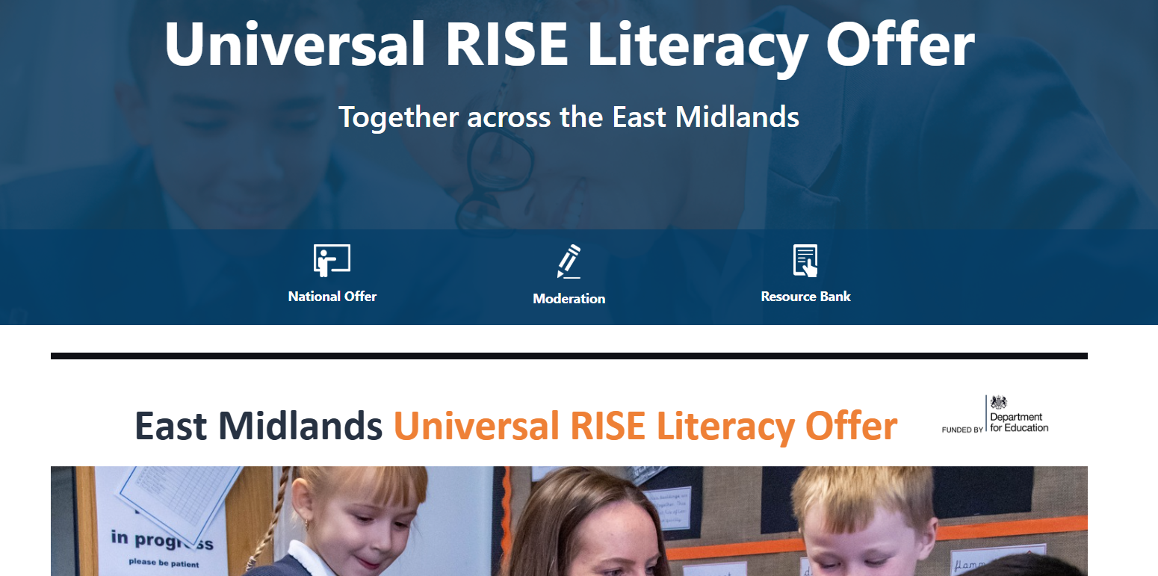
Working in partnership, achieving the highest outcomes for all.

Slide 19
English Beyond the DfE Remit
Working in partnership, achieving the highest outcomes for all.

Slide 20
Reception Year
Mainstream Inclusion

Slide 21

LA Offer
Including Workforce Development
RISE Universal Grant
LEARN SEND HUB
Audits
Modules and Resources
DfE Conferences and Resources
Conference and Resources
Working in partnership, achieving the highest outcomes for all.

Slide 22
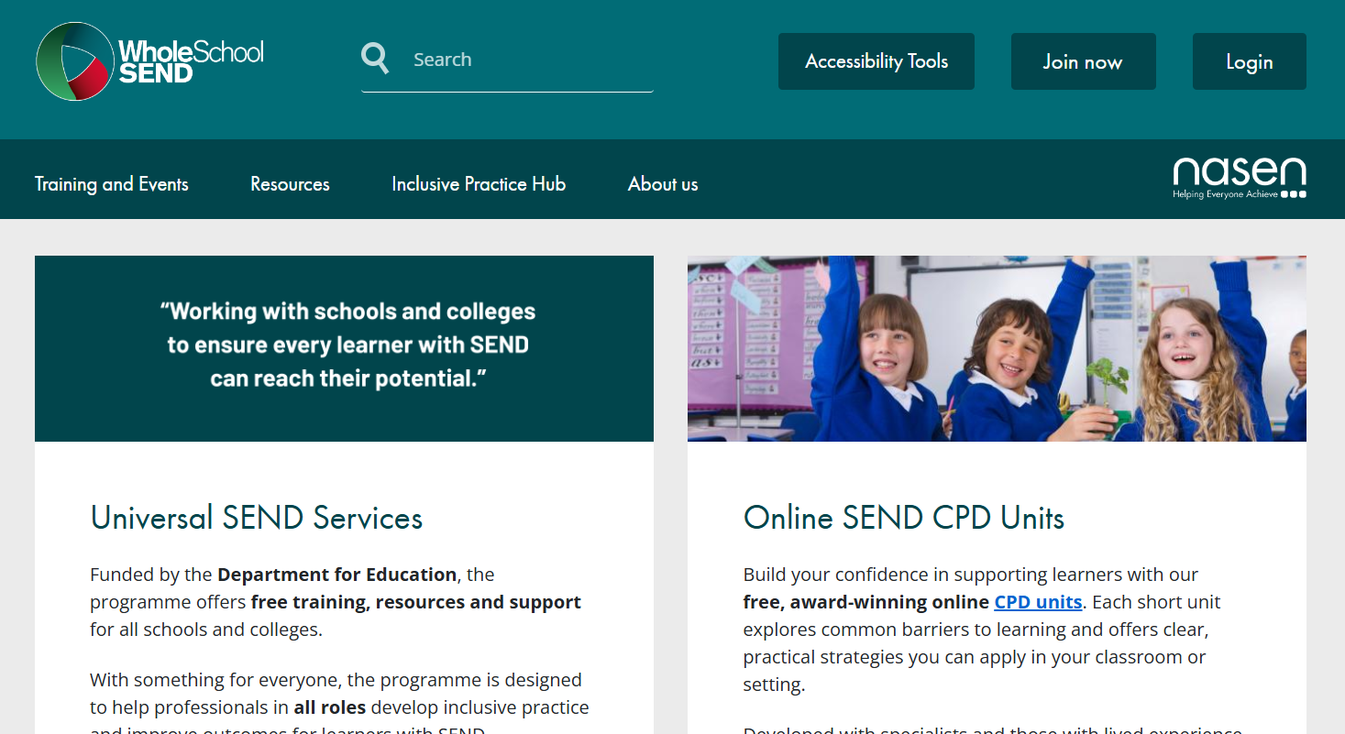

2027
Existing- online resources
Sept 27
DfE Training for Teachers and Leaders
around Inclusion
Working in partnership, achieving the highest outcomes for all.

