Slide 1

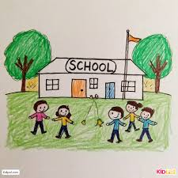
Off-Site Direction Case Studies
Karen Richardson
Inclusion Team Manager
Notes:
---

Slide 2
Secondary Case Study – A Fresh Start
Notes:
Background and Context, Interventions, PRT Involvement and Outcomes

Slide 3

Background and Context
Early Trauma Impact
  Early adverse experiences caused emotional and behavioural difficulties evident from early school years.
Escalation of Behaviours
  Behavioural issues escalated over time, becoming more dysregulated and physical despite school interventions.
School Support Strategies
  School implemented differentiated approaches, pastoral support, and collaborated with external agencies to manage behaviours.
Need for Multi-Agency Approach
  Escalation led to coordinated multi-agency response recognising need for flexible, tailored educational pathways.
Notes:
Child X has experienced a significantly disrupted and traumatic upbringing, characterised by frequent changes in care arrangements and educational settings. These early adverse experiences have contributed to emotional and behavioural difficulties that became evident from an early stage in school life. Behavioural concerns began to emerge during Year 1, although at that time they were relatively low-level and could be managed effectively within the school environment using standard classroom strategies and pastoral support. As Child X progressed through school, however, the cumulative impact of instability and trauma became more apparent. By November 2025, there was a marked escalation in behaviours, with incidents becoming increasingly dysregulated and physical in nature. School X implemented a wide range of strategies in an attempt to support Child X, including differentiated approaches, increased pastoral input, and communication with external agencies. Despite these efforts, behaviours continued to escalate, and the risk to both Child X and others increased. This context set the scene for a more coordinated, multi-agency response, recognising that Child X required a different approach in order to re-engage with education successfully and safely. The background highlights the importance of early trauma-informed understanding, the limits of in-school strategies for some pupils, and the necessity of flexible pathways when a child’s needs exceed what a single setting can reasonably manage.

Slide 4

Interventions, PRT Involvement and Outcomes
Initial Intervention Efforts
  PRT involvement began after concerns about escalating behaviour and suspensions, initiating BOSS and health support.
Off-site Direction as Fresh Start
  Off-site placement was used proactively as a restorative option, supported positively by parents and school leaders.
Positive Behavioral Outcomes
  Post-placement, Child X showed improved behaviour, increased stability, and better engagement in education.
Sustained Progress and Future Plans
  Ongoing success has led to discussions on early single registration, reflecting confidence in intervention outcomes.
Notes:
The Pupil Reintegration Team (PRT) became involved in November 2025 following sustained concerns regarding Child X’s escalating behaviour and repeated suspensions. At this stage, multiple support options were explored collaboratively, including targeted work through BOSS and engagement with Community Paediatrics and Healthy Minds. Initially, BOSS intervention showed promising early signs, with some improvements in regulation and engagement. However, these gains were not sustained, and behaviours once again intensified, placing Child X at risk of permanent exclusion following further suspensions. Recognising the potential long-term impact of exclusion, PRT worked closely with school leaders and parents to explore alternative pathways. Off-site direction was introduced as a proactive and restorative option, framed as an opportunity for a fresh start rather than a punitive measure. Parents responded positively and were keen to support this approach. An off-site placement was successfully agreed with another school, and Child X transitioned into the new setting with continuity of BOSS support to provide consistency and focus on emotional regulation. Since commencing the off-site direction, Child X has made positive choices, demonstrated improved behaviour, and has not displayed previous levels of concerning conduct. The impact on both Child X and the family has been significant, with increased stability, optimism, and engagement in education. Due to sustained progress, discussions are underway regarding early single registration, reflecting confidence in the placement’s success and the effectiveness of timely, coordinated intervention.

Slide 5
Primary Case Study – Preventing Permanent Exclusion
Notes:
Background and Presenting Concerns, PRT Intervention, Off-Site Direction and Impact

Slide 6
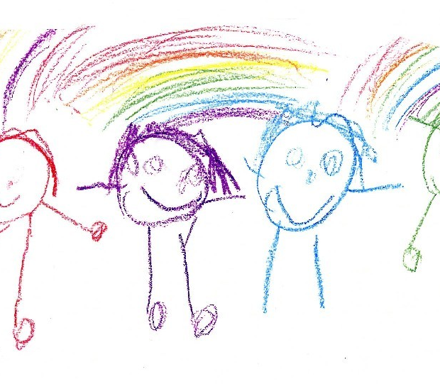
Background and Presenting Concerns
Critical Referral and Exclusion Risk
  Permanent exclusion was considered without an alternative provision, prompting urgent intervention by PRT.
Pastoral and Agency Support
  Pastoral Support Plan and previous agency involvement helped manage behaviour before escalation.
Escalation and Influencing Factors
  Peer dynamics and sibling influence increased concerns about placement sustainability and behaviour.
Need for Timely Intervention
  Swift action at escalation point is crucial to prevent exclusion and support educational inclusion.
Notes:
In this case, the school contacted PRT at a critical point, advising that permanent exclusion was being actively considered unless an alternative provision could be identified. The pupil had been managed internally through a Pastoral Support Plan (PSP), with behaviours previously addressed at school level without PRT involvement. Historical agency involvement included Early Help and Social Care, though there was no current statutory input at the time of referral. BOSS support had already been completed earlier in the academic year, closing in June 2025, and EMTET remained involved to provide cultural and emotional support. The escalation toward potential permanent exclusion highlighted growing concerns regarding the sustainability of the current placement and the impact of peer dynamics on the pupil’s behaviour, particularly the influence of siblings attending the same school. The situation required swift and decisive action to prevent exclusion and minimise long-term negative outcomes. This background demonstrates how pupils can reach crisis point even when support plans are in place, and how timely intervention at the point of escalation is crucial in preserving educational inclusion and wellbeing.

Slide 7

PRT Intervention, Off-Site Direction and Impact
Timely PRT Intervention
  PRT engaged promptly to prevent permanent exclusion through sensitive communication and reassurance with the pupil’s family.
Exploring Off-Site Placement
  Extensive liaison with local schools identified an off-site placement within the same trust as a supportive alternative to exclusion.
Positive Impact and Outcomes
  After monitoring and reviews, the off-site placement converted to a managed move resulting in improved behaviour and wellbeing.
Notes:
PRT became involved on 10 February in direct response to the imminent risk of permanent exclusion. Initial discussions with the pupil’s mother revealed understandable reluctance regarding off-site direction; however, through sensitive explanation and reassurance, agreement was reached as an alternative to exclusion remaining on the pupil’s record. PRT undertook extensive liaison work, contacting several local primary schools to explore potential placements, though capacity constraints initially limited options. Collaborative discussions with the school’s leadership resulted in agreement to trial an off-site placement within the same trust, which was viewed as a more supportive and proportionate response than permanent exclusion. Following visits and joint meetings with staff and family, the placement began and was closely monitored. A two-week review indicated that the pupil had settled well overall, with only minor transitional challenges. At the four-week point, all parties agreed to convert the placement to a managed move, successfully avoiding permanent exclusion. The pupil is now more settled, demonstrating improved behaviour and emotional wellbeing, supported by the removal of negative peer influences and ongoing EMTET involvement. This outcome illustrates the effectiveness of timely PRT intervention, collaborative problem-solving, and flexible use of off-site direction to achieve positive, inclusive outcomes for vulnerable pupils.

