Slide 1
Inclusion Agenda within the new Ofsted Framework

Slide 2

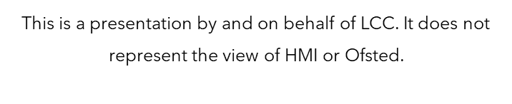

Slide 3
Key learning
What is Inclusion? What is Belonging?
What do we mean by “vulnerable” groups?
Who should our professional partners be?
What should an Education setting be offering vulnerable pupils?

Slide 4

What is inclusion?
What is belonging?

Slide 5
Ofsted definition of inclusion and belonging
Inclusion
Making sure every learner—especially those who need the most support—can fully access education, feel valued, and have any barriers to learning actively removed.
Belonging
Learners feel welcome, respected, safe, and genuinely part of the school community, not just present in it.

Slide 6
Responsibilities and expectations for inclusion
Safeguarding
Multi-agency working
Promoting educational outcomes
Supporting learning and/or well-being

Slide 7
Inclusion starts with the words we use
Pupils with SEND
SEND Pupils

Slide 8
language
Children with SEND is more respectful that SEND pupils because it is person first and doesn’t define children by their challenges.
Inclusive language helps create a culture of belonging.
Language is powerful – about seeing potential and not limitations. Inclusive language is fundamental.
Ensure you have consistent and clear terminology in policies, meeting minutes, all conversations, teaching etc. Make it part of the culture at work.

Slide 9

Vulnerable groups

Slide 10
The Ofsted framework
The Inclusion evaluation area considers how leaders and staff identify and support:
socioeconomically disadvantaged pupils (those eligible for the pupil premium)
pupils with SEND; this means pupils receiving special educational needs (SEN) support, and those with an education, health and care (EHC) plan
pupils who are known (or previously known) to children’s social care, such as children in need and looked-after children
pupils who may face other barriers to their learning and/or well-being, which may include pupils who share a protected characteristic

Slide 11
Pupils who are eligible for pupil premium (Dis-advantaged)
Pupil Premium to include Ever 6 (PP)
Pupil Premium Plus (PP+)
EY Pupil Premium (EYPP)
Service Pupil Premium to include Ever 6 (SPP)

Slide 12
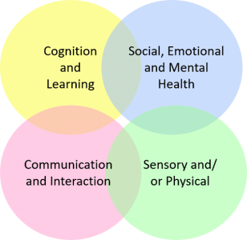

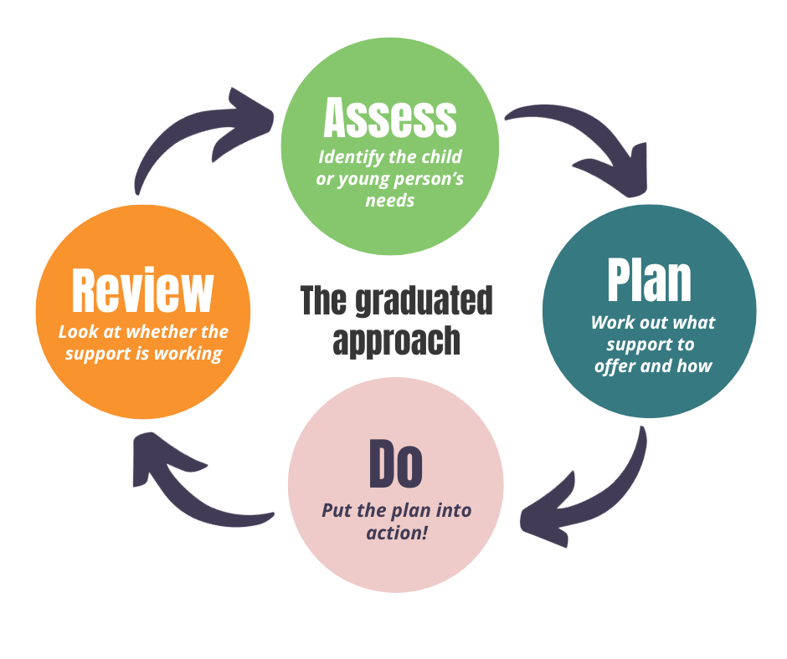
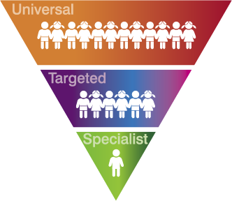
Pupils with send

Slide 13
Pupils who are known (or previously known) to children’s social care
Looked After Children (LAC)
Previously Looked After Children
Care Leavers
Child in Need (CIN)
Child Protection (CP)

Slide 14
Pupils who face other barriers to their learning and / or well-being
EAL / Summer born
Protected characteristic
Medical condition (physical or mantal)
Injury (broken arm / leg)
Death of a family member
Parental concerns – e.g. drugs, alcohol, prison, DA, housing instability etc.
Refugee
Young carer who has not met section 17 thresholds
High level of behaviour concerns / suspensions / risk of NEET
Low attendance

Slide 15

Partnerships

Slide 16





Who?

Slide 17
HOW SHOULD I WORK WITH PARTNERS?
Share relevant information
Day-to-day support in the school setting
Address barriers to attendance, behaviour, engagement or well-being
Contribute to multi-agency plans
Use of additional funding and/or signposting
Escalate concerns

Slide 18

Education of vulnerable pupils

Slide 19
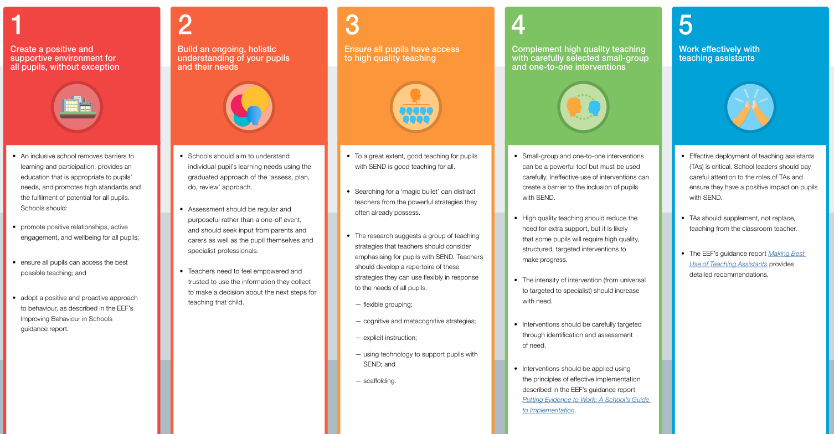
SEND

Slide 20
Send unit / hub
Specific provision on a mainstream site
Vital that leaders can articulate the context and ambition
Same expectation in terms of curriculum sequencing and starting points but will be more steps that are bespoke
Essential all leaders (including subject leaders) know about the curriculum being delivered in the SEND Hub for their subject as they would for the whole school

Slide 21
The inclusion meeting
SENCO is predominant but not all about SENCO
SENCO / DSL / Inclusion Lead / Designated Teacher / PP Lead / Pastoral managers
Expect meeting to be at the end of day 1. After inspectors have got questions about what they have seen.
Difficult to plan for – no longer a set of questions to rehearse and boxes to tick! Is there an inclusive culture of safeguarding in its widest sense.
Intent V impact

Slide 22
Conversations with leaders
Know who your designated teacher is and who your Virtual School contact is.
Know your IDSR inside out (always a starting point for discussion)
Know any patterns in attendance and behaviour (explained and unexplained)
Know your vulnerable pupils (particularly those who are known to social care), what their needs and barriers are, what you are doing above and beyond for them and how you know it is working
Know how you identify needs
Know who and how you work with others to support these pupils
Know what the impact is of additional funding for these pupils
Know how you oversee progress and outcomes for these pupils
Be able to evidence that the support you are giving is timely, appropriate and effective
Know what the pupils and parents say about their support. Have they been included in what happens? Is it helping them? Why / Why not?

Slide 23
KEY TAKEAWAYS
Inclusion is central and embedded to culture. It does not stand alone. Every area of the toolkit feeds into inclusion.
Every inspection is different depending on the context and what leaders say.
Not just about looking through paper trails and inspecting provision, but what it is like in reality in the classroom:
  What are the barriers and how successfully are they being removed?
  Do minutes to meetings, referral forms and / or IEP’s reflect what is seen?
  Are systems and processes robust and how do they work in practice?
  Is your accessibility plan up to date and how is it reflected in reality?

Slide 24
KEY TAKEAWAYS CONTINNUED
What are expectations for high quality teaching? What does CPD look like over time? What is the impact of this on pupil outcomes and progress?
Always be ready to provide and example of what you say happens – show me!
Code of practice is fundamental – it is not just a document.
Language is important.
If we get it right for the most disadvantaged and vulnerable, we get it right for everyone

Slide 25

Any Questions?

