Slide 1



Reflective Practice in Education
Ben Shearer
LCC Pupil Reintegration Officer

Slide 2
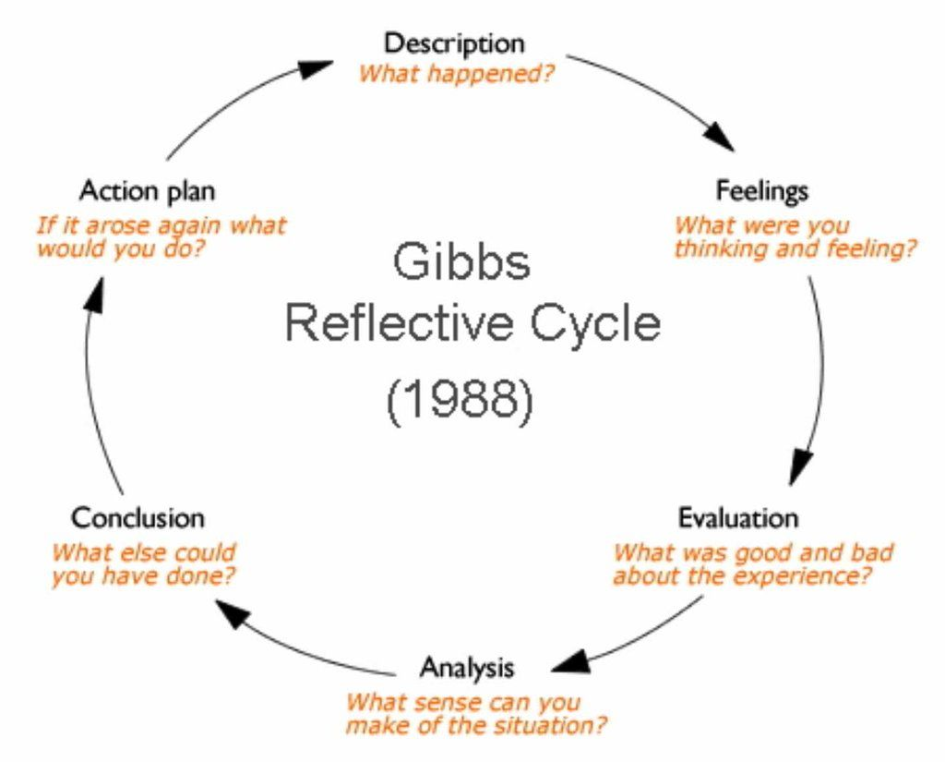

Geoff

Slide 3

What are we covering?
Definition of Reflective Practice
  Reflective practice is a deliberate process of thinking about professional experiences to improve future actions.
Challenges in Education
  Educators face fast-paced demands, complex decisions, and diverse learner needs daily.
Benefits of Reflective Practice
  Reflective practice helps teachers improve effectiveness, adapt strategies, and maintain wellbeing.
Embedding Reflection in Routine
  Small reflective habits integrated daily lead to meaningful improvements for learners and educators.

Slide 4

What Is Reflective Practice?
Definition of Reflective Practice
  Reflective practice involves critically examining experiences to learn and improve future professional actions.

Slide 5
What Is Reflective Practice?
Definition of Reflective Practice
  Reflective practice involves critically examining experiences to learn and improve future professional actions.
Learning walks, lesson observations, data targets, appraisals, SATs results, GCSE results, Ofsted, times tables checks, phonics screening…
Just more negativity?

Slide 6

Why Reflection Matters in Educational Settings***
***according to AI
Adaptive Teaching Through Reflection
  Reflection helps educators adapt teaching to meet changing learner needs influenced by many factors.
Improving Practice and Decision Making
  Reflective practice enables evaluation of interventions and informed adjustments to teaching strategies.
Supporting Professional Autonomy
  Reflection allows educators to justify their decisions based on experience and evidence.
Promoting Ethical and Learner-Centered Practice
  Reflective practice fosters ethical considerations and keeps education learner-focused amid policy pressures.

Slide 7
Why Reflection Matters in Educational Settings
Now that we’ve cleared that up…
“Insanity Is Doing the Same Thing Over and Over Again and Expecting Different Results”

Slide 8

How Reflective Practice Supports Educators
Enhances Self-Awareness
Improves Problem-Solving
Builds Resilience and Wellbeing
Supports Professional Development

Slide 9

Impact of Reflective Practice on Learners
Tailored Teaching and Interventions
Strengthening Educator-Learner Relationships
Supporting Vulnerable Learners
Improved Engagement and Outcomes

Slide 10
So... With a bit more reflection, teachers would be happy and education would be fixed?

Slide 11

When and how should we reflect?
Constantly
  Micro-reflections happen throughout the day.
collaboratively
  Reflection can be personal or shared with peers or even the children if you are brave enough!
Post-incident
  Good or bad, we should always aim to reflect on the significant things that happen.
Time-spaced
  Often, time away from the event allows time to see it in a clearer light.

Slide 12
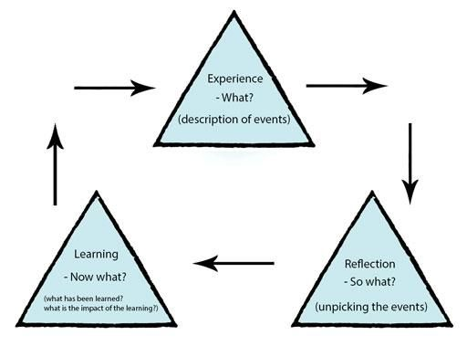
Gibbs vs Boud

Slide 13

Addressing Common Myths About Reflection
Reflection Can Be Brief
  Effective reflection does not require lengthy time or writing and can be integrated into daily routines.
Reflection Is Constructive
  Reflection promotes positive, solution-focused thinking rather than overthinking or self-criticism.
Reflection Strengthens Expertise
  Experienced practitioners benefit from reflective learning to strengthen their professional skills – don’t be a stick in the mud!
Reframing Reflection
  Viewing reflection as a practical tool – we do it naturally anyway so it’s just thinking about how it can be more useful.

Slide 14
With reflection being so beneficial, what gets in the way?
TIME!

Slide 15

Making Reflection Part of Everyday Practice
Be honest
With yourself and those that you trust.
Create an ethos of reflection
Reflection should be practiced by everyone – including those that you teach!
Reflection with CYP has to be scaffolded – “when you, I feel, You should’
Creating a Supportive Culture
Time has to be given for reflection. This time has to be given from a SLT or else reflection simply becomes a ‘drive home task’.

Slide 16

Key Messages and Final Reflection
Benefits of Reflective Practice
  Reflective practice enhances professional effectiveness and supports wellbeing
  Fostering Learning Cultures
  Reflection fosters cultures of learning and continuous improvement in education settings.
Practical Reflective Habits
  Small, consistent reflective actions can drive meaningful change without requiring extensive time commitment.
Reflection as Essential Practice
  Reflection is a core element of high-quality education, not an additional task for educators. (I get it now, Geoff)

