Slide 1
What every teacher should know about phonological awareness
Professor Helen Stringer, Newcastle University, UK.

Slide 2


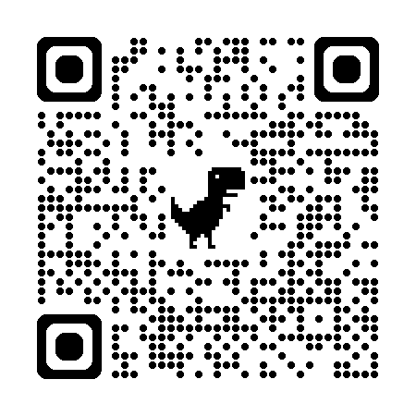
Free Resources
What every teacher should know about phonological awareness
Narrative handout (more information on everything)
The Newcastle Assessment of Phonological Awareness (NAPA) plus score sheets
The Newcastle Intervention for Phonological Awareness (NIPA)
Stimulus pictures for NIPA
Scan the QR code
Or use the URL
https://research.ncl.ac.uk/phonologicalawareness/
Notes:
Mention that they will need to leave details But they are free

Slide 3

What is phonological awareness?
What every teacher should know about phonological awareness
Phonological awareness is the individual’s awareness of the sound or phonological structure of a spoken word (Gillon, 2004)
Implicit phonological awareness →recognise and understand speech, self-correct errors
Explicit phonological awareness →learn to read and spell
Phonological awareness is an auditory skill not a visual skill
Gillon, G. T. (2004). Phonological Awareness. New York: Guildford Press
Notes:
home language,
Phonological awareness is recognised as a crucial skill for learning to read alphabetic languages.

Slide 4

A glossary and IPA
What every teacher should know about phonological awareness
Phonics is not the same as phonology, phonemic or phonemes (except they start with the same sound /f/ and the same three letters ‘pho’)
Specific terminology (check meanings, don’t assume)
https://www.internationalphoneticalphabet.org/ipa-sounds/ipa-chart-with-sounds/
Notes:
Glossary of terms in the handout, don’t assume that others know the meaning of the terms you use
IPA used by all SLTs, is a representation of speech and how it sounds,
Information online and Wikipedia

Slide 5
What is phonological awareness?
What every teacher should know about phonological awareness
Syllable
Phoneme
Phonological awareness always progresses from large to small
Anthony, J. L., & Francis, D. J. (2005). Development of Phonological Awareness. Current Directions in Psychological Science, 14(5), 255-259. doi: 10.1111/j.0963-7214.2005.00376.x; Carroll, J. M., Snowling, M. J., Hulme, C., & Stevenson, J. (2003). The development of phonological awareness in preschool children. Developmental Psychology, 39(5), 913–923. https://doi.org/10.1037/0012-1649.39.5.913
Notes:
Overlapping patterns
increasingly sensitive to smaller and smaller units
detect and manipulate syllables
as far as the auditory skill is concerned there is just syllable and phoneme, not onset-rime

Slide 6


Why is phonological awareness important?
What every teacher should know about phonological awareness
Hello!
Speech
Vocabulary (and syntax)
Reading & spelling
Bore da!
Phonological awareness is essential for learning how to put sounds together to make meaningful words, for listening to, learning and saying words
Hola!
Bonjour!
Broomfield, J. and Dodd, B., 2004, Children with speech and language disability: caseload characteristics. International journal of language & communication disorders. 39, 303–324. https://doi.org/10.1080/13682820310001625589.; Zens, N. K., Gillon, G. T., & Moran, C. (2009). Effects of phonological awareness and semantic intervention on word-learning in children with SLI. International Journal of Speech-Language Pathology, 11(6), 509-524. doi: doi:10.3109/17549500902926881; Anthony, J. L., & Francis, D. J. (2005). Development of Phonological Awareness. Current Directions in Psychological Science, 14(5), 255-259. doi: 10.1111/j.0963-7214.2005.00376.x
Notes:
Speaking and playing with sounds, syllables and words supports PA development. Chatting, listening to and telling stories, singing, nursery rhymes, all contribute to PA development
Over 70% of children with speech sound disorders will have PA difficulties., even more children with language difficulties
Importance of PA in class as targeted intervention
CLICK : Bilingual children have an advantage as phonological awareness develops in the same way in all languages so far studied and good PA in one language supports PA in the others. This is true for spelling and reading.

Slide 7



Stable learning trajectory
What every teacher should know about phonological awareness
Children who struggle will always need support. Don’t let them get left behind
Children who arrive in school with good phonological awareness skills will carry on progressing (the runners).
Children who arrive in school with poor phonological awareness skills will always need extra support (the walkers)
Anthony, J. L., & Francis, D. J. (2005). Development of Phonological Awareness. Current Directions in Psychological Science, 14(5), 255-259. doi: 10.1111/j.0963-7214.2005.00376.x;
Notes:
Two overlapping patterns of development are evident in the research on phonological awareness development (Anthony & Francis, 2005). CLICK for next slide to show trajectory graph

Slide 8
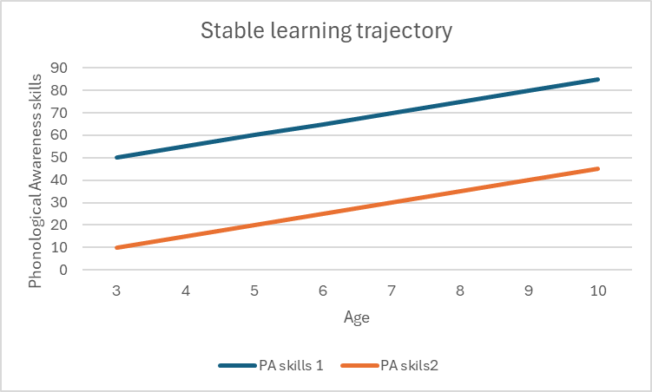
Stable learning trajectory
What every teacher should know about phonological awareness
Anthony, J. L., & Francis, D. J. (2005). Development of Phonological Awareness. Current Directions in Psychological Science, 14(5), 255-259. doi: 10.1111/j.0963-7214.2005.00376.x;
Notes:
Explain stable learning trajectory and importance of early and ongoing identification
If not already assessed, may need to assess all children in your school?

Slide 9


What can impact on phonological awareness?
What every teacher should know about phonological awareness
The languages that children hear around them (ambient language)
Their predisposition for phonological awareness
Their own speech and language development
  Speech sound disorders
  Poor vocabulary development
Learning to read
Robust phonological awareness skills are needed for reading and spelling
Zourou, F., Ecalle, J., Magnan, A., & Sanchez, M. (2010). The fragile nature of phonological awareness in children with specific language impairment: Evidence from literacy development. Child Language Teaching and Therapy, 26(3), 347-358. doi: 10.1177/0265659010369288
Notes:
Quick talk though slide
CLICK for learning to read and the need for capability to transfer
Talk though Zourou study

Slide 10
When do children with SLCN acquire phonological awareness skills?
What every teacher should know about phonological awareness
4;05-4;11
Verbal Syllable Segmentation
4;11-5;04
Final Syllable Deletion
5;05-5;10
Counting & Clapping Syllables; Initial Phoneme Identification; Final Phoneme Identification
5;11-6;04
6;05-6,10
6;11-7;04
8;03-8;07
Letter Sound Knowledge
Initial Syllable Deletion; Rhyme Identification
Initial Phoneme Deletion; Rhyme Generation
Final Phoneme Deletion
What a mess!
Notes:
Data collected from SLTs sending it in
n=597
Age range 2;11-10;00
Included EAL, SLCN
Most data at syllable level because fewer children progressed beyond this
Age correlated positively with all skills i.e. got better as get older (as expected)
Syllable level precede phoneme level
devastating impact on children’s PA acquisition. learning skills out of sequence, impact on spelling and then with writing, as well as reading
reading load increases as children go through KS1 and how this will impact the phonics screen
CLICK for what a mess star

Slide 11

Assessing phonological awareness: when?
What every teacher should know about phonological awareness
Preschool/early years (nursery and reception class) for all children age 3-5 years
On entry to year 1 for children age 6-7 who are not excelling at phonics
At any point in primary years if child is struggling with vocabulary learning, reading, spelling
On entry to secondary school for children who may be considered ‘low achieving’ or who have problem behaviour
Are phonological awareness skills of every child recorded in your school?
Notes:
Ideally, all children will be assessed at 3 and will have robust PA skills on leaving reception class

Slide 12
Assessing phonological awareness: how?
What every teacher should know about phonological awareness
Clapping, drumming, pausing between words or syllables are as good as counting
Newcastle Assessment of Phonological Awareness (NAPA)
Stringer (2019)
Download from here: https://research.ncl.ac.uk/phonologicalawareness/
Give visual support but never written words
Complex sounds are consonant clusters e.g. str, bl, pr, fl, kw
A syllable level skill important for spelling
Don’t do this unless you know they can
Notes:
Have any of you used the NAPA already?
Background to development
Any questions from you?
Click through arrows and explain with examples.
Red arrow, points to start session

Slide 13
Assessing phonological awareness: how?
What every teacher should know about phonological awareness
Confidence in decision making
The score tells us
Which session to start as main focus
Which sessions we need to provide extra practice to maintain skills
Scores in Needs Support in this column
Scores Competent in this column
Notes:
Click though arrows

Slide 14
Assessing phonological awareness: how?
What every teacher should know about phonological awareness
What support does the child need to get the answer?
What dynamic assessment adds
Newcastle Assessment of Phonological Awareness (NAPA)
Stringer (2019)
Hand over hand support to clap/tap/point
Give a verbal model for them to copy
Visual support e.g. coloured lines, duplo blocks
A choice of pictures to point to e.g. Jolly phonics-type
Notes:
What does the support we provide tell us about the child’s ability
Looking for ZAD and ZPD
Click through arrows

Slide 15

Because phonological awareness is important
What every teacher should know about phonological awareness
Children with good phonological awareness skills are at an advantage. Children who struggle will always struggle unless given help
Support must be continued until the child is competent and confident
Phonological awareness interventions
Are effective
Are easy to implement
Can be done at any age from about 3 onwards
Can be done in any language
Phonological awareness intervention will help the child’s speech, vocabulary, reading, spelling and may have the hidden bonus of improving their listening and attention skills
Anthony, J. L., & Francis, D. J. (2005). Development of Phonological Awareness. Current Directions in Psychological Science, 14(5), 255-259. doi: 10.1111/j.0963-7214.2005.00376.x; Carroll, J. M., Snowling, M. J., Hulme, C., & Stevenson, J. (2003). The development of phonological awareness in preschool children. Developmental Psychology, 39(5), 913–923. https://doi.org/10.1037/0012-1649.39.5.913
Notes:
Click for bluebird and message to arrive.

Slide 16
Teaching phonological awareness
What every teacher should know about phonological awareness
Comprehensive cover of syllable and phoneme level skills
The Ultimate Guide to Phonological Awareness (Essex County Council, 2009) Email: aispublications@essex.gov.uk
Newcastle Intervention for Phonological Awareness (NIPA) (Stringer, 2019).* http://research.ncl.ac.uk/phonologicalawareness/
*Look out for teaching materials from Speech & Language UK
Notes:
Programmes available

Slide 17

Summary
NAPA
  Scripted
  Dynamic assessment/ZPD
  Not standardised
  Developmental progression from large to small units
  Suitable from pre-school age
  Useful for older children who are struggling with reading and/or spelling

Slide 18
NAPA
  Counting Words
  Segmenting Syllables
  Syllable Deletion
  Initial Sound Identification
  Sound Deletion
  Sound Substitution
  Complex Sound Deletion
  Rhyme Identification
  Letter-Sound Knowledge

