Slide 1

Pupil
Re-Integration Team
Ladder Update
Karen Richardson
Inclusion Team Manager

Slide 2
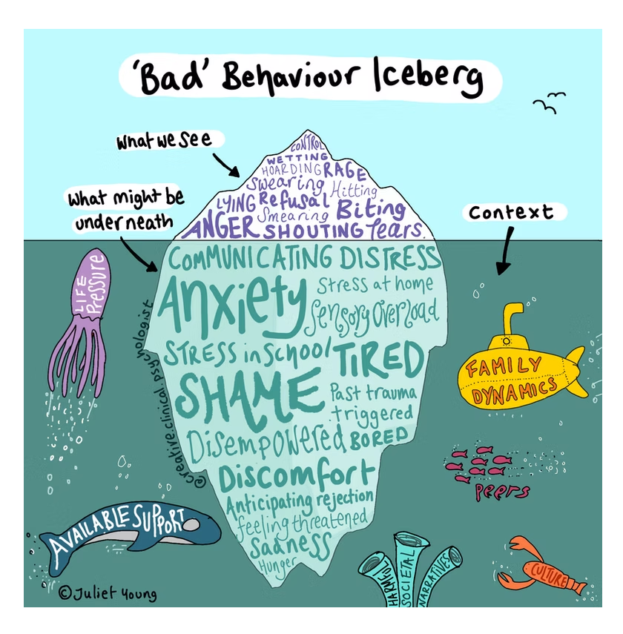
The Revised Ladder

Slide 3

Numbers of Exclusions Continue to be a Concern in Lincolnshire
(graphic used courtesy of The Difference)
Lincolnshire has higher rates of exclusion than national and regional rates

Slide 4
Step of the Ladder
Initial Steps | Whole School Approaches | Underpins Everything
Next Steps | Identifying Factors | Part of Assess
 | Early Intervention | Part of Plan, Do
Further Steps | Targeted Involvement | Part of Do, Review, Assess
Following a Graduated Approach

Slide 5
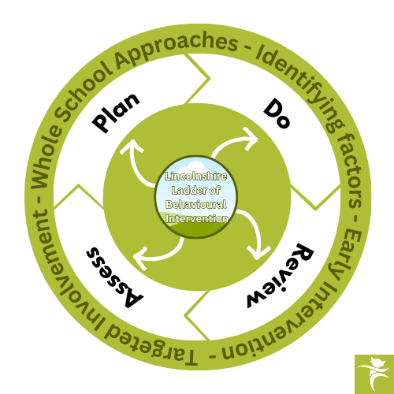
Following a Graduated Approach

Slide 6
Whole School Approaches
A whole school approach to managing behaviour underpins all elements of the Ladder and is essential for creating a consistent, supportive, and inclusive learning environment. A unified approach promotes a shared responsibility among teachers, support staff, and leadership, fostering a positive school culture built on respect and accountability. Ultimately, a whole school approach not only improves classroom behaviour but also enhances pupil wellbeing and academic outcomes by creating a safe and structured environment where everyone can thrive.
Whole School Approaches can include:
Audit Tools
Restorative Approaches
Creating a Relational Behaviour Policy
Teach Behaviours
Creating a Co-Regulation Plan

Slide 7
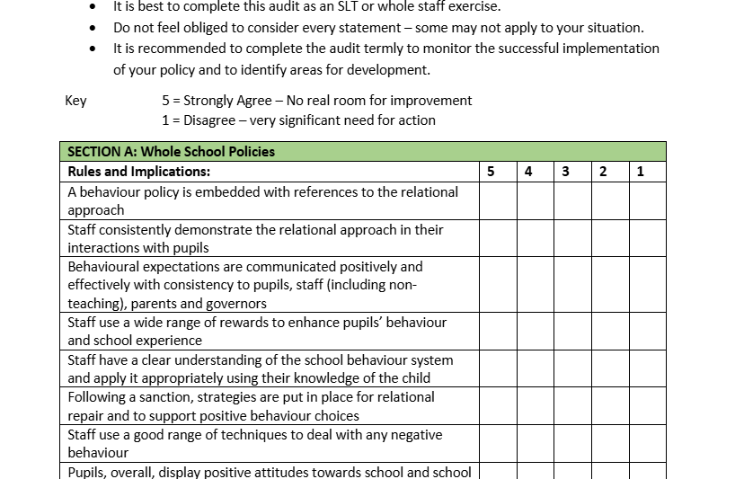
Audit tools are a useful resource for identifying areas for development and celebrate areas of success. The Ladder Toolkit provides several audits for completion on a whole school or class basis such as the Behavioural Environment Audit or the DfE audit and action planning tools. These audit tools should be used and reviewed on a regular basis to monitor implementation and adjustment of policy and practice.

Slide 8
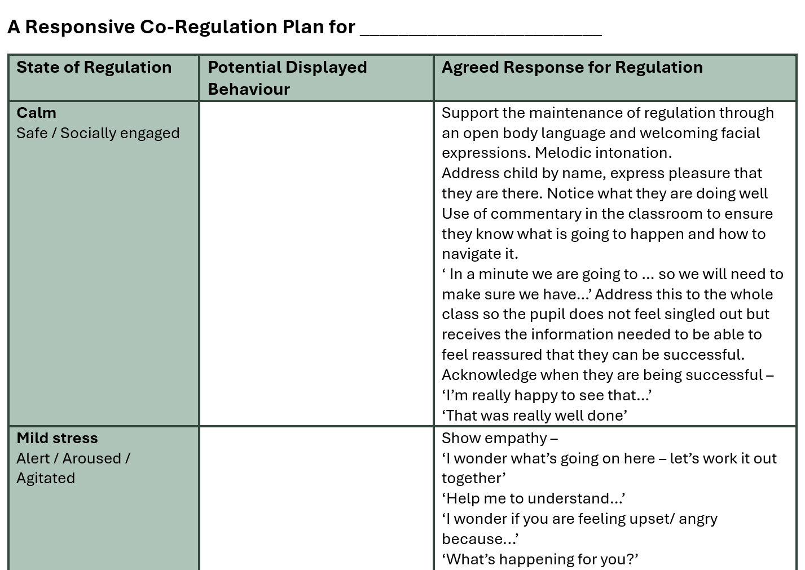
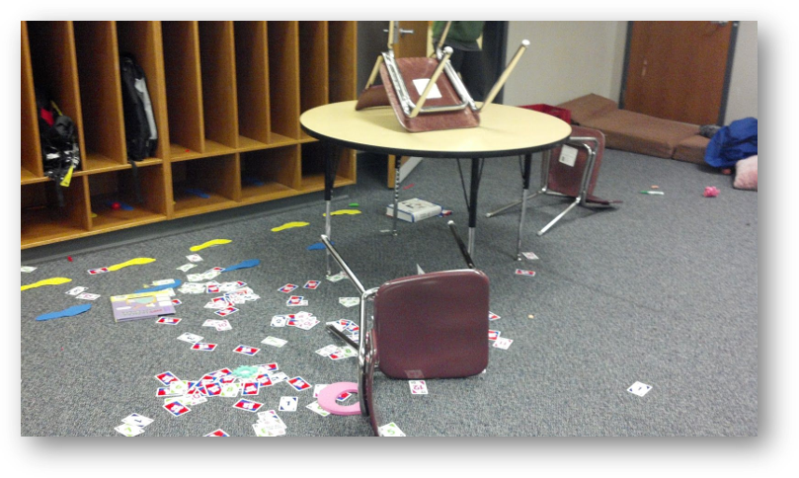
Create a responsive co regulation plan for your school. This will set out a consistent response for staff when they are faced with dysregulated behaviours. Develop the plan with input from all staff to ensure ownership. A template for a plan and guidance can be found in the Ladder Toolkit.

Slide 9
Identifying Factors –
Next Steps (assess)
Where the Initial Steps aren’t enough, identifying and assessing learning needs as part of behaviour support in schools is crucial because pupils' behaviour is often influenced by their academic challenges, learning difficulties, and social-emotional needs. Addressing the root causes of behaviour is essential for providing effective support and fostering an environment where all pupils can succeed.
An analysis by the DfES of all pupils permanently excluded in Year 9 in the 2004-5 academic year data showed that pupils who entered secondary school with very low literacy skills (below National Curriculum Level 3 in English) had an exclusion rate five times that of pupils entering Key Stage 3 at Level 4 or above (0.5% of those with severe literacy difficulties were excluded, compared to 0.1% of those with at least average literacy levels).
-Timpson Review of School Exclusion, May 2019

Slide 10
Using Screening Tools as part of the Lincolnshire Ladder of Behavioural Intervention.
Responsive Co-regulation Planning | Whole School | The responsive co-regulation plan is about how to respond in the moment to ensure de-escalation and also ensures that the child experiences co-regulation (repeated experiences of being regulated leads to increased self-regulation). The plan also outlines what needs to happen when the child is calm to enable them to develop their ability to regulate.
Pupil PSP Questionnaire | Pupils KS1-KS4 | The Pupil PSP questionnaire is a brief behavioural screening questionnaire to be completed with pupils
Class Teacher PSP Questionnaire | Class Teachers | The Class Teacher PSP questionnaire is a brief behavioural screening questionnaire to be completed by the child’s class teacher or someone who works closely with them
Parent/Carer PSP Questionnaire | Parents | The Parent/Carer PSP questionnaire is a brief behavioural screening questionnaire to be completed by parents/carers
Behaviour Risk Screening Tool | All Staff | Individual risk screening tools help to identify potential triggers by assessing extenuating factors. By understanding individual risk factors, interventions can be tailored to address specific needs and promote safer outcomes.
Individual Pupil Risk Assessment | All Staff | Individual pupil risk assessments for behaviour help to ensure the safety and well-being of students and staff, especially when a student's behaviour poses a risk to themselves or others. These assessments help identify potential hazards, evaluate the level of risk, and implement appropriate control measures to mitigate those risks.

Slide 11

Additional Screening including SEND
Additional screening for pupils may be appropriate including those pupils with SEND .
Screening could include:
  Academic Assessments such as reading, spelling, writing, maths and speech & language assessments.
  Cognitive and learning assessments such as working memory, processing speed, reasoning , dyslexia, dyscalculia, or dyspraxia screening tools.
  Developmental and Functional assessments such as developmental checklists, Occupational Therapy or Physiotherapy assessments.
  External Agency reports such as CAMHS assessments, community paediatrician reports or hearing and vision assessments.

Slide 12

Why assess SLCN?
UK data reports prevalence of speech, language and communication needs in young offenders to be around 60–70%, with international prevalence studies mirroring these statistics. However, studies have shown that only 5–8% of those with measurable SLCN have had these previously identified . In addition to this 81% of children with emotional and behavioural disorders have unidentified SLCN (Bercow: Ten Years On, 2018). These behavioural difficulties can leave SLCN unidentified as they are often the more overt behaviour and therefore the focus of concern.
Bryan et al., 2015

Slide 13
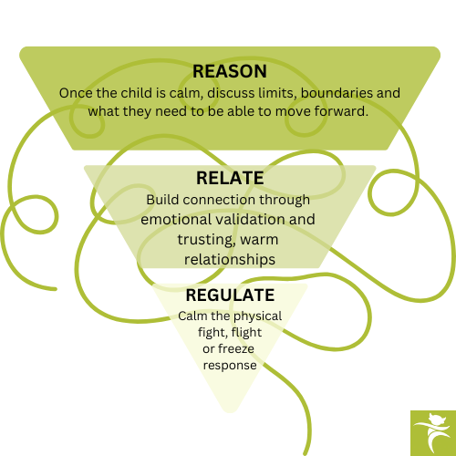
Pupils with Attachment and Trauma
Consideration should be given to how attachment or trauma could be impacting on healthy development, and particularly a pupil's capacity for self-regulation. Resources to support with attachment, trauma-informed practice and Adverse Childhood Experiences (ACEs) can be found in the Ladder Toolkit. The work of authors such as Bruce Perry (see below for his 3 Rs model) and Louise Bomber can be particularly useful when seeking information around supporting pupils with attachment and trauma.

Slide 14

Early Intervention
– Next Steps (Plan, Do)
It is important for schools to seek to understand the underlying causes of behaviour through Early Intervention and whether additional support is needed. Underlying causes of persistent disruptive behaviour should be investigated, and support provided such that permanent exclusion is only ever a "last resort." The assessments and information that has been gathered in the Identifying Factors stage will be crucial here when planning for the Next Steps.

Slide 15

Utilising a PSP
What does a good PSP Look Like?
It should contain:
Student Information
Reason for the Plan
Strengths and Interests
Areas of Concern
Targets (SMART Goals)
Strategies and Interventions
Staff Roles and Responsibilities
Student Voice
Parental/Carer Involvement
Review Dates and Monitoring
Consequences and Rewards
Exit Strategy

Slide 16

PRT – How can we support?
Support from PRT can include:
Support for Pupils with Challenging Behaviour
Promote Inclusion and Reduce Isolation
Prevent Suspensions and Exclusions
Provide Guidance and Early Intervention for Schools and Governors
Offer Best Practice Solutions for Behaviour Management
Support Development of Effective Behaviour Management Systems
Encourage Partnership Working Across Agencies
Attend and Support PSP and Related Meetings
Provide Exclusion Training for Governors
PRT Caseworker Support
Access to PRT Funding to Reduce Risk of Exclusion
Funding Available for Therapies, Resources, and Skill-Building Projects
Support in Creating Inclusive Educational Environments
Anything else?

Slide 17

Using Off Site Direction
Using off site direction (OSD) as early as possible can have real benefits.
Planning for an OSD includes:
Identify Need for Intervention
Case-by-Case Decision Making
Plan the Off-Site Direction Placement
Agree on Type and Duration of Placement
Transition Planning and Support
Implement the Placement
Review and Evaluate
Plan for Reintegration or Next Steps
Some schools are starting to use OSD as a short-term intervention. Could this be more widely used?

Slide 18
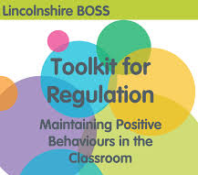
Early Support from the Behaviour Outreach Support Service (BOSS)
Lincolnshire BOSS’ ‘Toolkit for Regulation’ (Primary and Secondary) should be consulted for additional ideas of how to maintain positive behaviours in the classroom. BOSS Toolkits for Regulation
An anonymised, bookable consultation with BOSS (40 minutes) may be appropriate or supportive as part of early intervention. This can be identified through consultation with PRT Case Worker in the following cases prior to the 12 week referral process and is for:
Children moving into Lincolnshire displaying significant needs
Where a child has entered school through the mid-year admissions process and additional support is required to enable their transition
Children showing a rapid increase in challenging behaviours
Where risk of exclusion is felt to be 8+
Where a PSP has been started but impact is minimal, and it is felt that specialist advice would be useful to inform outcomes

Slide 19

Targeted Involvement – Further Steps (Do, Review, assess)
If after following the earlier steps of the ladder, there are continued concerns regarding a pupil displaying challenging behaviour then the Further Steps stage of the ladder looks at more significant support from specialist outside agencies. Support from specialists is crucial in addressing pupil behaviour in order to bring expert knowledge and experience in understanding and managing complex needs. Specialists can assess underlying issues that often contribute to challenging behaviour. Involving specialists ensures a more holistic and coordinated approach, helping to create a supportive environment where pupils can thrive both emotionally and academically. Further information on what specialist outside agencies are available can be found in the Ladder Toolkit.
Targeted Involvement can include:
Requesting BOSS Support
Specialist Teaching Team
Educational Psychologist
Occupational Therapist
Clinical Psychologist
Speech and Language Therapist
As well as many others

Slide 20
Expertise in Addressing Complex Needs – providing specialised knowledge and individualised support
Early Intervention and Prevention – identifying early signs preventing escalation and promoting inclusion
Supporting Mental Health and Wellbeing – through addressing underlying issues and promoting positive mental health strategies
Providing Targeted Interventions and monitoring progress
Supporting the School Community – such as training or developing whole school approaches
Family Involvement – engaging with families and helping to create a network of support
Why use outside specialist support?

Slide 21
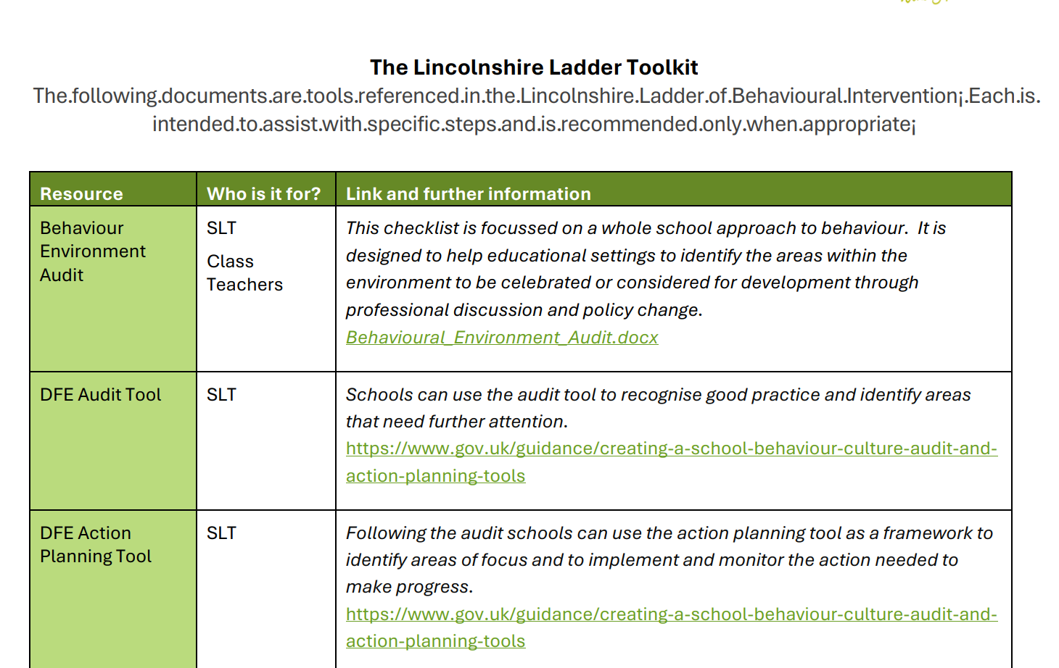
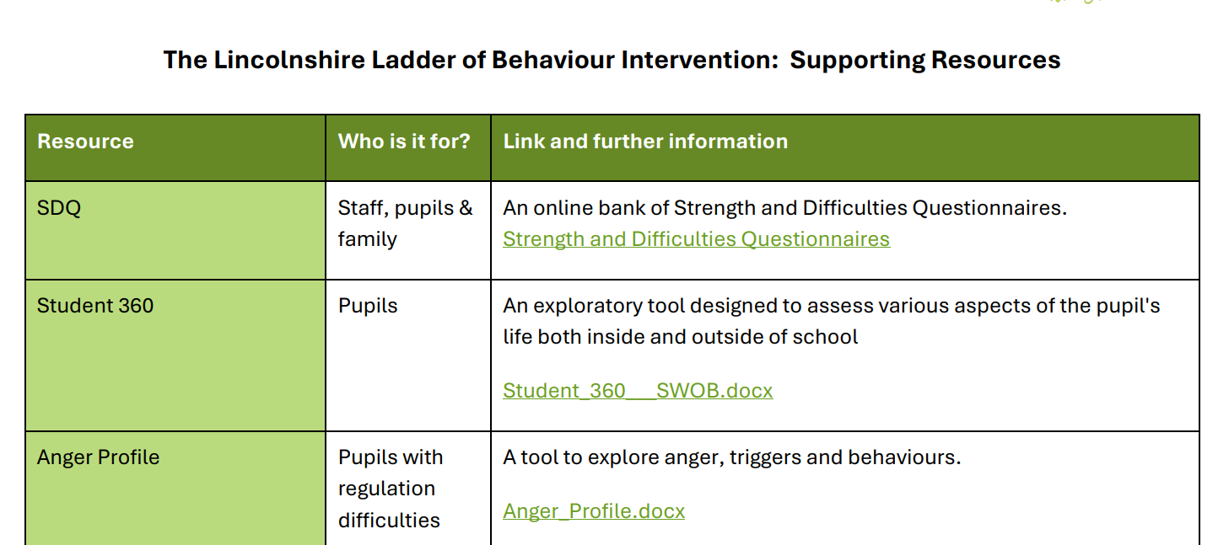
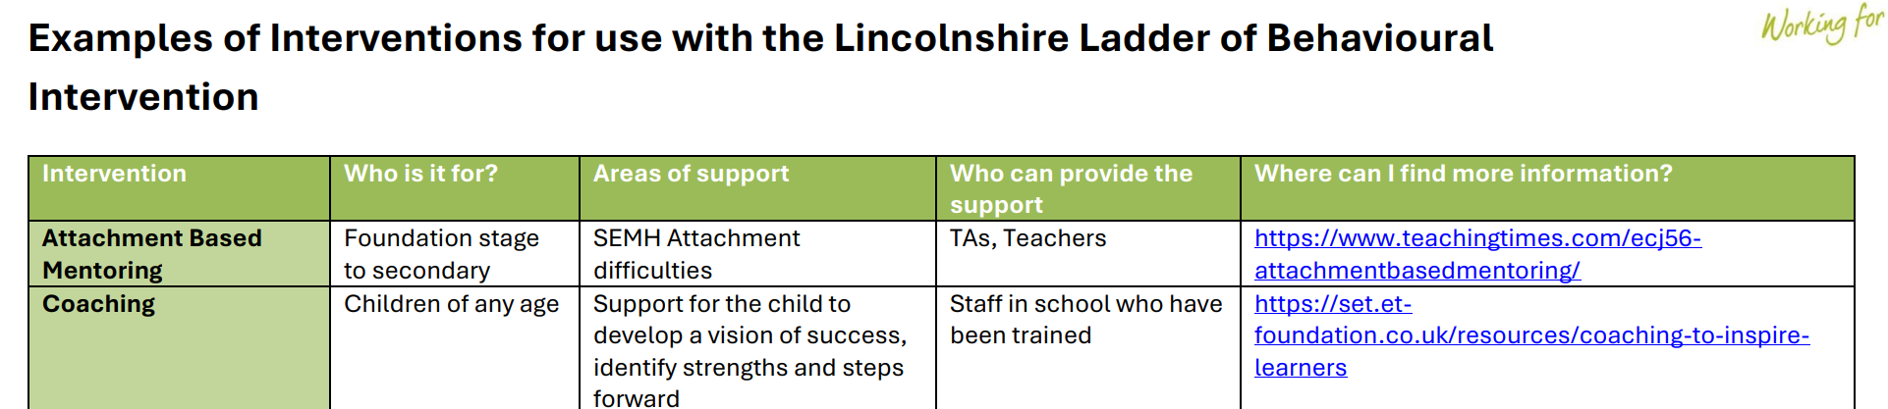
What else is there to help?
Lincolnshire Ladder of Behavioural Intervention - Link to Ladder
Ladder Toolkit
Ladder Resources
Ladder Interventions

Slide 22

Any Questions

