Slide 1



L.E.A.D. Professional Development
Updates and Headlines
‘Working in Partnership, Achieving the Highest Outcomes for All’
Notes:
Welcome

Slide 2

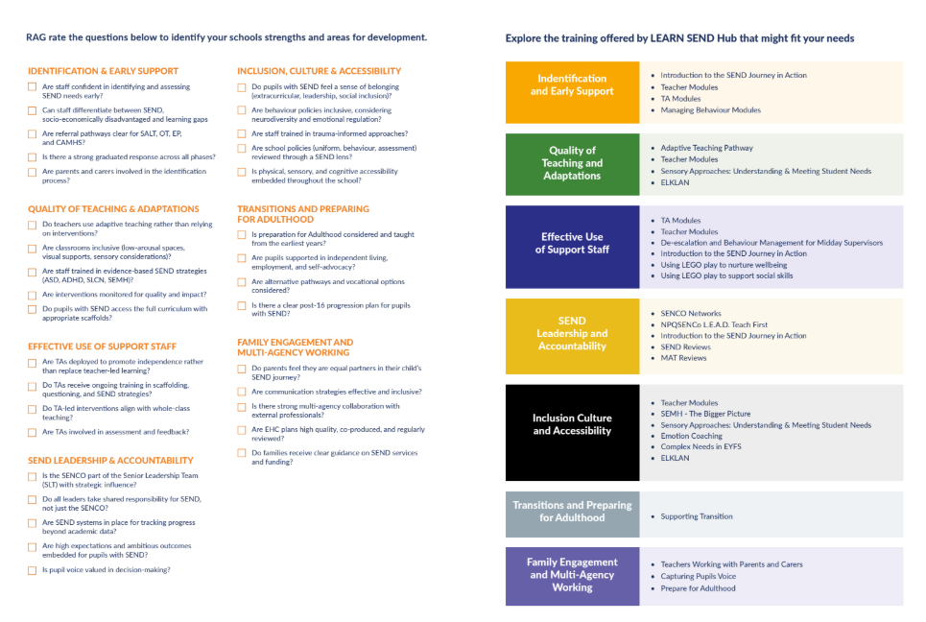
Working in partnership, achieving the highest outcomes for all.

Slide 3


Working in partnership, achieving the highest outcomes for all.

Slide 4


Slide 5


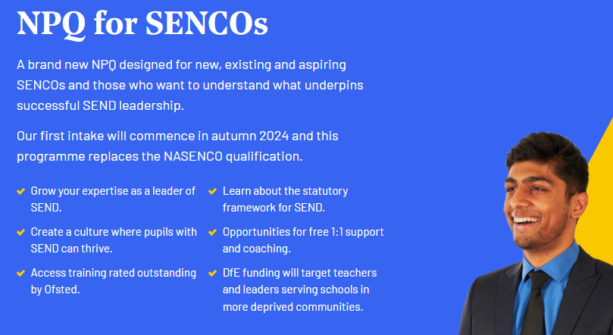

Update - NPQSENCO
Cohort 1 – (4a) commenced Autumn 2024
Cohort 2 – (4b) commenced May 2025
Cohort 3 (5) November 2025
2
Working in partnership, achieving the highest outcomes for all.
Notes:
Our first cohort is underway – 57 participants in total
Unsure as to whether there is going to be further funding for this programme – we suspect there will be as this is mandatory.
The next cohort is due to run in April 2025 IF the DfE decide to continue on a two cohort a year model moving forwards.
We will make everyone aware when the DfE registration platform opens but in the meantime you can submit an EOI using the QR code which will give us your name and contact details – we will then be able to contact you directly once we know that registration is open – this will give you more of a chance of getting a funded place.

Slide 6
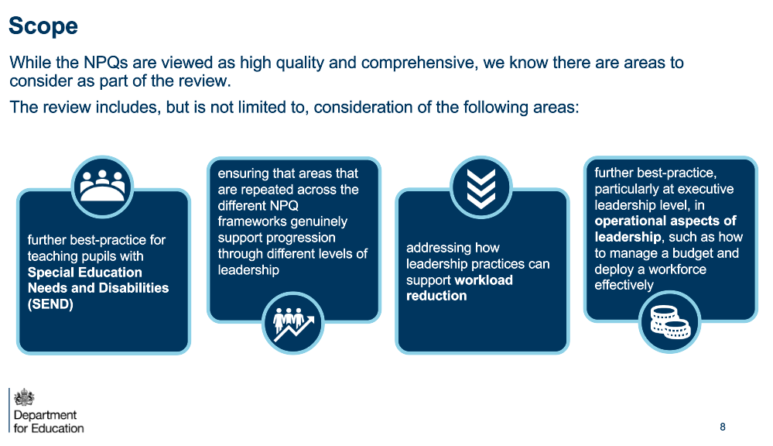
Working in partnership, achieving the highest outcomes for all.

Slide 7
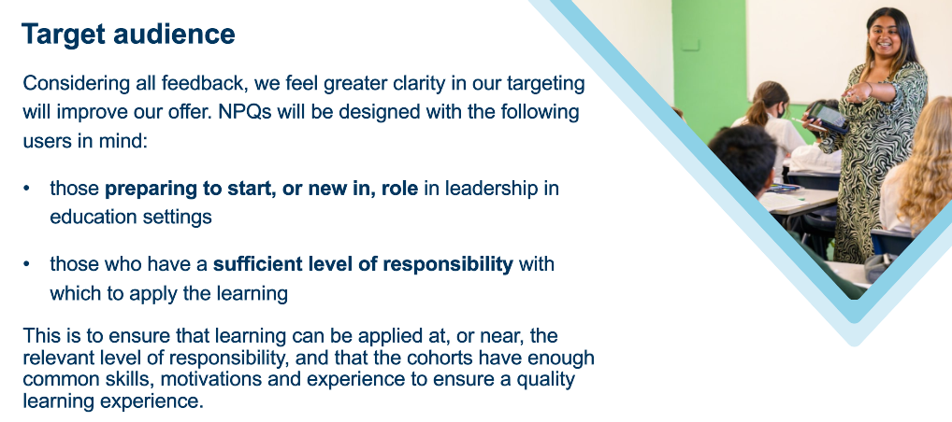
Working in partnership, achieving the highest outcomes for all.

Slide 8
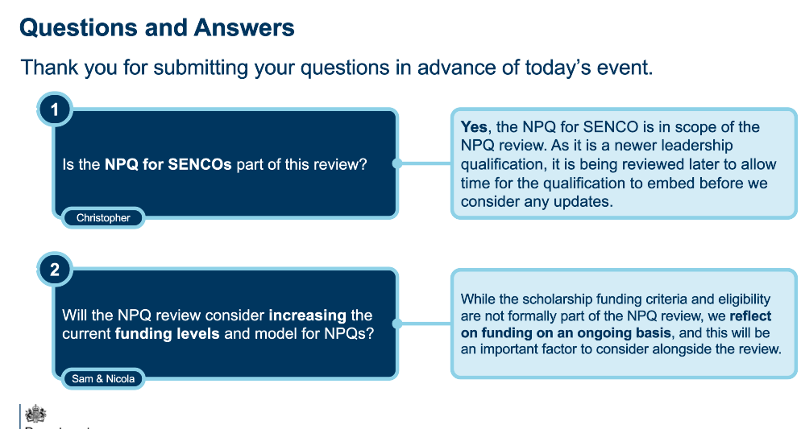
Working in partnership, achieving the highest outcomes for all.

Slide 9

Working in partnership, achieving the highest outcomes for all.

Slide 10

The Year of Reading
Overview
Early years
Primary
Secondary
The Dfe announced that a UK-wide National Year of Reading will be launching in 2026.
The theme is 'Go All In' - inspiring people across the nation to discover that whatever they're passionate about, there's a book for it. Whether that be football, music, gaming or something else entirely, we want to help them dive deeper through reading. If you’re into it, read into it.
Working with the National Literacy Trust and their partners, we're bringing you a full year of engaging events, practical resources and expert support - all designed to make reading come alive in your classroom. The programme has been tailored with dedicated support and resources for early years, primary and secondary phases, all led by experts.
Working in partnership, achieving the highest outcomes for all.

Slide 11

Whole School SEND?
Whole School SEND (WSS), as part of nasen, leads the Universal SEND Services Programme (USS) on behalf of the DfE.
The WSS team comprises of experienced SEND leaders from across the education sector, including mainstream, special settings and local authorities.
The work of WSS is based on 5 key principles:
  Collaboration and Knowledge Exchange
  Every Leader a Leader of SEND
  Inclusive Pedagogy – Universal First
  Regional Expertise for National Impact
  Equity, Evidence, and Sustainability
Notes:
Highlight strategic partners – ETF & delivery partners - AET

Slide 12



Online SEND CPD Units
Developed in partnership with young people, specialists and mainstream practitioners.
Explore some of the most commonly observed barriers to learning, regardless of age, label or area of need.
Each unit can be completed in under an hour. No need to complete units in a single session – progress is saved.
Provides knowledge and skills required to build a holistic understanding of individual learners’ characteristics.
Provides clear guidance and strategies to enable practitioners to adapt their teaching, across the age range, to meet the needs of a wider range of learners.
Badges and certificates awarded for completion of multiple units.
"Another unit that puts the learner at the forefront of practice and enables us as educators to adapt our environment to support children with a range of needs" (Unit 12)
Notes:
20 minute interactive CPD units which are free once you register with Whole School SEND.

Slide 13
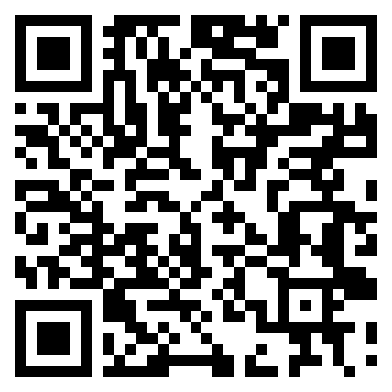
Autism Training
High-quality, autism-focused training programme for the workforce across all education settings.
Development of 3 training packages for teachers and leaders to deliver autism training in their settings.
Delivery of webinars to support the implementation of training packages using a ‘train-the-trainer’ model.
Launch of five new autism online units.
Notes:
NEW train the trainer programme.
Details from the website about it;
ur DfE-funded 'Train the Trainer' packages are designed for leaders, SENCOs, and inclusion teams who want to deliver high-quality, evidence-based autism training to staff — with clarity, confidence, and minimal preparation time.
We know that the most effective training comes from people who understand their own setting. That’s why our packages give you the tools to deliver it yourself — with everything you need to lead quality-assured sessions tailored to your setting.
They're designed to be:
Relevant – easily tailored to your setting’s context
Flexible – run as a half-day session or split into shorter 1-hour modules
Sustainable – ideal for ongoing CPD and long-term staff development
Aligned with the latest DfE and EEF standards, the packages include:
A recorded webinar that provides essential context and planning guidance
A set of ready-made training slides with speaker notes, activities, and recommended reading
A step-by-step video guidethat walks you through the training slides and how to use them effectively, available to watch at any time
Getting set up takes just three simple steps — our approach saves time, builds staff confidence, and supports a consistent, inclusive experience for autistic learners across your school.

Slide 14

Notes:
Autism Awareness and Inclusion | Whole School SEND
What is looks like for the three packages on the website.

Slide 15

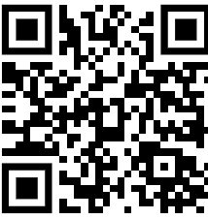
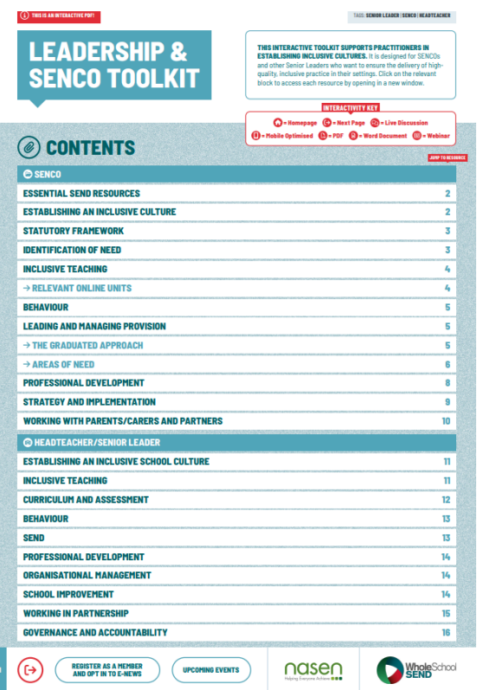
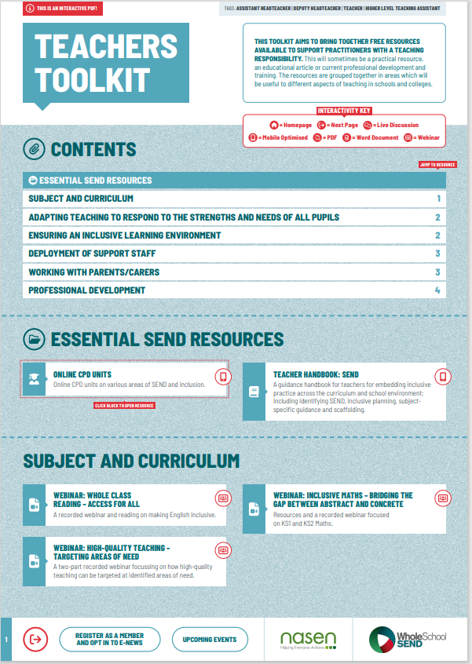
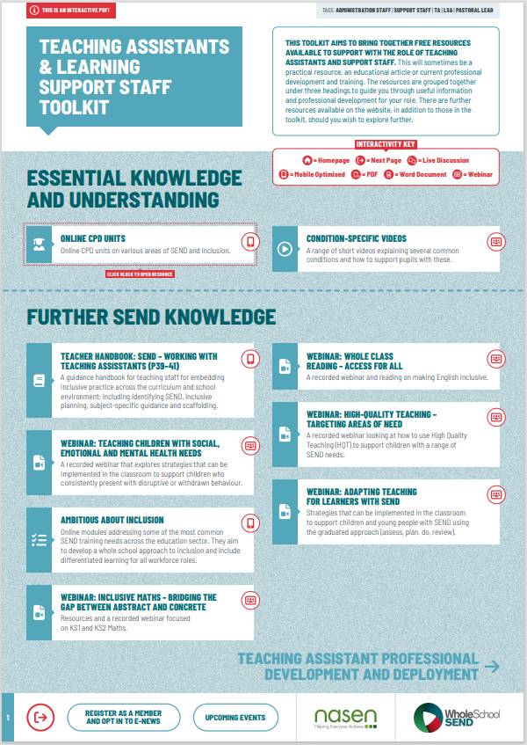
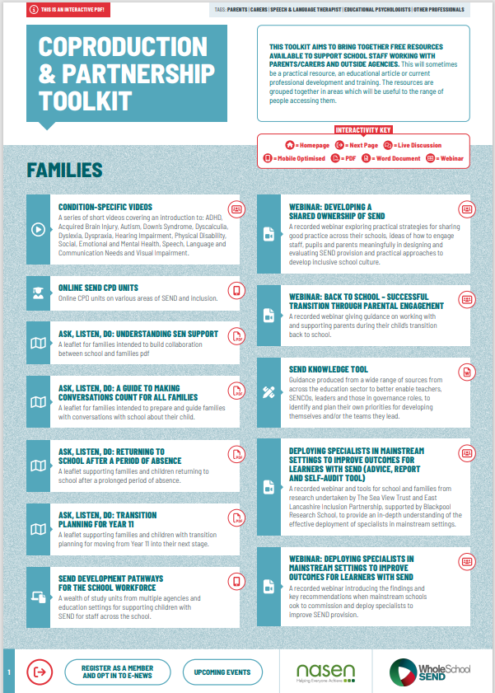
Toolkits
Interactive resource directories tailored for a range of roles. The toolkits make it easy to find the information and resources you need.
Find out more here: https://www.wholeschoolsend.org.uk/toolkits
Notes:
Interactive PDFs to help navigate the whole school send website to look for suitable resources and training..

Slide 16
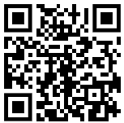

The Teacher Handbook: SEND
A comprehensive resource for teachers. The Handbook brings together practical examples of high quality, inclusive teaching – placing a focus on removing barriers to learning, getting to know and understand individual learners and bringing the graduates approach to life.
Find out more here: https://www.wholeschoolsend.org.uk/teacher-handbook
Notes:
2
Other DfE SEND contracts – NNPCF, NDTi, BASE, Project Search, Local Government Association

Slide 17

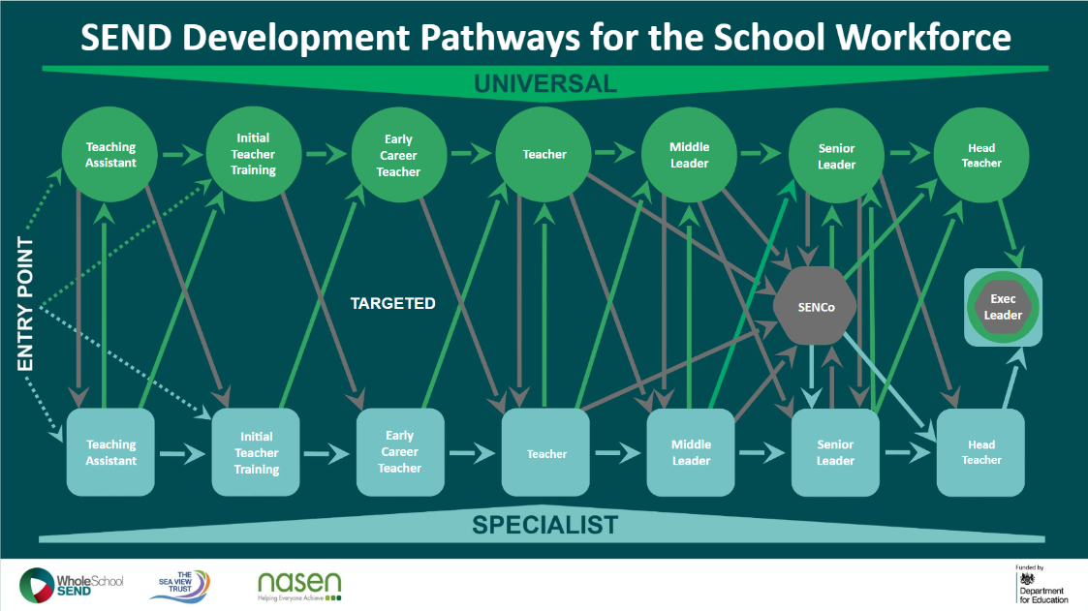
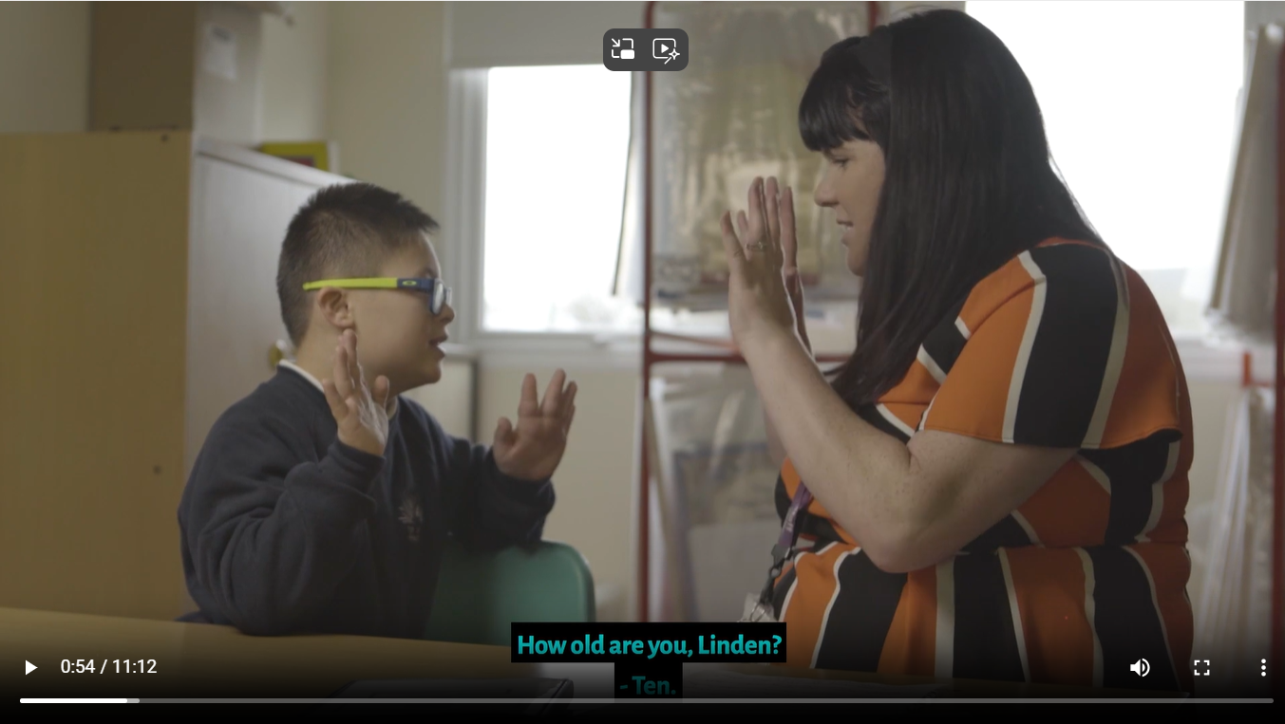


Other resources
ITT and mentor resources
SEND Development Pathways
Condition-specific videos
https://www.wholeschoolsend.org.uk/itt-resources
https://www.wholeschoolsend.org.uk/resources/send-development-pathways-interactive-powerpoint
https://www.wholeschoolsend.org.uk/page/condition-specific-videos
SENCO Induction Pack
Parent Leaflets
https://www.wholeschoolsend.org.uk/resources/ask-listen-do-guide-making-conversations-count-all-families
https://www.wholeschoolsend.org.uk/resources/senco-induction-pack-revised-edition

Slide 18

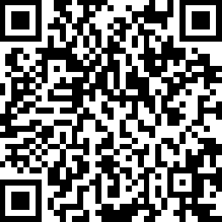




Find out more and join our member community
Stay in touch
info@wholeschoolsend.org.uk
@WholeSchoolSEND
@wholeschoolsend
www.wholeschoolsend.org.uk
@whole-school-send

Slide 19


SEND Workforce Development
Scan the QR code to register for FREE!
14,000+
Modules
completed
343
Lincs schools
engaged
99%
Satisfaction
rate
25
Average mins per module
chris.lincoln@learnsendhub.co.uk | sendworkforcedevelopment.my.canva.site
Notes:
The SEND Workforce Development project continues to be accessed by staff in schools across Lincolnshire.

Slide 20
SEND Workforce Development
Modules available include:
Induction Tier:
(Now also available to parents)
Types of SEND
Awareness of a Neuro-Typical Child
What is Inclusion?
SEND Code of Practice
Respecting Individuals
Working with Professionals
Tier 1:
Sensory Processing and Integration
Supporting Transitions
Support Interventions
Restorative Practice
Four Areas of Need
Nurture Principles
Personal Care and Dignity
Introduction to Attachment
Introduction to Trauma
Scan the QR code to register for free:
@SENDworkforce
Have your staff completed some
of these modules?
Have they helped to make a positive impact in your school?
chris.lincoln@learnsendhub.co.uk | sendworkforcedevelopment.my.canva.site
Notes:
All of these modules are live and available to access. If any staff need support, they can contact us through the QR code and a member of the team will get in touch.

Slide 21
SEND Workforce Development
Modules available include:
Tier 1 Extension
Belonging in Your School
Parent/Carer Engagement
Every Teacher is a Teacher of SEND
Understanding Neurodiversity
Enabling and Inclusive Environments
Introduction to DLD
Behaviour as a form of Communication
De-Escalation
Dual Coding (1st December)
Regulation Strategies
Speech and Language and Behaviour
Trauma (extension of Tier 1)
Relationships
ADHD
Scan the QR code to register for free:
@SENDworkforce
“A very clear and concise toolkit
of strategies. I enjoyed working through the scenarios and the downloadable content”
chris.lincoln@learnsendhub.co.uk | sendworkforcedevelopment.my.canva.site
Notes:
Next stage of the project

Slide 22
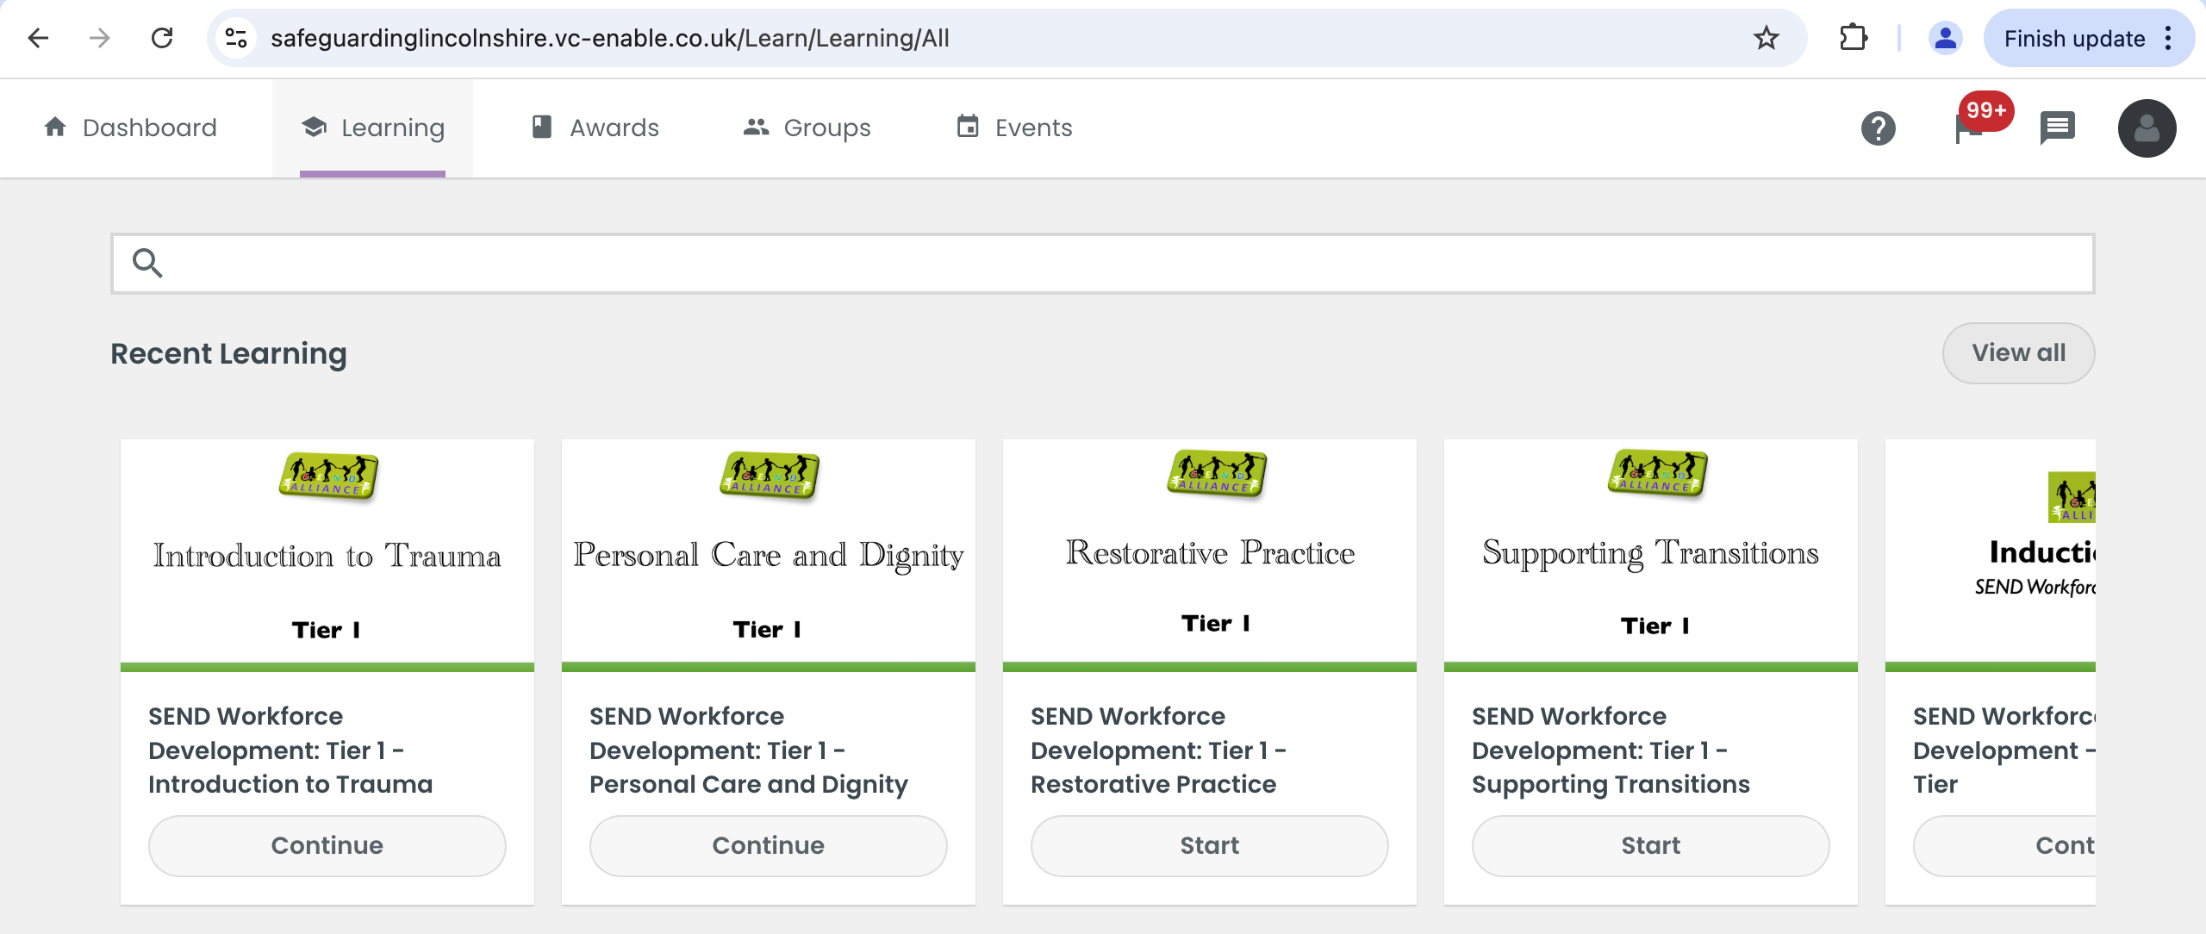
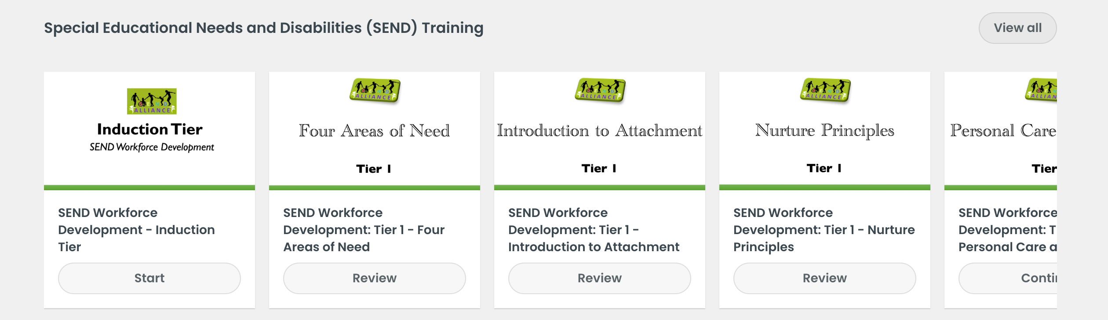
SEND Workforce Development
chris.lincoln@learnsendhub.co.uk | sendworkforcedevelopment.my.canva.site
Notes:
A reminder that any member of staff who has an account on the Lincolnshire Safeguarding Children Partnership platform, should be able to see and access all of the modules that have gone live when they sign into the platform.

Slide 23

SEND Workforce Development
Parent Flyer
Scan the QR code to register for free:
@SENDworkforce
chris.lincoln@learnsendhub.co.uk | sendworkforcedevelopment.my.canva.site
Notes:
Induction Tier modules are available to parents for free. If you would like a flyer about the content that you can send to parents and carers, please contact Chris on the email address at the bottom of the slide. We are really looking to promote this content to as many parents as possible.

Slide 24
SEND Workforce Development
How schools use the modules…
Whole staff training during Inset Days or remotely
Inset Day or remote training for specific staff members such as Teaching Assistants
Part of an induction for new staff members
Specific modules for specific staff. For example, Personal Care and Dignity for staff members who support a young person with toileting
Signposting for staff who wish to explore further CPD
Scan the QR code to register for free:
@SENDworkforce
All of the content remains free to access
chris.lincoln@learnsendhub.co.uk | sendworkforcedevelopment.my.canva.site
Notes:
You can pick and choose the modules most relevant to your staff and school. Here are some examples of how schools have used the modules

Slide 25

LEARN CPD
www.learnsendhub.co.uk

Slide 26
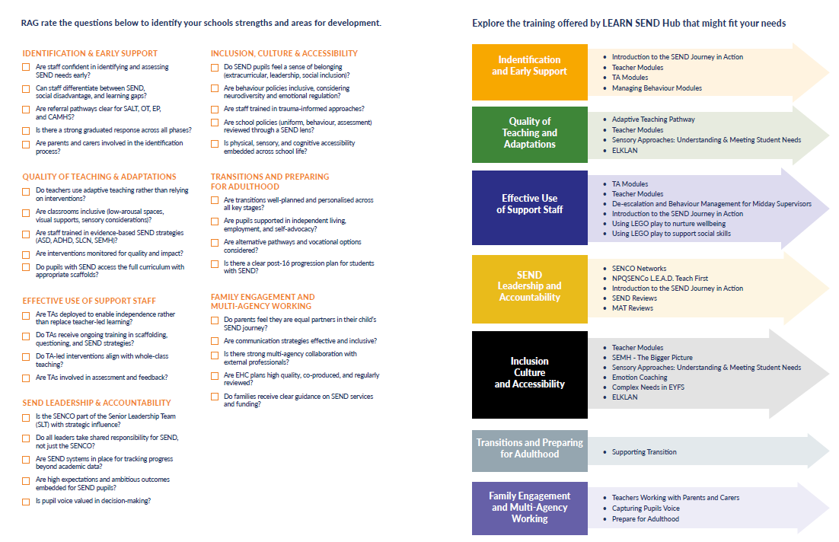
www.learnsendhub.co.uk

Slide 27
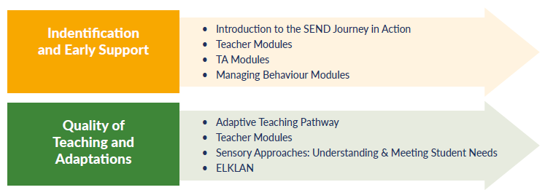
www.learnsendhub.co.uk

Slide 28
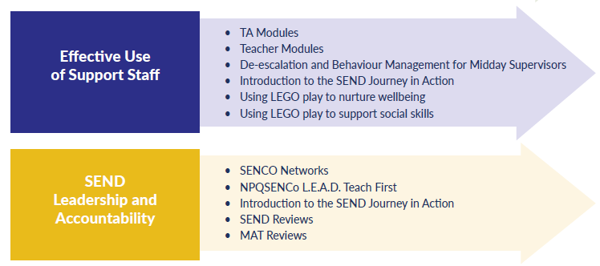
www.learnsendhub.co.uk

Slide 29
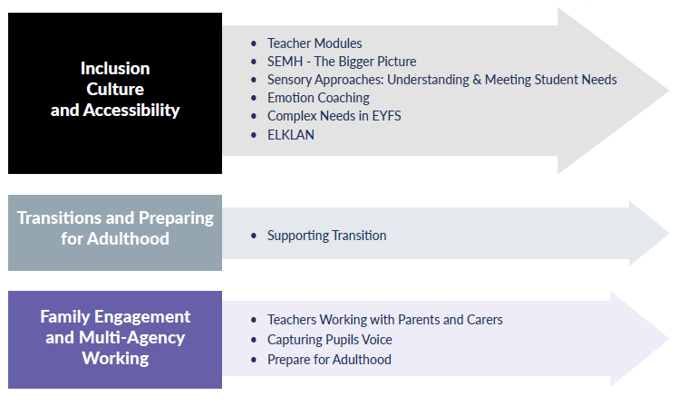
www.learnsendhub.co.uk

Slide 30
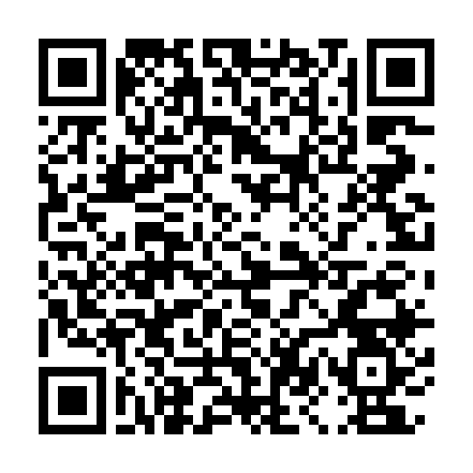
Teaching Assistant Modules
A modular toolkit of one-hour webinars for teaching assistants in mainstream primary and secondary schools, designed to enhance skills, effectiveness, and confidence in supporting pupils with SEND.
Book here
Module 1 | The role of the TA with pupils with SEND and development of working relationships
Module 2 | High Quality Teaching
Module 3 | Promoting effective group working
Module 4 | Promoting independence
Module 5 | Scaffolding and questioning
Module 6 | Delivering effective intervention programmes
Module 7 | Providing valuable feedback for teachers and pupil
Module 8 | Understanding Communication and Interaction Needs
Module 9 | Understanding Cognition and Learning Needs
Module 10 | Understanding SEMH Needs
Module 11 | Understanding Physical and Sensory Needs
Module 12 | Calm and ‘ready’ to learn
https://bit.ly/4gjqFC0
www.learnsendhub.co.uk

Slide 31
Courses continuing in 2025/26
Emergency First Aid at Work
Paediatric First Aid
Lego Therapy
SEMH – The Bigger Picture
SEND Network Meetings
Specialist School Leadership Meetings
Meeting Complex Needs in EYFS
Teaching Assistant Modules
Managing Behaviour Modules
Teaching Modules
www.learnsendhub.co.uk

Slide 32
New courses for 2025/26
Sensory Approaches: Understanding and Meeting Student Needs
Readiness to Learn: Approaches to Behaviour
Supporting Transitions
Teacher working with Parents and Carers
Adult Mental Health Aware
Mental Health Skills for Managers
Mental Health First Aid
Youth Mental Health First Aid
Gestalt Language Processing
Understanding the Adolescent Brain
www.learnsendhub.co.uk

