Slide 1






Lincolnshire Parent Carer Forum
Lincolnshire Parent Carer Forum

Slide 2
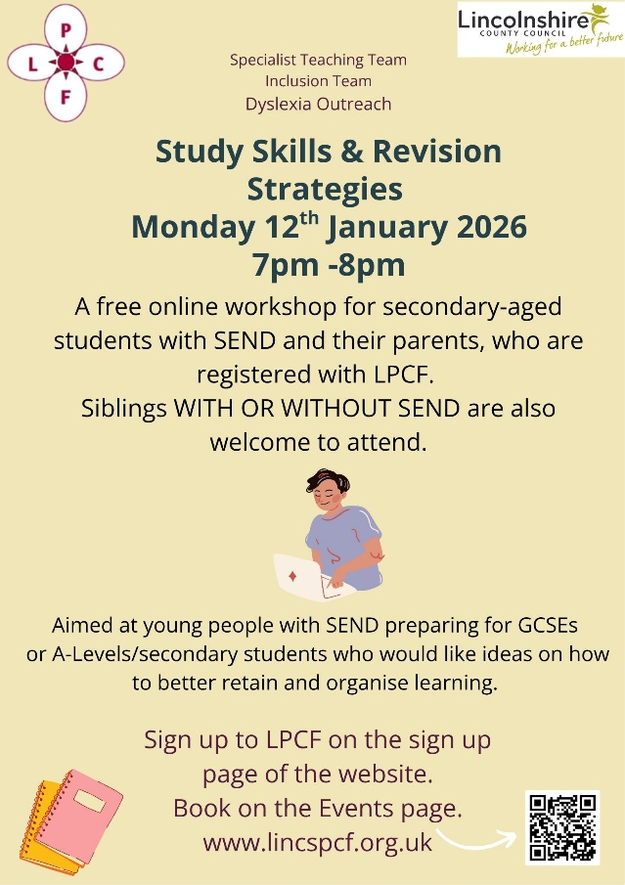


Lincolnshire Parent Carer Forum
Lincolnshire Parent Carer Forum

