Slide 1
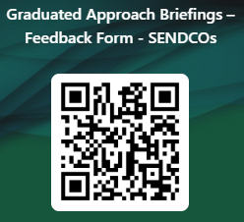

Graduated Approach Briefings
Nov/Dec 2025
Notices

Slide 2
Please complete the SENCO GAB survey...
35 responses so far…
You said/we did:
Length ok, contents ok, like sharing new ideas and hearing real experiences
Like mix of online and face to face
Want to know topic areas and age range
Want more joined up working with SEND
Want updates on Ofsted and SEND reforms
Want SALT updates and ideas for SEMH and behaviour management
If you ask for it… we will do our best to provide!

Slide 3
Remember to book your places for each briefing throughout the year on the Local Offer
Month | Meeting 1 | Meeting 2 | Meeting 3
September 2025 | NO meetings
November /December 2025 | TEAMS: Thurs 27th November 13:00 – 15:30 | TEAMS: Tues 2nd December: 09:30 – 12:00 | N/A
February 2026 | TEAMS: Thurs 5th February 13.00 – 15.30 | TEAMS: Tuesday 10th February 09.30 – 12.00 | N/A
April/May 2026 | F2F: Thursday 23rd April 09.30 – 14.30 (Including 9.30 – 10.00 networking; 30 mins lunch; and 14.00 – 14.30 networking opportunities) Venue: LEAD Teaching School Hub, The Regatta, Henley Way, Lincoln. LN6 3QR Maximum 50 attendees Please bring own lunch | F2F: Tues 28th April 09.30 – 14.30 (Including 9.30 – 10.00 networking; 30 mins lunch; and 14.00 – 14.30 networking opportunities) Venue: LEARN Teaching Centre, Warwick House, Long Bennington Business Park. NG23 5JR Maximum 50 attendees Please bring own lunch | TEAMS: Tuesday 5th May: 09.00 – 12.30
June/July 2026 | TEAMS: Tuesday 23rd June 13.00 – 15.30 | TEAMS: Thursday 2nd July 09.30 – 12.00 | N/A
Graduated approach briefings – Professional resources (lincolnshire.gov.uk)

Slide 4



More information on the role of the Virtual School can be
found at: Promoting the education of children with a social worker and children in kinship care arrangements: virtual school head role extension - GOV.UK (www.gov.uk)
Please don’t hesitate to contact us for any CiC, CWSW, PLAC and Kinship care guidance: VirtualSchool@Lincolnshire.gov.uk or contact your co-ordinator directly.
Notes:
Jen

Slide 5


Lincolnshire Virtual School Training Offer
All bookings are made through our 2025 – 2026 booklet. You do not have to have a child in care to attend our training.
If you require any further information or advice around our training offer, email us on: VirtualSchoolTraining@lincolnshire.gov.uk
Notes:
Jen

Slide 6
Lincolnshire Virtual School
Training events
Please use the training booklet to book onto any of the courses. Our current up and coming events are….
Kids Skills: Solution Focused Coaching – 11 December 2025, 10:00–12:00 The Strength and Difficulties Questionnaire (SDQ) and Supporting Emotional Wellbeing – 15 January 2026, 13:30–15:00 A Relationship Based Approach to Inclusion – Policy & Practice – 15 January 2026, 09:30–11:30 The Role and Responsibilities of the Designated Teacher and the Virtual School in Lincolnshire – 22 January 2026, 13:30–15:00 The Role of the Designated Teacher in meeting the needs of children previously in care – 27 January 2026, 09:30–11:00
Notes:
Jen

Slide 7
Lincolnshire Virtual School
Training events
Please use the training booklet to book onto any of the courses.
Please don’t hesitate to contact us via email: VirtualSchoolTraining@lincolnshire.gov.uk if you
require any further information or advice.
Social Pedagogy: Educating the Whole Child – 29 January 2026, 10:00–12:00 Understanding ADHD from a Carer's Perspective – 29 January 2026, 19:00–21:00 Caring Schools Audit Tool: Evaluating Good Practice in Education Settings – 3 February 2026, 09:30–11:00 Sleep Workshop: Supporting Sleep, Nightmares and Night Terrors – 12 February 2026, 10:00–12:00
Notes:
Jen

Slide 8

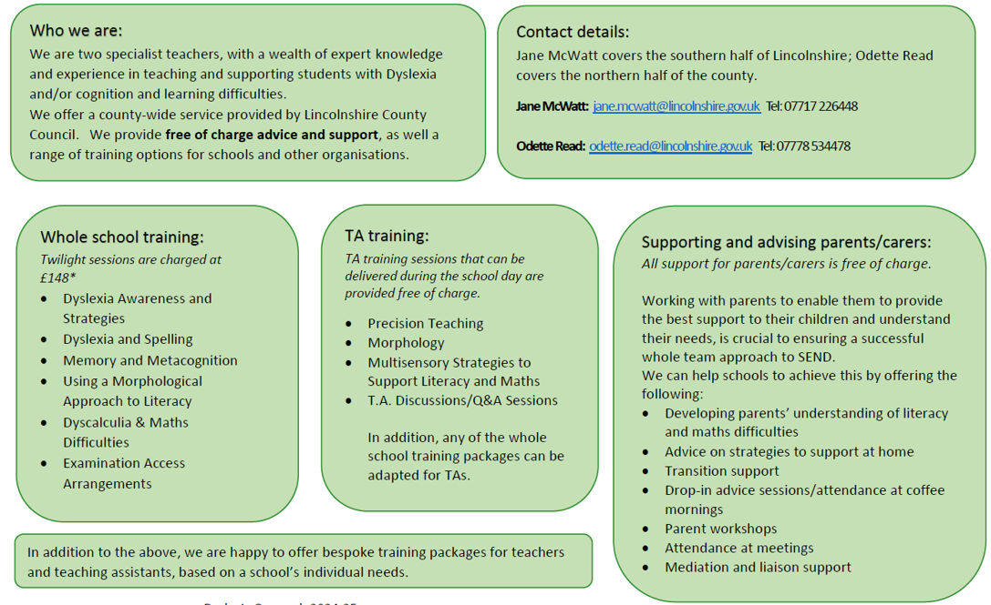

Dyslexia Outreach Support - EduLincs – Lincolnshire County Council

Slide 9


Dyslexia Outreach Support - EduLincs – Lincolnshire County Council

Slide 10
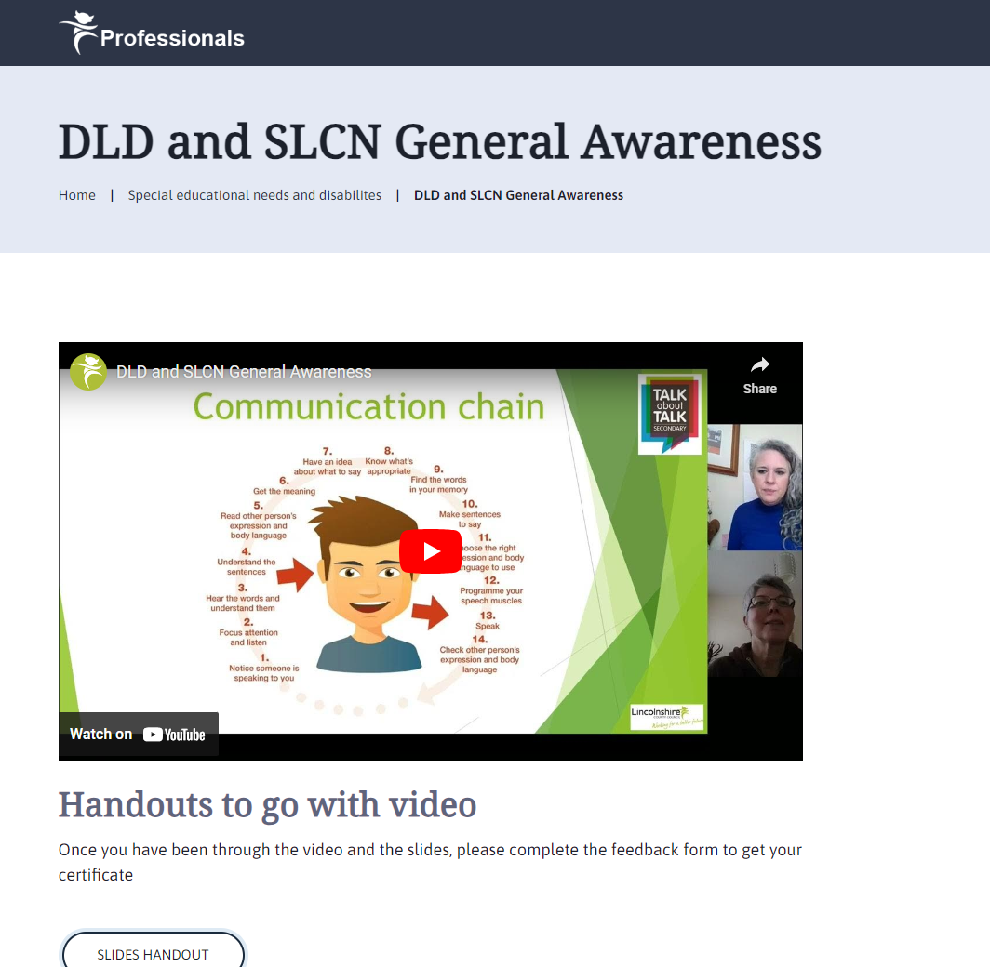
Specialist Speech and Language Training Offer
Free recorded general awareness training for settings:
DLD and SLCN General Awareness – Professional resources (lincolnshire.gov.uk)

Slide 11
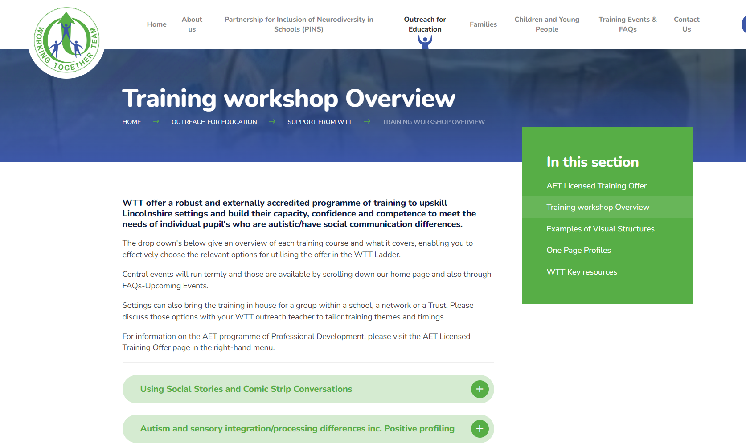

WTT Central Training Offer now available too:
Information about this has been circulated to all schools but if you have missed it, it will be uploaded on our pages too. Or check out the website: www.wtt.org.uk
Notes:
Jen

Slide 12



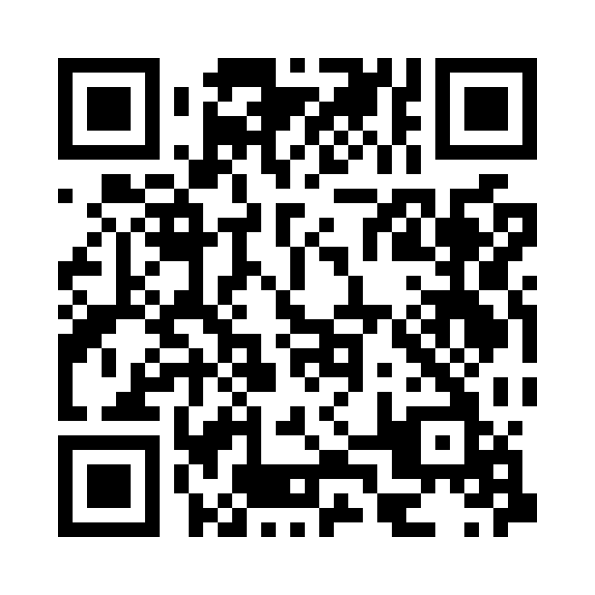


Lumi Nova: Tales of Courage
NICE recommended digital therapy through a fun mobile game (smartphone/tablet)
For 7-12 year olds
Supports mild to moderate fears, worries & anxiety
Based on CBT and provides Exposure Therapy (Gold standard treatment)
Low risk medical device - Safe, effective & easy to use
Lincolnshire Update:
As of 31st October, 1621 Lincolnshire families have signed up to Lumi Nova.
Lumi Nova is reaching a broad range of CYP:
31% stated they have SEND
44% are Male
7% are from ethnic minority backgrounds
88% of CYP using Lumi Nova are seeing improvement or stabilisation.
(Source: VitaMind Hub data launch - 31st October 2025)
Feedback shows:
85% of users would recommend Lumi Nova to friend and family
81% said it helped their child understand their worries
(Source: Lincolnshire Parent Survey of Lumi Nova users)
Families in Lincolnshire can get free access to Lumi Nova now: luminova.app/lincolnshire

Slide 13
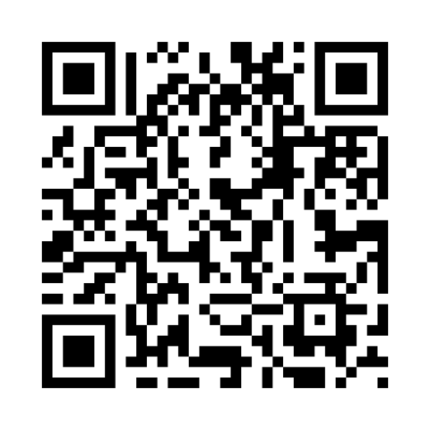
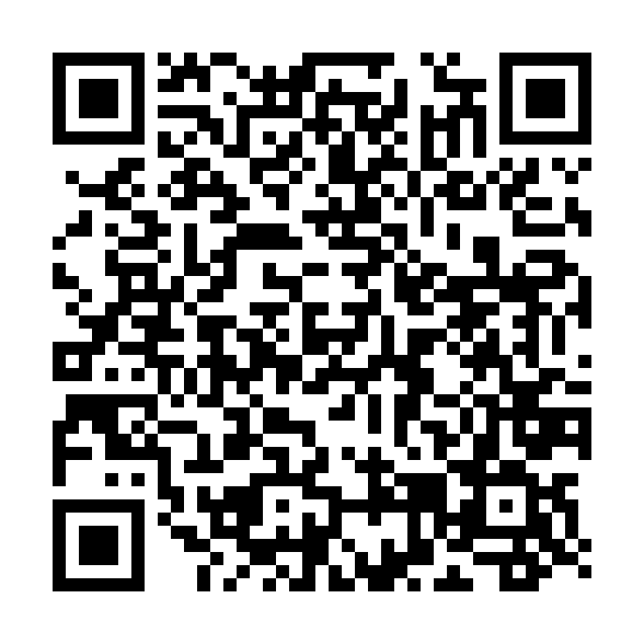

Benefits for you:
Widely accessible for families
No referral forms, no thresholds
Stand alone support
Alongside other support
As part of a step down offer
Within a ‘Waiting Well initiative’
As part of a Whole School Approach
As part of a PSHE scheme
Support for professionals:
Join an online Lumi Nova Discovery Session for professionals - 45 minute webinar
Request a Digital resource kit; including 2 new assets - Lumi Nova Club and Interactive Assembly
For more information email the team on luminova@bfb-labs.com

Slide 14
Free Classroom Programme: Learning About Neurodiversity at School (LEANS)
We’re pleased to share a free resource available to mainstream primary schools: Learning About Neurodiversity at School (LEANS).
LEANS is a classroom programme designed for pupils aged 8–11 years, helping them understand neurodiversity and how it shapes our experiences at school. The programme promotes inclusion, empathy, and awareness—supporting a more understanding school environment for all learners.
What’s Included:
A full set of free teaching materials to deliver the LEANS programme
Activities and discussions tailored to KS2 pupils
Guidance for teachers and support staff
Resources:
Article: Neurodiversity Can Explain Differences in How People Experience Everyday Life
The LEANS website
LEANS information written for parents and carers
Learning About Neurodiversity at School: A feasibility study of a new classroom programme for mainstream primary schools
We encourage you to explore LEANS and consider how it could support your pupils in building a more inclusive and understanding school community.

Slide 15


Slide 16

Presentations and Videos will be available from 12th December 2025
Remember to visit the Graduated Approach Briefings page on the Local Offer so that you can view the presentations and videos for this round of briefings and any from the previous academic year.
Graduated approach briefings – Professional resources (lincolnshire.gov.uk)

