Slide 1

Inclusion Project
Emma Broddle
Hannah Bradford
Claire Green

Slide 2

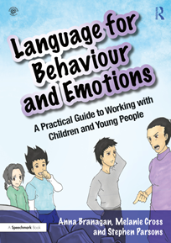
To introduce The Inclusion Project & Language for Behaviour and Emotion Resource.
To reaffirm the need for the resource in schools.
Our Journey so far; The impact of wave 1
Aims:

Slide 3
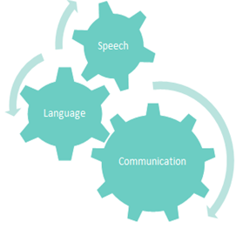
What is the Inclusion Project?
This is an evidence-based intervention programme designed to support improved student behaviour and reduce suspensions and exclusions from schools by supporting young people to develop their language and communication skills and understand their emotions related to this.
Notes:
The project aims to increase understanding of speech, language and communication needs and to provide practical suggestions to support young people with speech, language and communication difficulties.
Our aim is to help improve awareness of SLCN, upskill school staff and provide strategies to help them also to bridge the gap between language barriers that cause issues for our YP.

Slide 4
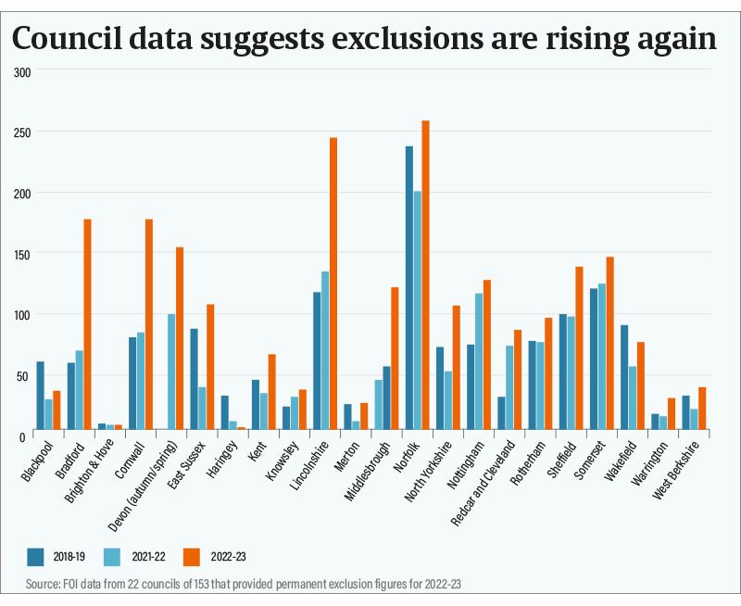
Why is there a need?
More than 1.4 million children and young people in the UK have speech, language and communication needs (SLCN)
7.6% - At least 2 students in every classroom have a developmental language disorder that persists throughout school and impacts on learning and on their social and emotional development.
As many as 50% of children in deprived areas of the UK start school without the language they need to learn, learn to read or make friends.
Notes:
On average, 2 pupils in every class will experience DLD enough to hinder academic progress. It also impacts literacy, learning, friendships and emotional wellbeing.
Clear evidence, such as the ‘Berkow 10 years on’ report, shows the significant impact of SLCN on children across the age ranges and on learning, socialisation and later life chances.
Gaps in language and emotional skills can have a negative impact on behaviour as well as mental health and self-esteem.
Never has it been more important to ensure the support that is needed is in place.

Slide 5
Notes:
The Trends from the government statistics:
Generally the number of students being suspended year on year is significantly increasing across Lincolnshire. And the number of YP being PX’s is also slowing rising.
203 PX students across Lincolnshire in 23/24
165 PX students in 22/23

Slide 6
Facts!
Only 25% of pupils with SLCN achieve the expected level in English at the end of KS2
40% of 7 to 14 year olds referred to child psychiatric services had a language impairment that had never been suspected
01
2/3 of 7-14 year olds with serious behaviour problems have language impairment
02
03
04
05
“..communication skills are the most important employability skills and a lack of them in a candidate is a deal breaker... for many employers”. (Skills for life report).
Young people with SLCN are more likey to be bullied and are more susceptible to grooming behaviours
One study suggests that 81% of young people presenting with SEMH and or behavioural problems also have SLCN, and this is mostly unrecognised.
Hollo et al 2014
Notes:
Practitioners don’t intentionally disregard language and communication needs, but these difficulties can be hard to detect.
SEMH can overshadow SLCN. Many students with SEMH are talkative but may not have the skills required to understand complex language, talk about feelings, negotiate or explain reasoning.
Poor response to instructions given by adults or figures of authority can easily be labelled as being due to poor attention or a lack of cooperation rather than difficulty understanding.
Many young people with SEMH also lack the self-awareness and confidence to seek help and instead develop sophisticated ‘camouflage’ techniques. This is especially prevalent in teen girls.

Slide 7









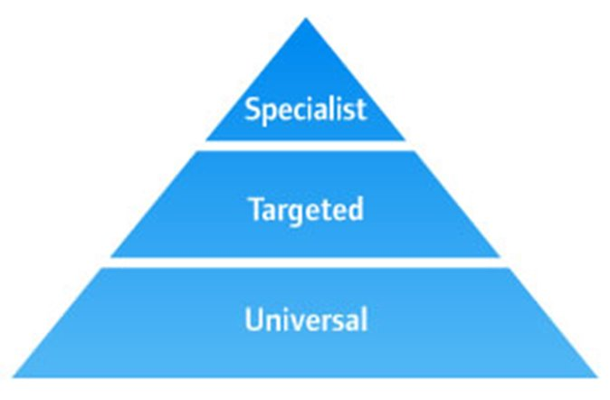

Levels of support
            Specialist support
              Targeted support
              General strategies​
    Reasonable adjustments for young people with SLCN​
Notes:
When supporting SLCN:
Universal Strategies
Things we do everyday, we implement for everyone regardless of a SLCN or diagnosis; everyone in the class can engage and should be encouraged and it is beneficial for everyone.
Targeted Support
Some pupils (around 50%) in some areas need targeted interventions to help them catch up. This is us, The Inclusion Project. We will target a specific population (children in care and children with a social worker).
Specialist Support
A few pupils (10%) need specialist support to make progress. This is very specialist support from teams such as ECLIPS.

Slide 8







intervention Overview
Notes:
The programme will be delivered in your school by a trained Inclusion Caseworker alongside a key member of your staff.
Whilst we are specifically targeting those in care or with a social worker, it is comprehensive training for the wider school staff which will enable you to continue to implement this intervention in the future to anyone you feel could benefit.

Slide 9
How will the project work?
Inclusion Caseworkers will deliver whole school training to all staff.
2 weeks for pre-assessment which provide a profile of key areas to target
10 weeks of intervention – 2 sessions per week (no more than 45 minutes per session)
1 session led by Inclusion Project Caseworker
Second session led by key worker staff following resources provided
Post-assessment to review progress and identify new areas to work on
Each young person to receive an individual report which discussed progress made, targets for future work and recommendations for education settings.
5 students identified that fits the criteria of CIC or CSW, high levels of CPOMS and at risk of exclusion
Notes:
Initial assessments are carried out to provide us with a complete profile of the young person’s communication and identify their language level. This will take approx. 2 weeks.
An LFBE profile will then be produced. A further 10 weeks of interventions will be tailored to meet the needs of each young person and work on the key areas identified in their profile.
We will make recommendations throughout the project things such as reasonable adjustments which could be as simple as implementing resources from the book to aid with witness/statement reports, increasing vocabulary, suggesting child specific strategies tailored to the YP’s needs to that will benefit them in areas such as asking for help.

Slide 10
Key Skills
Focus on specific skills linked to behaviour
1
A framework for assessment
2
Downloadable activities, worksheets and resources
We will deliver the Language for Behaviour and Emotion (LFBE) resource to the whole school community.
3
60 illustrated scenarios
4
Suitable for a range of abilities
5
The resource is designed by professionals
who work with children and young people
who have Social Emotional and Mental Health Needs (SEMH) and Speech, Language and Communication Needs (SLCN).
Notes:
Targeted interventions focus on specific skills linked to behaviour such as understanding meaning, verbal reasoning and emotional literacy skills.
This resource is not a specialist led assessment which makes this programme sustainable for school staff/students to continue to utilize and benefit from.
Included are sixty illustrated scenarios that can be used flexibly with a wide range of ages and abilities to promote language skills, emotional skills and self-awareness.
It is suitable for a range of abilities and can be delivered 1:1, small group or whole class. It is particularly applicable to students who are aiming to develop wider language, social and emotional skills including those with Developmental Language Disorder.

Slide 11
Language for Emotions and Behaviour approach
What to do when things don’t make sense (understanding language)
Saying when you don’t understand (comprehension monitoring)
Understanding words (vocabulary)
When people don’t say what they mean (figurative language)
Talking about feelings (emotional literacy)
What’s that feeling called (naming emotions)
Dealing with feelings (emotional regulation)
Finding clues and explaining thinking (inferencing and verbal reasoning)
The story (narrative)
Bringing it all together and solving people problems
LFBE provides a systematic approach to developing language and emotion skills so that young people can learn to work through and understand social interaction difficulties.
Notes:
This intervention cannot be delivered in isolation and just focused on skill development in the young person alone.
Communication happens across the day and within a social context, so for it to be effective it is about everyone who works with the young person understanding the individual’s language and communication profile and implementing strategies to create a communication rich environment.

Slide 12
What’s in it for schools?
The programme will include:
Two 1 hour whole staff training sessions in school led by the team
Delivery of a 10-12 week behaviour improvement intervention for up to 5 students from your school by a fully trained Inclusion Caseworker
Free programme resources for you to keep
Weekly Intervention Days from the Inclusion Caseworker
Full support from the Virtual School Education Coordinators throughout
Continuous access to via email with caseworker of support after the programme has come to an end.
Notes:
We will require a commitment from the school to fully participate in the training and development activities and nominate appropriate staff members who will engage with the initial programme delivery to individual students for its duration.
Language and communication needs cannot be ‘fixed’ by one person.
Effective support requires positive engagement with the young person and collaboration with professionals and families to develop skills and strategies. Teamwork and sharing knowledge are therefore crucial.

Slide 13

The Impact
Gaps in Language and Behaviour
Can have a negative Impact
Using the LFBE resource and strategies
Improves social Interaction Difficulties
Notes:
This resource is designed to be used by professionals who work with children and young people who have Social, Emotional and Mental Health needs and Speech, Language and Communication needs.
Gaps in language and emotional skills can have a negative impact on behaviour as well as mental health and self-esteem.
Language for behaviour and emotions provides a systematic approach to developing these skills so that young people can understand and work through social interaction difficulties.

Slide 14
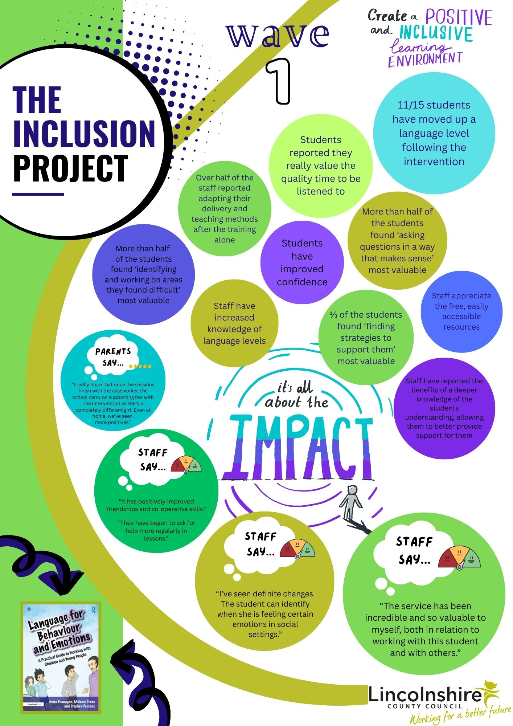
Wave 1 - Facts
11/15 (73.33%) students moved up a language level.
More than 50% of staff have adapted their teaching and delivery methods after training alone.
More than 50% of students found that ‘identifying and working on areas they find difficult in school’ the most valuable thing.

Slide 15
Wave 1 - Feedback
Parents say: “I really hope the school continue with the intervention, she’s a completely different girl, even at home.”
Staff Say: “The service has been incredible and so valuable to myself, both in relation to working with this student and with others”

Slide 16
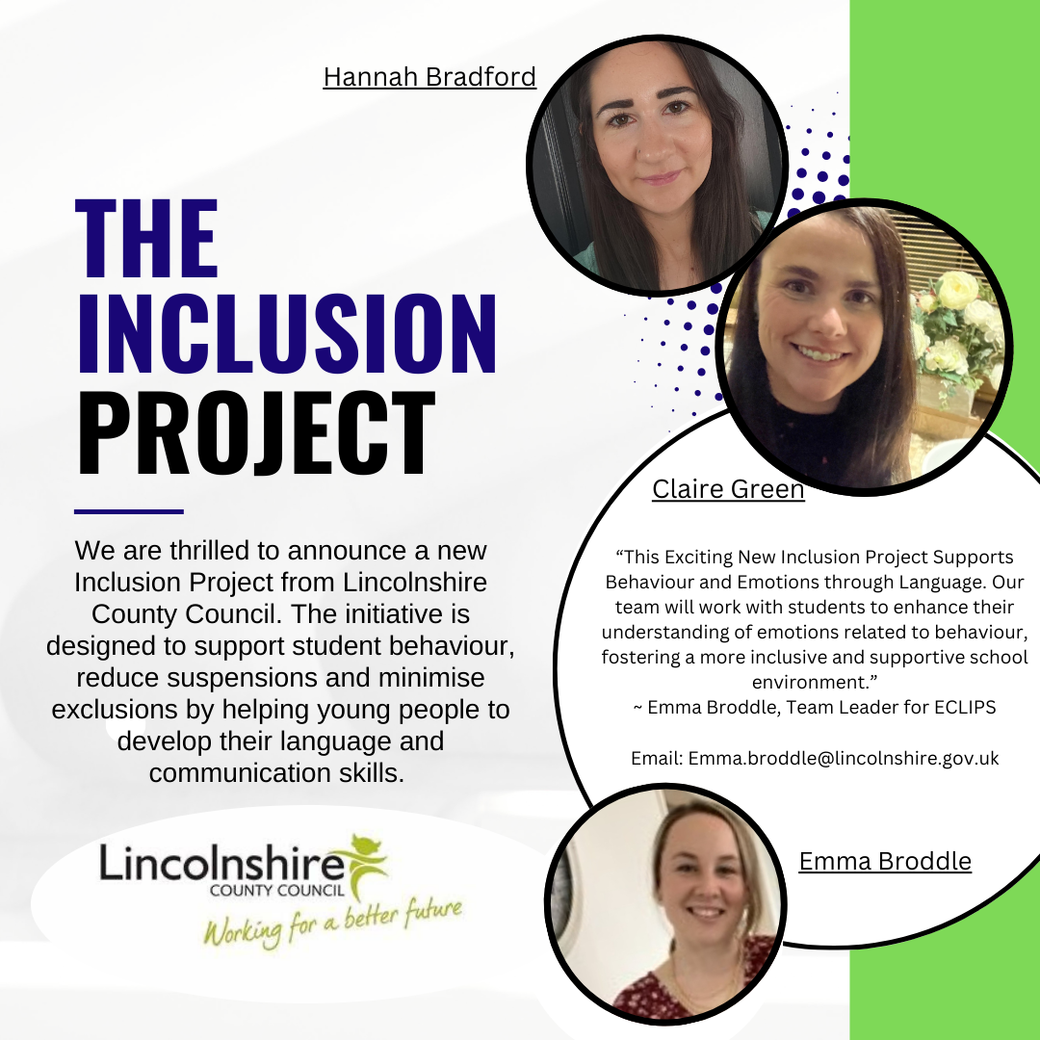
What’s Next?
Wave 2 has begun
Wave 3 – full ✓
Wave 4 full ✓
21 more schools on the waiting list who meet criteria for December 2026
Meetings still ongoing throughout
Notes:
Wave 2 – 8 schools, 40 students, 16 whole school training packages delivered
First Lincolnshire, then THE WORLD!

Slide 17

Questions
If you have any questions, or would like further information about the Inclusion Project, please don’t hesitate to contact Emma Broddle at emma.broddle@lincolnshire.gov.uk

