Slide 1


Manual Handling of loads Training

Slide 2
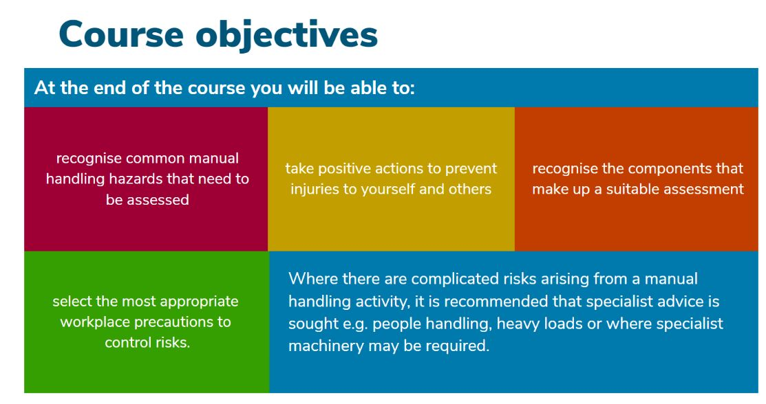



Slide 3


Slide 4


Slide 5
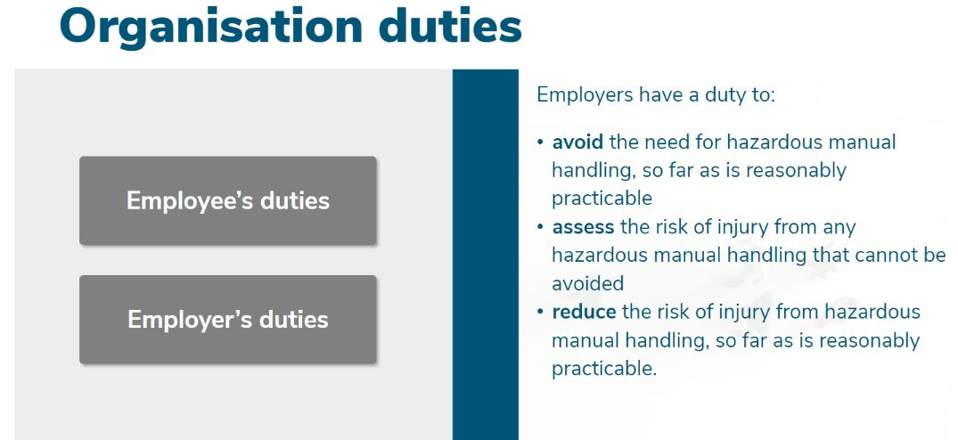

Slide 6
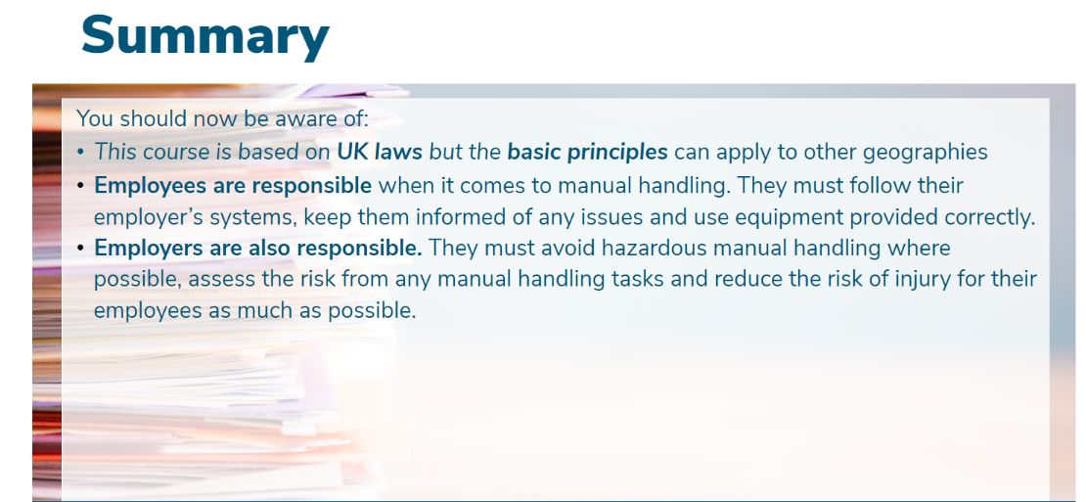

Slide 7
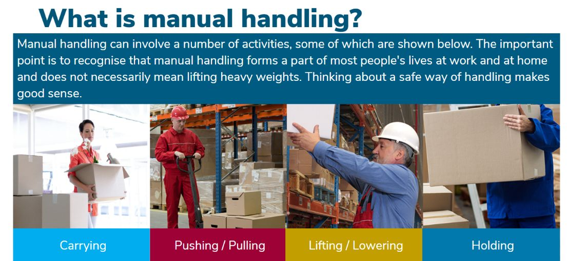

Slide 8
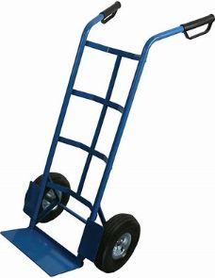
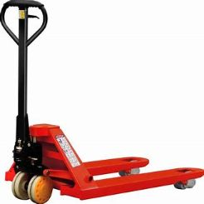
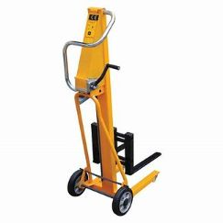
It includes the use of mechanical aids such as sack barrows, trucks or trolleys.

Slide 9
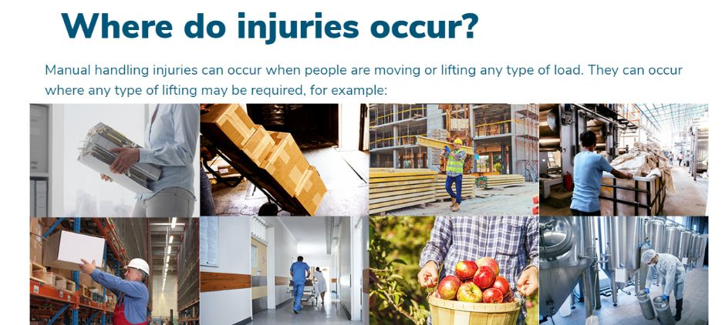









Slide 10
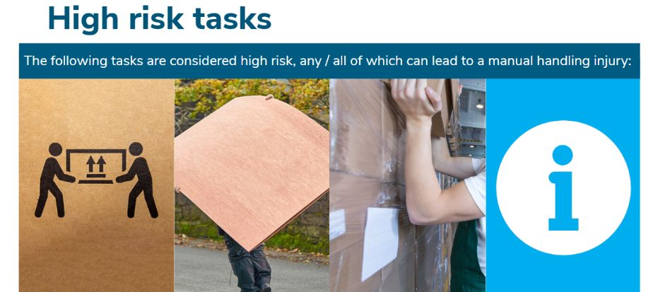
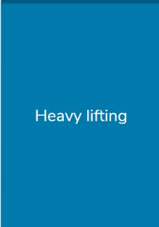
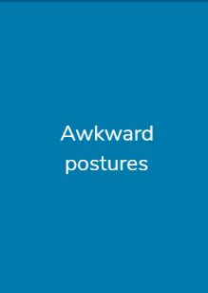

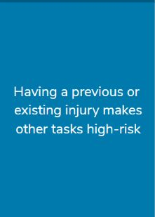

Slide 11
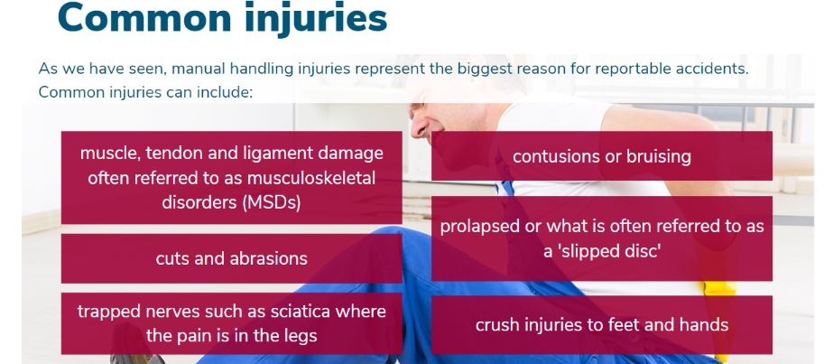

Slide 12
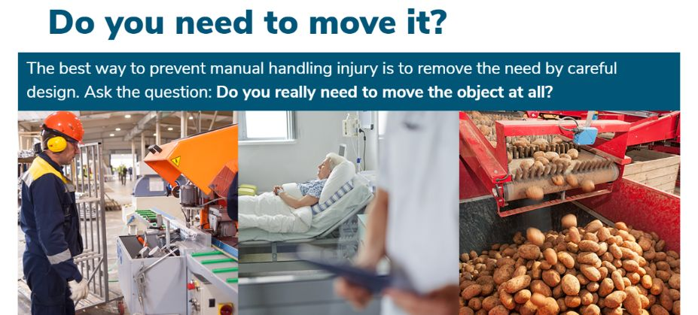
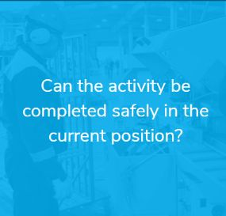



Slide 13


Slide 14

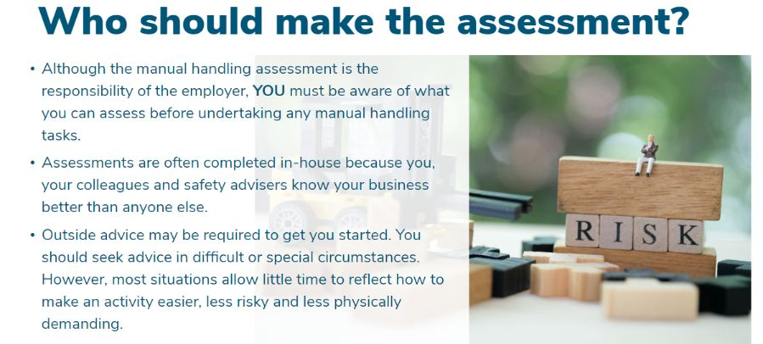

Slide 15
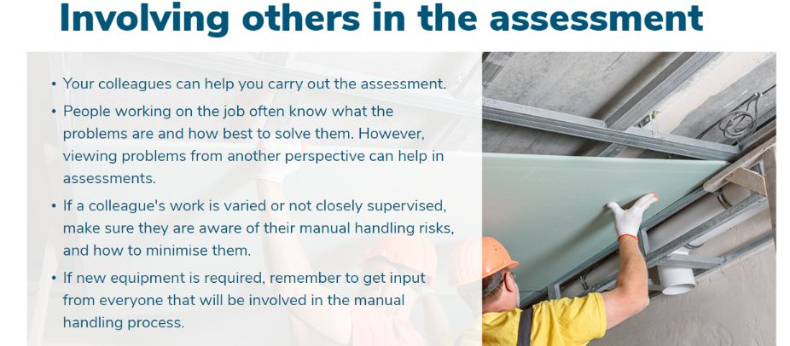

Slide 16
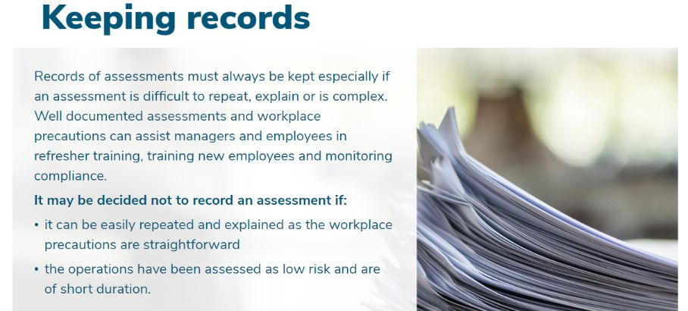

Slide 17

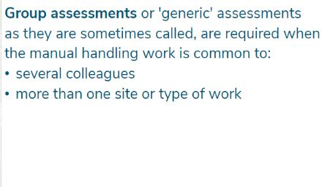

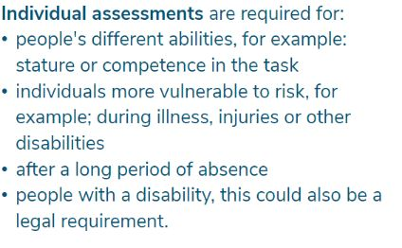

Slide 18
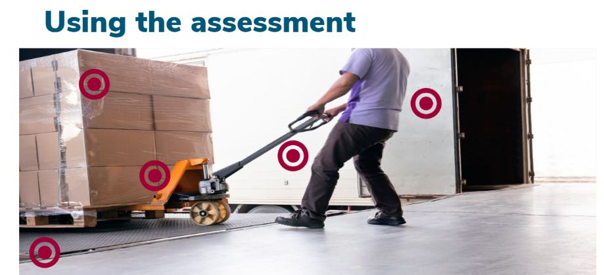
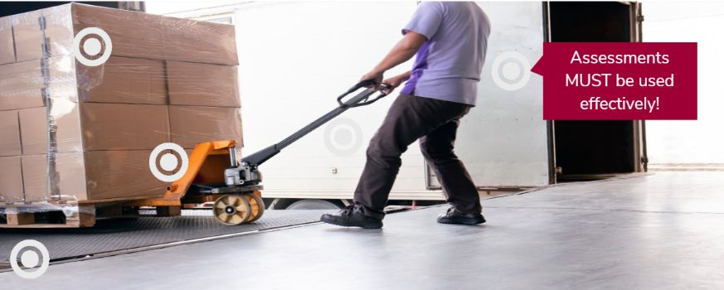
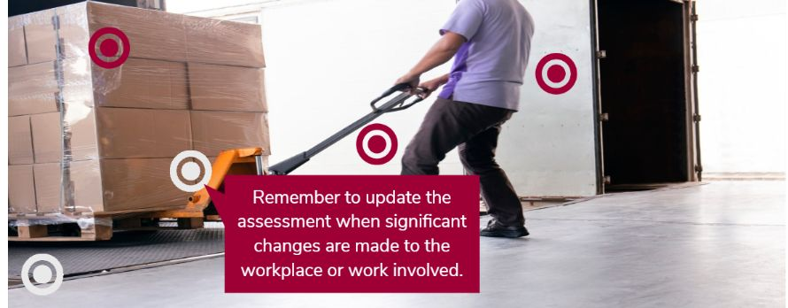
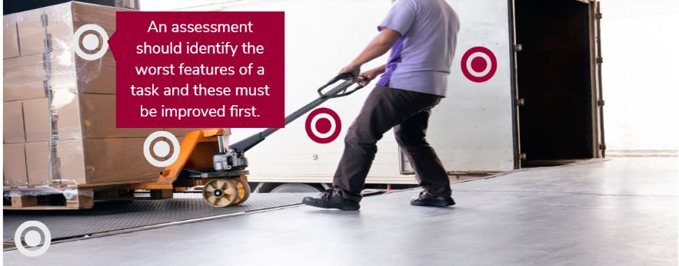



Slide 19
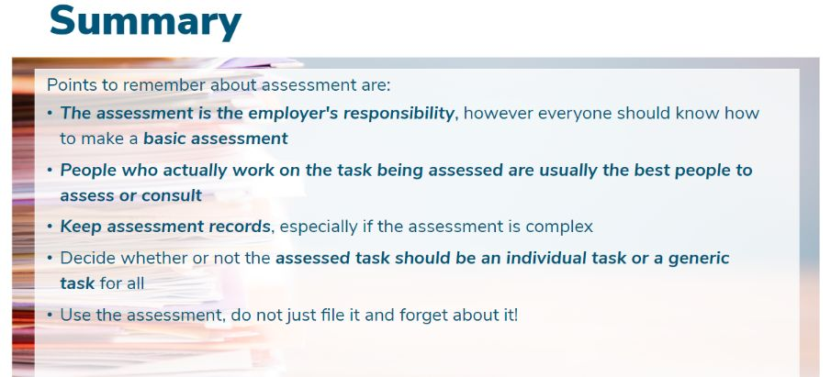

Slide 20
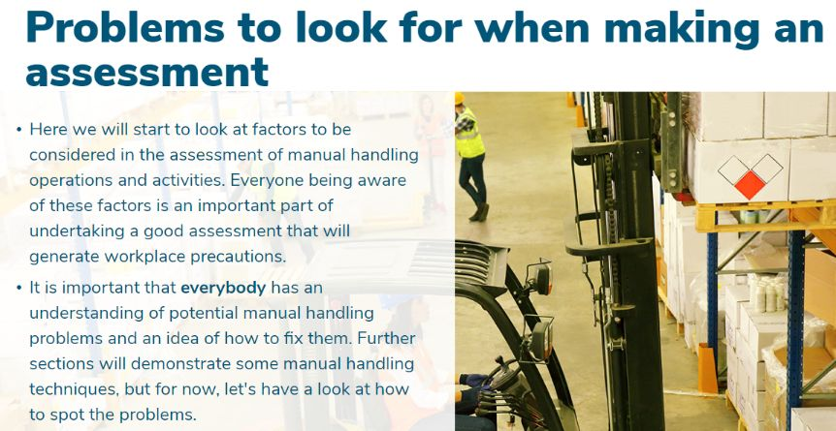

Slide 21
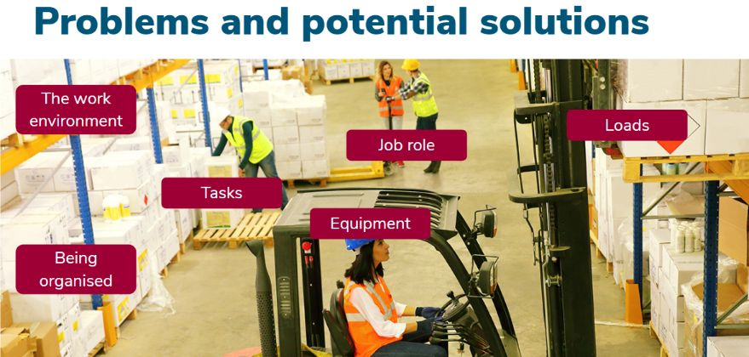

Slide 22
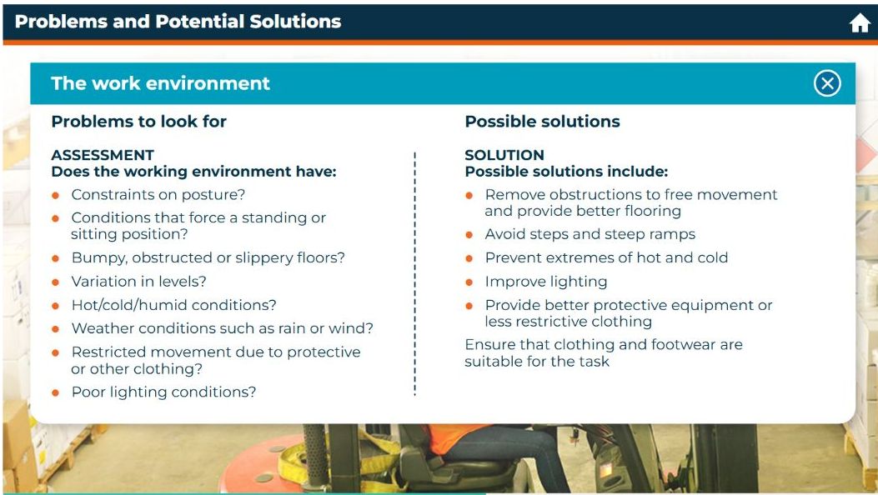

Slide 23
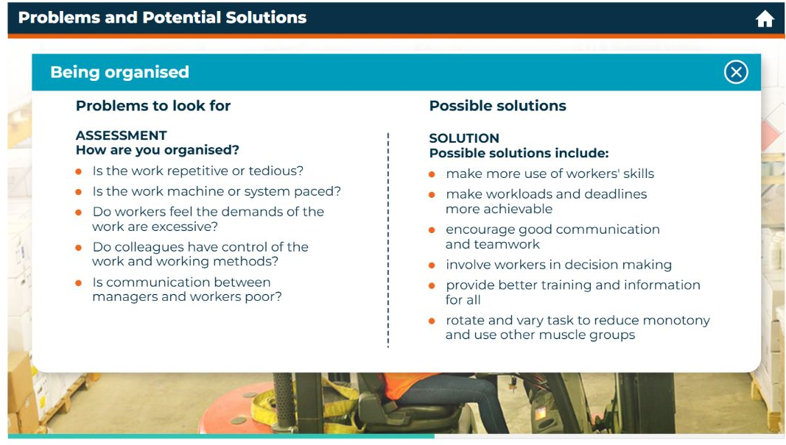

Slide 24
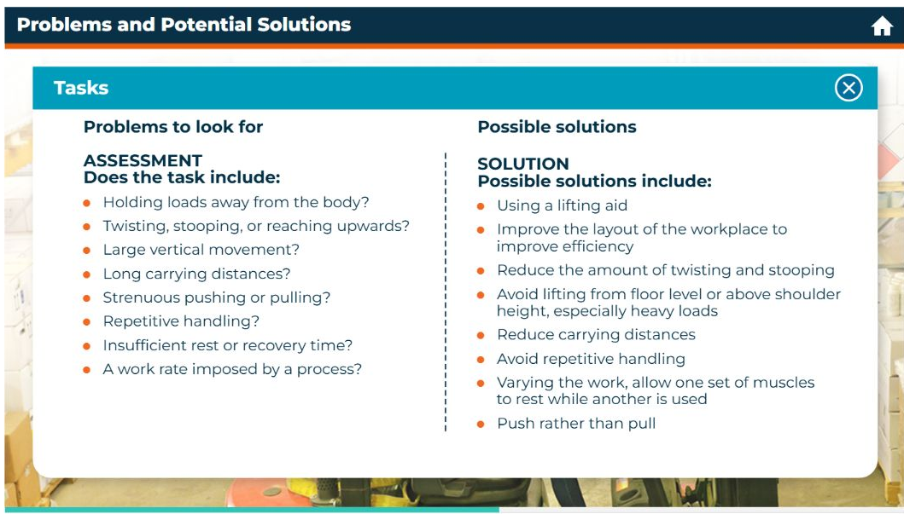

Slide 25
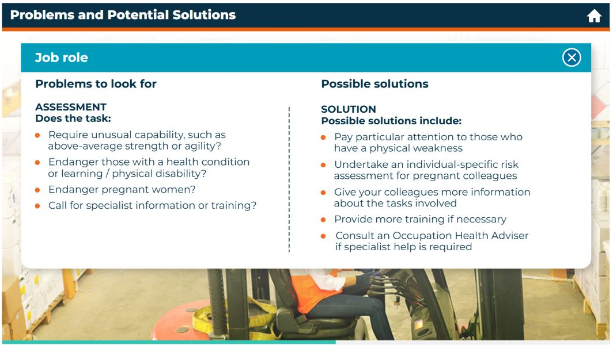

Slide 26
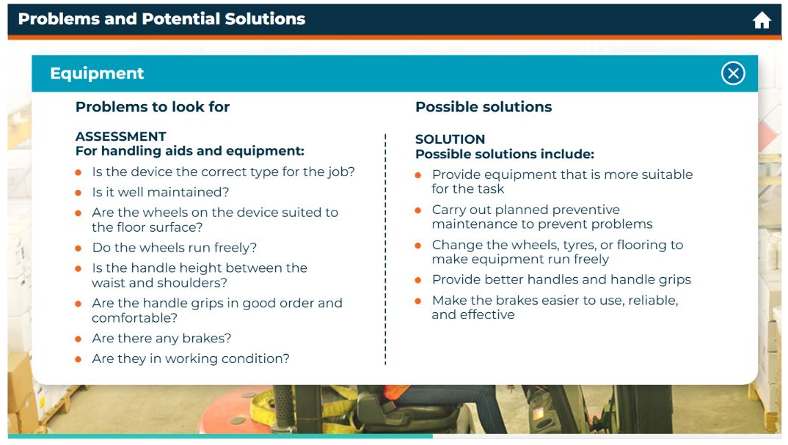

Slide 27
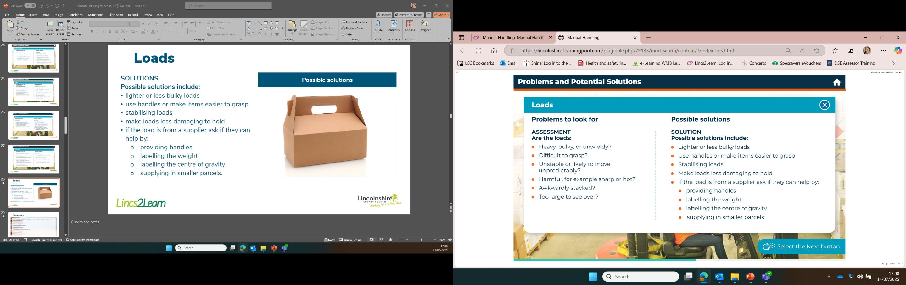

Slide 28
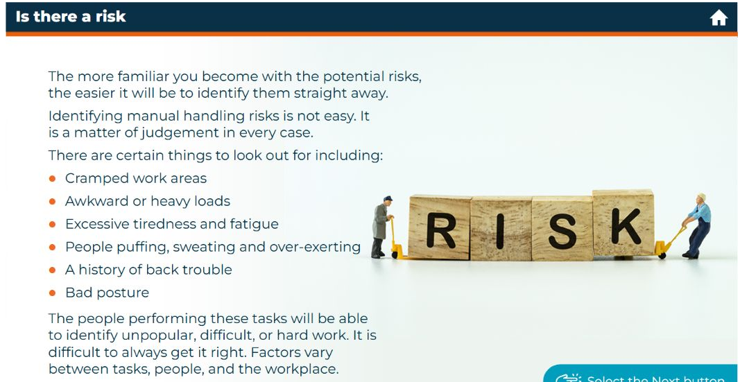

Slide 29
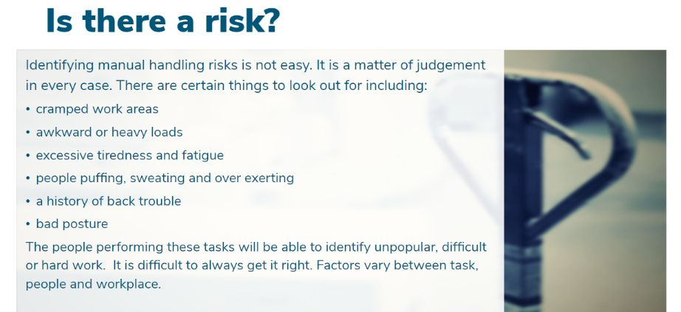
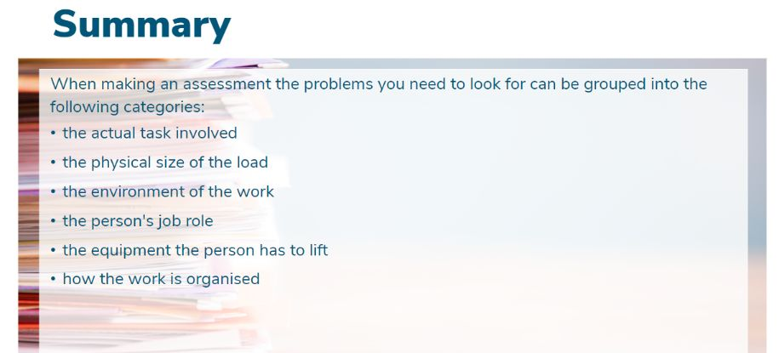

Slide 30
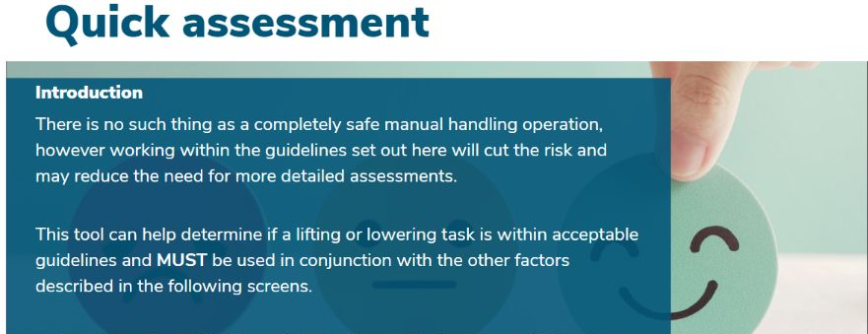

Slide 31
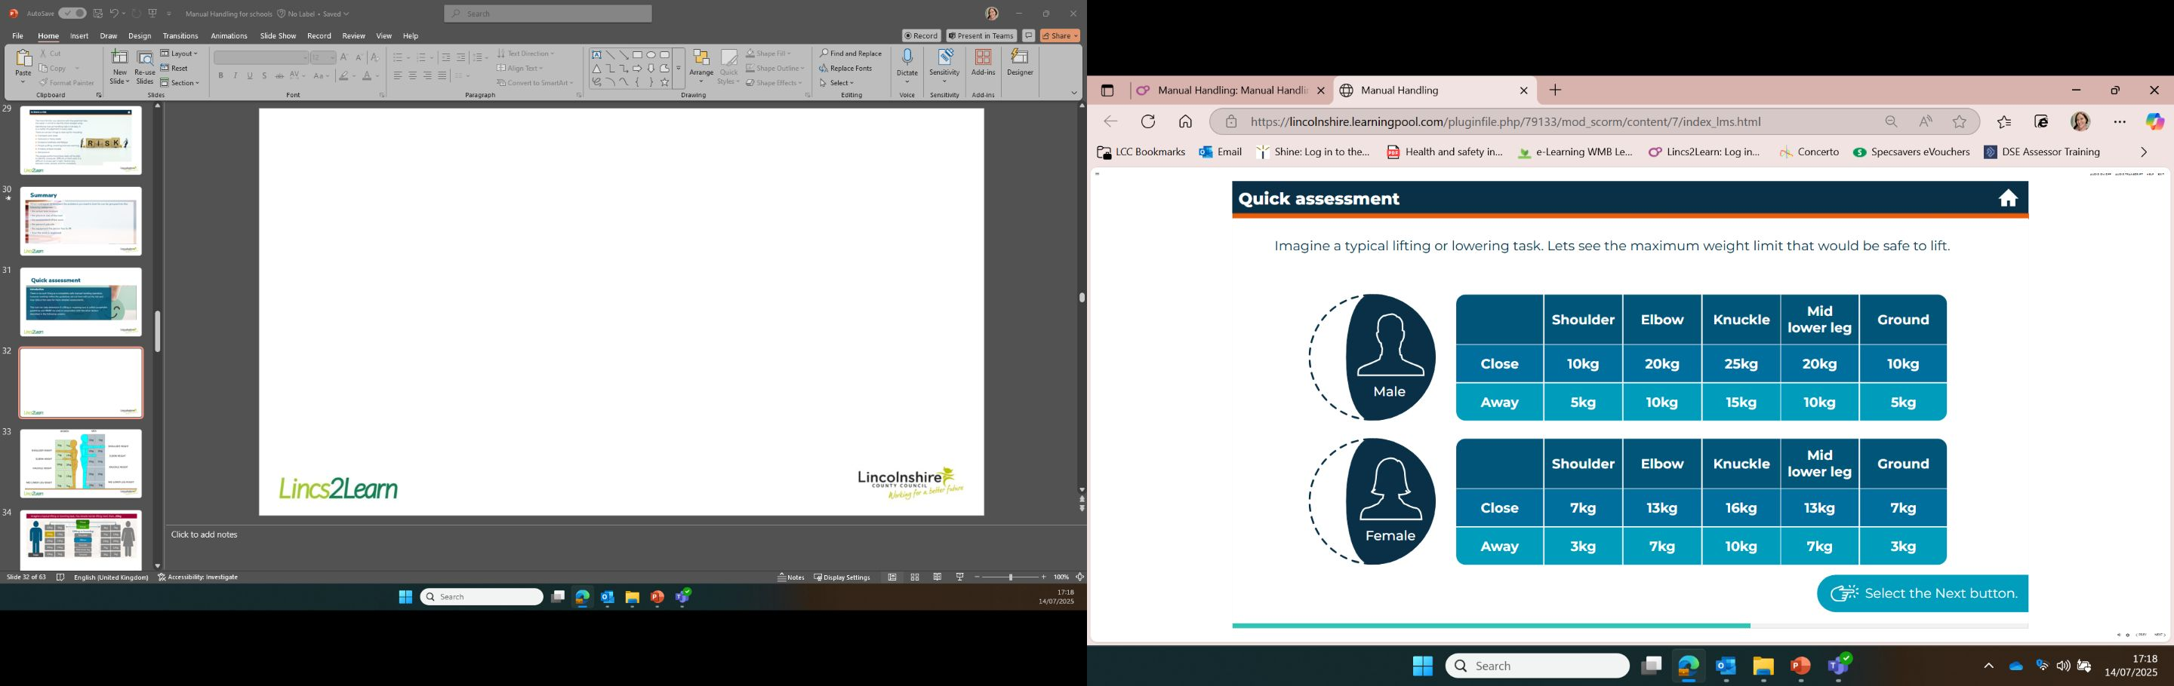

Slide 32
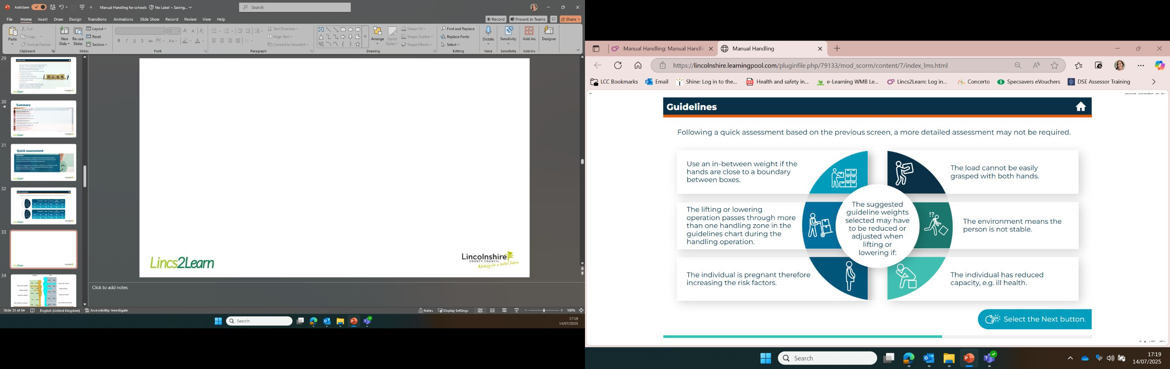

Slide 33
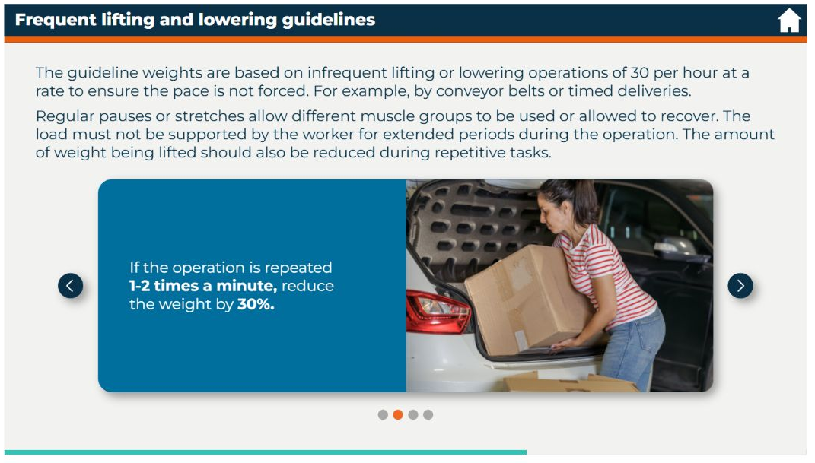

Slide 34
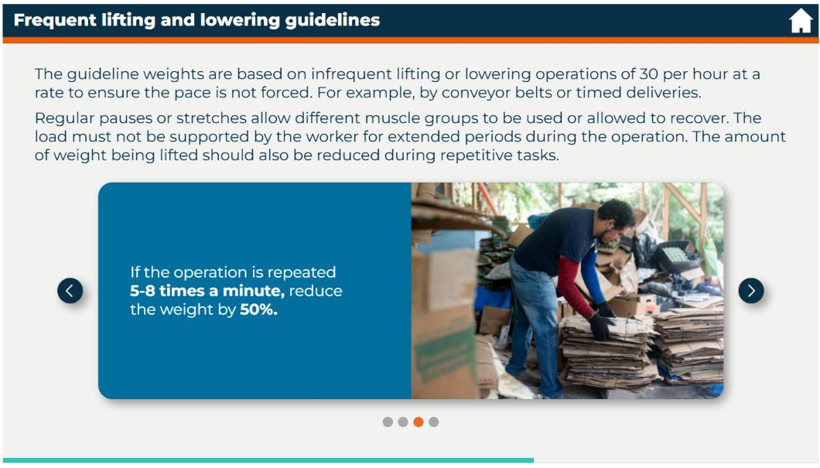

Slide 35
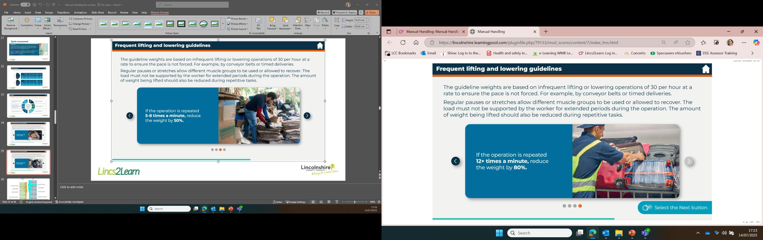

Slide 36
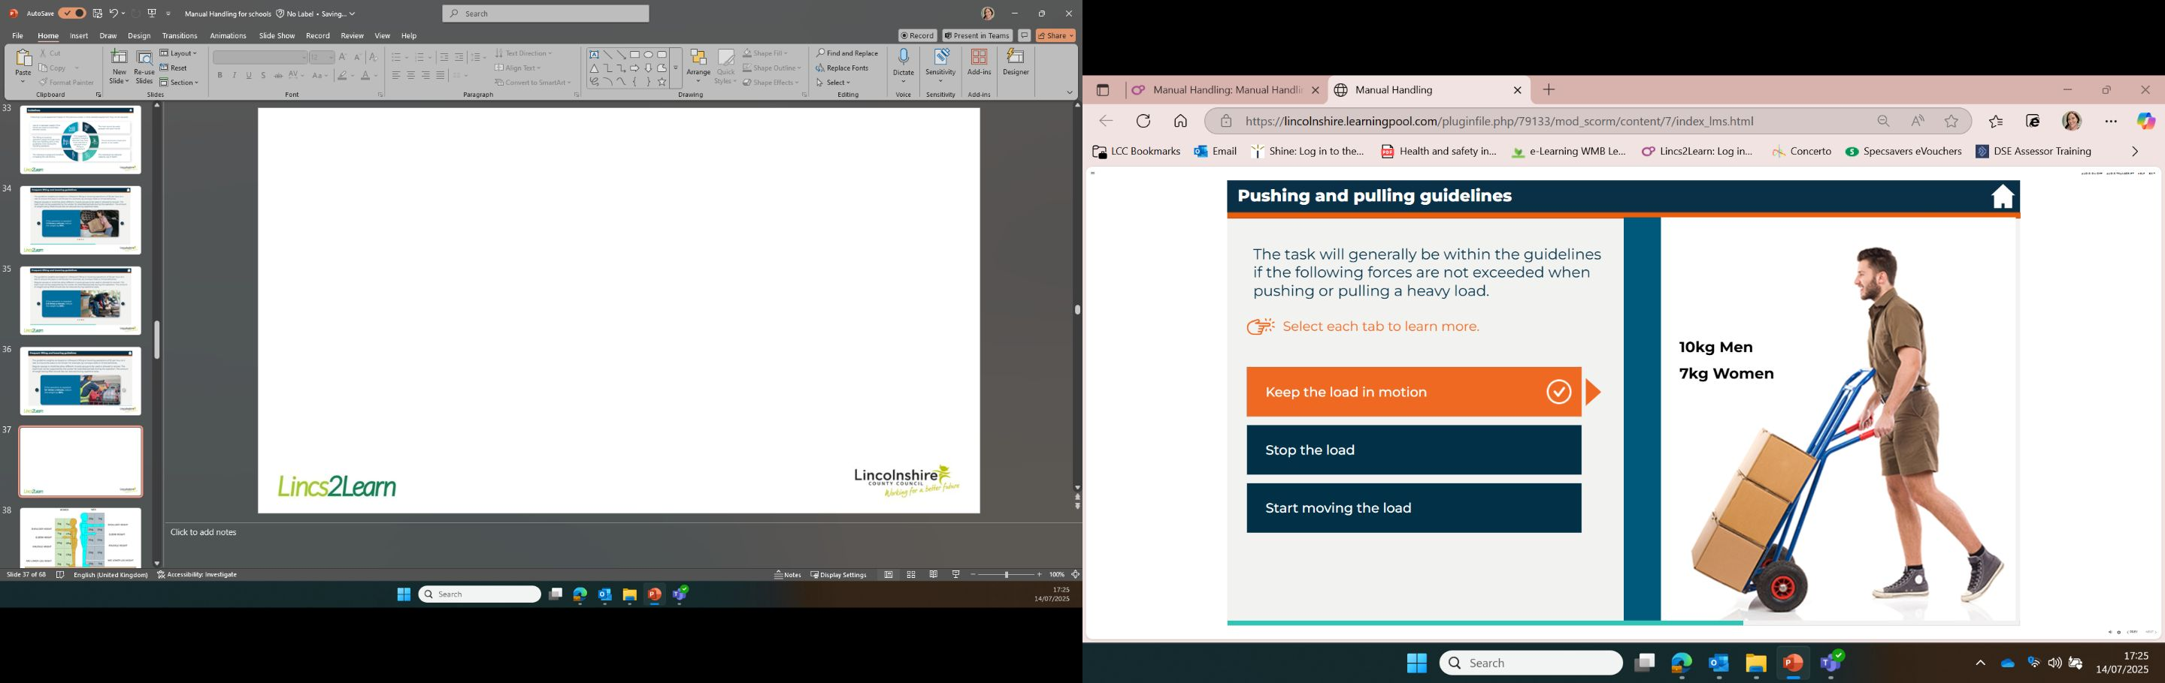

Slide 37
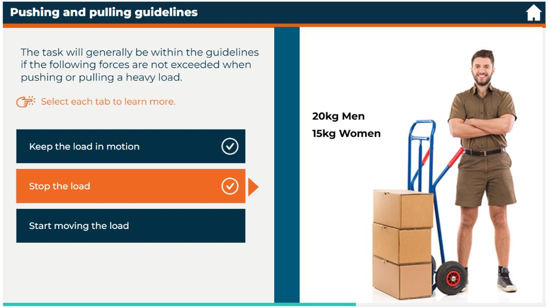

Slide 38
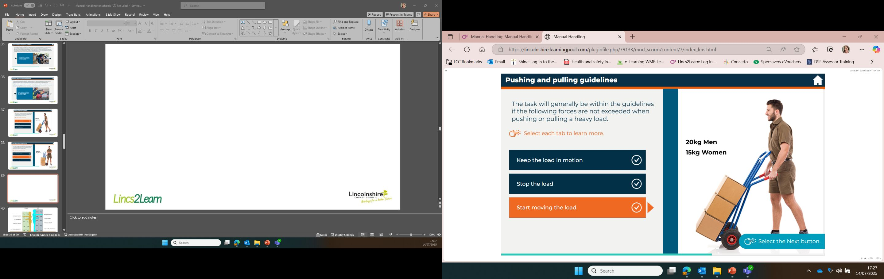

Slide 39
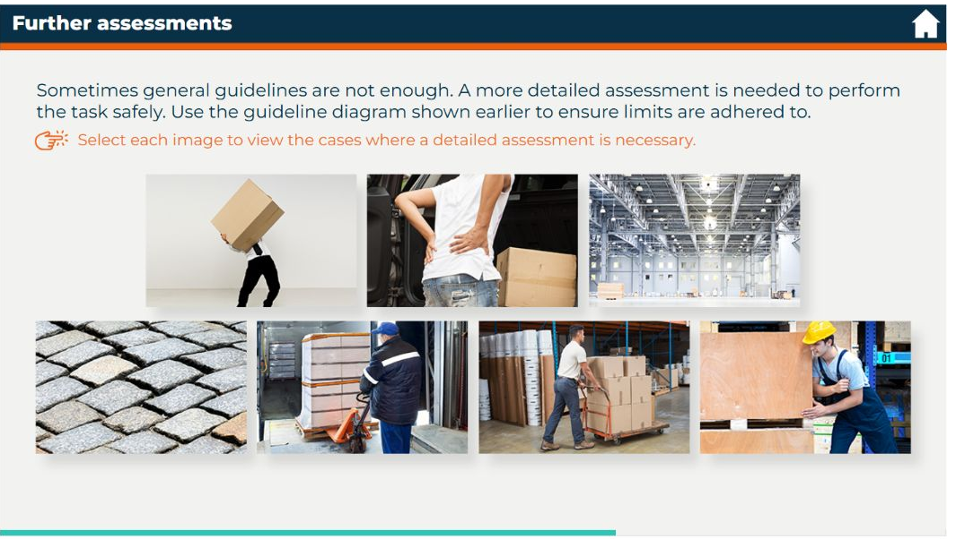
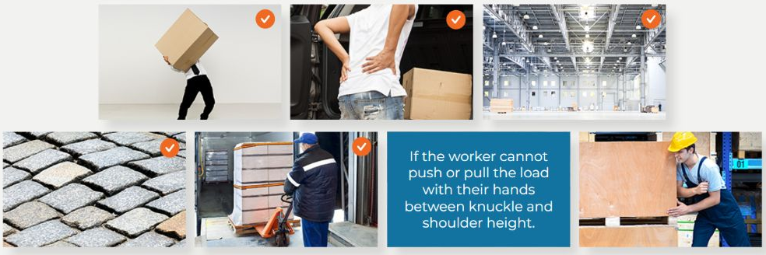
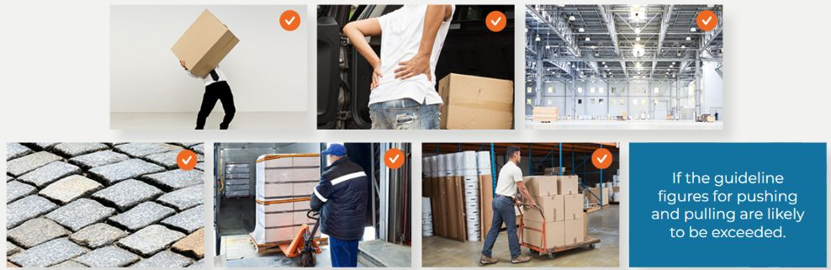
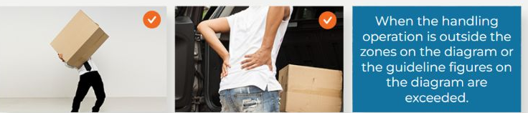
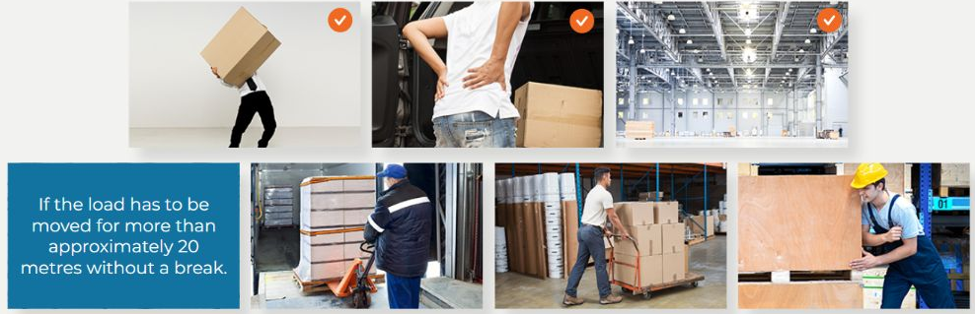




Slide 40


Slide 41




Slide 42


Slide 43








Slide 44





Slide 45


Slide 46








Slide 47










Slide 48


Slide 49


Slide 50








Slide 51


Slide 52


Slide 53


Slide 54


Slide 55


Slide 56


Slide 57
When handling loads, remember:
Good posture and stable base to handle the load
Think and make an assessment before handling a load
Relax the body before handling
Make smooth, flowing movements
Feet hip width apart and one foot slightly in front of the other
Raise your head to lock the back and avoid flexing
Avoid twisting actions by using the feet to change direction
Communicate and ask for help if needed
Get a good grip of the load

Slide 58
When pushing and pulling loads, remember:
Use a well-maintained handling device such as a trolley
Keep to the limits of 2% of the weight to ensure a safe push
Keep feet away from the load and walk at a safe distance
Get help when moving up or down a slope
Get help when moving over uneven surfaces

Slide 59


Slide 60
What should the employer first consider when looking at manual handling problems?
Only employ people who can lift heavy loads
Provide suitable training for everyone
Avoid the need for manual handling if possible
Providing safety equipment for manual handling

Slide 61
Assessments should not involve those who undertake manual handling
True
OR
False

Slide 62
What advice would you give to somebody who was twisting their body while conducting manual handling tasks?
To practise twisting exercises at home
To ask someone to pass the load to them
To move their feet and body position instead
To use appropriate PPE

Slide 63
Everyone has the same capacity for manual handling; therefore, the same guidelines apply to everyone.
True
OR
False

