Slide 1
Charlotte Heffernan
Sector support and development consultant with a lead for Inclusion
Charlotte.heffernan@lincolnshire.gov.uk

Slide 2
Who are Dingley's?
Since 1983, Dingley’s Promise has transformed the lives of children with Special Educational Needs and Disabilities (SEND). Now, we extend that expertise across the nation through our SEND online training courses, tailored and specially designed for Early Years educators, practitioners, and institutions

Slide 3
Dingley’s settings
Dingley's currently have nine settings designed specifically for children with SEND.
A diagnosis is not needed to attend, but all families must apply for a place.
Notes:
GLOUCESTER
WORCESTER
CHELTENHAM
DROITWICH
READING
WOKINGHAM
WEST BERKSHIRE
SOUTHAMPTON
BOURNEMOUTH

Slide 4
Dingley's partnerships

Slide 5
Who is Dingley’s training for?
Professional's
Parents/Carers
Local authority staff
Practitioners

Slide 6
Training modules
Up to 8 hours to complete the online self-guided study,
practical activities and webinars.
Designed for you to study at your own pace with our distance learning scheme.
Contains a variety of free resources
Supported by the Training team for Dingley’s Promise through the training mailbox.
You will receive a certificate from Dingley’s Promise.

Slide 7
Early Years Inclusive Practice
Introduction to early years inclusive practice aims to increase learners’ awareness of the needs of all children, especially those with Special Educational Needs and Disabilities (SEND) during early childhood development.
Notes:
This early years inclusion focused training explores three key principles that underpin effective inclusive practice:
Principle 1: The environment enables learning for all children with SEND
Principle 2: Different developmental levels and different learning styles are always considered in early childhood development
Principle 3: The staff team works together to offer all children opportunities for both independent and individualised/supported learning

Slide 8
The Voice of the Child
This training aims to provide learners with the confidence and skills to listen and understand the unique voice of each child, however they communicate.

Slide 9
Behaviours That Challenge
Considers different influences on behaviour and thinks about how we can change what we do and the support that we give in order to limit the occasions that a child resorts to the fight/flight/freeze/flop response to situations in our setting.
Considers how we can prevent a child’s behaviour becoming a reason for them to not be able to access the setting or the full learning experience; i.e. how we can prevent their impairment from becoming a disability.
Notes:
This training considers different influences on behaviour and thinks about how we can change what we do and the support that we give in order to limit the occasions that a child resorts to the fight/flight/freeze/flop response to situations in our setting.
With a focus on inclusion, we want to consider how we can prevent a child’s behaviour becoming a reason for them to not be able to access the setting or the full learning experience that you can provide there; i.e. how we can prevent their impairment from becoming a disability.

Slide 10
Early years SEND transitions
Explores significant transitions for children with SEND. Focus on those children who are moving from an Early Years setting to school.
Explores strategies for good transitions.
Considers the development profile of children with SEND, the dynamics of their family unit, and the strengths and challenges for settings to personalise transition.
Notes:
This training explores significant transitions for children with Special Educational Needs and Disabilities (SEND), with particular focus on those children who are moving from an Early Years setting to school.
It considers how all effective long term transitions involve a period of preparation, followed by the actual move or change, and then a process of adjustment and acceptance, and explores strategies for good transitions.
It also considers the development profile of children with SEND, the dynamics of their family unit, and the strengths and challenges for settings so that you will better understand individual support needs and can use this knowledge to personalise transition.

Slide 11
Difficult conversations with families
This training aims to provide learners with strategies for managing even the most difficult of conversations, whether planned or unplanned.
Notes:
This training explores the conversations that you sometimes need to have if a child is not making the progress in their learning or behaviour that you would expect.
First, we will look at your own communication and interaction skills. Are you a good listener and how do you show that to the parent you are talking to? How do you know if they are listening to you in turn and what can you do to remove barriers to their understanding and acceptance?
Next, we will look at the difficult conversations you can plan for. What can you do to ensure the best possible outcomes for the child and their family? What part can you play in starting or maintaining a process of discovery about the child’s strengths, difficulties and needs?
And finally, we will consider the unplanned conversations you may encounter with frustrated, worried or even angry parents. How can you be ready to respond with professionalism and how can you keep yourself safe from harm and accusation?

Slide 12
Intersections within Early Years
We will consider the different intersections and how intersectionality impacts the lives of children with SEND and their families.
Notes:
Explore the meaning of intersectionality and how people can experience intersecting forms of discrimination.
Discover the common themes of discrimination and how these have formed over many years.
Reflect on the early years legislative statutory and non-statutory guidance which ensures fair treatment for all families.
Recognise how intersectionality can impact families of children with special educational needs and disabilities (SEND).
Consider how you can adapt your practice to reduce the impacts of intersectionality and increase inclusion.

Slide 13
Leadership and management for inclusion
Your setting environment, curriculum and approach to learning and development must adapt to the changing need of your cohort of children and this course will provide strategies to enable this.
Notes:
The units include practical advice and strategies as well as activities which encourage you to reflect on the leadership and management of your setting to help you plan more effectively for inclusion.
They include:
The duties of an inclusive leader and manager
Preparing for inclusion
Business planning for inclusion
Delivering inclusion
The importance of creating leadership goals and the legal frameworks to refer to when developing an inclusive approach to leadership and management in your setting.
The considerations when developing a clear vision for your setting and how to embed this whilst working in partnership to build inclusion
How to create an inclusive curriculum and learning environment
How to analyse the wider opportunities and threats when setting your short and long term objectives for your setting.
How to effectively examine the local market, specifically supply and demand for your service and respond to these with effective financial management practices.
Practical aspects of setting management and partnership working.

Slide 14
Learner statistics
32 Local authorities
17, 155 Learners
23, 194 courses completed

Slide 15
Lincolnshire Feedback
“As SENco in my setting I found the training extremely useful”.
“It has been really useful to focus my mind on what is important and how we need to think more about individual needs, rather than everyone having to fit into a mainstream school system”.
“I enjoyed the videos which demonstrated strategies and the video which showed how children with sensory issues may feel in an environment”.
“Really enjoyed this module, i feel that I learnt more than previous SEND lv 3 course”.
“Really insightful and given ideas for current children that I work with”.
“Lots of practical and realistic advice and ideas”.

Slide 16
Mark of achievement
Settings with 4 practitioners or more:
75% will have undertaken the inclusive practice course along with 2 additional courses of their choice
Settings with less than 4 practitioners (eg childminders):
The lead practitioner will have completed the inclusive practice course and 2 additional courses of their choice.
Notes:
8 settings, no schools!

Slide 17
Free resources on their website
Outdoor Provision
Low Arousal Environments
Sensory Circuits
Makaton
Intensive Interaction
Sensory Stories
Calm Box
Now and Next Boards
Social Stories
Singing
Stimming
Oral Sensory Seeking
Notes:
Dingley’s Promise Provision Audit
Department for Education – Curriculum Planning
Leuven Scale of Wellbeing
Leuven Scale of Involvement

Slide 18
Free resources on their website
Notes:
four assessment tools centred around the four broad areas of need
examples of how to use the assessment tools in practice
a one page profile to capture the voice of the child
SMART targets sheet to set short-term targets
support and achievement play plans (SAPPs) to capture a child’s long-term goals and needs
The assessment tools
There are four assessment tools, that reflect the four broad areas of need, with a focus on the core skills children with SEND may gain in each area. You can use them at any stage of supporting a child, and they are designed to be used individually or together based on the needs of a child.

Slide 19
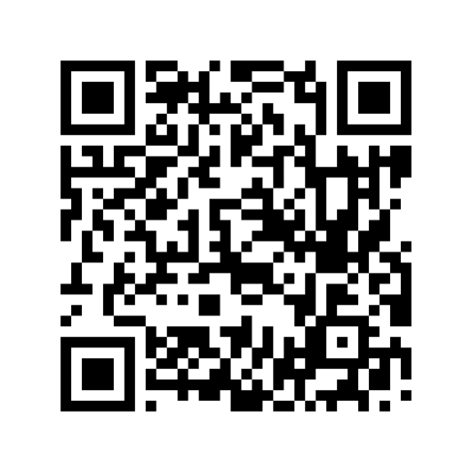
Training team
Dingley's Promise Training Team 07388 943498 training@dingley.org.uk
FUNDRAISING Head of Fundraising fundraising@dingley.org.uk
Phone: 01183277424
Email: info@dingley.org.uk
Project code: comic relief

