Slide 1
L.E.A.D. Teaching School Hub
Updates and Headlines
‘Working in Partnership, Achieving the Highest Outcomes for All’
Notes:
Welcome

Slide 2
Update - NPQSENCO
Cohort 1 – (4a) commenced Autumn 2024
Cohort 2 – (4b) due to commence May 2025
Notes:
Our first cohort is underway – 57 participants in total
Unsure as to whether there is going to be further funding for this programme – we suspect there will be as this is mandatory.
The next cohort is due to run in April 2025 IF the DfE decide to continue on a two cohort a year model moving forwards.
We will make everyone aware when the DfE registration platform opens but in the meantime you can submit an EOI using the QR code which will give us your name and contact details – we will then be able to contact you directly once we know that registration is open – this will give you more of a chance of getting a funded place.

Slide 3
Good mix of different activities. Really useful information. Thank you.
Fantastic presentations and interesting conversations had.
Absolutely fantastic speakers and very knowledgeable.
Very informative and engaging.
It was great to hear from really passionate people with a wealth of experience and knowledge.
Excellent day of training with lots of time for discussions about all things SEND.
NPQSENCO Conference
3rd April 2025

Slide 4
NPQSENCO comparison of cohorts: role

Slide 5
NPQSENCO comparison of cohorts: phase

Slide 6
ECF
ECF: ECTE
From September 2025, the Early Career Teacher Entitlement (ECTE) will be introduced. Changes include:
• mentor training reducing to 1 year
• More diagnostic pathways of learning
• Increase in subject specific materials including SEND materials
• Portal changes so that there is only one point of registration and sign up for schools.
The DfE have announced upcoming changes to the ECF Programme.
The role of the mentor is key to the success of the ECTE; we are working in partnership with EDT to maximise opportunities for support and reflection for ECTs, in a way that is manageable and sustainable for schools
ECT YR1 – full coverage through personalised pathways
ECF YR2 – structured and individualised learning – owned by the ECT and mentor
A mentoring programme focussing on the use of instructional coaching,
.

Slide 7
ECF
Taken from The Initial Teacher Training and Early Career Framework
Disabilities (SEND) The ITTECF has been designed in the knowledge that high quality teaching is the most important way to improve outcomes for pupils – particularly those with SEND.
There is now significantly more content related to adaptive teaching and supporting pupils with SEND, some of which has been adapted from the new NPQ for SENCOs to be relevant for trainees and ECTs. We have also made some edits to existing statements to improve inclusivity for SEND throughout the framework.
In special schools or where children with particularly complex needs are educated in mainstream settings, trainees and ECTs should be supported by their mentor and other expert colleagues to apply the statements within this framework in the most appropriate way. For example, the ‘Learn how to…’ statement ‘requiring high quality oral language’ within section 3 may not have the same relevance to pupils with complex disabilities, including those who are non-verbal. In this instance, the mentor or other expert colleague should use their judgement to provide appropriate support for the trainee or ECT.
Recognising the importance of ensuring trainees and ECTs are confident in supporting pupils with SEND to succeed, we will be enhancing the requirements on ECT training lead providers in creating SEND exemplification materials.
Notes:
AB team - Positive impact of ECTs working with SENCOs to adapt teaching, and meet the needs of students across a wide attaninment range. ECT work with SENCOs to adapt EHCPs

Slide 8
Leadership Briefings Spring 2025
Identification and Schemes of Delegation
Belonging/Language
Layers of Provision
SEND: Future Proofing Strategically
Notes:
Last time, opportunity to shape what this looks like – structure/ content/ climate
Continue to shape this as we move forward- like anything, It will not hit the spot instantly.

Slide 9
LEARN CPD Summer Term
www.learnsendhub.co.uk

Slide 10
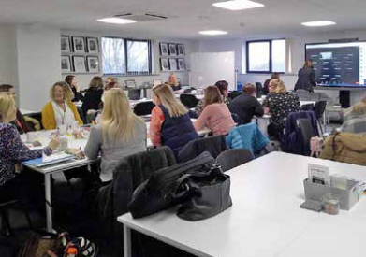
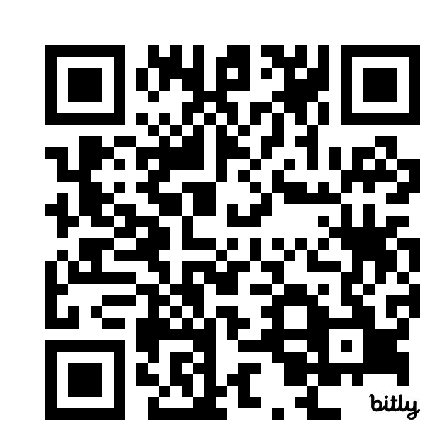
SEND Network Meetings
Termly cluster meetings will provide the latest SEND updates, including insights from Whole School SEND. Research-informed resources will be shared, fostering reflection on implementing best practices in your setting.
Book here
https://bit.ly/4jB5Dli
www.learnsendhub.co.uk

Slide 11
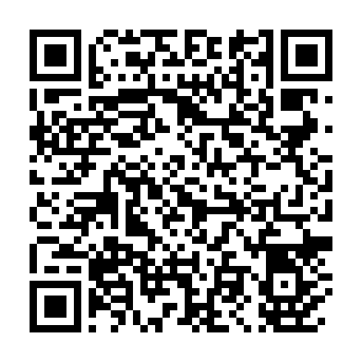
Tier 4: Teachers – Online Sessions
Delivered by our in-house SEND consultant, these 1.5-hour learning sessions are part of a modular toolkit accessible to all teachers based on their CPD needs. The twelve modules, offered through live Zoom webinars, complement ECT and NPQ packages with practical guidance on research and common themes affecting learners and schools.
Book here
Module 10 – 24/04/25 | Learning Environments
Module 11 – 22/05/25 | Working in Partnership
Module 12 – 12/06/25 | Successful SEND support – graduated approach cycle
https://bit.ly/42yp0oS
www.learnsendhub.co.uk

Slide 12
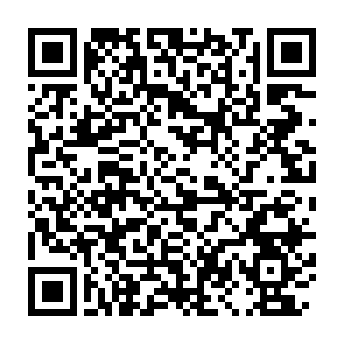
Teaching Assistant Modules
A modular toolkit of one-hour webinars for teaching assistants in mainstream primary and secondary schools, designed to enhance skills, effectiveness, and confidence in supporting pupils with SEND.
Book here
Module 1 | The role of the TA with pupils with SEND and development of working relationships
Module 2 | High Quality Teaching
Module 3 | Promoting effective group working
Module 4 | Promoting independence
Module 5 | Scaffolding and questioning
Module 6 | Delivering effective intervention programmes
Module 7 | Providing valuable feedback for teachers and pupil
Module 8 | Understanding Communication and Interaction Needs
Module 9 | Understanding Cognition and Learning Needs
Module 10 | Understanding SEMH Needs
Module 11 | Understanding Physical and Sensory Needs
Module 12 | Calm and ‘ready’ to learn
https://bit.ly/4gjqFC0
www.learnsendhub.co.uk

Slide 13
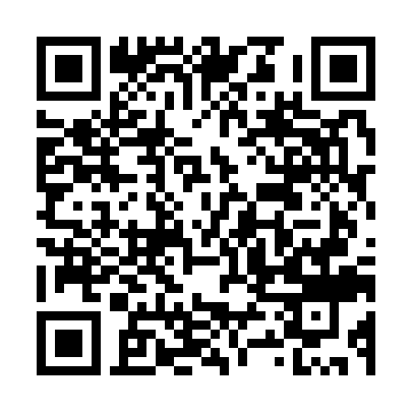
Managing Behaviour Pathway
A modular toolkit for staff seeking to understand and manage classroom behaviours. Delivered through 2-hour pre-recorded webinars by experienced SEND professionals, with each module designed for completion in 30-minute sessions.
Book here
Module 1 | Behaviour as a form of communication
Module 2 | Managing extreme emotions and teaching learning behaviours
Module 3 | Relationship-based approaches to inclusion development
Module 4 | Emotion Coaching
Module 5 | Trauma-informed practice
Module 6 | The impact of ADHD on behaviour
Module 7 | ‘Every Child Deserves a Champion’ – how do we change the narrative?
Module 8 | Know and understand your pupils
Module 9 | De-escalation
Module 10 | Relationship with curriculum, others and self
Module 11 | Building a positive behaviour environment – physically safe, socially safe and emotionally safe
https://bit.ly/4heEIdf
www.learnsendhub.co.uk
Notes:
SEMH – The Bigger Picture was also launched at the Leadership Conference Nov 22nd 2024 – Ali Williams delivered a workshop to start us thinking about SEMH and the many challenges that young people identified with this, can face. This pathway takes this thinking further. The second image shows other courses focusing on SEMH, that you may be interested in. If this is something that you are interested in, it might be worth speaking to your HT / Senior Leadership team and join the dots with the Leadership Conference.

Slide 14
www.learnsendhub.co.uk

Slide 15
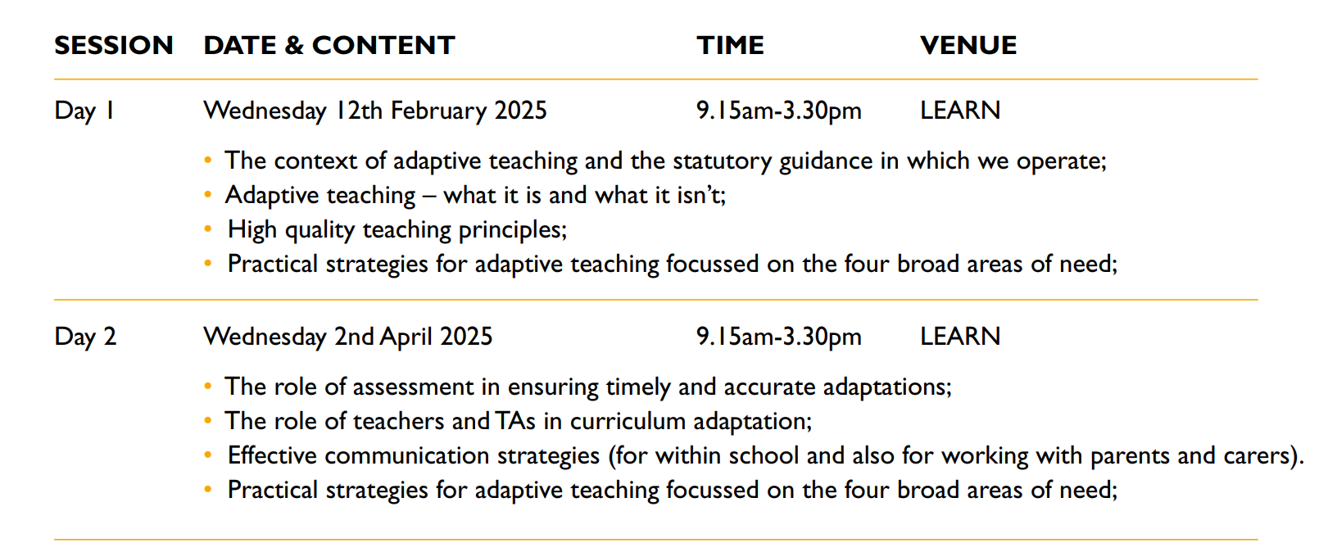
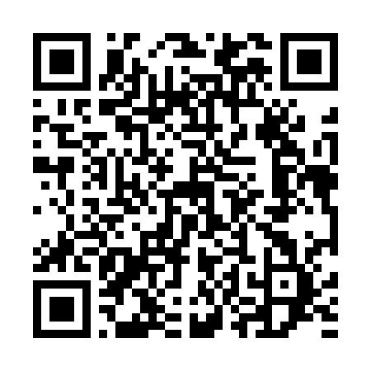
The Adaptive Teacher Pathway
Adaptive teaching tailors instruction to meet individual pupil needs, continuously assessing progress and adjusting strategies and content as needed.
Book here
https://bit.ly/40QoDVA
www.learnsendhub.co.uk
Notes:
Adaptive Teaching was launched at the Leadership Conference Nov 22nd 2024 – Margaret Mulholland. Emily Walker spoke to share with leaders the fact that there is a programme that follows on from this – The Adaptive Teacher Pathway. If this is something that you are interested in might be worth speaking to your HT / Senior Leadership team and join the dots with the Leadership Conference.

Slide 16
LEARN CPD 2025/26
www.learnsendhub.co.uk

Slide 17
www.learnsendhub.co.uk

Slide 18
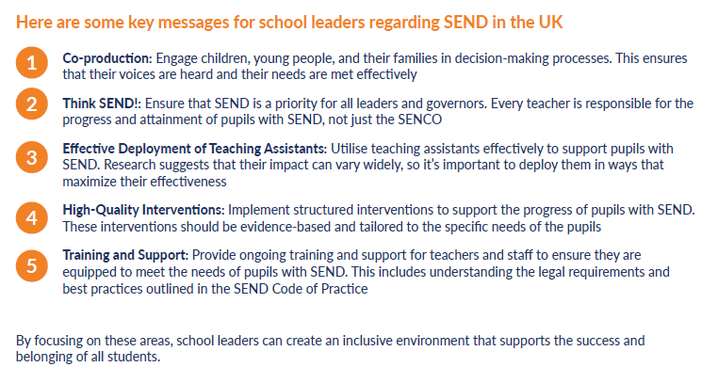
www.learnsendhub.co.uk

Slide 19
www.learnsendhub.co.uk

Slide 20
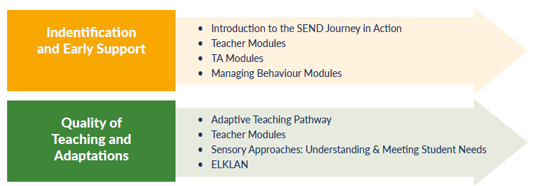
www.learnsendhub.co.uk

Slide 21
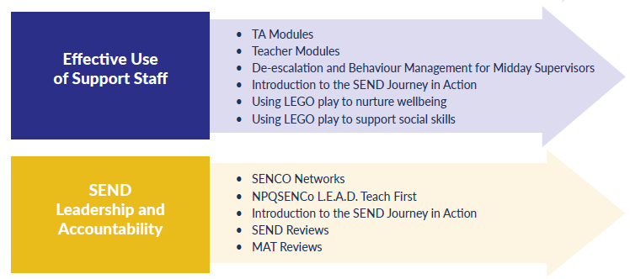
www.learnsendhub.co.uk

Slide 22
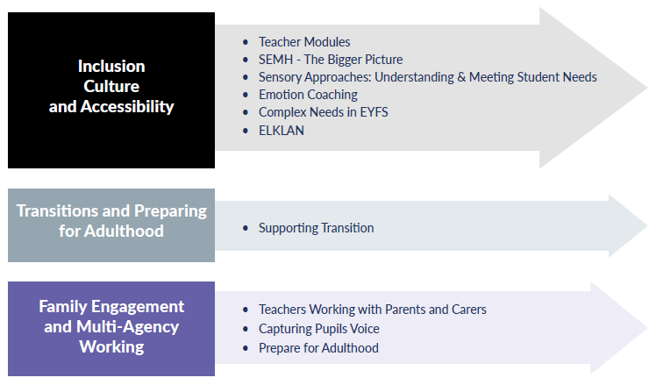
www.learnsendhub.co.uk

Slide 23
Courses continuing in 2025/26
ELKLAN
Emergency First Aid at Work
Paediatric First Aid
Midday Supervisors De-escalation and Behaviour Management
Lego Therapy
SEMH – The Bigger Picture
Adaptive Teacher Pathway
SEND Network Meetings
Specialist School Leadership Meetings
Meeting Complex Needs in EYFS
Teaching Assistant Modules
Managing Behaviour Modules
Teaching Modules
www.learnsendhub.co.uk

Slide 24
New courses for 2025/26
Sensory Approaches: Understanding and Meeting Student Needs
Introduction to the SEND Journey in Action
Readiness to Learn: Approaches to Behaviour
Supporting Transitions
Teacher working with Parents and Carers
Adult Mental Health Aware
Mental Health Skills for Managers
Mental Health First Aid
Youth Mental Health First Aid
Gestalt Language Processing
Understanding the Adolescent Brain
www.learnsendhub.co.uk

Slide 26
Free Online CPD units
Sign up / login here:
https://www.wholeschoolsend.org.uk/page/online-cpd-units

Slide 27
SEND Interactive Toolkits
Each interactive toolkit is a comprehensive resource hub designed to guide professionals through resources to support various aspects of Special Educational Needs and Disabilities (SEND). Tailored for a range of roles, these toolkits offer a variety of guides and webinars categorised for easy navigation.
Toolkits: https://www.wholeschoolsend.org.uk/toolkits

Slide 28
SEND Workforce Development
Scan the QR code to register for FREE!
11,000+
Modules
completed
331
Lincs schools
engaged
99%
Satisfaction
rate
25
Average mins per module
chris.lincoln@learnsendhub.co.uk
Notes:
The SEND Workforce Development project continues to be accessed by staff in schools across Lincolnshire.

Slide 29
SEND Workforce Development
Modules available include:
Induction Tier:
(Now also available to parents)
Types of SEND
Awareness of a Neuro-Typical Child
What is Inclusion?
SEND Code of Practice
Respecting Individuals
Working with Professionals
Tier 1:
Sensory Processing and Integration
Supporting Transitions
Support Interventions
Restorative Practice
Four Areas of Need
Nurture Principles
Personal Care and Dignity
Introduction to Attachment
Introduction to Trauma
Scan the QR code to register for free:
@SENDworkforce
Induction Tier content was
updated over Easter to include the latest statistics and guidance
chris.lincoln@learnsendhub.co.uk
Notes:
All of these modules are live and available to access. If any staff need support, they can contact us through the QR code and a member of the team will get in touch.

Slide 30
SEND Workforce Development
Parent Flyer
Scan the QR code to register for free:
@SENDworkforce
chris.lincoln@learnsendhub.co.uk
Notes:
Induction Tier modules are available to parents for free. If you would like a flyer about the content that you can send to parents and carers, please contact Chris on the email address at the bottom of the slide. We are really looking to promote this content to as many parents as possible.

Slide 31
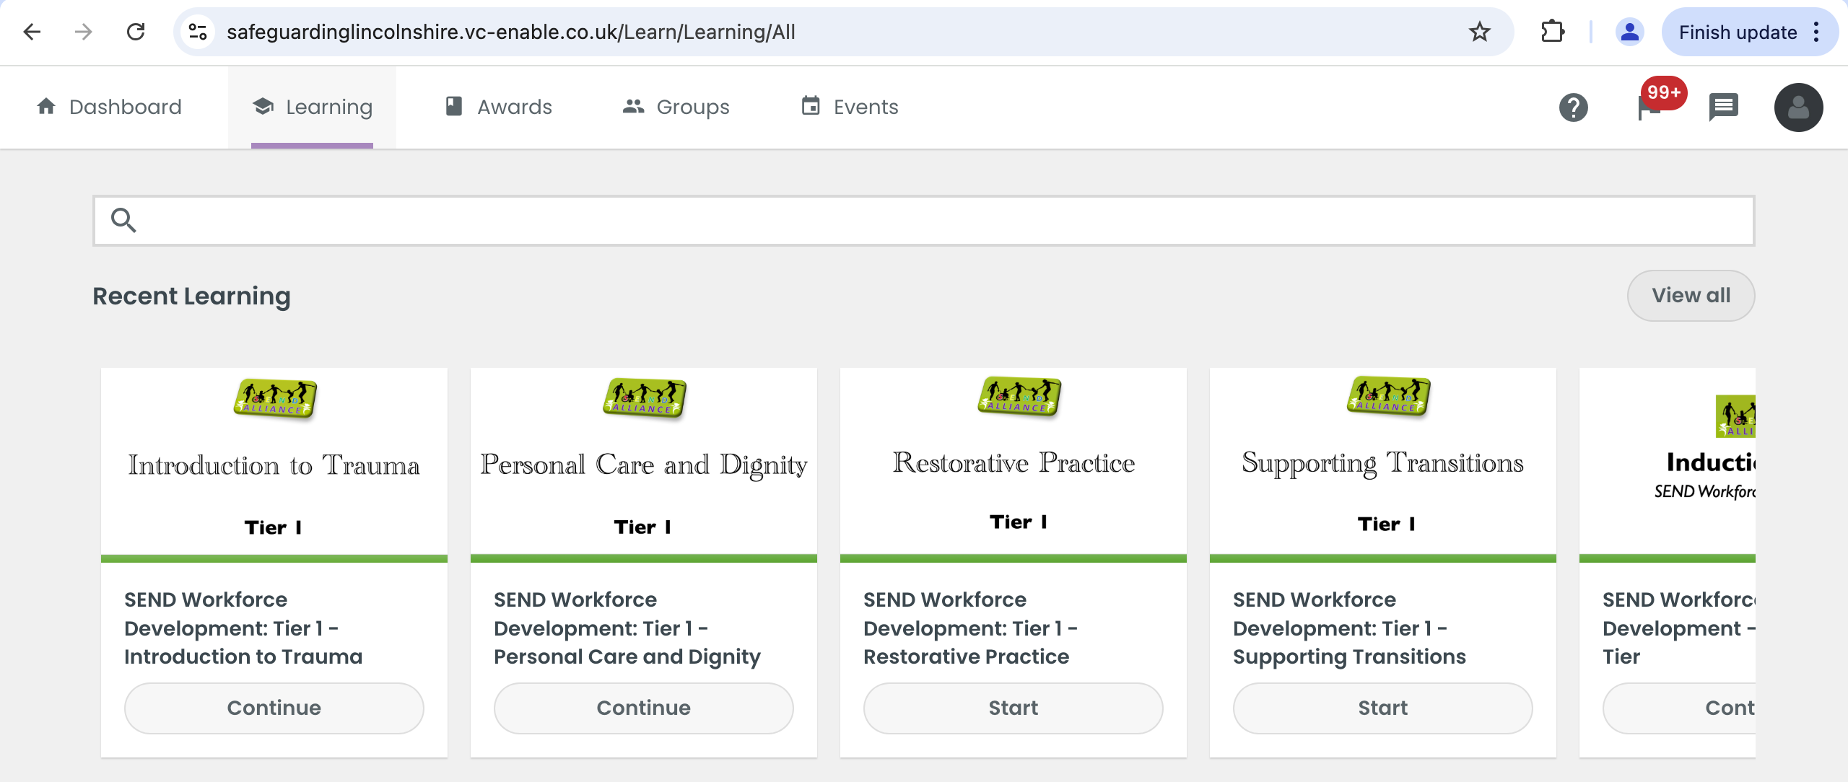
SEND Workforce Development
chris.lincoln@learnsendhub.co.uk
Notes:
A reminder that any member of staff who has an account on the Lincolnshire Safeguarding Children Partnership platform, should be able to see and access all of the modules that have gone live when they sign into the platform.

Slide 32
SEND Workforce Development
BREAKING NEWS!
More modules coming!
Belonging – going live today!
Parent/Carer Engagement – 8th May
Every Teacher is a Teacher of SEND – due to go live after May half-term
Neurodiversity
Environments
Sensory Needs
Dual Coding
@SENDworkforce
Zones of Regulation
Speech and Language and Behaviour
Introduction to DLD
Trauma (extension of Tier 1)
Relationships
Behaviour as a Communicator
De-Escalation
ADHD
Scan the QR code to register for free:
chris.lincoln@learnsendhub.co.uk
Notes:
Next stage of the project. The modules are starting to get rolled out, beginning today!

Slide 33
SEND Workforce Development
How schools use the modules…
Whole staff training during Inset Days or remotely
Inset Day or remote training for specific staff members such as Teaching Assistants
Part of an induction for new staff members
Specific modules for specific staff. For example, Personal Care and Dignity for staff members who support a young person with toileting
Signposting for staff who wish to explore further CPD
Scan the QR code to register for free:
@SENDworkforce
All of the content remains free to access
chris.lincoln@learnsendhub.co.uk
Notes:
You can pick and choose the modules most relevant to your staff and school. Here are some examples of how schools have used the modules

