Slide 1
Supporting Children with Down’s Syndrome (and other complex needs) in a Mainstream Setting.
By Emma Hall
(BA Hons, QTS, QTVI)
24.04.25
GAB – The Regatta, Lincoln.

Slide 2
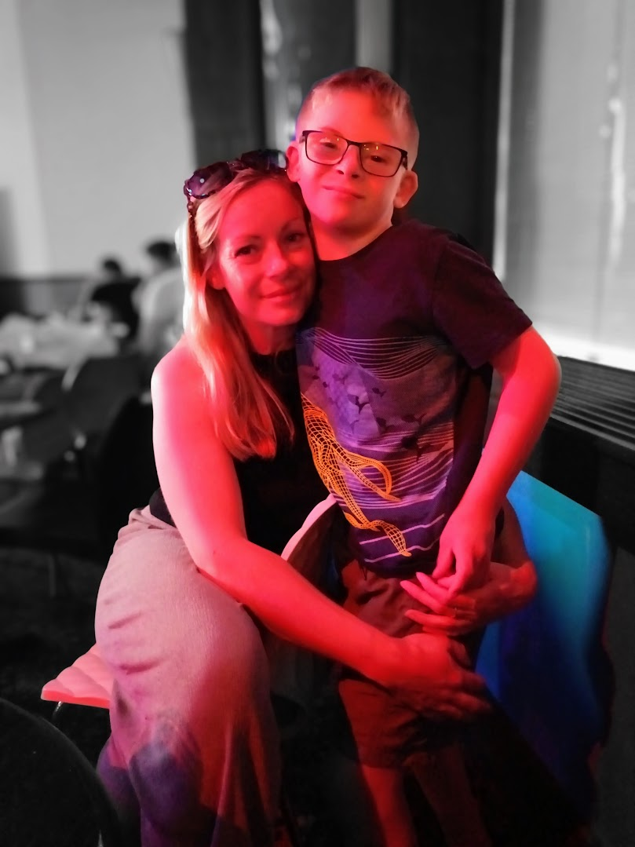
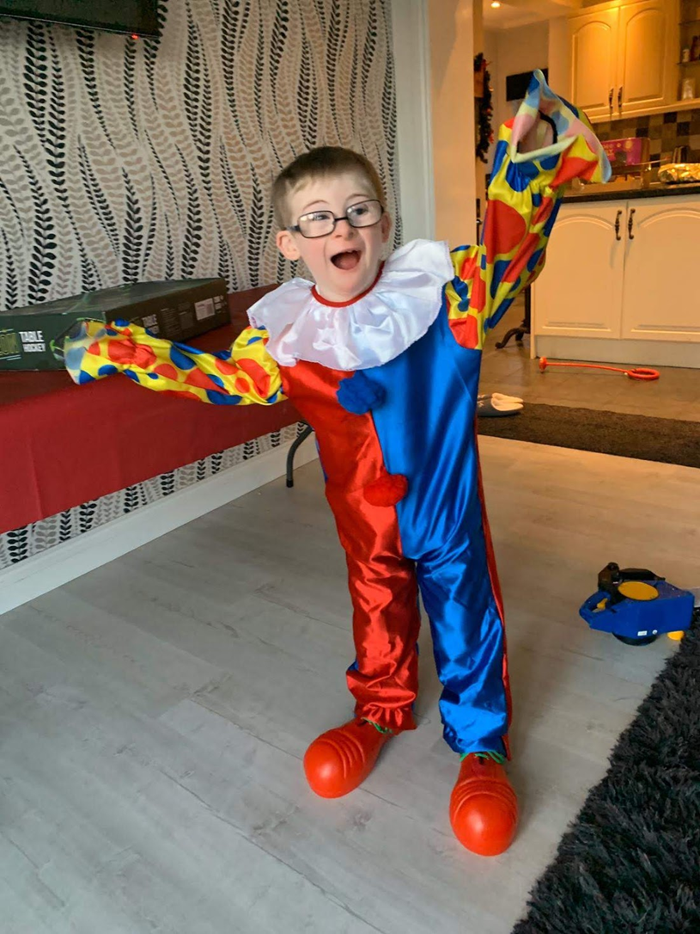
Focus areas:
Awareness of the Learning profile of a child with Down’s syndrome.
Strategies to support teaching and learning.
Ideas for Inclusive Practice.
Strategies to support behaviour.
Signposting to other services/resources.

Slide 3
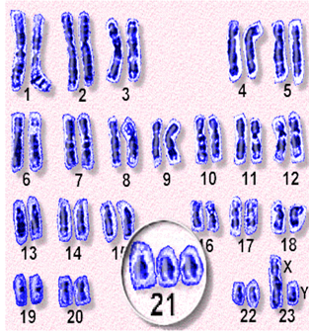
About Down’s Syndrome
The majority of us have 46 chromosomes, people with Down’s Syndrome have 47 due to a copy of chromosome 21 (This is why DS is known as trisomy 21)
Around one in every 1000 babies born in the UK will have Down’s syndrome.
There are approximately 47,000 people in the UK with the condition.
People with the syndrome will have a learning disability. The learning disability affects a person’s ability to learn, it does not mean they cannot learn.

Slide 4
Strengths of children with Downs Syndrome
Empathetic
Sociable
A want to please
Love praise!
Learn well with music and singing
Sense of humour!

Slide 5
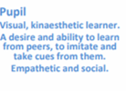
The Learning Profile
How Down’s Syndrome affects learning

Slide 6
Strategies to support Speech and Language.
Sign and gesture can support new vocabulary learning and visual scaffolds such as photos and pictures support language learning (Colourful semantics).
Time to process and respond to information.
Augmentative and Alternative Communication (AAC)
Dress up!
Down’s Syndrome SaLT pathway.
Change pace and tone.
Work with the family.

Slide 8
https://www.youtube.com/watch?v=x_I2ysM0w0g

Slide 9
The Learning Profile
How Down’s Syndrome affects learning

Slide 10
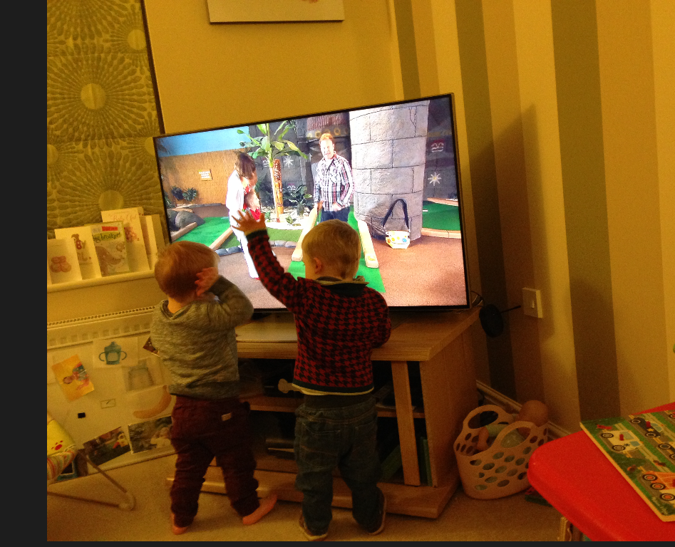
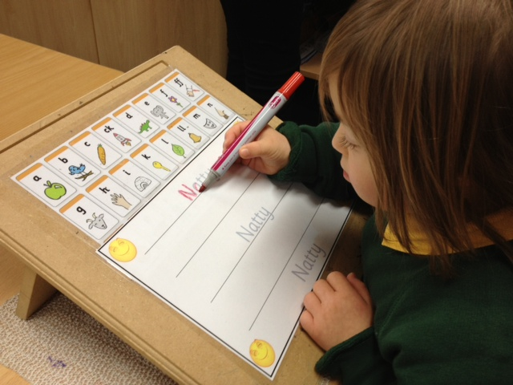
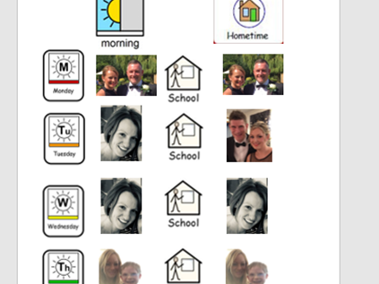
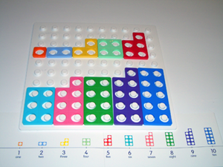
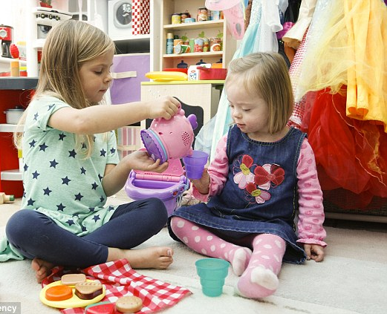
Strategies to support strong visual learning skills.
Uncluttered resources
Bright, bold, chunky
Positive role models
Actions/videos – to music!
Timetables for transition/changes to routine.
Notepad and pen
Lanyards (Dinner staff)
Photos of places/faces.
*Warning!

Slide 11
The Learning Profile
How Down’s Syndrome affects learning

Slide 12
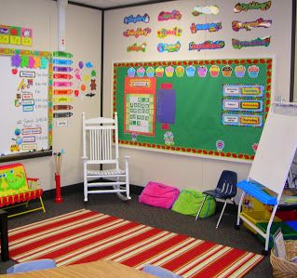
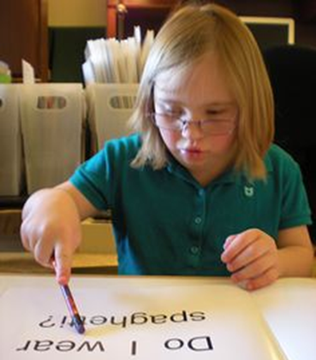
Strategies to support visual difficulties.
A
Uncluttered, clear environments.
Auditory cues as well as visual.
Clean glasses!
Uncluttered resources.
Referral to SEST – especially if have a known VI.
Lipstick!
Seat at front.
Morning core interventions.
*100% of the population of people with Down’s Syndrome have poor visual acuity.

Slide 13
The Learning Profile
How Down’s Syndrome affects learning

Slide 14
Strategies to support fine and gross motor skills and attention.
Now and Next
Fatigue
Sensory diet
Outdoor walks
Jobs
Physio/Movement
Dancing/singing/rhythm
Varied ways to record work/photo evidence

Slide 15
The Learning Profile
How Down’s Syndrome affects learning

Slide 16
Strategies to support short term auditory working memory.
Memory games (phonics/numbers).
Singing – rhythmical.
Repetition, repetition, repetition…
ALWAYS include visual and kinaesthetic to support a concept.
Small group work.
Seating for carpet time (Fiddle box/sensory spot).
Pre-learning materials – Homework .
Step by step instructions.
Demonstrating expectations.

Slide 17
The Learning Profile
How Down’s Syndrome affects learning

Slide 18
Strategies to support hearing.
Consider best seating position for carpet time and class work.
Employ lots of the visual supports and strategies.
Makaton.
When doing 1:1 work (SaLT), ensure they look at you so they can also see how your mouth is moving.
SEST referral.
Now and next boards.

Slide 19
Inclusion
☺ Effective transition
☺ Maximise their independence
☺ Move up with their chronological age
☺ Plan to the individual’s talents and interests.
☺ Use of support staff and resources must be planned to meet the needs of individuals.
☺ Home–school links communicate and share priorities and strategies.
☺ Assessment that informs effective planning.
☺ Positive role models
☺ Support from internal and external specialist services must be deployed to meet the support
needs of the team working with the pupil and enhance practice in school.

Slide 20
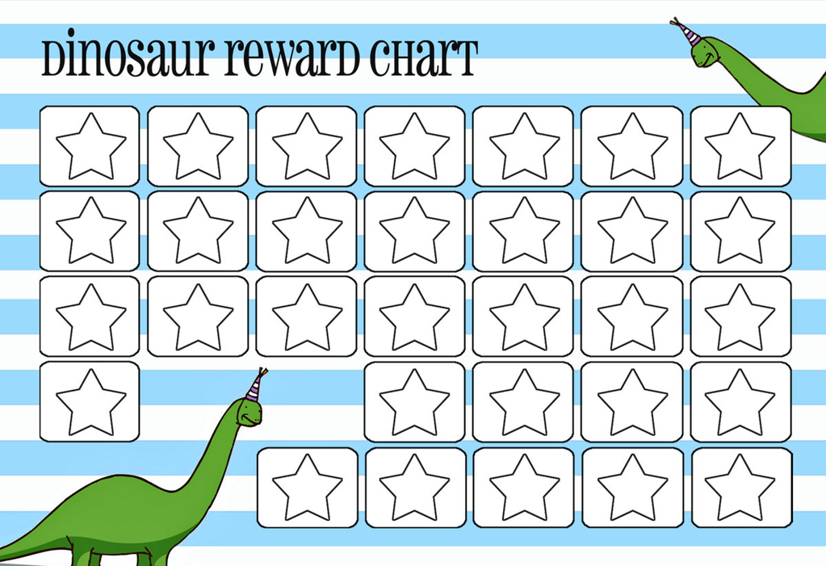
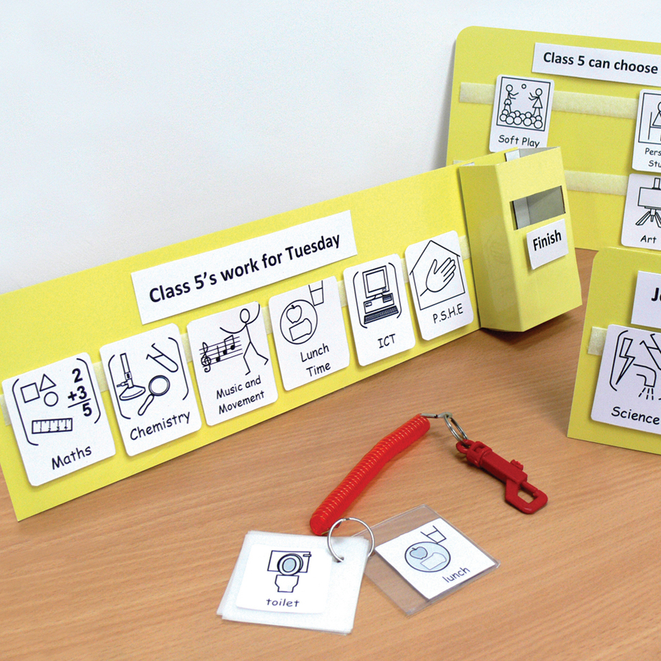
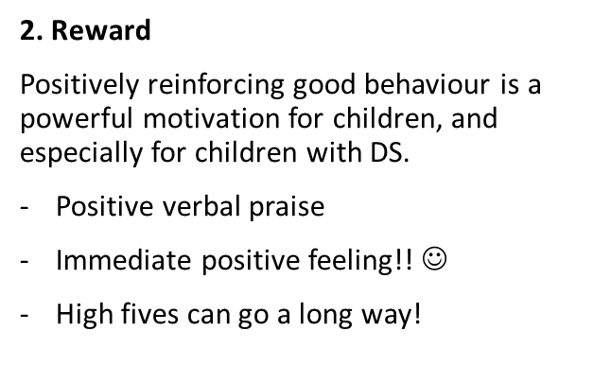
Every Behaviour is a Communication…
1. Routine
Individuals with DS often have trouble receiving and remembering verbal direction and remembering verbal directions if they are too complicated.
Visual timetables (daily activities/new routines/transition/changes to the norm)
Being consistent (Explain in short statements, help avoid negative behaviour)

Slide 21
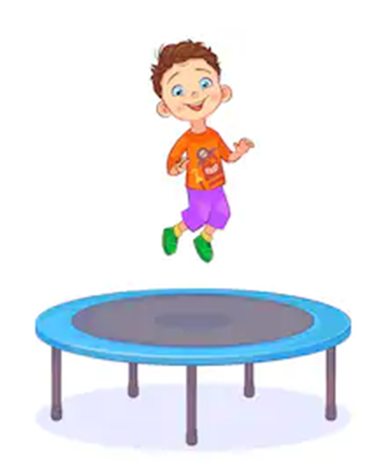
Every Behaviour is a Communication…
4. Redirection
Children with DS can easily slip into the habit of sensory seeking. Sensory input are messages we receive from our five senses, and can be used by children to sooth themselves in times of stress or to act out when they are feeling frustrated or unhappy.
- Sensory seeking behaviours may be annoying or displeasing.
- Some behaviours may occur out of boredom and a need for attention. (Jumping, frequently touching others/objects, and making loud noises).
Direct their free time – structure
Look for triggers/patterns
Use choice
Replacement activities – teaching moment!
3. Choice
Whenever possible, give your child a choice. This will help them feel empowered and it will also minimise negative behaviour triggers.
- Choice of 2
- Flexibility in discipline is also important – Choose your battles!!

Slide 22
5. Consistency
Consistency is important for behaviour modification.
Present a united, consistent front at home and at school.
Behaviour can be simply for attention or a reaction.
A reaction would positively reward the very inappropriate behaviour you want to stop.

Slide 23
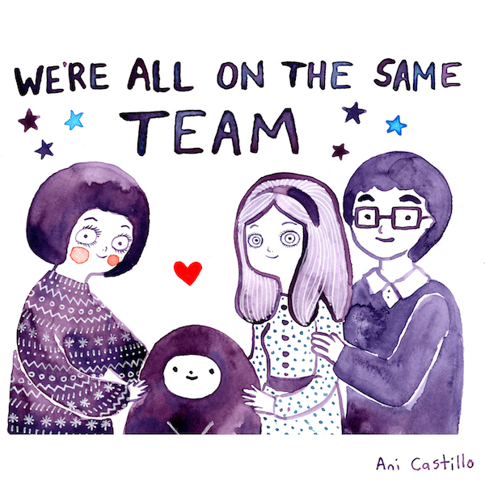
Working with parents…
Maintain a good relationship and regular contact with parents/carers
The school should ensure all staff have basic training about Down’s syndrome
Always use the correct person-first terminology.
Communication book to support health needs that affect learning – for example information about how to use glasses, support hearing, physical or sleep related concerns.
Highlight successes.

Slide 25
Thank you for your time. Are there any questions?

Slide 26
My contact details:
Email: emma@thisismeltd.co.uk
Offer of support:
Face to face staff training
TA support
Student observations and feedback
TA Networking events

