Slide 1
SEND Advice Line Lincolnshire (Ask SALL)
Current Team Members
Sharon Drewery
Linda Baldwin
Nicole Amott
Contact:
AskSALL@lincolnshire.gov.uk
Notes:
Sharon – Early Years and ESCO
Linda – Primary and LSS (now STT)
Nicole – Secondary and Specialist

Slide 2
SEND Advice Line Lincolnshire (AskSALL)
Contact:​AskSALL@lincolnshire.gov.uk ​
Support Offer​
The service will offer settings:​
Easy and quick access to an experienced advisor to discuss the individual child/young person, or broader school/setting issue and provide information, advice and guidance (IAG).​
Signposting to the Local Offer, SEND inclusion toolkit, the Valuing SEND tool and other services to better understand and meet need.​
Where appropriate, a follow up appointment with a relevant Ask SALL team member, or other professional (Educational Psychologist, Early Years Specialist Teacher) can be arranged. ​
For quick queries, you can call the dedicated number for the team on:
- 01522 553199​
- Mon-Fri 9:30 –16:30
For more specific information, concerns regarding individual pupils or whole school issues we ask for you to Complete the online form with brief details and reason for your consultation request.​ Request SEND advice (Ask SALL) | Your details – Lincolnshire County Council
Local Offer Information:
https://www.lincolnshire.gov.uk/support-education/ask-sall

Slide 3
Where we sit

Slide 4
Collaboration is key – cross team working
We liaise and share information across teams including the Pupil Reintegration Team (PRT) and Emotional Based School Avoidance (EBSA) caseworkers following consults to ensure all parties have access to the same information and advice shared.
Other LCC teams we can link to include the locality SEND teams, Early Years Teams, Specialist Teaching Teams (including Dyslexia outreach), ESCO, Early Help and Virtual School (including Caring2Learn)
We can also liaise and contact some health teams, for example, the specialist nursing team, 0-19 health care etc.
We also work with Educational Psychologists and can offer telephone consults to schools to provide further early intervention strategy discussions (only after full consult with SALL and dependent on complexity/stage of case)

Slide 5
So, who contacts us?

Slide 6
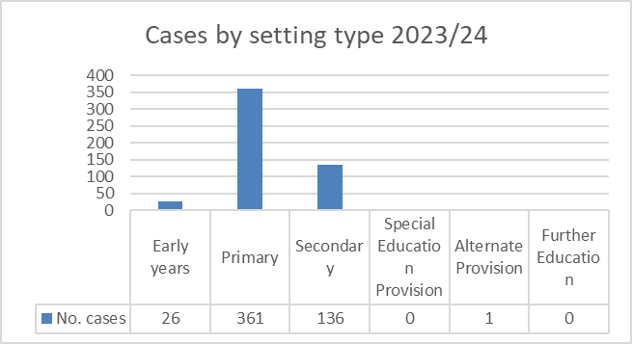
You do!
Contacts have more than doubled since the first year of SALL being launched. This year, to date, we have responded to an average of 80 contacts per month that have come in via our online portal. We continue to receive a higher number of contacts regarding primary aged children.

Slide 7
What do you contact us about?

Slide 8
When SALL launched in September 2020, Communication and Interaction was the most common area of need identified. Following the national Covid lockdowns the number of contacts in relation to Social, Emotional and Mental Health Needs increased and this has remained the case.

Slide 9
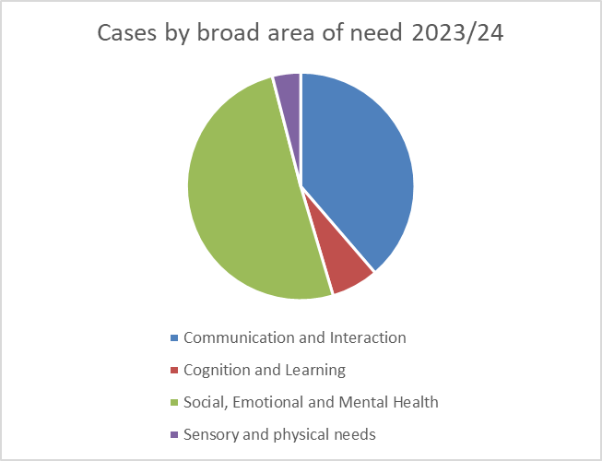
Over half of all contacts submitted to us (both last year and this) indicate the main area of need continues to be SEMH
Communication and Interaction needs account for a further 35-40% with Cognition and Learning and Physical and Sensory needs making up the remainder

Slide 10
And what is the area you mainly are seeking information, advice and guidance for?

Slide 11
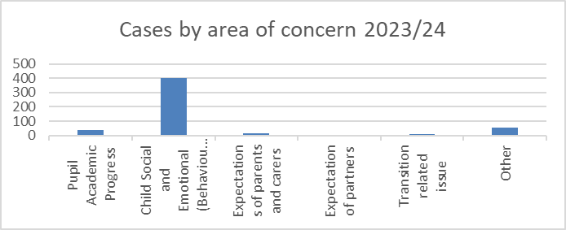
Both this year and last, over 70% of enquiries were seeking advice and support for social, emotional and behavioural needs

Slide 12
Ask SALL- Case Study – Early Years SEMH
Phone consult with Nursery Manager and SENDCO
Age 4 male with SEMH challenges
Recent significant and sudden onset of challenging and risky behaviours (to self and others)
Setting shared the family had been ‘advised’ by a family friend to apply for an EHCNAR; setting do not feel they have evidence to support this
EYST due to visit at point of consult to discuss inclusion funding
High adult ratio in place – sensory profiling completed, star/ABC analysis have not indicated triggers, no trauma or specific incidents identified
Visuals and social stories in place to support communication of safe/desirous behaviours
Safe/calm space offered; has refused to use this
No indication of underlying SCLN (Wellcomm assessments indicate ARE in all areas)
EHA agreed and due to be completed with family
Advised to also consider completing the VSEND and refer to inclusion toolkit.
Consider if the SEMH SPOT tool would offer further insight and unpick with family the cause of change in behaviour
Shared resources on emotional regulation in the Early Years, a Sensory Needs Processing Toolkit, information on supporting oppositional behaviours
Consider accessing support from Health Visitor
Information on transition support including Sesame workshop school readiness information
Advised information on EHCNAR process may be useful to share and explain with family what evidence is required for this and how (if Inclusion funding is warranted) the impact of this should be considered as part of cycles of APDR and a GA
Advised to consult SALL again after EYST discussion and time to implement advice shared
The information provided signposted to additional support to further profile needs and cause and access support from additional agencies/professionals.

Slide 13
Ask SALL- Case Study – Primary SEMH
Online contact form to ASKSALL from primary SENCo requesting an email response. A call back was offered and a discussion arranged (Feb 2025) to investigate the difficulties in more detail.
The discussion was about a 5-year-old male with a diagnosis of ASD and with an EHCP in place.
Concerns were around school struggling to meet sensory needs that were posing a safety risk to the child and others.
School were requesting support on meeting proprioception needs.
The conversation explored the difficulties being seen both at home and at school and the approaches , adjustments and strategies already being implemented.
The child was subject to an SGO , living with Grandparents who were also struggling to meet his need.
The child is non-verbal in school although is now saying a few words at home.
School are seeing constant dysregulation and unsafe behaviours requiring them to provide 1:1 support by an adult at all times.
School are using First Move, have completed a referral to the ASD specialist nursing team and have signposted grandparents to an ESCO drop in.
The Ask SALL advisor explained the process for accessing services within LCC and identified the following solutions which were sent in a summary email following the conversation:
Advised completing some sensory profiling so school were fully aware of his sensory needs so they could look at appropriate strategies of support alongside implementing sensory circuits/movement breaks during the day .
Suggested accessing the Linkage sensory Library and/or sensory bus for borrowing sensory resources to try and meet his needs.
Implement the Working Together Team Ladder to enable school to access direct support at the appropriate step for further advice.
Consider accessing funding from Adoption support service /Bromhead Charity to seek a private sensory OT assessment.
Provided proprioception resources.
The SALL Advisor recognised that the conversation had enabled setting to discuss the strategies already being implemented whilst reflecting on the impact. Further resources and avenues of support were provided for the school to investigate.
The outcomes and advice identified solutions that would help with investigating and accessing further avenues of support to meet the presenting needs.

Slide 14
Ask SALL- Case Study – Secondary SEMH
Direct call with SALL from attendance officer and SENDCO, mainstream secondary academy, following online contact submission
The call was regarding a 13-year-old girl with SEMH and attendance issues
Indication of historic trauma (DV) and access to Kooth, EDAN and Healthy Minds
School concerned for child and parent as child becoming increasingly violent towards mum
Combined discussion between SENCO and attendance officer to ensure support is correctly triaged and supported across the academy
Some parental conflict – parent works within an SEMH specialist setting and has been resistant to some offers and pathways of support to date.
Some possible attachment issues between child and mum
School have offered discussion around referral to MSP
The Ask SALL adviser explained that should PRT support an MSP referral it would be advisable to have the Valuing SEND tool completed. The SALL advisor also identified the following solutions which were sent in a summary email following the conversation:
Refer to the Inclusion toolkit for further advice and strategies around supporting the SEMH needs
Signposted to other SEMH support services including Not Fine In School and the Anna Freud Centre
Contact the Caring 2 Learn service
Consider completing an EHA to explore further the family history and background
The setting were also offered a follow up consultation with an EP to have further conversation around the EBSA
The outcomes and solutions identified will triage the support available to the child and ensure a collaborative approach to ensure a robust graduated approach.

Slide 15
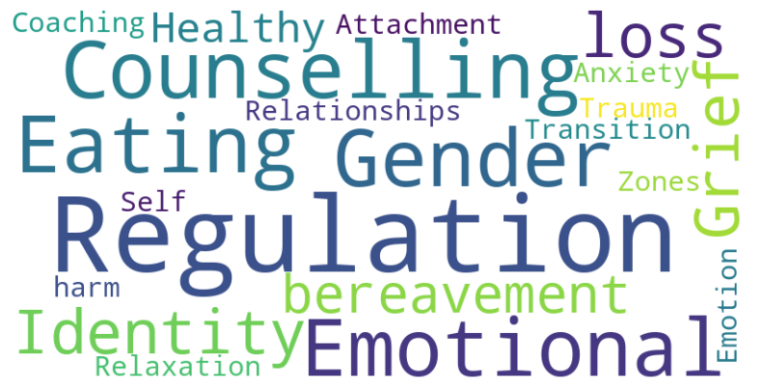
Areas within SEMH we have discussed with you...and provided IAG on...

Slide 16
Local and National links
Local sources/agencies include:
School News Bulletins
Safeguarding News Bulletins
Int Comms
LPCF
WTT
BOSS
Futures4Me
EMTET
LIAISE
STT
SEST
Lincolnshire Health Services
We endeavor to keep abreast of both the local and national picture. This includes sharing information we receive/become aware of from other agencies and organisations.
National sources/agencies include:
Other health authorities
The Anna Freud Centre
Beacon House
NSPCC

Slide 17
Feedback We Have Received
“I found the interaction with the ASK SALL practitioner helpful in bouncing ideas off of possible next steps with the child but also reassuring that actually as a setting we have put in place all we really could do. I found the practitioner really listened to my concerns and thought carefully about her response.” DEC 24
“Very professional and supportive, she listened and asked questions to ensure that the best advice and support was offered for the young person.
The ASK SALL adviser and the EP were both excellent” Feb 25
"A child had recently moved to our school. Previous school had had significant involvement with other agencies. ASKSALL was able to identify what the other setting had been advised from their involvement. Our conversation joined up some missing links and identified the best next steps." FEB 25
'We were at a crossroads with a child and the phone call gave us options that we had not thought of.' Feb 25
"I've had several conversations this term and ALL have been really helpful. SALL are just wonderful to talk to- they listen carefully and give really helpful advice, direct actions and help me talk through cases and work out a clear plan of action for each of the children I have shared with them. I never come away from a call without something that is an actionable next step to support a child.” Nov 24
“ The practitioner had read through the information which I had already provided when booking the call online. Once I had given a little more information, she was able to signpost me straight away to services which would be able to support the parent (and therefore also the child). This was followed up with all of the relevant information and contact details in an email the very next day.” June 24

Slide 18
Concerns
Points Raised
Response
Sometimes there is a bit too much information coming back and it would take me a month to give it all my attention.
We endeavor to make advice as bespoke as we can and ensure what we advise/email is relevant – discussion should indicate our guidance is for consideration and not a 'to do' list!
Can be a delay between having the EP conversation and receiving the summary
Once returned to ASKSALL, All EP reports have to be passed for Quality Assurance before being sent out to settings. Advice is to always 'make notes' during the conversations so any advice can be swiftly actioned.
I simply rang the service because it was stipulated on a referral form
We recognise the SALL service is named by other teams, including PRT, EBSA and SEND caseworkers. Conversations can be affirmations that everything that should be in place, is, but may also offer some alternative strategies and resources. Can also facilitate collaborative practice to ensure the right agencies/professionals are involved
Notes:
We do listen

Slide 19
And what else do SALL do?

Slide 20
In addition to the online contacts received, we have also responded to over 160 direct calls so far this academic year – with queries ranging from access to the VSEND tool, how to contact specific services or teams relating to SEND, and a whole host of other queries

Slide 21
6 week SEND allocation panel information (Education Health Care Needs Assessment Requests)
The Ask SALL advisors also sit in on Wednesday allocation panel meetings.
We do not hold decision making powers but can be asked to confirm/expand on any SALL contact.
Follow up contact and advice following declined Education Health Care Needs Assessment Requests (EHCNAR) is then offered to settings.
“I am contacting you from the SEND Advice Line Lincolnshire to see if there is any further advice, we can offer you for a case that was submitted to the Education Health and Care Needs Assessment Panel (as a parental request). The child’s initials are XX ; screening took place on xx/xx/xx and the decision was made not to proceed with an EHC Needs Assessment. The decision is now available to see on the EHC Hub and reason for decision and advice from panel is:
Please let me know when the most convenient day/time would be for me to give you a call back to discuss this further.”
Notes:
Our other role – messengers not decision makers. But do read hub submissions, discuss good practice as a team to enable other settings. Challenge too – can see the parity and fairness in the panel when discussing individual cases

Slide 22
Any Questions

