Slide 1
Graduated Approach Briefings
April/May 2025
Notices

Slide 2
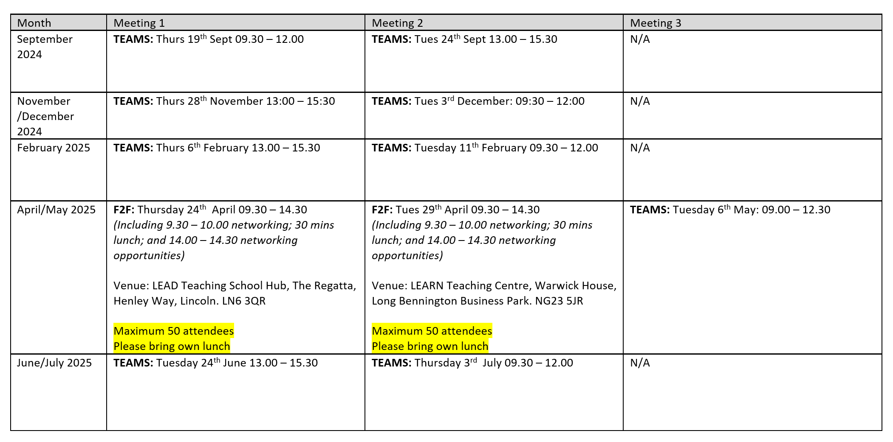
Remember to book your places for each briefing throughout the year on the Local Offer
Graduated approach briefings – Professional resources (lincolnshire.gov.uk)

Slide 3
Dyslexia Outreach Support - EduLincs – Lincolnshire County Council

Slide 4
Specialist Teaching Team
Inclusion Service
Dyslexia Outreach
Dates for Diaries 2024 - 25
Contact Jane.McWatt@lincolnshire.gov.uk to register interest for 01/10/24, 21/05/25 and 13/05/25 dates. More details will be sent closer to the time.
Free, online, evening workshops for parents/careers and pupils, over the next academic year.
* These events are being delivered through the Lincolnshire Parent Carer Forum – see website for details: www.lincspcf.org.uk
Supporting your Child at Home
Tuesday 1st October 2024
Monday 24th February 2025*
Ideas and strategies to support your child at home with language, reading, spelling, maths, memory and personal organisation.
Aimed primarily at parents/carers of children in KS2-3 but open to all interested parents and carers.
Study Skills and Revision Strategies
Monday 4th November 2024*
Tuesday 21st January 2025
Ideas for supporting memory and learning in the classroom.
Aimed at all secondary aged pupils and especially relevant for those preparing for national exams: GCSEs, Vocational Qualification and A-levels
Primary to Secondary Transition Workshop
Tuesday 13th May 2025
Monday 9th June 2025*
Information and advice to ensure that your children are well set up and organised to make their transition go as smoothly as possible.

Slide 5
Specialist Speech and Language Training Offer
Free recorded general awareness training for settings:
DLD and SLCN General Awareness – Professional resources (lincolnshire.gov.uk)

Slide 6
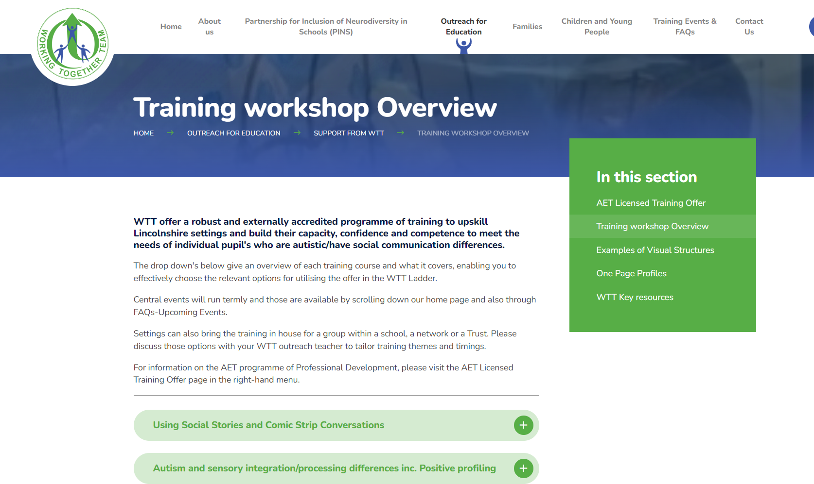
WTT Central Training Offer now available too:
Information about this has been circulated to all schools but if you have missed it, it will be uploaded on our pages too. Or check out the website: www.wtt.org.uk
Notes:
Jen

Slide 7
Lumi Nova: Inclusive digital therapeutic support for fears, worries and anxiety
Launched 8th January 2025 in Lincolnshire!

Slide 8
Launched in Lincolnshire 8th January 2025!
Lumi Nova
Inclusive digital therapy for a new generation
Lumi Nova has been commissioned in Lincolnshire to provide early access support for childhood worries and anxiety.
Prior to launch:
Register for a Lumi Nova Discovery webinar to find out more (multiple dates are available)
Subscribe to the Lumi Nova Newsletter to receive a Lumi Nova Resource Kit at launch
Order print resources or arrange training for your staff by emailing the team on luminova@bfb-labs.com
Recommended by
Co-developed with young people, families, educators, clinicians & academics

Slide 9
Presentations and Videos will be available from 19th May
Remember to visit the Graduated Approach Briefings page on the Local Offer so that you can view the presentations and videos for this round of briefings and any from the previous academic year.
Graduated approach briefings – Professional resources (lincolnshire.gov.uk)

