Slide 1
Pupil Re-Integration Team Updates
Karen Richardson
Inclusion Team Manager

Slide 2
The Revised Ladder

Slide 3
How has the Revised Ladder been created?
The Working Group has been meeting over the last year
Representatives from:
A Lincolnshire Primary School
A Lincolnshire Secondary School
BOSS
Springwell
Lincolnshire Parent Carer Forum
STT and ECLIPS
PRT

Slide 4
Schools are telling us that their needs and the needs of pupils have changed
Greater emphasis on whole school approaches
To make the Ladder more of a useful tool for schools
The PSP to be a central tool to support planning and a graduated approach
Reasons for the Update

Slide 5
Numbers of Exclusions Continue to Rise in Lincolnshire
(graphic used courtesy of The Difference)
Lincolnshire has higher rates of exclusion than national and regional rates

Slide 6
Behaviour is Everyone’s Responsibility
Everyone is key – starting in the classroom
“I’ve come to a frightening conclusion that I am the decisive element in the classroom. It’s my personal approach that creates the climate. It’s my daily mood that makes the weather. As a teacher, I possess a tremendous power to make a child’s life miserable or joyous. I can be a tool of torture or an instrument of inspiration. I can humiliate or heal. In all situations, it is my response that decides whether a crisis will be escalated or de-escalated and a child humanized or dehumanized.”
Haim Ginott

Slide 7
Whole School Approaches Intervene in the Conflict Spiral

Slide 8
Step of the Ladder
Initial Steps | Whole School Approaches | Underpins Everything
Next Steps | Identifying Factors | Part of Assess
 | Early Intervention | Part of Plan, Do
Further Steps | Targeted Involvement | Part of Do, Review, Assess
Following a Graduated Approach

Slide 9
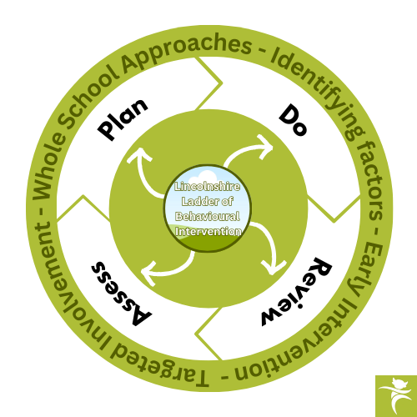
Following a Graduated Approach

Slide 10
Identifying Factors – Next Steps
Identifying and assessing learning needs as part of behaviour support in schools is crucial because students' behaviour is often influenced by their academic challenges, learning difficulties, and social-emotional needs. Addressing the root causes of behaviour is essential for providing effective support and fostering an environment where all students can succeed.
This underpins everything – continuously – sets the tone and the ethos of the school.
Steps of
the Ladder
Whole School Approaches – Initial Steps

Slide 11
Early Intervention – Next Steps
It is important for schools to seek to understand the underlying causes of behaviour through early intervention and whether additional support is needed. Underlying causes of persistent disruptive behaviour should be investigated, and support provided such that permanent exclusion is only ever a "last resort."
Targeted Involvement – Further Steps
If after following the earlier steps of the ladder, there are continued concerns regarding pupils displaying challenging behaviour then the ‘further steps’ stage of the ladder looks at more significant support from outside agencies.
Steps of
the Ladder

Slide 12
What Else is in the Ladder?
Ladder Toolkit
Contents include:
Behavioural Environmental Audit
Class Teacher Questionnaire
Pupil Questionnaire
Parent/Carer Questionnaire
Behaviour Risk Screening Tool
PSP Template
Ladder Resource Bank
Examples of useful resources and information that can be used in schools
Ladder Interventions Bank
Examples of research based interventions that can be used in schools to support behaviour

Slide 13
So, What Next?
Consultation process with schools during the summer term
The revised Lincolnshire Ladder of Behavioural Intervention and tools/ resources will be available to schools following the completion of the Graduated Approach Briefings at the beginning of May
Schools will be asked for feedback to be returned by the 9th June 2025
Revised Ladder will be implemented from the beginning of September 2025

Slide 14
Other Updates
Transition work with the Early Years Team
We have been working closely with the Early Years team to look at better ways of improving transitions. There will be an online briefing on the morning of Monday 16th June to look at different ways of supporting transition in the early years. The booking link for this will be sent out next week.

Slide 15
Any Questions

