Slide 1
Lincolnshire Virtual School Visual Reasoning and Maths Skills
Spring Term 2025
Assistant Head Teacher: Zara Thorpe
Academic Progress Lead: Jen Dunning

Slide 2
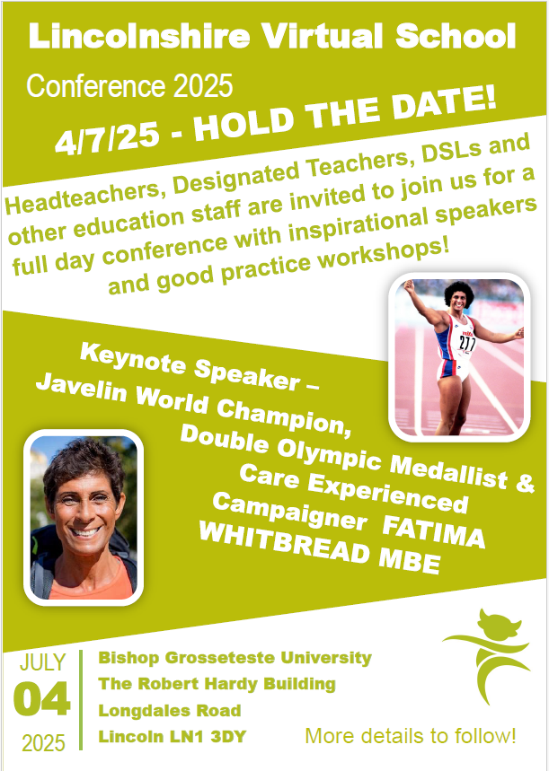
Lincolnshire Virtual School Training Offer
All bookings are made through our 2024 – 2025 booklet. You do not have to have a child in care to attend our training.
If you require any further information or advice around our training offer, email us on: VirtualSchoolTraining@lincolnshire.gov.uk
More information on the role of the Virtual School can be
found at: Promoting the education of children with a social worker and children in kinship care arrangements: virtual school head role extension - GOV.UK (www.gov.uk) Please don’t hesitate to contact us for any CiC, CWSW, PLAC and Kinship care guidance: VirtualSchool@Lincolnshire.gov.uk.

Slide 3
Lincolnshire Virtual School
Training events
Please use the training booklet to book onto any of the courses. Our current up and coming events are….
A Relationships based approach to inclusion – policy and practice Caring Schools Audit Workshop SDQs – what they are, why we do them, and how to complete them The role of the Designated Teacher in meeting the needs of children in care The role of the Designated Teacher in meeting the needs of children previously in care Introduction to the Responsibilities of the Designated Teacher An introduction to the Lincolnshire ePEP System Governor Training Understanding Dyslexia for carers and schools | 9 May 2025, 13:00—15:00 3 June 2025, 13:00—14:30 12 June 2025, 09:30—11:00 29 April 2025, 09:30—11:30 1 May 2025, 13:30—15:00 17 June 2025, 09:30—11:00 18 June 2025, 09:30 – 11:00 22 April 10:00—12:00 16 June 18:30-19:30

Slide 4
Lincolnshire Virtual School
Training events
Additional workshops available include:
Please use the training booklet to book onto any of the courses.
Please don’t hesitate to contact us via email: VirtualSchoolTraining@lincolnshire.gov.uk if you
require any further information or advice.
An introduction to social pedagogy Introduction to Restorative Practice Kids Skills: Solution Focused Coaching Relational repair: supporting children to trust others and invest in relationships Supporting grief, loss and positive endings Sleep workshop: supporting sleep, nightmares and night terrors An Introduction to Trauma Awareness Creating calm: emotional regulation for children and adults | Zoom 23 April 12:00 - 14:00 Zoom 7 May 2025, 13:00—15:00 Zoom 19 May 13:00 —15:00 Zoom 6 June 10:00 – 12:00 Zoom 16 May 10:00 — 12:00 Zoom 19 June 2025, 10:00—12:00 F2F 26 June 2025, 10:00—14:00 in Grantham or online over 2 sessions 3 & 10 June, 10:00 - 12:00) F2F 7 July 10:00 – 14:00 in Lincoln

Slide 5
The Role of the Virtual School
The Virtual School has a statutory duty to promote the educational outcomes for children in care and those previously looked-after. The school does not exist in real terms as a building, nor does it provide online learning. The Virtual School supports all children in care aged 3 – 18 years in the care of Lincolnshire, regardless of where they are living or accessing education.
At the Virtual School our statutory role is to:
Promote high aspiration and raise achievement for our children in care through challenge, support and targeted intervention
Ensure that our children in care access high quality teaching and learning
Celebrate the achievements of our young people in care
Work closely with all those involved in the care and education of children in care, providing training and support to help understand their unique needs and ensure they achieve success in their educational careers
Co-ordinate and quality assure all Personal Education Plans (PEPs)
Monitor and challenge education settings to make the most effective use of Pupil Premium Plus
Ensure effective transition is provided between schools or settings
Provide training for Designated Teachers and bespoke packages of support to schools and settings
Ensure educational settings are meeting the needs of our young people through the graduated approach as part of the SEND Code of Practice

Slide 6
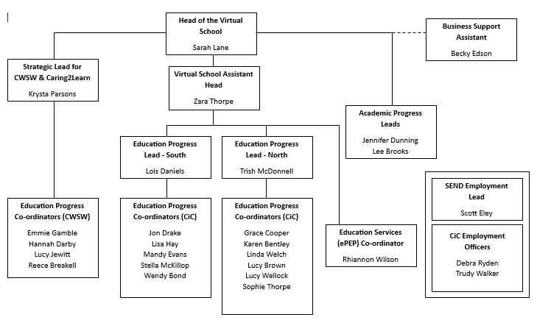
Lincolnshire Virtual School

Slide 7
Visual Reasoning and Maths Skills
Visual Reasoning is the ability to make sense of and complete a pattern or series of related images.
It supports the understanding of visual information and the ability to solve problems using reasoning and logical thinking skills.
It suggests an aptitude for learning through direct experience and logic; it does not rely on the use of language and is less influenced by academic experiences.
Visual reasoning supports the learning of many mathematical concepts, computer tasks and scientific problem-solving in the curriculum.
For example:

Slide 8
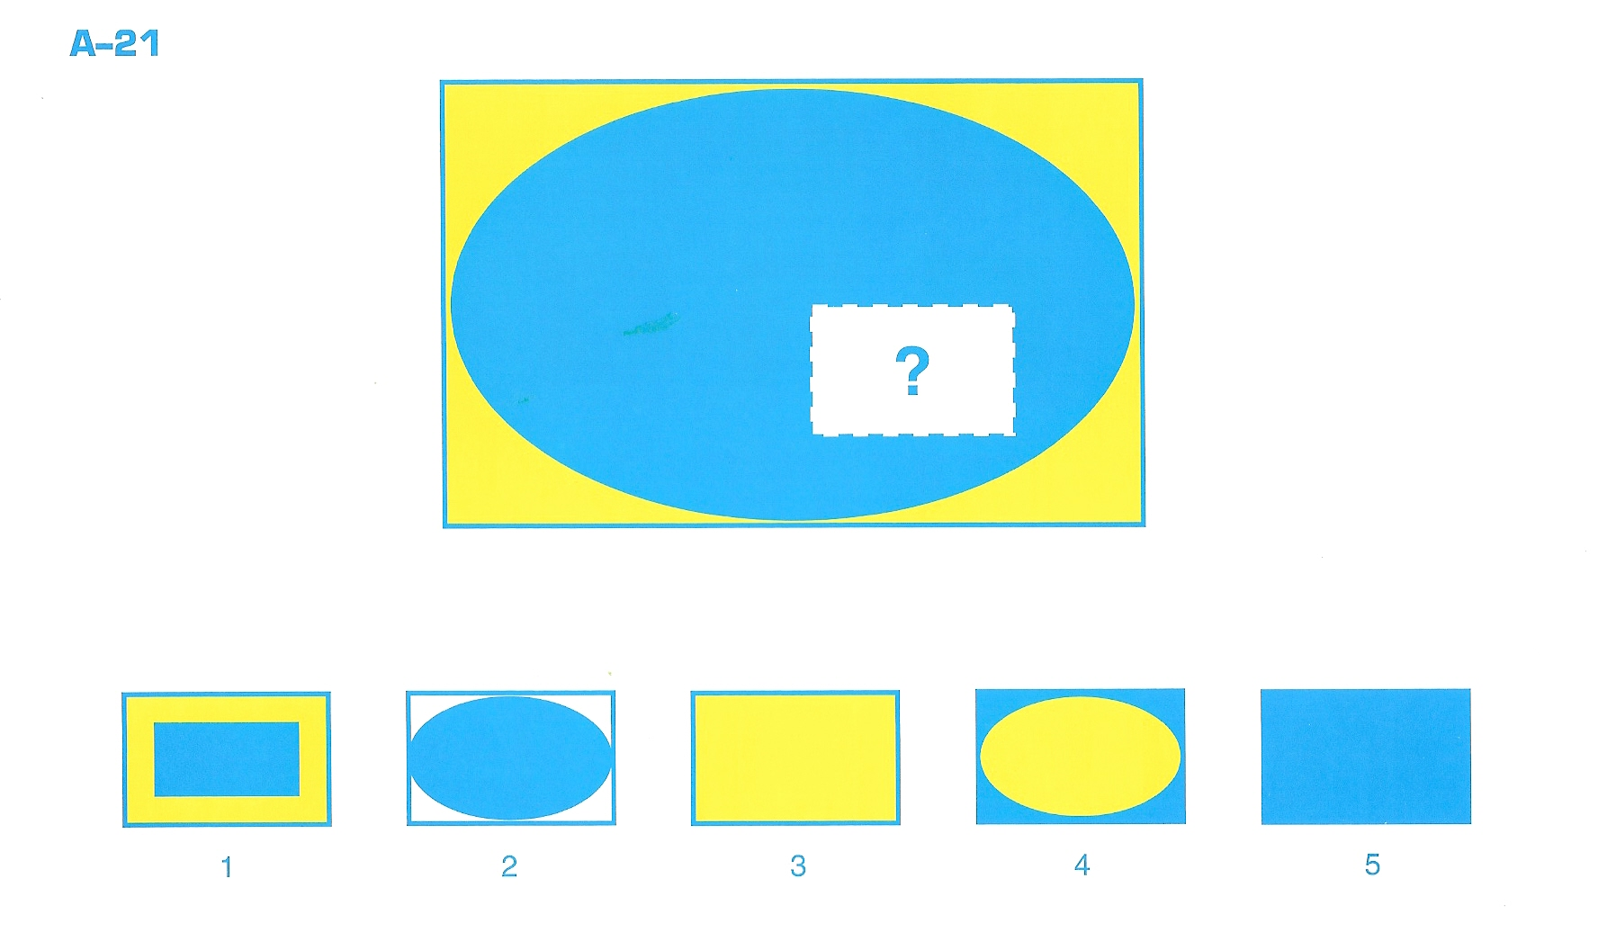

Slide 9
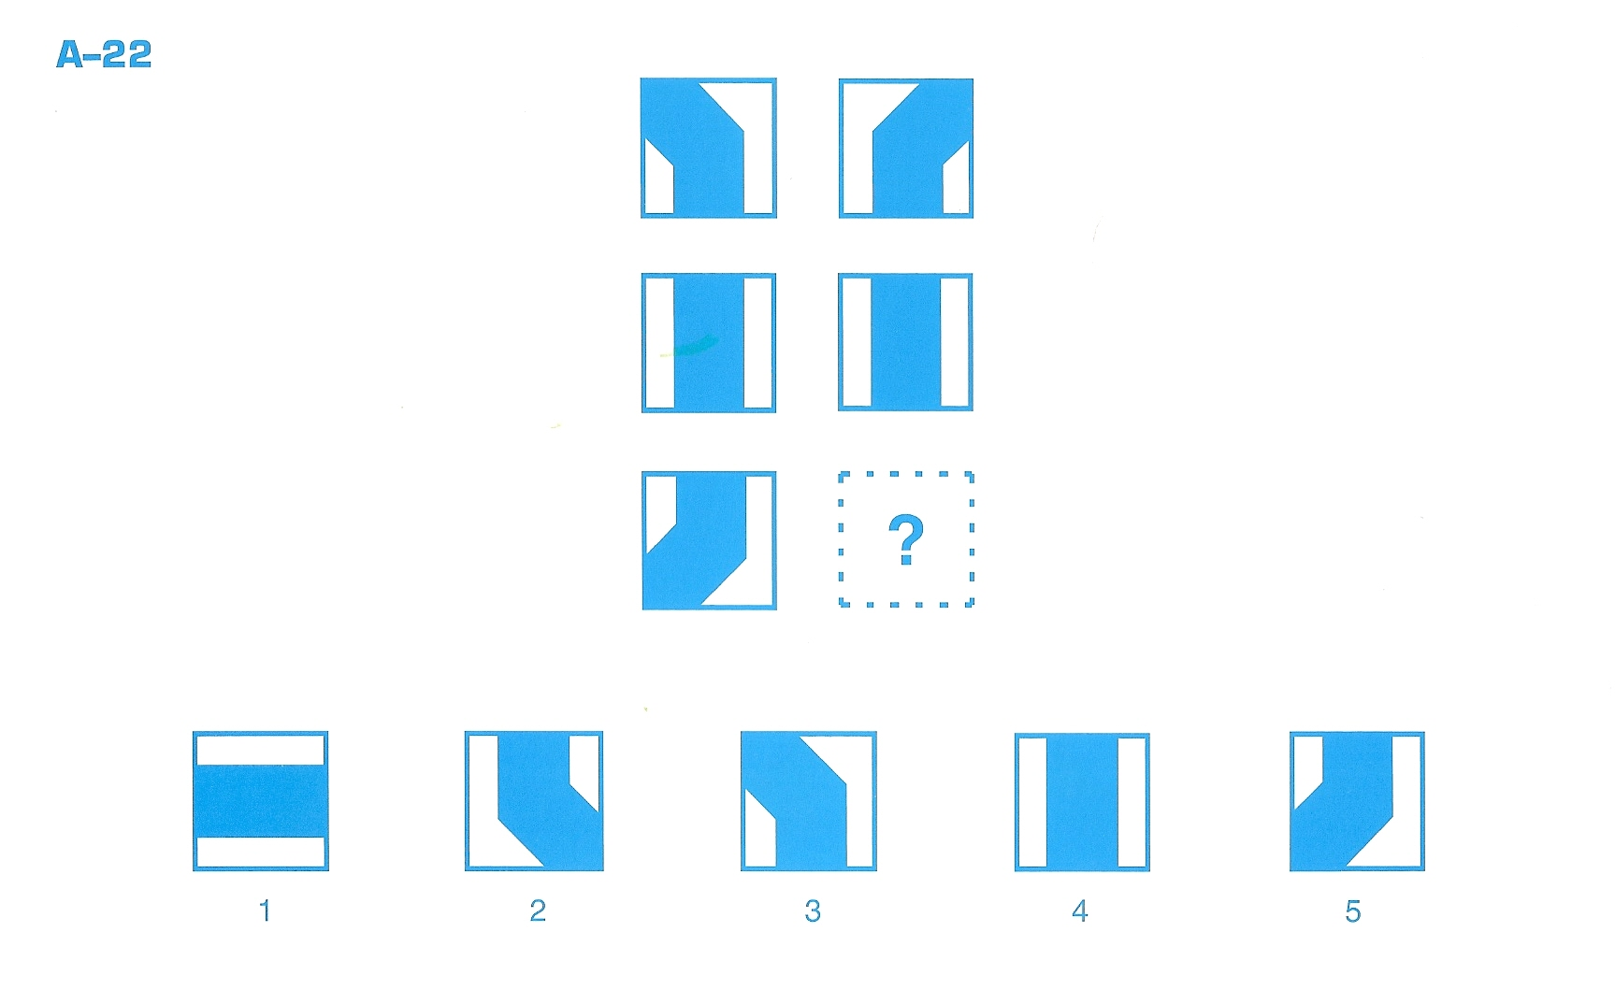

Slide 10
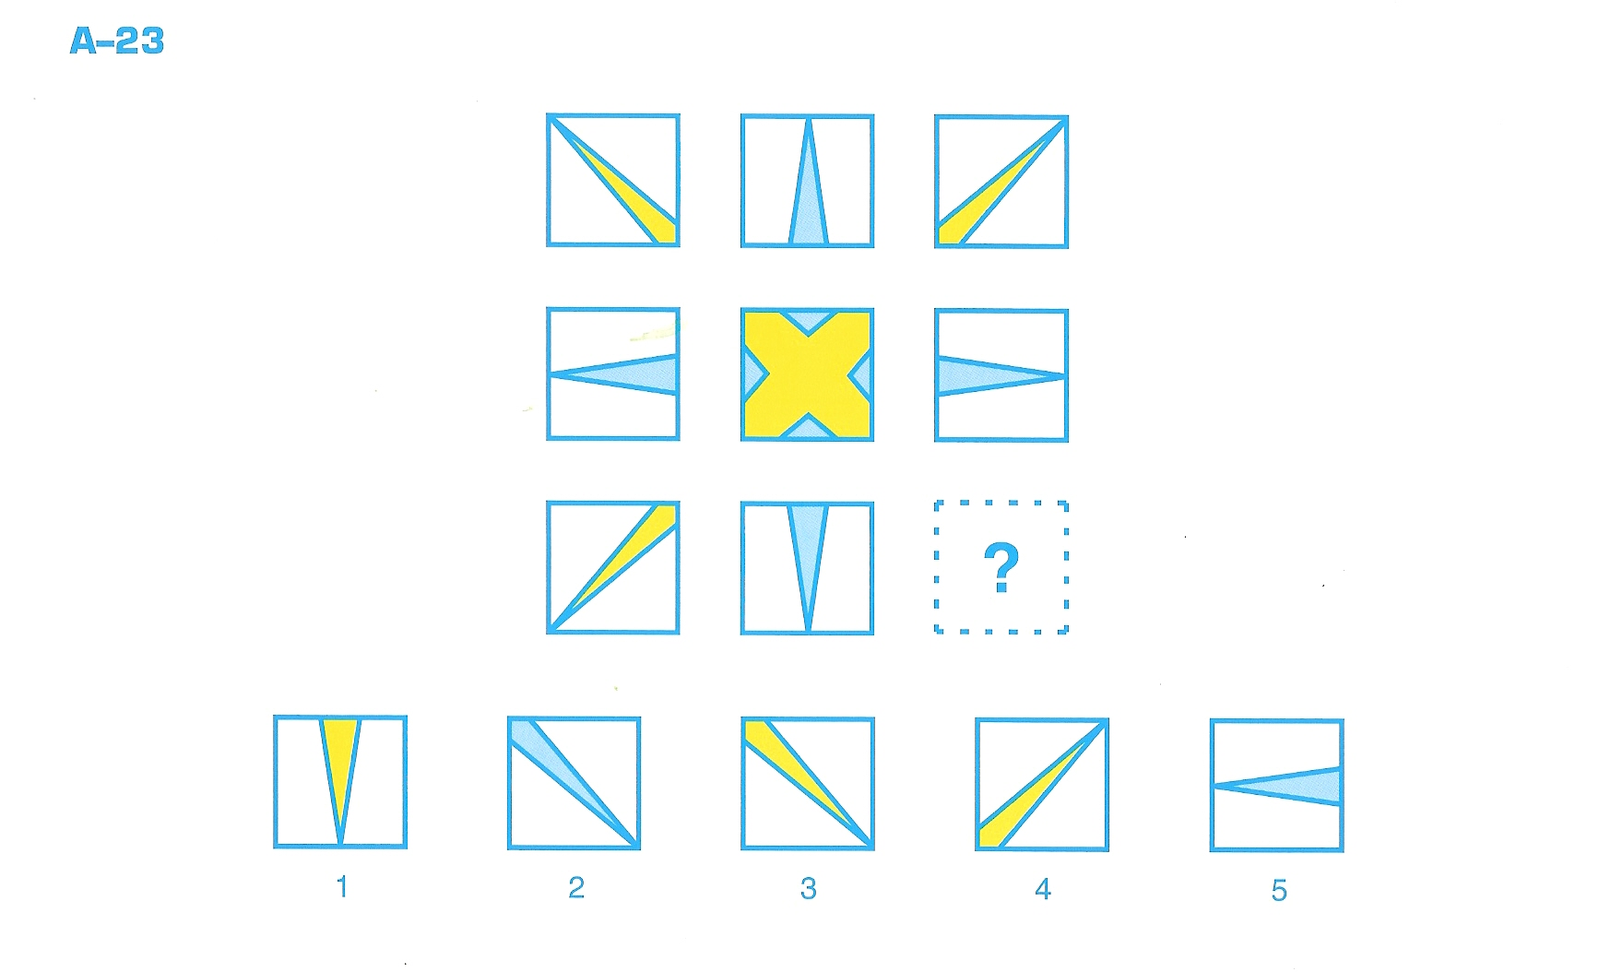

Slide 11
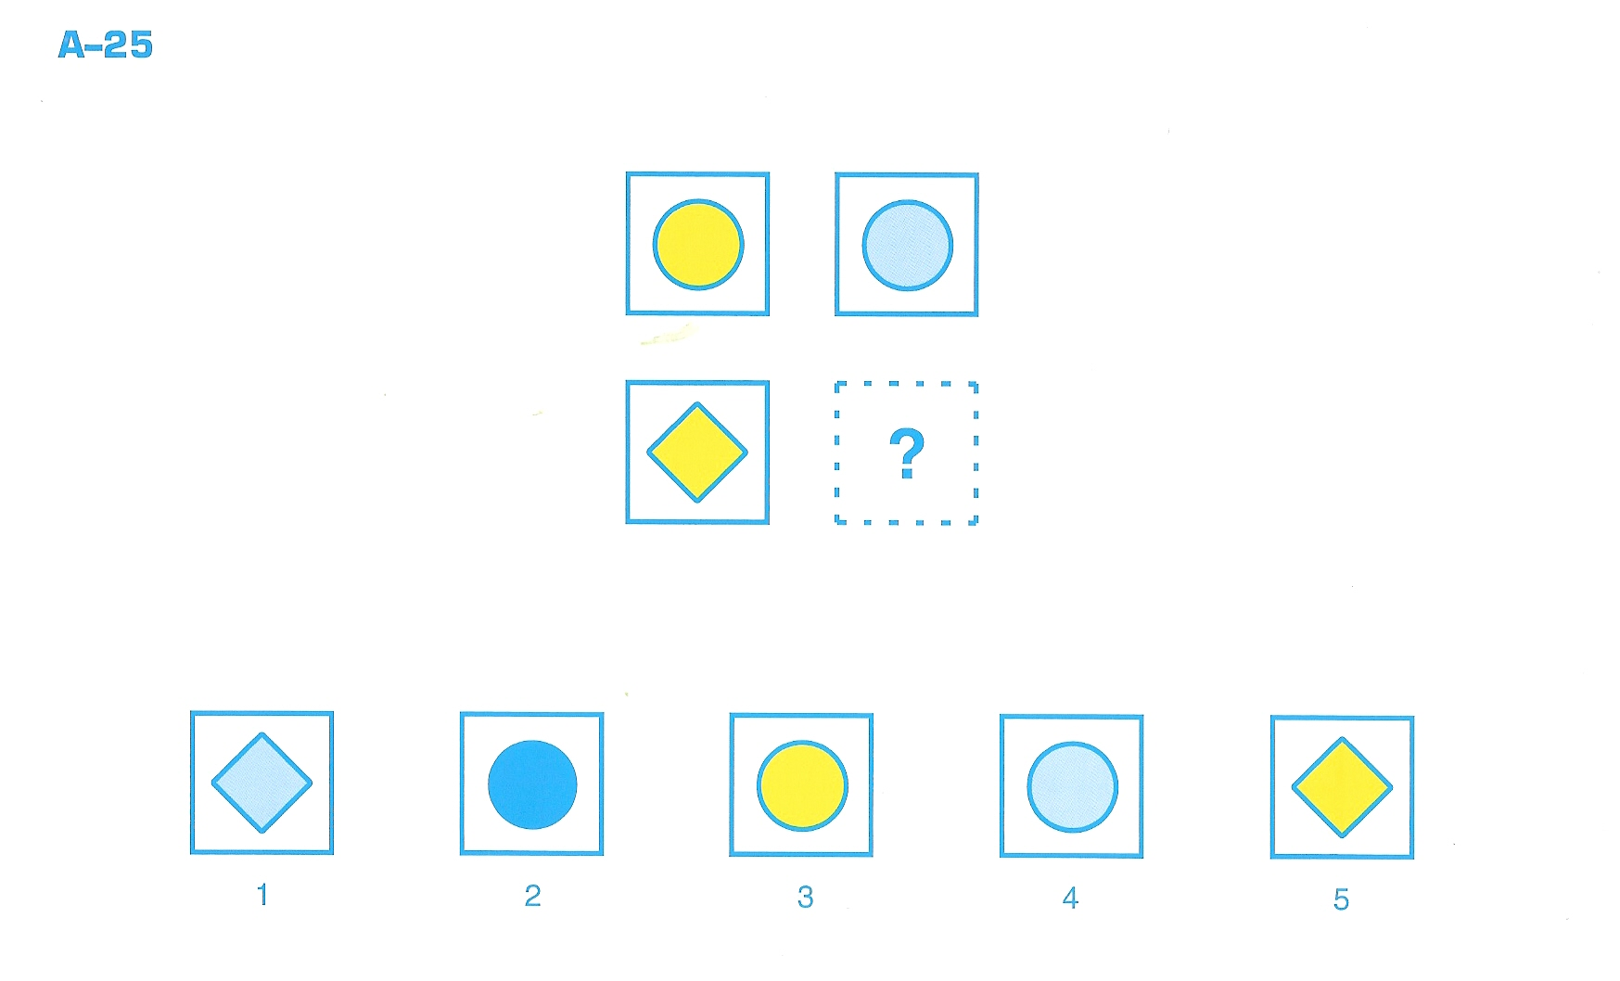

Slide 12
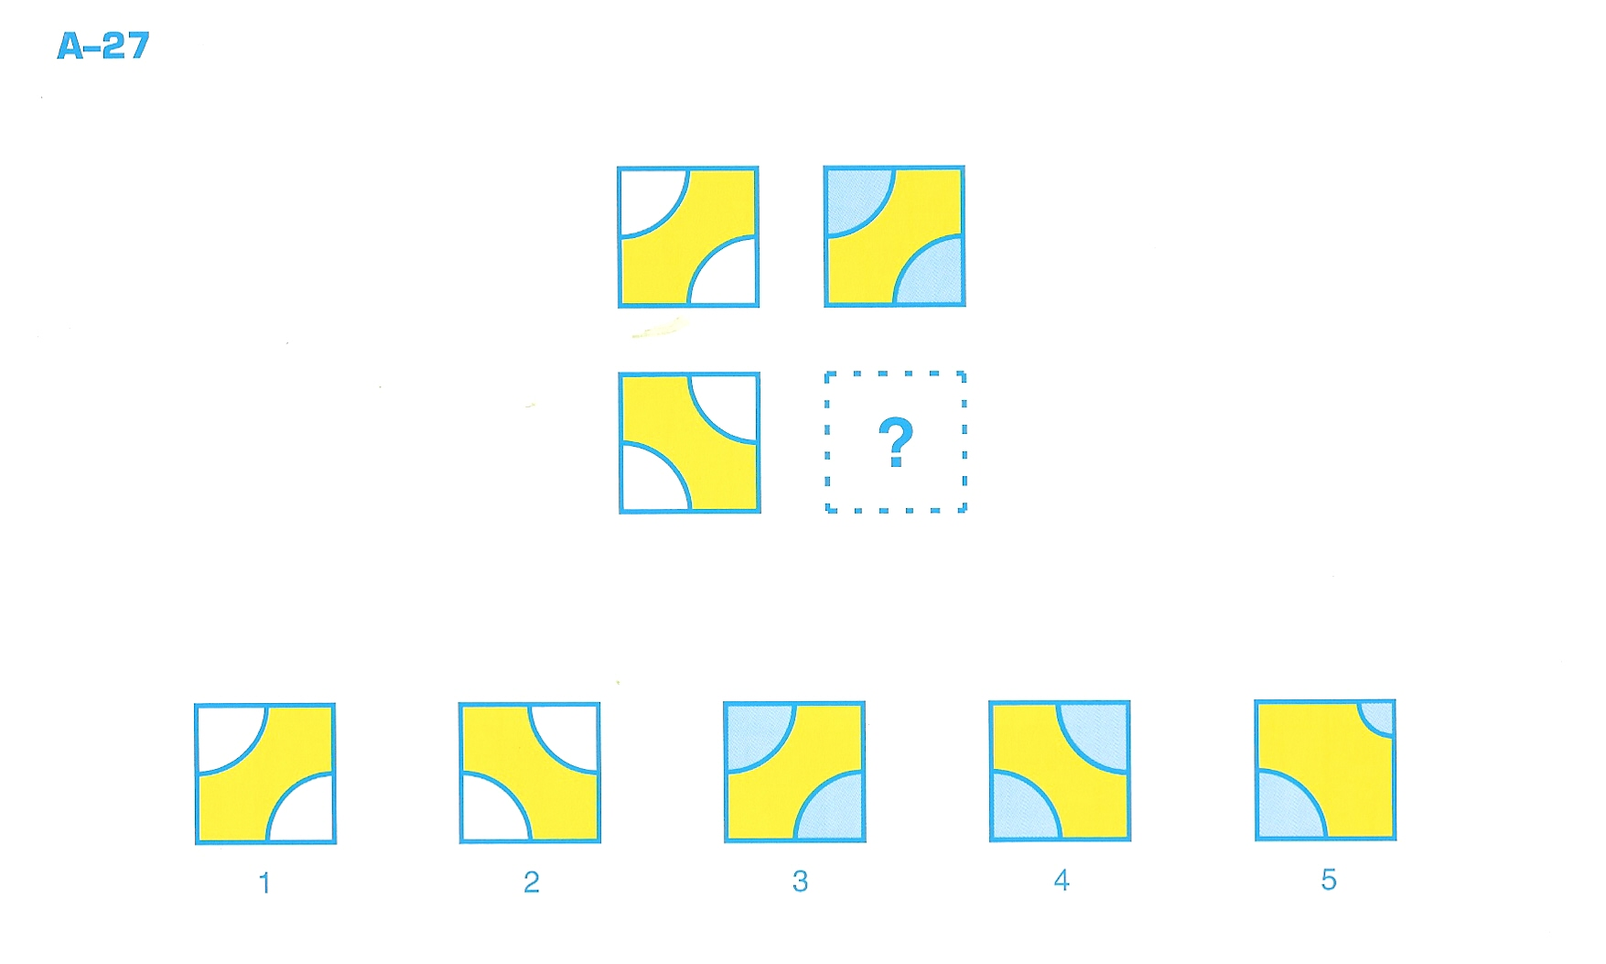

Slide 13
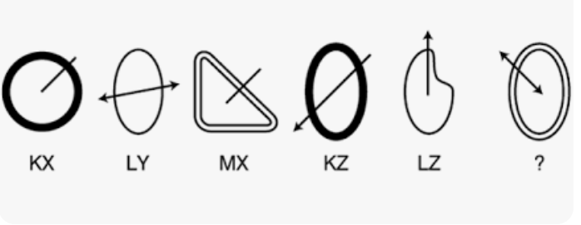
Visual Reasoning and Maths Skills
In Lincolnshire, we would typically consider visual reasoning skills as something needed for 11+ as part of the non-verbal reasoning paper.

Slide 14
Visual Reasoning and Maths Skills
To help the Virtual School identify these needs, we buy in hours from STT to assess our children at specific points within their school journey.

Slide 15
 | Wellcomm – By EY teacher / STT | STT assessment
EYFS / Reception
Y1 |  | Baseline
Y2 |  | If needed / reviewed due to low progress
Y3 |  | If needed / reviewed due to low progress
Y4 |  | New baseline
Y5
Y6
Y7 – 8 |  | New baseline Potential access arrangements are advised
Y 9 – 11

Slide 16
Visual Reasoning and Maths Skills
In Lincolnshire, our Maths skills for children in care are lower than that of children in care in other areas.
Analysis of data of Lincolnshire’s children in care’s STT reports also shows a continuing pattern.

Slide 17
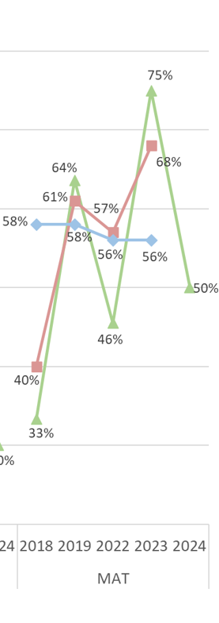
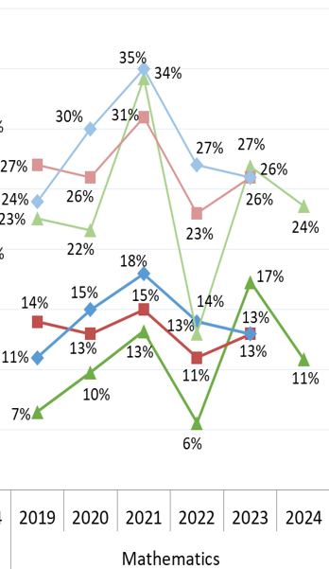
Visual Reasoning and Maths Skills
EYFS
KS2
GCSEs

Slide 18
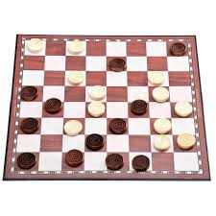
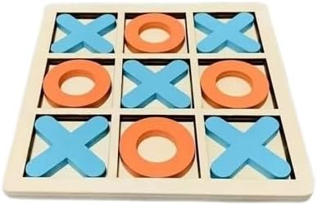
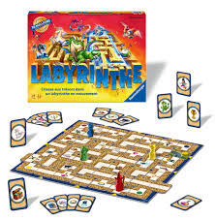
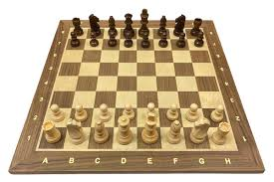
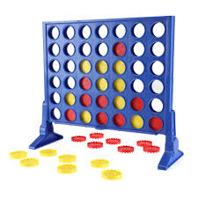
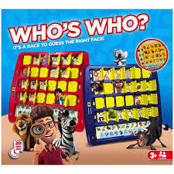
Visual Reasoning and Maths Skills
Playing games is a great way to improve visual reasoning!
Strategy Games…

Slide 19
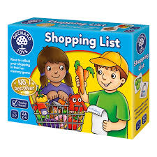
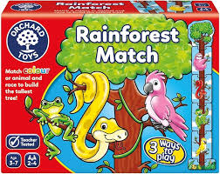
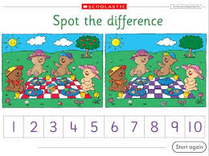
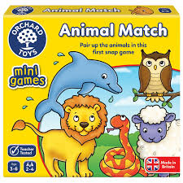
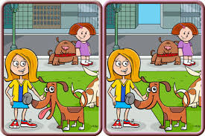
Visual Reasoning and Maths Skills
Spot the difference or matching games…

Slide 20
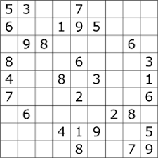
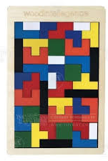
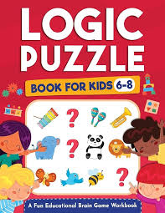
Visual Reasoning and Maths Skills
Logic puzzles…
Printable Logic Puzzles
www.dailysudoku.co.uk

Slide 21
Visual Reasoning and Maths Skills
The Happy Puzzle Company…
Educational Puzzles, Games & Toys for All Ages - The Happy Puzzle Company

Slide 22
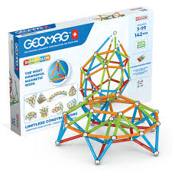
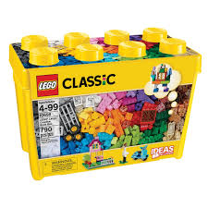
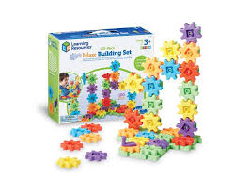
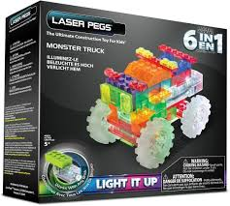
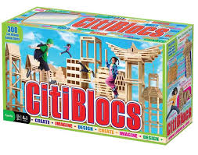
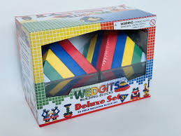
Visual Reasoning and Maths Skills
Construction toys…

Slide 23
Visual Reasoning and Maths Skills
How can we fit this in?
Breakfast club…
Coming in to school…
Assembly times…
Lunchtime clubs…
Play times…
Games clubs…

