Slide 1
L.E.A.D. Teaching School Hub
Updates and Headlines
‘Working in Partnership, Achieving the Highest Outcomes for All’
Notes:
Welcome

Slide 2
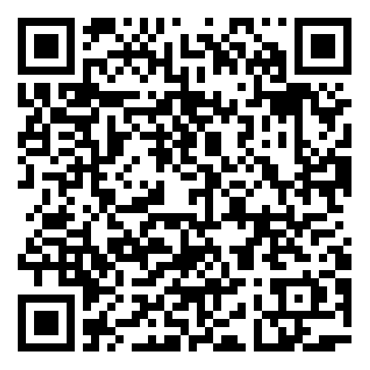
Update - NPQSENCO
Notes:
Our first cohort is underway – 57 participants in total
Unsure as to whether there is going to be further funding for this programme – we suspect there will be as this is mandatory.
The next cohort is due to run in April 2025 IF the DfE decide to continue on a two cohort a year model moving forwards.
We will make everyone aware when the DfE registration platform opens but in the meantime you can submit an EOI using the QR code which will give us your name and contact details – we will then be able to contact you directly once we know that registration is open – this will give you more of a chance of getting a funded place.

Slide 3
Update - NPQSENCO
Notes:
Looking at the structure of the programme the model gives SENCOs the opportunity to visit other settings – we have decided to organize this in the same way as the SEMH visits were organized – Tour and Talk
Equally – there are two conferences built into the programme – opportunity for all SENCOs to come together – we will build in aspects that SENCOs make us aware of as the programme progresses – listening to you and your requests / needs around this.
You will notice that the Teach First structure is predominantly online – this might be something that you think great this will support travel etc. Equally if you are thinking I prefer a model where there is an opportunity for more face to face we are looking at how we can be more “creative” with the framework moving forwards having had the green light from TF to have flexibility to meet the needs of our region.

Slide 4
Adaptive Teaching
Notes:
Adaptive Teaching was launched at the Leadership Conference Nov 22nd 2024 – Margaret Mulholland. Emily Walker spoke to share with leaders the fact that there is a programme that follows on from this – The Adaptive Teacher Pathway. If this is something that you are interested in might be worth speaking to your HT / Senior Leadership team and join the dots with the Leadership Conference.

Slide 5
SEMH – The Bigger Picture
Notes:
SEMH – The Bigger Picture was also launched at the Leadership Conference Nov 22nd 2024 – Ali Williams delivered a workshop to start us thinking about SEMH and the many challenges that young people identified with this, can face. This pathway takes this thinking further. The second image shows other courses focusing on SEMH, that you may be interested in. If this is something that you are interested in, it might be worth speaking to your HT / Senior Leadership team and join the dots with the Leadership Conference.

Slide 6
Leadership of SEND
Notes:
If you have not been successful in getting a place on the NPQSENCO or have people in school that support your role there is the option of attending the tier 2 sessions on the Leadership of SEND programme. You will notice that this has already started but we can run this session again if there is the interest in this.
Link in chat to collate an EOI in this so we know if it is worth us putting this on again.

Slide 7
Leadership of SEND
Notes:
Tier 3 – this is the offer for subject leaders to support them with ensuring that the curriculum offered in school / their specific subject is appropriate for pupils with SEND – supports subject leaders with reviewing their subject and think about how it can be adapted for SEND learners.
We appreciate that there may be multiple subject leaders within your school who would like to access this – talk to us about the numbers you are thinking about and we will be able to respond with a price that matches the needs of your school.

Slide 9
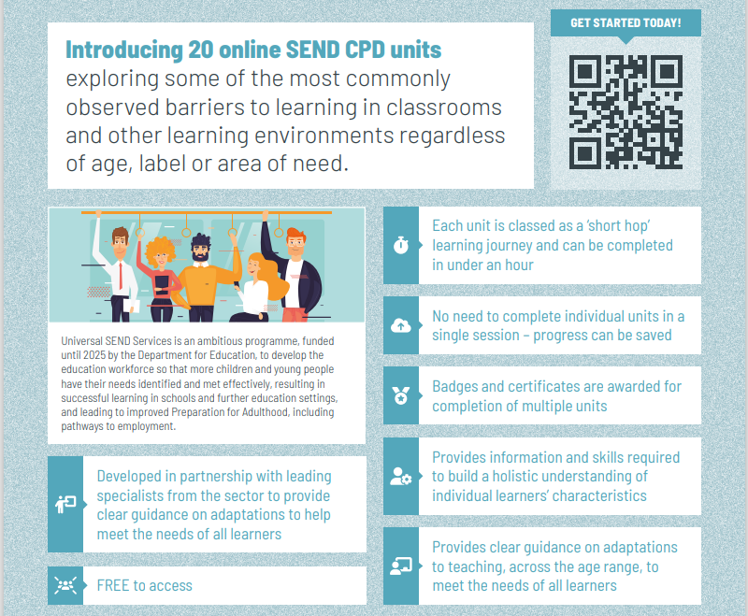

Slide 10
Free Online CPD units
Sign up / login here:
https://www.wholeschoolsend.org.uk/page/online-cpd-units

Slide 11
SEND Interactive Toolkits
Each interactive toolkit is a comprehensive resource hub designed to guide professionals through resources to support various aspects of Special Educational Needs and Disabilities (SEND). Tailored for a range of roles, these toolkits offer a variety of guides and webinars categorised for easy navigation.
Toolkits: https://www.wholeschoolsend.org.uk/toolkits

Slide 12
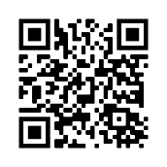
Universal SEND Services programme: Webinars and webinar recordings
WSS: Four live webinars each year, responding to the needs of the sector
Access to recordings of all previous webinars
Led by National Coordinators, regional leads, external speakers
Previous USS webinars:
Ensuring accurate identification of SEN
Supporting reflection on SEND using Ofsted framework
Anxiety and school attendance
Ensuring an ambitious curriculum for learners with SEND
“Amazing session. Thoroughly practical and in a relaxed, supporting manner. Many thanks”
Book webinars and access recordings here: https://www.wholeschoolsend.org.uk/events
Notes:
2

Slide 13
Universal SEND Services programme: Specialist Spotlight sessions
Support contextualisation & application of learning from units
Informal, interactive online meetings
Led by a ‘SEND specialist’, including Educational Psychologists, Speech and Language Therapists, Occupational Therapists
Delegates share experiences and ask questions about the units
Network with, learn from colleagues from across the country
Rolling programme of sessions across the year
“It has been wonderful to be able to share experiences and approaches with people from different settings. Very enriching.”
Book onto sessions here: https://www.wholeschoolsend.org.uk/events
Notes:
5

Slide 14
Changing practice (6 month follow up survey)
Outcomes
SEND CPD units
94% report changes to practice
Responsive webinars and networking sessions
93% report changes to practice
PD groups
98% reported changes to practice
On average, 95% of participants report changes to practice, as a result of attending professional development activity.

Slide 15
Impact (6 month follow up survey)
Impact
SEND CPD units
93% reported positive impact
Responsive webinars and networking sessions
89% reported positive impact
PD groups
97% reported positive impact
On average, 93% of participants report positive impacts for learners with SEND.

Slide 16
Thank you
@WholeSchoolSEND
Whole School SEND
Rsl.emsyh@wholeschoolsend.com
Whole School SEND
www.wholeschoolsend.org.uk

Slide 17
SEND Workforce Development
Scan the QR code to register for FREE!
9400+
Modules
completed
324
Lincs schools
engaged
99%
Satisfaction
rate
25
Average mins per module
chris.lincoln@learnsendhub.co.uk
Notes:
The SEND Workforce Development project continues to be accessed by staff in schools across Lincolnshire.

Slide 18
SEND Workforce Development
Modules available include:
Induction Tier:
(Now also available to parents)
Types of SEND
Awareness of a Neuro-Typical Child
What is Inclusion?
SEND Code of Practice
Respecting Individuals
Working with Professionals
Tier 1:
Sensory Processing and Integration
Supporting Transitions
Support Interventions
Restorative Practice
Four Areas of Need
Nurture Principles
Personal Care and Dignity
Introduction to Attachment
Introduction to Trauma
MORE COMING SOON!
Scan the QR code to register for free:
@SENDworkforce
“A very clear and concise toolkit
of strategies. I enjoyed working through the scenarios and the downloadable content”
chris.lincoln@learnsendhub.co.uk
Notes:
All of these modules are live and available to access. Introduction to Trauma has just gone live. A reminder that any member of staff who has an account on the Lincolnshire Safeguarding Children Partnership platform, should be able to see and access all of the modules that have gone live when they sign into the platform. If any staff need support, they can contact us through the QR code and a member of the team will get in touch.

Slide 19
SEND Workforce Development
Parent Flyer
Scan the QR code to register for free:
@SENDworkforce
chris.lincoln@learnsendhub.co.uk
Notes:
Induction Tier modules are available to parents for free. If you would like a flyer about the content that you can send to parents and carers, please contact Chris on the email address at the bottom of the slide. We are really looking to promote this content to as many parents as possible.

Slide 20
SEND Workforce Development
Case Study
Scan the QR code to register for free:
@SENDworkforce
chris.lincoln@learnsendhub.co.uk
Notes:
Case study from an external professional

Slide 21
Notes:
The impact of the modules

Slide 22
SEND Workforce Development
How schools use the modules…
Whole staff training during Inset Days or remotely
Inset Day or remote training for specific staff members such as Teaching Assistants
Part of an induction for new staff members
Specific modules for specific staff. For example, Personal Care and Dignity for staff members who support a young person with toileting
Signposting for staff who wish to explore further CPD
Scan the QR code to register for free:
@SENDworkforce
All of the content remains free to access
chris.lincoln@learnsendhub.co.uk
Notes:
You can pick and choose the modules most relevant to your staff and school. Here are some examples of how schools have used the modules

