Slide 1
Graduated Approach Briefings
November 2024
Notices

Slide 2
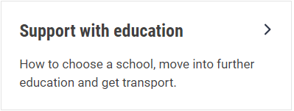
Welcome
To locate information about the Graduated Approach Briefings on the Local Offer, go to: https://professionals.lincolnshire.gov.uk/homepage/54/graduated-approach-briefings
Or on the Home Page, click on: Support with Education
Then scroll down to: Graduated Approach Briefings
Welcome and thank you for joining us for this virtual training session.
Please sign in through the Chat to register your attendance.
As usual, to support everyone to maintain connectivity with so many attendees being here:
Please Mute your microphone and turn off your video when not speaking – we have a large number of participants present today and this may mean that we experience feedback or slowing of the network connection if everybody has their microphone and video on. However, we would like to see you if you ask a question, please, so feel free to switch on both your microphone and video in these instances.
Please note that this meeting, or sections of it, will be being recorded for use on the council’s professionals’ website. If you do not wish to be recorded, you should leave the meeting and watch it back later.
If you would like to ask questions, please use the raise your hand facility or use the chat function in Teams
Please keep discussion in the ‘chat’ relevant – the person presenting may not be able to see your comments but we will have someone monitoring it in order to make sure all questions are answered.

Slide 3
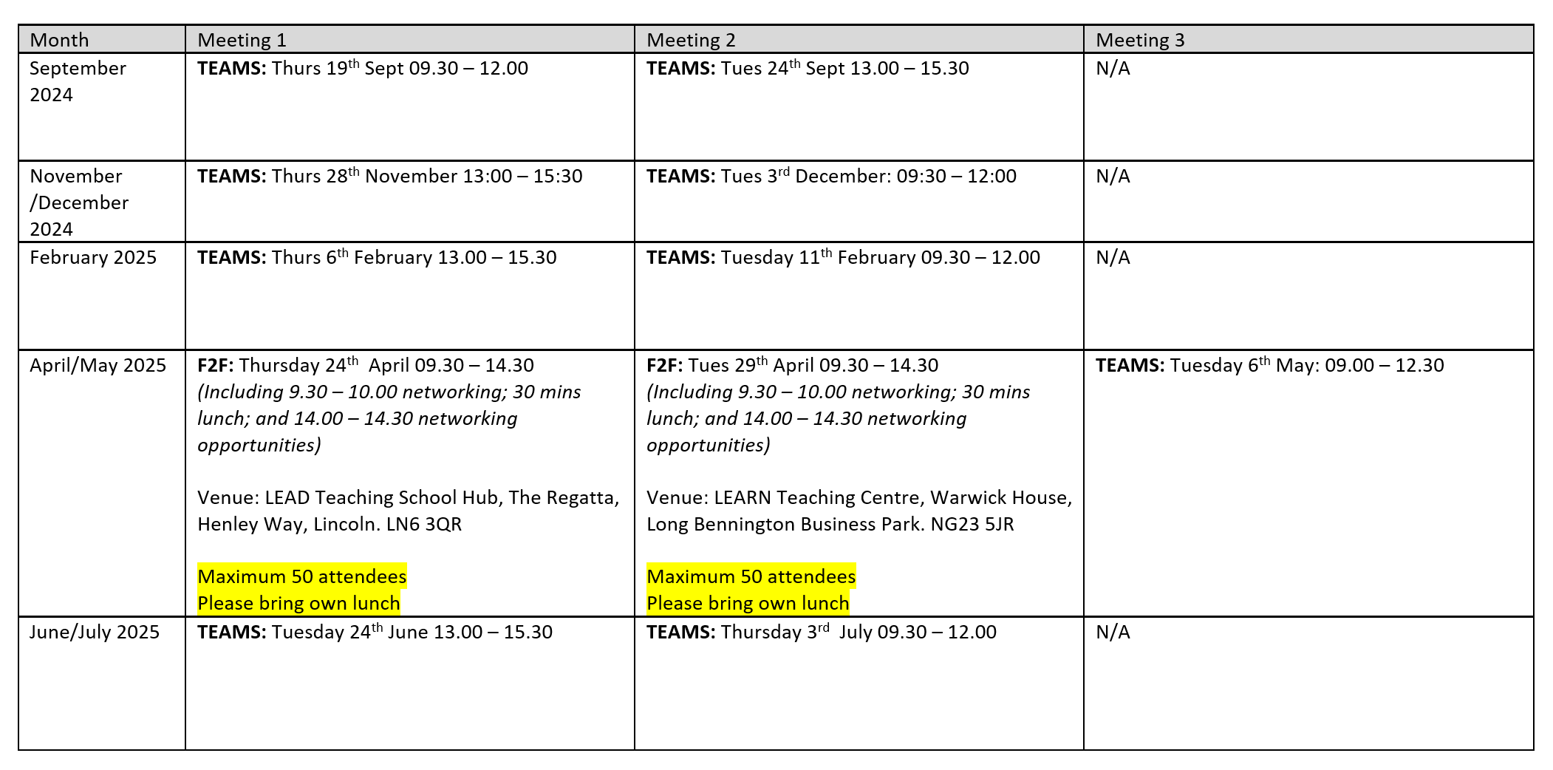
Remember to book your places for each briefing throughout the year on the Local Offer
Graduated approach briefings – Professional resources (lincolnshire.gov.uk)

Slide 4
Dyslexia Outreach Support - EduLincs – Lincolnshire County Council

Slide 5
Specialist Teaching Team
Inclusion Service
Dyslexia Outreach
Dates for Diaries 2024 - 25
Contact Jane.McWatt@lincolnshire.gov.uk to register interest for 01/10/24, 21/05/25 and 13/05/25 dates. More details will be sent closer to the time.
Free, online, evening workshops for parents/careers and pupils, over the next academic year.
* These events are being delivered through the Lincolnshire Parent Carer Forum – see website for details: www.lincspcf.org.uk
Supporting your Child at Home
Tuesday 1st October 2024
Monday 24th February 2025*
Ideas and strategies to support your child at home with language, reading, spelling, maths, memory and personal organisation.
Aimed primarily at parents/carers of children in KS2-3 but open to all interested parents and carers.
Study Skills and Revision Strategies
Monday 4th November 2024*
Tuesday 21st January 2025
Ideas for supporting memory and learning in the classroom.
Aimed at all secondary aged pupils and especially relevant for those preparing for national exams: GCSEs, Vocational Qualification and A-levels
Primary to Secondary Transition Workshop
Tuesday 13th May 2025
Monday 9th June 2025*
Information and advice to ensure that your children are well set up and organised to make their transition go as smoothly as possible.

Slide 6
Specialist Speech and Language Training Offer
Free recorded general awareness training for settings:
DLD and SLCN General Awareness – Professional resources (lincolnshire.gov.uk)

Slide 7
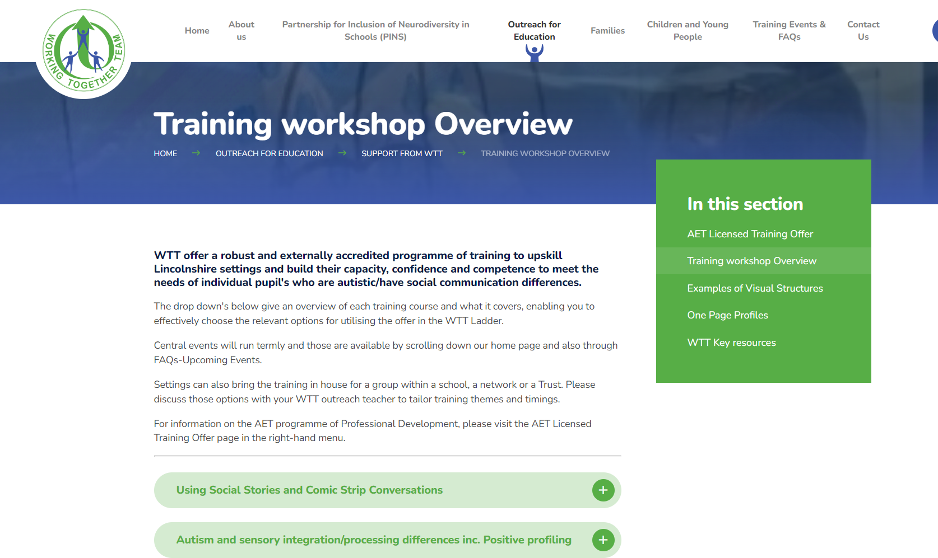
WTT Central Training Offer now available too:
Information about this has been circulated to all schools but if you have missed it, it will be uploaded on our pages too. Or check out the website: www.wtt.org.uk
Notes:
Jen

Slide 8
Lincolnshire Virtual School Training Offer
All bookings are made through our 2024 – 2025 booklet. You do not have to have a child in care to attend our training.
If you require any further information or advice around our training offer, email us on: VirtualSchoolTraining@lincolnshire.gov.uk
More information on the role of the Virtual School can be
found at: Promoting the education of children with a social worker and children in kinship care arrangements: virtual school head role extension - GOV.UK (www.gov.uk) Please don’t hesitate to contact us for any CiC, CWSW, PLAC and Kinship care guidance: VirtualSchool@Lincolnshire.gov.uk.
Notes:
Jen

Slide 9
Lincolnshire Virtual School
Training events
Please use the training booklet to book onto any of the courses. Our current up and coming events are….
SDQs – what they are, why we do them, and how to complete them A Relationships based approach to inclusion – policy and practice Caring Schools Audit Workshop Introduction to the Responsibilities of the Designated Teacher The role of the Designated Teacher in meeting the needs of children in care The role of the Designated Teacher in meeting the needs of children previously in care Governor Training An introduction to the Lincolnshire ePEP System | 15 January 2025, 13:30—15:00 16 January 2025, 13:00—15:00 21 January 2025, 15:00—16:30 22 January 2025, 13:30—15:00 28 January 2025, 09:30—11:30 30 January 2025, 09:30—11:00 5 February 2025, 19:00—21:00 27 February 2025, 09:30 – 11:00
Notes:
Jen

Slide 10
Lincolnshire Virtual School
Training events
Additional workshops available include:
Please use the training booklet to book onto any of the courses.
Please don’t hesitate to contact us via email: VirtualSchoolTraining@lincolnshire.gov.uk if you
require any further information or advice.
Kids Skills: Solution Focused Coaching Understanding ADHD and FASD – form a carer’s perspective An introduction to social pedagogy An Introduction to Trauma Awareness Sleep workshop: supporting sleep, nightmares and night terrors Introduction to Restorative Practice | F2F 12 December 2024, 10:00—14:00 in Navenby Zoom 16 January 2025, 19:00—21:00 Zoom 6 February 2025, 10:00—12:00 F2F 12 February 2025, 10:00—14:00 in Sleaford and or online over 2 sessions 5 & 12 December 2024, 19:00— 21:00) Zoom 13 February 2025, 10:00—12:00 Zoom 24 February 2025, 10:00 –12:00
Notes:
Jen

Slide 11
Lumi Nova: Inclusive digital therapeutic support for fears, worries and anxiety
Launching 8th January 2025 in Lincolnshire!

Slide 12
Launching in Lincolnshire 8th January 2025!
Lumi Nova
Inclusive digital therapy for a new generation
Lumi Nova has been commissioned in Lincolnshire to provide early access support for childhood worries and anxiety.
Prior to launch:
Register for a Lumi Nova Discovery webinar to find out more (multiple dates are available)
Subscribe to the Lumi Nova Newsletter to receive a Lumi Nova Resource Kit at launch
Order print resources or arrange training for your staff by emailing the team on luminova@bfb-labs.com
Recommended by
Co-developed with young people, families, educators, clinicians & academics

Slide 13
Presentations and Videos will be available from 9th December
Remember to visit the Graduated Approach Briefings page on the Local Offer so that you can view the presentations and videos for this round of briefings and any from the previous academic year.
Graduated approach briefings – Professional resources (lincolnshire.gov.uk)

