Slide 1
L.E.A.D. Teaching School Hub
Updates and Headlines
‘Working in Partnership, Achieving the Highest Outcomes for All’
Notes:
Welcome

Slide 2
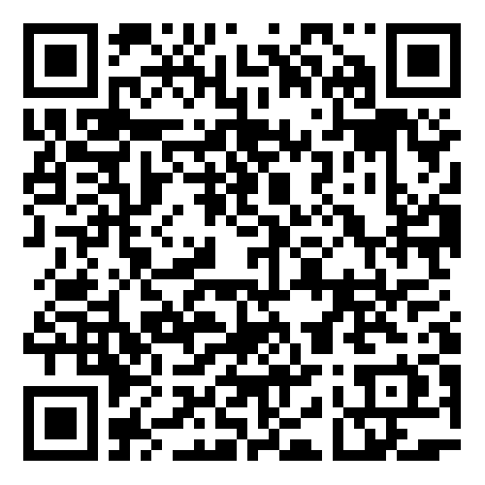
Update - NPQSENCO

Slide 3
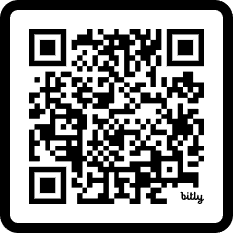
LEARN is part of the Community Inclusive Trust which is an ambitious multi-academy trust that caters for both mainstream primary and special schools across the East Midlands. Since opening in September 2014, we have developed a portfolio of programmes and have been involved in DfE funded SEND support projects. We are based in Lincolnshire, supporting the wider workforce across the East Midlands, South Yorkshire and Humber, as well as engaging with and delivering at National events.
LEARN is proud to be a partner of L.E.A.D. Teaching School Hub and has developed and written content for their SEND offer. With access to a wider network of specialist partners including the Director’s role as Regional Lead for Whole School SEND, we endeavour to ensure all of your CPD needs are met. If you cannot find what you are looking for, please contact us and we will signpost you in the right direction.
View our brochure:

Slide 4
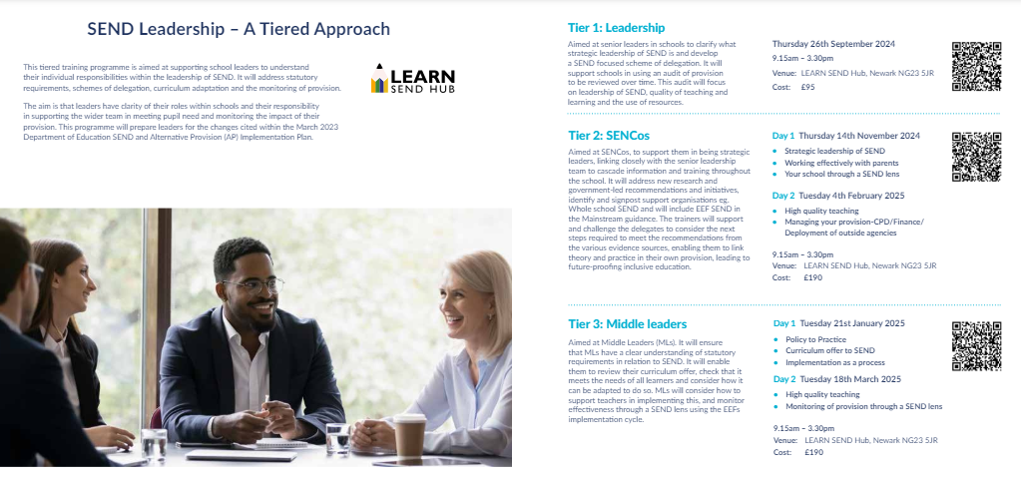
Do not miss out……FREE OF CHARGE!!!
Notes:
Back due to popularity
September start – bookings now open

Slide 5
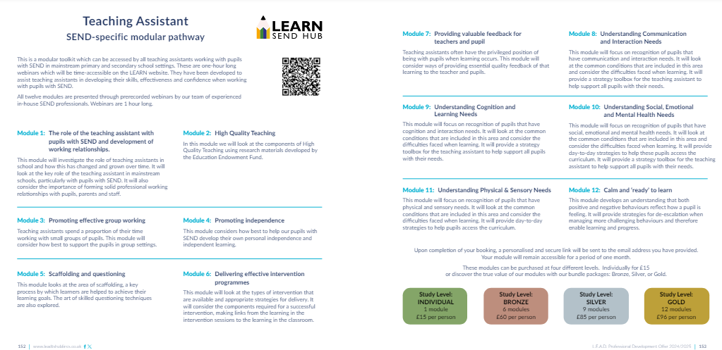
CPD Preview.
Notes:
HTs like this approach – pick and mix – think about the new staff that you have next year – what are their needs / gaps?

Slide 6
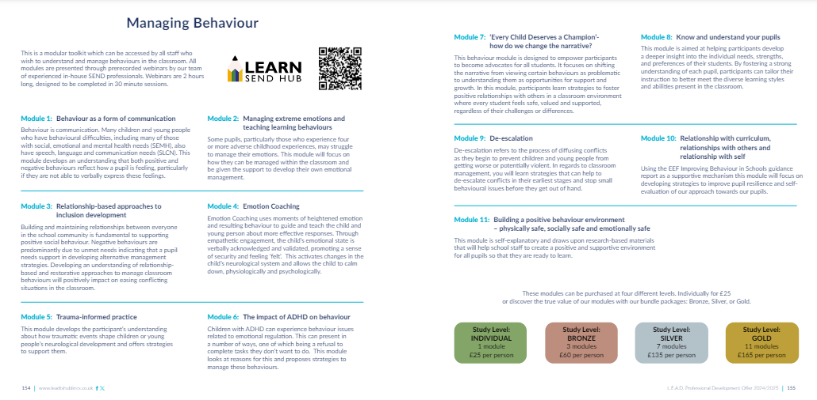
CPD Preview.
Notes:
A lot on behaviour next year – focus of Summer HT briefings – building on from this
Look out for the Behaviour curriculum – S Quinn and the Behaviour programme – Tom Belwood who heads up the B Hub
LEARN also offering Modules – pre recorded webinars – as many or as few as you like from the menu

Slide 7
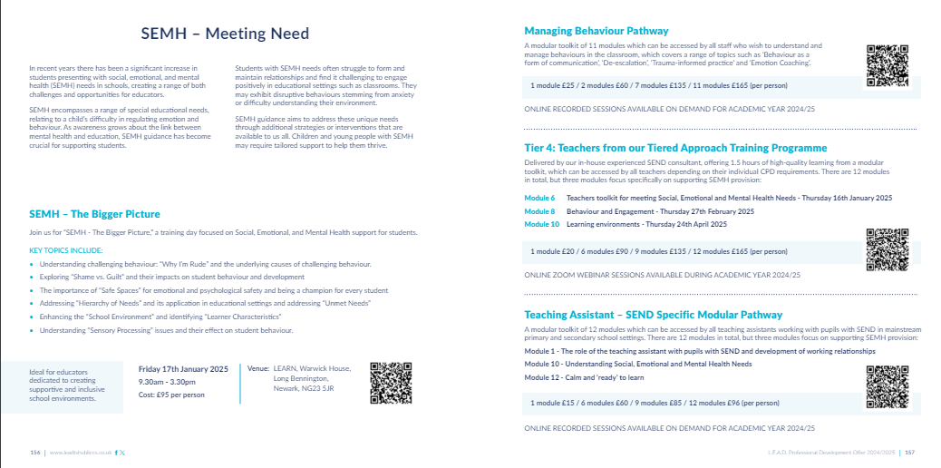
SEMH Preview.
Notes:
Similar approach to SEMH – so complex – enable schools to create their own bespoke offer from all the aspects we have put together

Slide 8
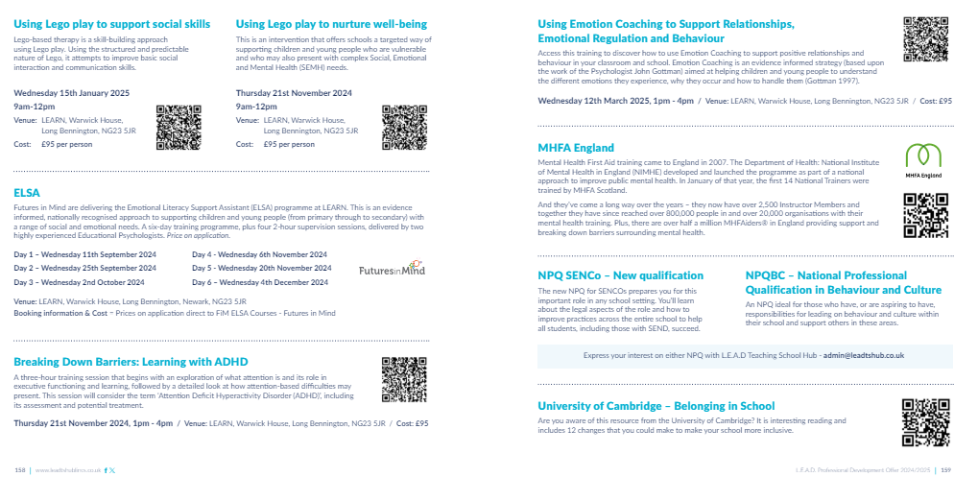
SEMH Preview.

Slide 9
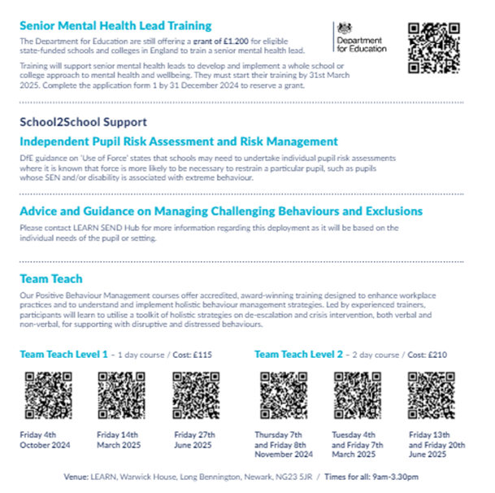
SEMH Preview.

Slide 10
CPD Preview.
Notes:
Adaptive Teaching launched at the Leadership Conference Nov 22nd 2024 – Margaret Mulholland

Slide 11
Universal SEND Services Programme 2022 - 2025
An overview
Notes:
Use for slides referring to the USS programme

Slide 12
Universal SEND Services programme: aims
To improve the quality of teaching to children and young people with SEND, particularly in mainstream settings (both schools and further education).
To ensure needs are identified and met earlier and more effectively, and that preparation for adulthood is delivered from the earliest stages, to support effective transitions, including into employment.

Slide 13
Universal SEND Services programme: overview of activity
Online units
20 asynchronous units to support schools and FE workforce
Live contextualising sessions
Online units will be supported by live, online sessions to enable delegates to contextualise the learning
Facilitated / led by RSLs / DRSLs, rolling programme across 3 years.
Responsive webinars
One per quarter
To respond to needs / priorities in the sector
Target audience: teachers, tutors

Slide 14
Universal SEND Services programme: overview of activity
Professional development groups
Building on success of activity 2021-22
Peer reviews and mentoring
Peer to peer SEND review project, for colleges
Community networks
Working together for co-produced solutions to local issues
Regional groups of school-based practitioners, supported to engage in evidence-informed, SEND based, school improvement project
Peer mentoring – support for schools who are RI, where SEND has been identified as an area to improve in Ofsted report.
Linking up existing regional networks
Also, national focus group

Slide 15
Universal SEND Services programme: overview of activity
Resources update and exemplification
Develop material to further support the use of existing resources, e.g. case studies, videos
Sector-led research
Action research and lesson study for SEND
Regional networking and support
School-based practitioners
Consider outcome of SEND Review
Innovation for SEND
Supporting prioritisation of SEND across the region

