Slide 1
Graduated Approach Briefings
September 2024
Notices

Slide 2
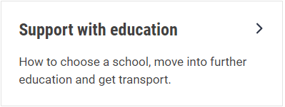
Welcome
To locate information about the Graduated Approach Briefings on the Local Offer, go to: https://professionals.lincolnshire.gov.uk/homepage/54/graduated-approach-briefings
Or on the Home Page, click on: Support with Education
Then scroll down to: Graduated Approach Briefings
Welcome and thank you for joining us for this virtual training session.
Please sign in through the Chat to register your attendance.
As usual, to support everyone to maintain connectivity with so many attendees being here:
Please Mute your microphone and turn off your video when not speaking – we have a large number of participants present today and this may mean that we experience feedback or slowing of the network connection if everybody has their microphone and video on. However, we would like to see you if you ask a question, please, so feel free to switch on both your microphone and video in these instances.
Please note that this meeting, or sections of it, will be being recorded for use on the council’s professionals’ website. If you do not wish to be recorded, you should leave the meeting and watch it back later.
If you would like to ask questions, please use the raise your hand facility or use the chat function in Teams
Please keep discussion in the ‘chat’ relevant – the person presenting may not be able to see your comments but we will have someone monitoring it in order to make sure all questions are answered.

Slide 3
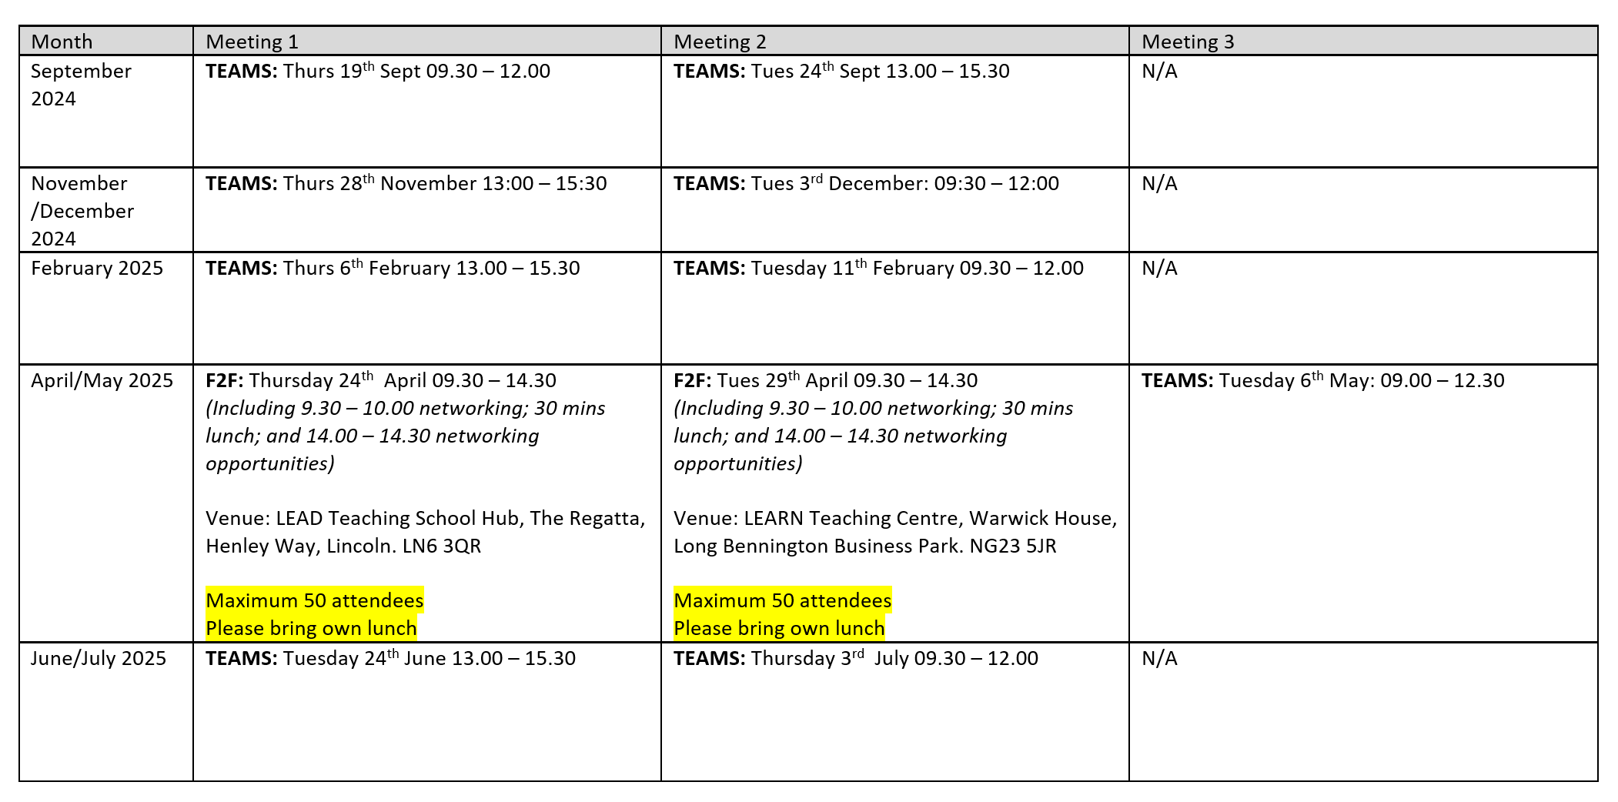
Remember to book your places for each briefing throughout the year on the Local Offer
Graduated approach briefings – Professional resources (lincolnshire.gov.uk)

Slide 4
Annual Review refresher SENCo sessions
2 more sessions planned:
Tuesday 1st October 2024 - 1:30pm – 3pm
Monday 7th October 2024 - 10am – 11:30am
N.B. There’s no need to confirm attendance: you can just click the relevant link to join the meeting at the appropriate time.
The Teams links have already been sent out via email, but if anyone doesn’t have them who’d like to attend, email EHCHub@lincolnshire.gov.uk and we’ll send it to them.
The session on 1st October will be recorded for anyone who can’t make one of the scheduled sessions. This will be uploaded in this month’s Graduated Approach Briefings section as soon as possible after this date.
Notes:
Same content is covered at each session so only need to book one.

Slide 5
Dyslexia Outreach Support - EduLincs – Lincolnshire County Council

Slide 6
Specialist Teaching Team
Inclusion Service
Dyslexia Outreach
Dates for Diaries 2024 - 25
Contact Jane.McWatt@lincolnshire.gov.uk to register interest for 01/10/24, 21/05/25 and 13/05/25 dates. More details will be sent closer to the time.
Free, online, evening workshops for parents/careers and pupils, over the next academic year.
* These events are being delivered through the Lincolnshire Parent Carer Forum – see website for details: www.lincspcf.org.uk
Supporting your Child at Home
Tuesday 1st October 2024
Monday 24th February 2025*
Ideas and strategies to support your child at home with language, reading, spelling, maths, memory and personal organisation.
Aimed primarily at parents/carers of children in KS2-3 but open to all interested parents and carers.
Study Skills and Revision Strategies
Monday 4th November 2024*
Tuesday 21st January 2025
Ideas for supporting memory and learning in the classroom.
Aimed at all secondary aged pupils and especially relevant for those preparing for national exams: GCSEs, Vocational Qualification and A-levels
Primary to Secondary Transition Workshop
Tuesday 13th May 2025
Monday 9th June 2025*
Information and advice to ensure that your children are well set up and organised to make their transition go as smoothly as possible.

Slide 7
Specialist Speech and Language Training Offer
Free recorded general awareness training for settings:
DLD and SLCN General Awareness – Professional resources (lincolnshire.gov.uk)

Slide 8
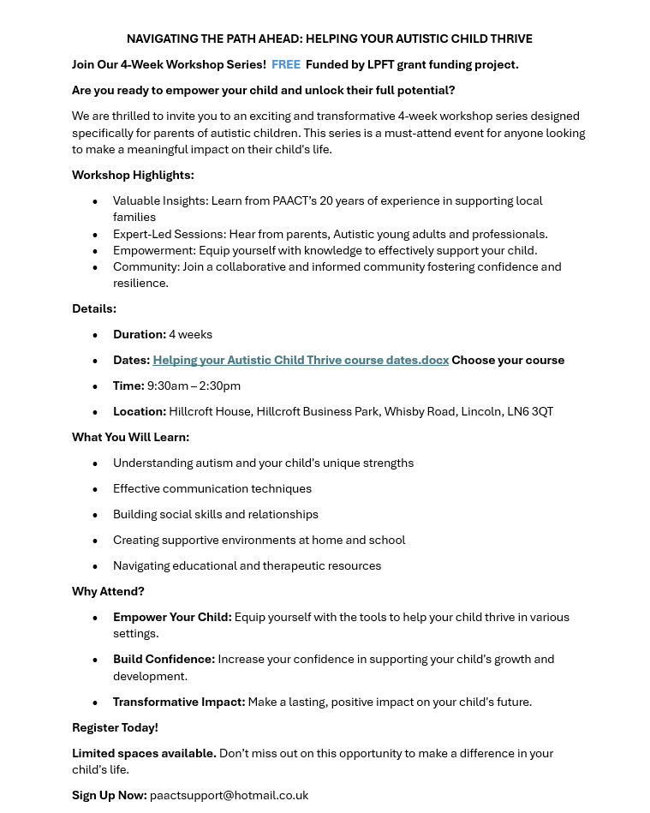
Free Autism courses for parents/carers – please download these two flyers and display on your school notice board and/or send out in your newsletter

Slide 9
Lincolnshire Virtual School
Our training offer has been developed to better support settings in promoting educational
outcomes for our children in care (CiC), children with a social worker (CWSW), and children
previously in care (PLAC). Since September 2024, the VS role has further extended to provide
professional advice for children in a kinship care arrangement (similar to that already provided
for PLAC). This will be explained in our training.
Our new booklet for 2024 – 2025 has now been published and shared. All bookings are made through it.
You do not have to have a child in care to attend our training.
Please don’t hesitate to contact us via email for any CiC, CWSW, PLAC and Kinship care requirements: VirtualSchool@Lincolnshire.gov.uk.
If you require any further information or advice around our training offer, email us on:
VirtualSchoolTraining@lincolnshire.gov.uk
More information on the extension of the Virtual School role can be
found at: Promoting the education of children with a social worker and children in kinship care arrangements: virtual school head role extension - GOV.UK (www.gov.uk)
Notes:
Jen

Slide 10
Lincolnshire Virtual School
Training events
Please use the training booklet to book onto any of the courses. Our current up and coming events are….
Please use the training booklet to book onto any of the courses.
SDQs – what they are, why we do them, and how to complete them Introduction to the Responsibilities of the Designated Teacher An introduction to the Lincolnshire ePEP System Governor Training The role of the Designated Teacher in meeting the needs of children previously in care Caring Schools Audit Workshop STT Assessments: what they are and how they are used to support learning at school and home The role of the Designated Teacher in meeting the needs of children in care | Thursday 26th September 09:30 – 11:00 Wednesday 2nd October 09:30 – 11:00 Wednesday 9th October 13:30 – 15:00 Thursday 10th October 10:00 – 12:00 Thursday 17th October 13:00 – 15:00 Thursday 31st October 13:00 – 14:30 Tuesday 5th November 18:30 – 19:30 Thursday 7th November 13:00 – 15:00
Notes:
Jen

Slide 11
Lincolnshire Virtual School
Training events
Additional workshops available include:
Please use the training booklet to book onto any of the courses.
Please don’t hesitate to contact us via email: VirtualSchoolTraining@lincolnshire.gov.uk if you
require any further information or advice.
Introduction to Restorative Practice (Zoom Tuesday 1st October 19:00 – 21:00) Supporting Grief, Loss and Positive Endings (Zoom Thursday 3rd October 13:00 – 15:00) An Introduction to Trauma Awareness (F2F Friday 4th October 10:00 – 14:00 in Lincoln) Relational Repair - Supporting children to trust others and invest in relationships (Zoom Wednesday 9th October 19:00 – 21:00) An introduction to social pedagogy (Zoom Wednesday 16th October 19:00 – 21:00) Sleep workshop: supporting sleep, nightmares and night terrors (Zoom Thursday 17th October 19:30 – 21:30) Creating Calm - emotional regulation for children and adults (F2F Monday 11th November 10:00 – 14:00 in Grantham)
Notes:
Jen

Slide 12
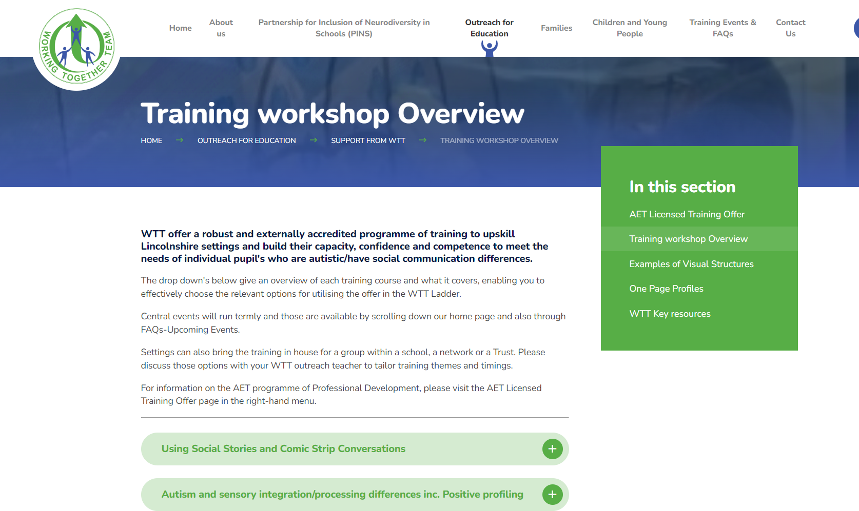
WTT Central Training Offer now available too:
Information about this has been circulated to all schools but if you have missed it, it will be uploaded on our pages too. Or check out the website: www.wtt.org.uk
Notes:
Jen

Slide 13
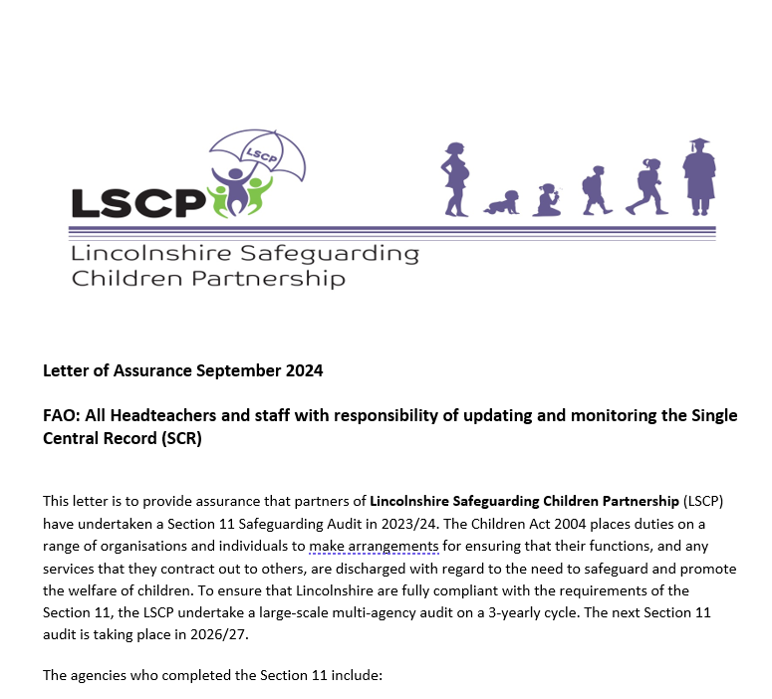
Updating and monitoring the Single Central Record (SCR)
To locate these documents and further information and resources about Safer Recruitment when logged into the Perspective Lite website, please follow the pathway- LA Documents > Safeguarding > Safer Recruitment.
Notes:
The LSCP have now shared their updated Letter of Assurance for their Safeguarding Partners - one of which is Lincolnshire County Council. This has been saved on the Perspective Lite website along with the LCC Letter of assurance. These should be uploaded to your Single Central Record so that you then have no need to ask LCC employees visiting your schools to see their DBS or complete an additional form. The specialist teachers are being asked to provide all sorts of information as we start this new term and being told that they can’t work with children individually if they don’t. That is not the case and these two letters are your proof of having fulfilled your duties with regard to LCC employees. Please make sure your office staff are aware of this, because our teachers will not be providing any additional personal data, which you are not allowed to copy or store anyway, other than showing their photo ID card when they visit your schools. Please don’t make them waste any more time waiting around for con

Slide 14
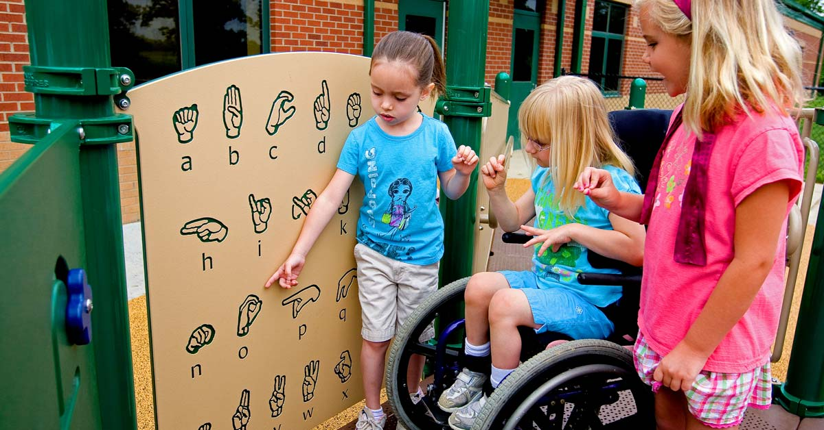
New Inclusion Team Manager – Specialist Teachers
Contact details:
Karen.Donnelly@lincolnshire.gov.uk
Or
STTEnquiries@lincolnshire.gov.uk (for all STT enquiries)
Or
BS_SEND@lincolnshire.gov.uk (for all SEST enquiries and general enquiries about the Graduated Approach Briefings)
Or
ECLIPS@lincolnshire.gov.uk (for all ECLIPS enquiries)
Or
DyslexiaOutreach@lincolnshire.gov.uk (for all Dyslexia Outreach enquiries)

Slide 15
Presentations and Videos will be available from 30th September
Remember to visit the Graduated Approach Briefings page on the Local Offer so that you can view the presentations and videos for this round of briefings and any from the previous academic year.
Graduated approach briefings – Professional resources (lincolnshire.gov.uk)

