Slide 1
Preparing for Adulthood
October 2024

Slide 2
Preparing For Adulthood
Who taught you to:
Manage your money
Get and eye or hearing test
Find a dentist
What your credit record is
How to buy a car
What your NI number is for
How to find a flat or house
How to pay utility bills
When bin day is
How to look after an animal
What might get you a criminal record and why it matters
How to use your dishwasher, washing machine, cooker
Use public transport
Understand Tax
How to vote
How to get a passport
Personal boundaries
Not being exploited in workplace
What ID you need and why
What to do if the electric goes off
What and to be wary off
The benefit system
As young people move towards the end of their education, outcomes should become less focussed on the achievement of qualifications (especially if these are low level qualifications) and more focused on ensuring that the young person has skills for everyday life that will make a material difference to them.

Slide 3
Preparing For Adulthood
All reviews taking place from Year 9 at the latest and onwards must include a focus on preparing for adulthood, including employment, independent living and participation in society. This transition planning must be built into the EHC plan and where relevant should include effective planning for young people moving from children’s to adult care and health services. It is particularly important in these reviews to seek and to record the views, wishes and feelings of the child or young person. The review meeting organiser should invite representatives of post-16 institutions to these review meetings, particularly where the child or young person has expressed a desire to attend a particular institution. Review meetings taking place in Year 9 should have a particular focus on considering options and choices for the next phase of education.
SEND COP pg 199-200

Slide 4
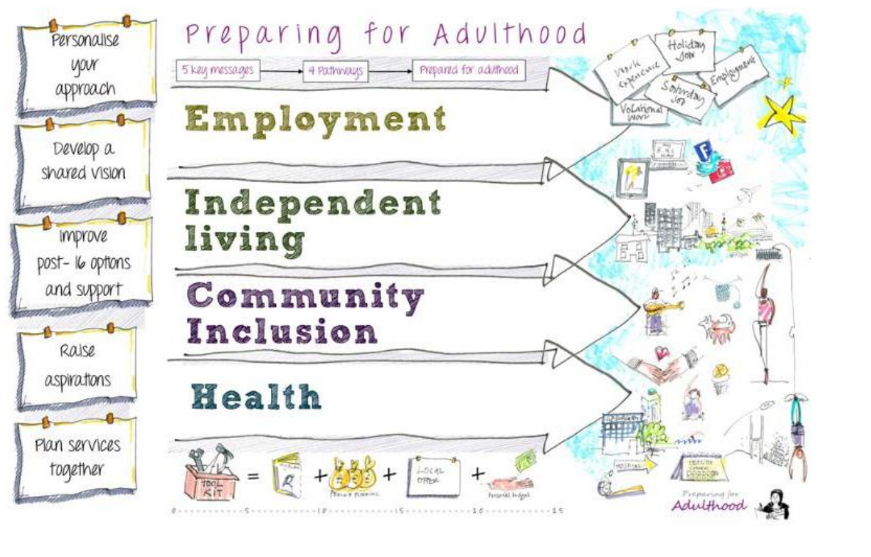
Preparing For Adulthood
Preparing for adulthood means preparing for:
• Higher education and/or employment – this includes exploring different employment options, such as support for becoming self-employed and help from supported employment agencies
• Independent living – this means young people having choice, control and freedom over their lives and the support they have, their accommodation and living arrangements, included supported living
• Participating in society, including having friends and supportive relationships and participating in, and contributing to, the local community
• Being as healthy as possible in adult life
Must Dos.pdf (councilfordisabledchildren.org.uk)

Slide 5
Generating Outcomes
Generating outcomes relevant for moving into adulthood should focus on the four key Preparing for Adulthood areas when setting outcomes in plan reviews from Year 9 onwards:
• Higher education and/or employment
• Independent living
• Participating in society
• Being as healthy as possible in adult life
For example, outcomes should be more directed towards the young person moving into further education or employment and what they need in place to support them to do this. This may mean that the focus is less on developing literacy and numeracy skills and more on increasing employability/working skills i.e. determining what kind of basic skills they will need to be able to get a job or be independent in the future.

Slide 6
Focus of outcomes
The end goal – what are they aiming for?
Planning must be centered around the individual and explore the child/young person’s aspirations and abilities, what they want to be able to do when they leave post-16 education or training and the support they need to achieve their outcomes. (8.1)
So you start from there and identify what they are ‘missing’ in terms of what they need to improve on/achieve

Slide 7
Mainstream Focus of Outcomes
English and/ or Maths
Achieving vocational/academic qualifications that continues to help them progress towards their adulthood aspiration
Study Support
Pastoral Support
Travel Training
Health
Examination concession assessment(this must be agreed and what is seen as ‘normal practice’ or regular testing provisions)

Slide 8
Preparing for change and transition
Early planning with new setting and family
Support parent/carers to support their child/young person – transition is a necessary part of life and it is natural to be anxious
Engage the child/young person according to their level of need through lists of their worries, things to remember, shopping lists, drawing, and making choices
Find out the new daily routines for the child or young person, including transport
Familiarise them with new uniforms and equipment
Use photos and social stories.
Supporting your child during transitions | Surrey Local Offer

Slide 9
Special Schools Focus of Outcomes
Maths and English (often functional levels)
Vocational subject or progression of knowledge
Communication/Interaction- community cohesion
Safety/vulnerability – in person, online
Personal care/hygiene/health
Travel training

Slide 10
Further/Higher Education and employment

Slide 11
Independent Living

Slide 12
Community Inclusion/Participating in society

Slide 13
Being Healthy

Slide 14
Post-16 Outcome examples- Linked to C&I
Outcomes | Provision
Confidence, starting up a conversation: By the end of XXXX YP will demonstrate that they can initiate conversations with people less familiar to them so that they can talk to peers, colleagues and members of the public when they become an employee.
Using non-offensive/foul language: By the end of XXXX YP will demonstrate that that they can start conversations and sustain them using appropriate, non-offensive language; he will understand what comments are not appropriate so that he reduces the risk of upsetting friends and strangers he meets as an adult in the future. | An LSA needs to work with XXXX individually, during group work, paired work and conversational interactions in the community (as part of his programme of learning); LSA needs to monitor and guide his verbal interactions, prompting him to use appropriate language and helping him to reflect on the impact of his choice of language; this is especially the case when Brad is using community facilities and interacting with members of the public. | LSA support, ratio 1:1
Managing routines and expectations (autism related) By the end of Key Stage 5, XXXX will record the routines and expectations of the classroom and his ability to manage change appropriately. This will enable him to: •Familiarise himself with the school day; and •Become less dependent upon structure within the school day. | XXXX to receive praise to reinforce correct behaviour as he is easily distracted when participating in whole class or large group activities. When not focused, XXXX displays a range of unwelcome behaviours which can disrupt not only his learning but also that of his peers XXXX to have clear expectations in relation to the quality and quantity of work expected and consequences if this is not produced XXXX to be prompted when his attention wanders in assessments Staff to support XXXX as he sometimes does not like to take advice from teachers and needs to take more support from his TAs Staff to support XXXX with the following strategies: • Allow XXXX to use his fiddle/triangle • Use clear concise language • Break long questions or instructions down into manageable tasks • Provide advance warning of changes or topics that may affect XXXX • Consider who XXXX is sat next to so as to avoid unnecessary distractions | Shared LSA support in lessons ratio 1:3

Slide 15
Post-16 Outcome examples- Linked to c & L
Outcomes | Provision
Academic progression: By the end of XXXX, YP will have achieved the grades they need in their GCSEs/Functional Skills qualifications so that they meet the entry criteria for their next course/qualification criteria set by an employer.
Work experience: By the end of KS5, XXXX will have undertaken work experience in a vocational area of interest so that he can learn the necessary practical and employment skills required to be successful in gaining paid employment as an adult. | XXX will require LSA support to attend work experience; LSA will provide job coaching, advice and encouragement, promoting Brad's personal, social and emotional independence. | LSA support, ratio 1:1
Attendance problems: To the end of KS5, XXXX will attend his chosen course of study/training to the required level, and be punctual in his attendance so that he is accustomed to expectations in the work place as an adult. | XXX's attendance will need close monitoring with early contact homemade if he does not attend as required. Tutor (delegated to attendance monitoring/LSA as necessary) to telephone home and speak to parents and establish if/what barriers to attendance there might be. Solutions to be identified and offered to support Brad's attendance and re-engagement.
Functional skills that support adult life: By the end of KS5, XXXX will have achieved Level XXX in functional literacy and numeracy skills so that has the ability to read, write, spell and calculate numeracy tasks that relate to everyday living and supported employment as an adult. | XXXX will need literacy and numeracy skills taught in small groups; use of practical aids and resources and community facilities such as shops/retail outlets; practical sessions such as cooking, budget planning and other practical maths tasks. | Small group ratio 1:8 with additional LSA ratio 1:1 within the group

Slide 16
Post-16 Outcome examples- Linked to c & L
Outcomes | Provision
GCSE's to meet industry/employer required level of maths and English: To the end of Key Stage 5, XXXX will achieve a Grade 4 GCSE in English and maths to support his career goal of securing a Level 3 apprenticeship in engineering followed by a career in that field. | XXXX will require additional adult support in English and maths lessons where he is continuing to work towards a GCSE at grade 4 or above. The shared adult supporter will need to provide verbal prompts, encouragement and praise to XXXX where his attention, focus and motivation are diminished and when he might become distracted. Motivational and 'XXXX led' aspirational factors should be used frequently with XX as he responds well to reminders that he is studying to 'benefit him and only him'. | Shared LSA ratio 1:2

Slide 17
Post-16 Outcome examples- Linked to SEMh
Outcomes | Provision
Physical aggression: By the end of Key Stage 5, XXX will act in a safe manner in the setting. By the end of year 13 XXXX will respond appropriately to reasonable requests in a work place context so that when is enters paid employment so that he is not dismissed from a job for misconduct. | XXXX needs a structured learning environment, with an individualised behaviour management and support programme. The language of choice is consistently used, so that XXXX is able to develop a sense of responsibility in relation to his behaviours. Social scripts, coaching and modelling by adults will teach XXXX how he should respond in a given situation and remind him of occasions when he has previously made good behavioural choices in similar circumstances. XXXX and his mentor will review his behaviour at the end of each day, and targets set for the following day. | LSA support in lessons 1:1 ratio Additional staff available to support where incidents escalate and a 2:1 ratio of support is required. Supervision during breaks and lunch time Ratio 1:1
Building tolerance of others, not becoming involved in arguments: To the end of Year 13, XXXX will demonstrate appropriate interactions with his peers, being intentional in avoiding conflict so that XXXX will be able to get on with his work colleagues and keep his job in the future. | XXXX will need to able to access daily pastoral mentoring and support in lessons. XXXX will need weekly sessions with a trained and skilled member of the pastoral team; sessions need to be used to identify any situations that could have or did lead to conflict for Liam; Liam needs to self-identify what happened and how in the future he could change his responses to avoid conflict arising again. | Weekly pastoral mentoring 90 minutes (can be split in to 3 x 30 once per day) LSA 1:1 support in lessons
By the end of Year 13, XXXX will demonstrate self-regulation in unstructured periods of the school day so that when he leaves school and progresses on to higher education or employment, he is viewed as mature and responsible by others. | All staff to offer XXXX verbal prompts on appropriate social skills and his interactions with peers where they are not in line with expectations or could cause offence.

Slide 18
Post-16 Outcome examples- linked sensory and/or Physical
Outcomes | Provision
Visual Impairment; accessing lesson materials etc XXXX to have achieved GCSE levels in Maths, English Language and Literature and Science commensurate with his ability by the end of Year 13. | Appropriate access arrangements identified and employed within XXXX's normal way of working and within any internal or external assessments. Discussions via contacts or meetings with all agencies supporting XXXX in conjunction with XXXX. Liaison between all agencies supporting XXXX to share/ discuss work tasks and assessments that require adapting into tactile/ audio format. Contacts or meetings with all agencies supporting XXXX. Adult support in all lessons. Provision of a Zyfuse heater machine and Zychem paper for the production of tactile diagrams and graphs. Access to tactile diagrams and graphs. Access to materials in audio format. SEST Support for identified adult to acquire the skills required to produce tactile diagrams and graphs. Advice re: specialist equipment to facilitate XXXX's access to all identified curriculum tasks to include: a Penfriend- audio labelling tool, Daisy Reader-accessing audio books, Supernova screen reader/ magnifier and laptop. Orcam – vision reading glasses with audio description. | 1:1 sighted guide in all lessons and work placement hours.

Slide 19
Post 16 settings
Careers – young people should receive careers guidance in school. Colleges will provide careers advice prior to young people choosing a course.
Exam conditions – EHCP Section F should state if exam conditions are needed.
Safety – Post 16 settings are not secure settings, and the public may be on College sites. Provision that is specifically for young people with high needs (often called foundation courses, or entry level courses) may be provided at a specific site that is safer – schools should ensure that they know the environment of the college when reviewing the EHCP so that any additional 1:1 for example is described in Section F.
Lunch and Break – Post 16 settings only have supervision in unstructured times for young people on foundation courses. If a young person is going to a Level 1, Level 2 or Level 3 course the EHCP will need to state if they need supervision outside of lessons.

Slide 20
Post-19 Reviews
Reforms to the SEND system (see the SEND code of practice) should mean that children and young people are better prepared for adulthood. The majority of young people with EHC plans complete further education with their peers by age 19, and our expectation is that this will continue. However, we recognise that some young people with SEND need longer to complete and consolidate their education and training. The length of time will vary according to each young person, and judgements on when to stop or maintain a plan must be made on a case-by-case basis and in accordance with the statutory tests and processes (see section 45 of the Children and Families Act 2014 and paragraphs 9.199 – 9.210 of the SEND Code of Practice).
It is important that young people start to think about their aspirations as early as possible. It is critical that, from year 9 at the latest, local authorities help young people (and their parents and carers) to start planning for a successful transition to adulthood. This includes setting stretching and ambitious outcomes. This should follow consideration of any further education or training that will enable young people to secure paid work, or other opportunities for a positive adult life.
Post 19 reviews are different from other reviews as the young person is nearing the end of their education and needs to be ready for daily life as an adult

Slide 21
Post-19 Reviews
Young people should be supported to exercise choice and control over their lives, including the 4 ‘preparing for adulthood’ outcomes:
moving into paid employment and higher education
independent living
having friends and relationships and being part of their communities
being as healthy as possible
More information on the 4 ‘preparing for adulthood’ outcomes can be found in chapter 8 of the SEND Code of Practice.
In line with preparing young people for adulthood, a local authority must not cease an EHC plan simply because a young person is aged 19 or over. Young people with EHC plans may need longer in education or training to achieve their outcomes and make an effective transition into adulthood. However, this position does not mean that there is an automatic entitlement to continued support at age 19 or an expectation that those with an EHC plan should all remain in education until age 25. A local authority may cease a plan for a 19- to 25-year-old if it decides that it is no longer necessary for the EHC plan to be maintained.

Slide 22
Post-19 Reviews
Section 45 of the Children and Families Act sets out the circumstances when a local authority may cease to maintain an EHC plan. This is when the local authority is no longer responsible for the young person, or they decide that it’s no longer necessary to maintain the plan (for example if special educational provision is no longer necessary). When determining whether a young person aged over 18 no longer requires a plan, a local authority must consider whether the educational or training outcomes specified in the plan have been achieved.
When a young person is close to finishing their education and training, the local authority should use the final annual review to agree the support needed to help them engage with services after they leave education.
Where a young person aged 18 or over leaves education or training before the end of their course, the local authority must not end the EHC plan without a review. The review should determine whether the young person wishes to return to education or training, either at the educational institution specified in the EHC plan or somewhere else.
If the young person does wish to return to education or training and the local authority decides that it’s appropriate, then they must amend the EHC plan as necessary and maintain the plan. The local authority should seek to re-engage the young person in education or training as soon as possible.

Slide 23
Post 16 Hub - funding - all elements to be funded must be in the outline: transition, setting assessment, exam arrangements, LSA or adult ratio, supervision in breaks, mentor, support for work experience, class size, supervision in general areas of the college, travelling between rooms and sites. - outcomes to be consistent with post 16 curriculum - be aware of the differences in a post 16 setting from schools, especially special schools -school should meet with the post 16 setting to agree appropriate outcomes and provision in Year 10. What to expect in a FE college: 18 students in a class, teacher only adult who is often part time and paid at an hourly rate, 1 induction day with some shared support, not necessarily entry assessments, little general pastoral support, no adults outside of classrooms, no support in work placements, students arrange own travel between sites, no provision outside of the study programme.

Slide 24
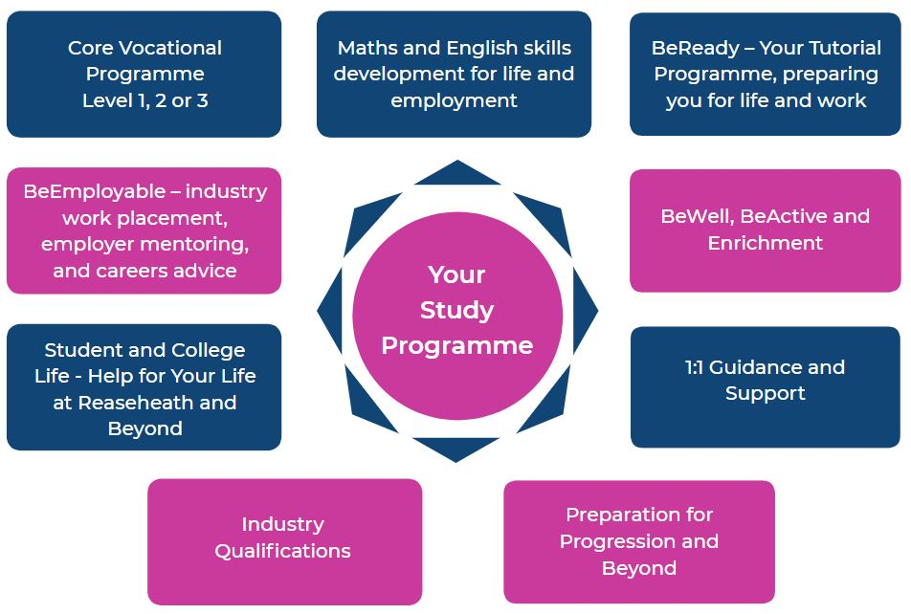
-

Slide 26
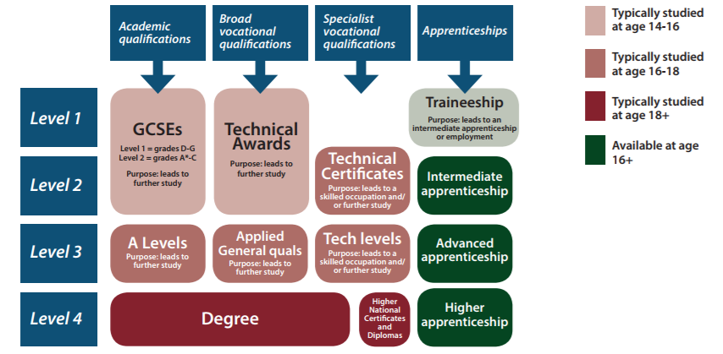

Slide 27
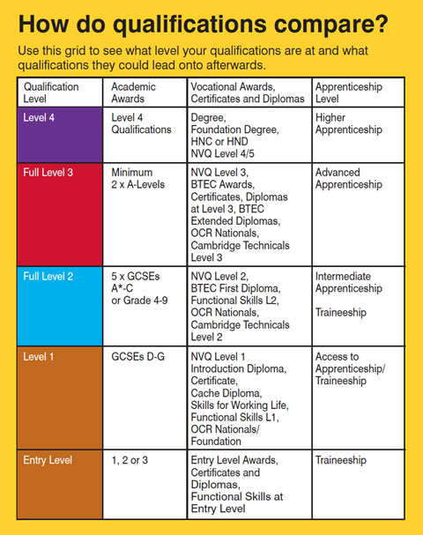

Slide 28
Entry 1, Entry 2 and Entry 3 are broadly equivalent to National Curriculum Levels 1, 2 and 3 respectively. When converting qualifications to school attainment points, Entry 1 is worth 10 points, Entry 2 is worth 12 and Entry 3 is worth 14. Each entry level qualification is available at three sub-levels - 1, 2 and 3. Entry level qualifications are: entry level award. entry level certificate ( ELC ) entry level diploma. entry level English for speakers of other languages ( ESOL ) entry level essential skills. entry level functional skills. Skills for Life. 6-100 Guided learning hours (NB A level is 360 glh) What qualification levels mean: England, Wales and Northern Ireland - GOV.UK (www.gov.uk)

