Slide 1
Vocational Profile launch

Slide 2
SEND Employment Project
Currently work with 9 specialist settings with 16-19 provision.
Embed an employment pathway into Special Schools
2. Promote the World of Work across the school to best prepare young people for this pathway
Key performance indicators:
Employer engagement across the Key Stage areas (161 encounters last year);
Students following an employment pathway;
Developed knowledge and resources to embed and maintain employment pathway for identified students.

Slide 3
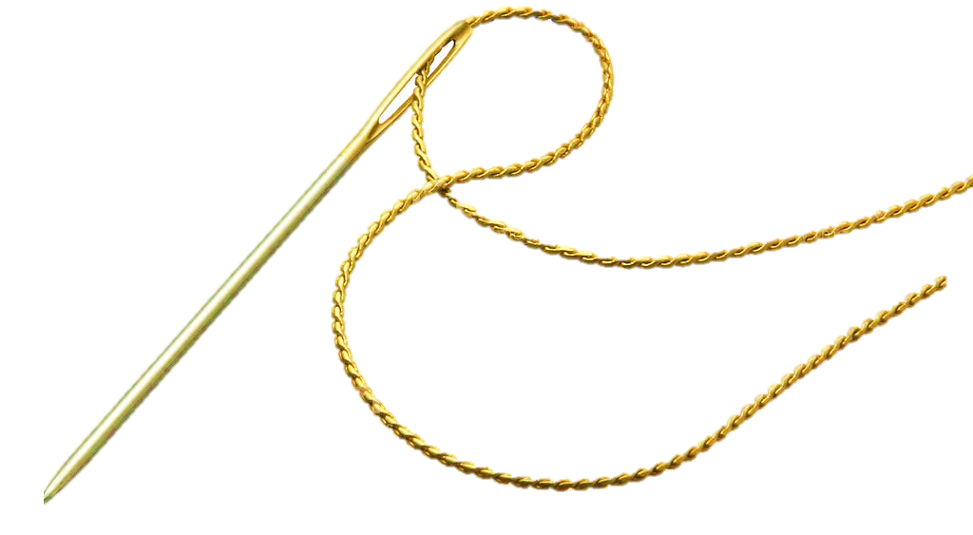
Establishing the golden thread
Pre-16 prep
Careers exposure
Vocational Profiling
Employer encounters
Work experience
Careers, advice and guidance
Post 16 transition work
Post-16
Vocational Profiling
Work Experience
Job Coach support
Mock interviews
Supported internships
Inclusive apprenticeships
Adults
Local Supported Employment Programme
Vocational Profiling
Job matching
Job Coach support
Employment

Slide 4
Supported Employment Curriculum
Preparing for Adulthood outcomes
Supported Internship
Apprenticeship
Direct Entry
Work Experience
Vocational Profiling
Employer Engagement
Transferable Skills
Careers Programme
‘Build it and they will come’
Independent Living Friends, Relationships and Community Healthy Living Employment | Raising the aspirations of young people at an early age and making them aware of the local labour market | Matching the student to the right placement. Provide meaningful work experience | Individualised Self-awareness tool. Develops staff understanding | Opportunities for personal development and focus on softer skills. Learning outside of the classroom.

Slide 5
Purpose of the Vocational Profile
Vocational profiling is one of the five key components of Supported Employment – it works!
They provide greater self-awareness for young people about future direction
Inform parents at an earlier age of the possibilities of employment upon leaving school
Raise awareness of professionals working with learners about their aspirations and career paths

Slide 6
Vision
To have vocational profiles embedded across the county for all learners (Year 9+) with an EHC plan.
PfA outcomes can be generated through the vocational profile – make progressive steps through the key stages
Profiles to be updated at least annually to reflect learner skills development and future thinking around destinations
Vocational profiles will travel with young people at key transition points – e.g. school to college at Year 11/Year 14 or a change of provision
Be submitted on the EHC Hub.

Slide 7
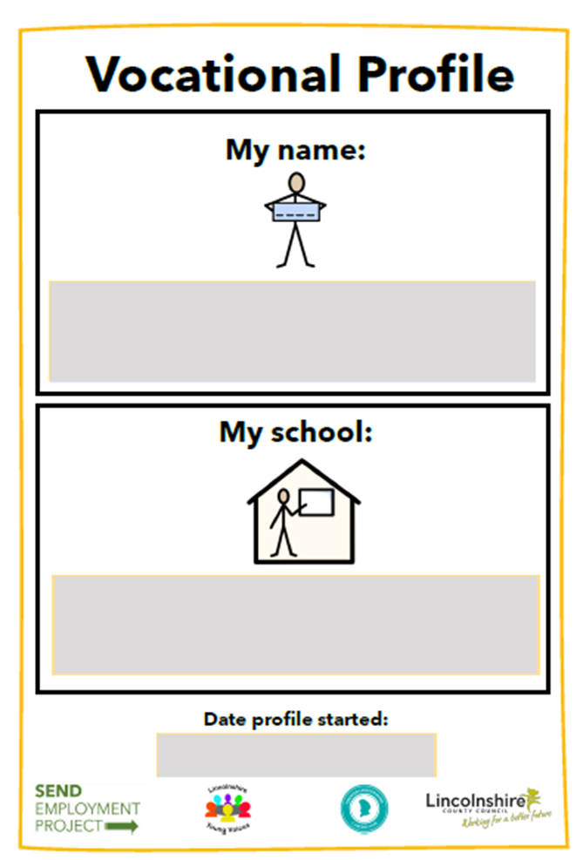
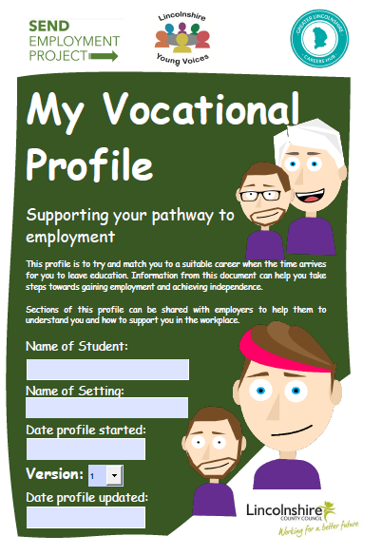
MLD/SLD Version 1.About me 2. What can I do 3. What jobs I would like to do? 4. My experiences of the workplace 5. Support I will need at work 6. My future Graphics/Printable versions

Slide 8
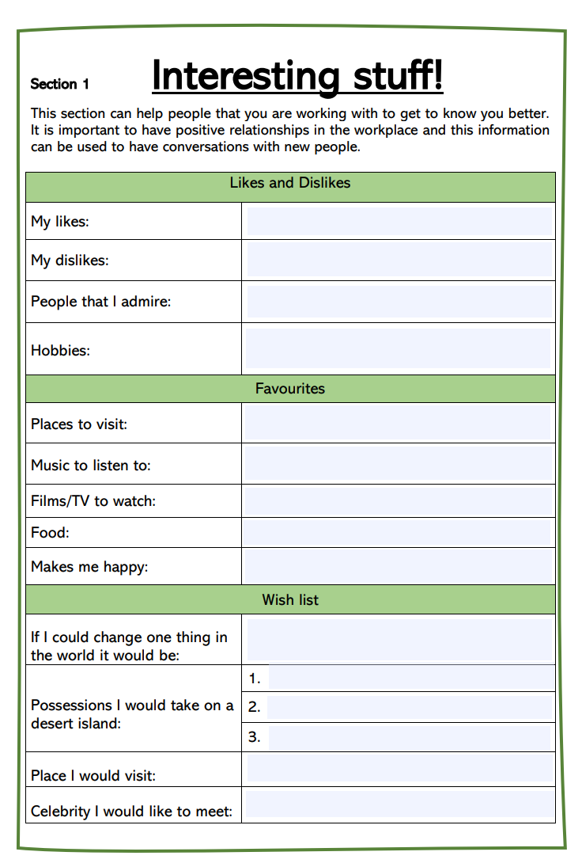
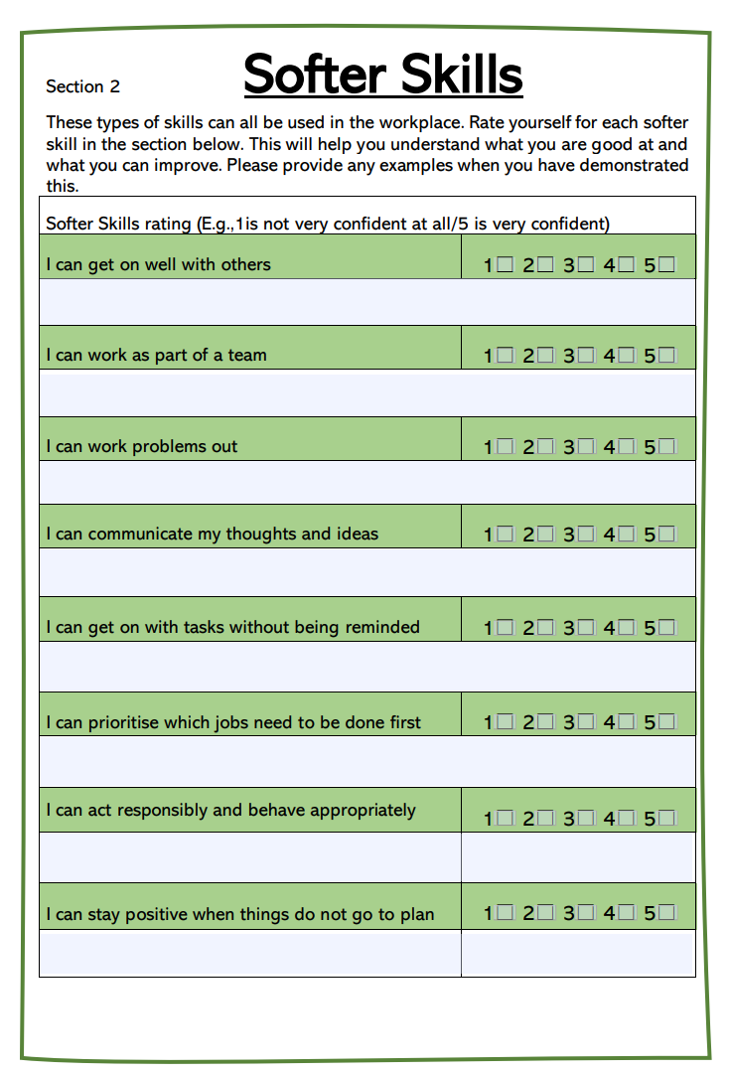

Slide 9
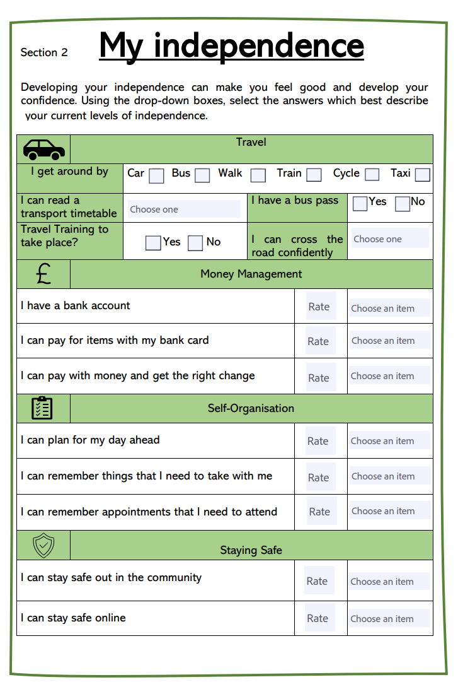
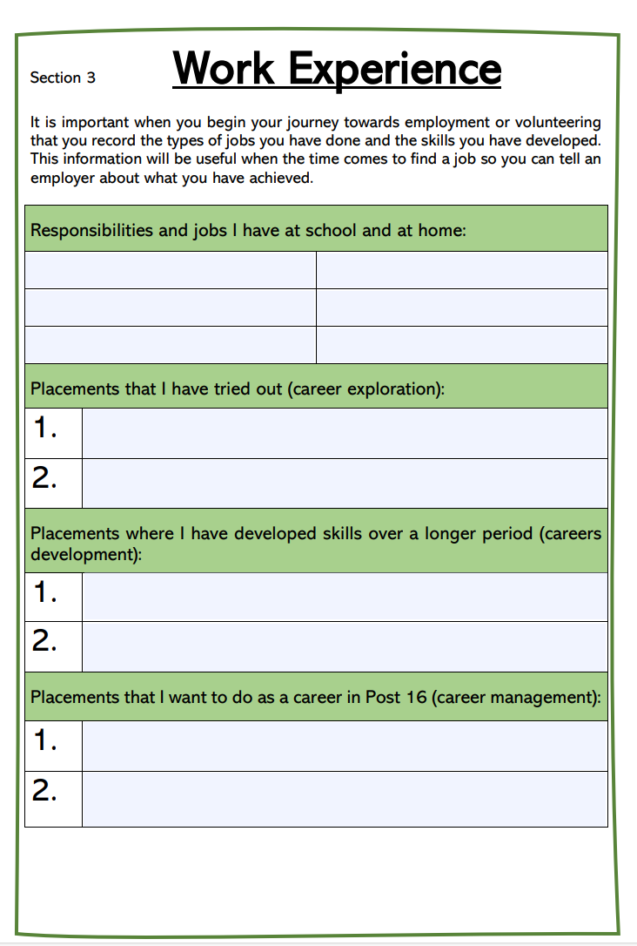

Slide 10
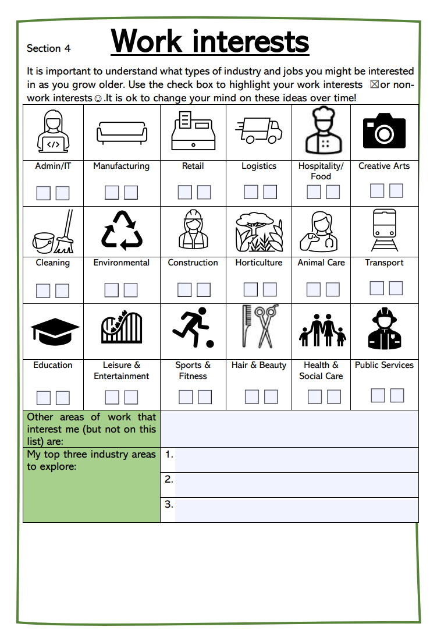
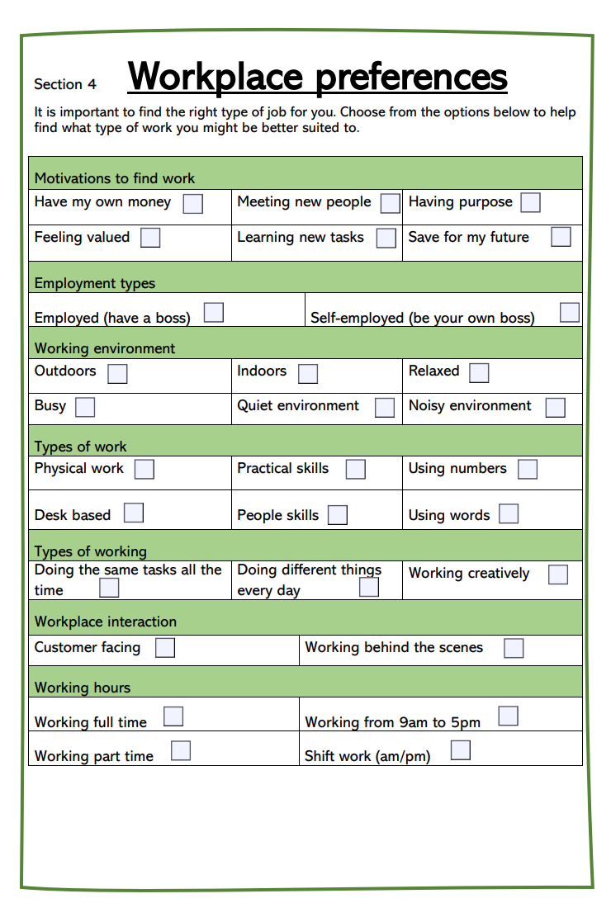

Slide 11
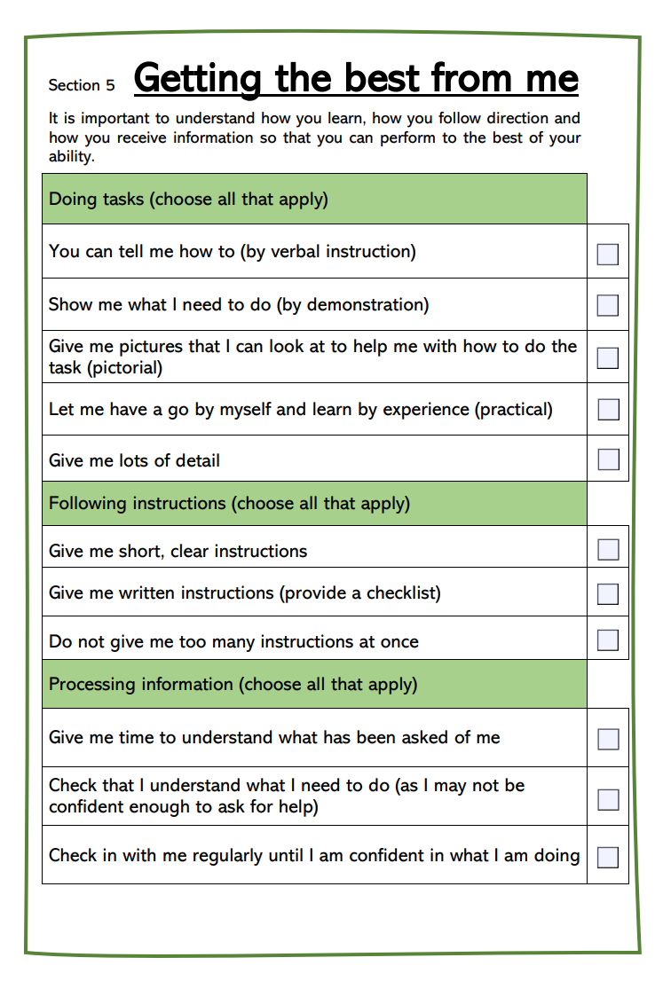
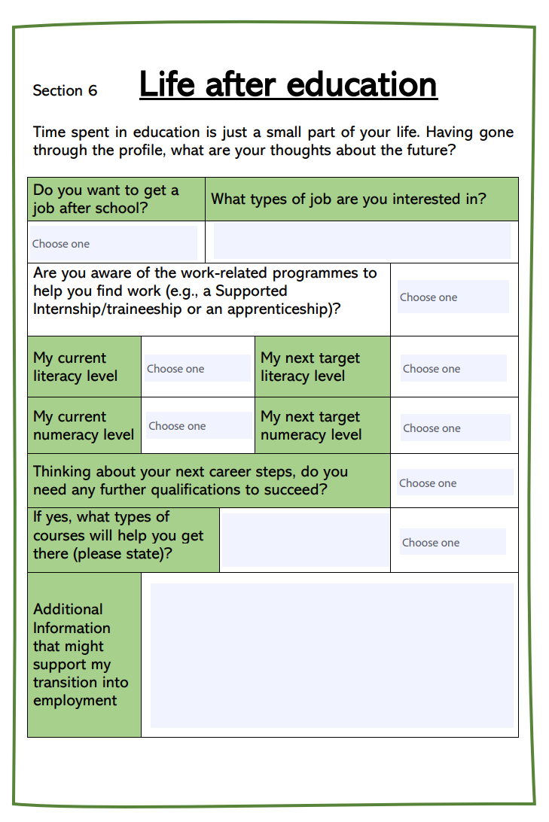

Slide 12
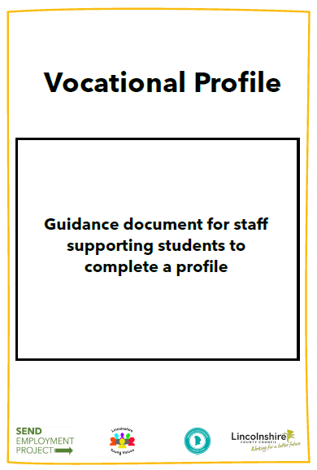
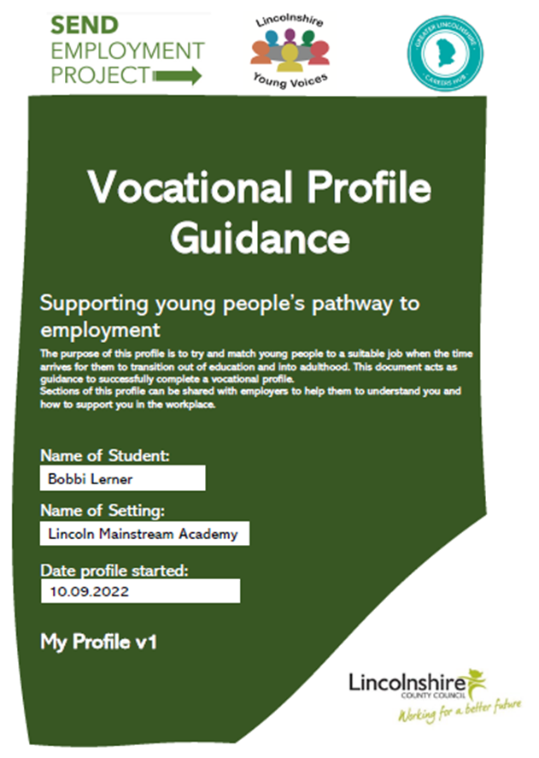
Guidance documents for each

Slide 13
Accompanying Resources
Lesson plans, slides & resources to support completion of the profiles (MLD & SLD)
Can be downloaded and adapted
Enable class or small group completion

Slide 14
Any questions?

