Slide 1






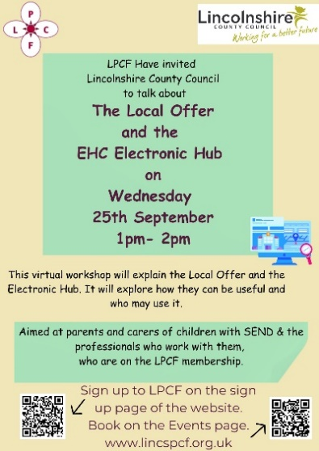



Lincolnshire Parent Carer Forum
Lincolnshire Parent Carer Forum

