Slide 1
SEND
SENDCO Briefing
Russell Outen-Coe, Designated Clinical Officer for CYP with SEND

Slide 2
Designated Clinical Officer
A Designated Clinical Officer (DCO) is a health professional who works for the NHS, usually and Integrated Care Board.
The role is to ensure that everyone in health is doing what they should to support children and young people with special educational needs and disabilities (SEND).
DCOs collaborate with professionals across health, education and social ca aiming to join up the support being delivered.
DCOs play a crucial part in implementing the SEND reforms and supporting coordinated efforts between health services and the LA. 😊
We can have a variety of clinical backgrounds e.g. Nurses, Health visitors, Therapists, Midwives.
Some areas have more than 1 DCO, some have Associate DCOs and some DMOs

Slide 3
Designated Clinical Officer
Non-Statutory
Clinicians SEND Education Programme
Quality Assurance Framework programme
Performance Data Dashboard programme
Support Peer Challenges/ CQC/Ofsted Inspection readiness
Development of the online Sensory Processing Difficulties Programme
Co-development of the Special Schools Programme Health Strategy and supporting the implementation of Clinical Interventions in educational settings programme.
Widening participation ‘Lincolnshire Young Voices’
Partnerships for Inclusion of Neurodiversity in Schools (PINS) designed to improve outcomes for neurodiverse pupils with special educational needs and disability (SEND) in mainstream primary schools.
Operational support and advice to families and professionals such as LIAISE, LPCF and ASKSALL
Ad-hoc projects such as Cloud Based EHCP Hub
Statutory
Work with the local authority to contribute to the Local Offer. This is a directory of services available online and designed to support CYP, Families and Professionals navigate the SEND landscape.
Commission services jointly for CYP (up to age 25) with SEND, including those with Education Health and Care Plans (EHCPs).
Have mechanisms in place to ensure practitioners and clinicians will support the integrated EHC needs assessment process, EHCP and tribunal process.

Slide 4
LICB SEND Workforce and capacity
DCO chairs SHCM
Sits on CYP IT Board, SEND Steering Group, Liaise Steering Group, CICT Steering Group, Lincolnshire Autism Partnership Board, Children in Care Steering Group, CYP OATS panel, Special Schools Health Strategy Group.
ADCO sits on Local Offer working group, CYP OATS panel
DCO/ ADCO share Hub
SRO
Director of Nursing
Assoc Director of Nursing and Quality CYP
(Assoc SRO)
Deputy Director of Nursing and Quality
(CYP and SEND)
DCO for CYP with SEND
Assoc DCO for CYP with SEND
0.6 WTE
CYP Commissioning Manager
CYP Programme Lead
Quality Support Officer

Slide 5
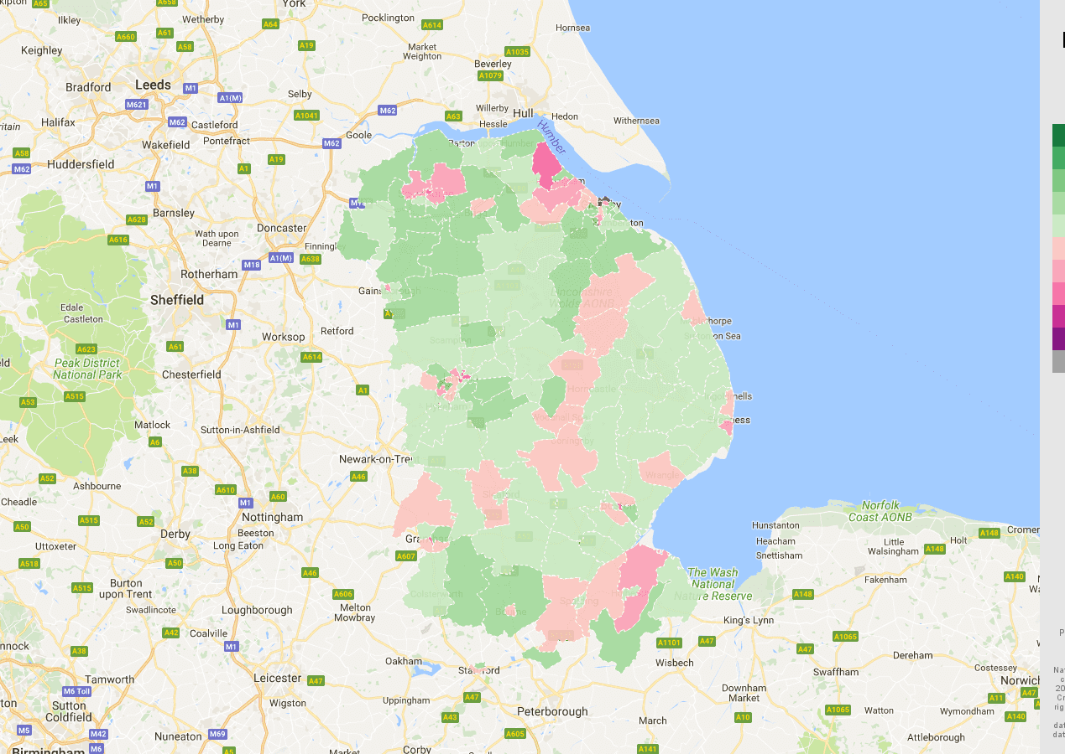
What does Lincolnshire look like?
Lincolnshire has around 7700 EHCPS
When compared to the national average we have:
A higher percentage of pupils with an EHC Plan.
A higher percentage of pupils requiring SEN support
One ICB - One L.A
Coterminous – Integrated Care System
Schools
5 Special maintained schools
13 Special academies
50 Children’s Centres
Three NHS providers:
Mental Health Trust (LPFT)
Community Health Services (LCHS)
Acute trust (ULHT) now shares same exec team with LCHS, called LCHG
3 main sites, Lincoln, Grantham, Boston

Slide 6
SEND Health Committee/ Chaired by DCO, LICB SEND Steering Group Chaired by HoS for SEND
Clinicians SEND Education Programme
Quality Assurance Framework programme
Performance Data Dashboard programme
Support Peer Challenges/ CQC/Ofsted Inspection readiness
Development of the online Sensory Processing Difficulties Programme
Co-development of the Special Schools Programme Health Strategy and supporting the implementation of Clinical Interventions in educational settings programme.
Widening participation ‘Lincolnshire Young Voices’
Partnerships for Inclusion of Neurodiversity in Schools (PINS) designed to improve outcomes for neurodiverse pupils with special educational needs and disability (SEND) in mainstream primary schools.
Operational support and advice to families and professionals such as LIAISE, LPCF and ASKSALL
Updating SEF, SEND Strategy
Ad-hoc projects such as Cloud Based EHCP Hub
Utilisation Quiqsolutions Cloud based Assurance tool;
Leadership
Joint arrangements
Commissioning
EHCP
Engagement
Monitoring and Redress
QUIQSOLUTIONS | Quality Compliance Framework Management Solutions
Notes:
russ

Slide 7
Governance, one county – one system.
CYP Integrated Transformation Board
SEND Steering Group
Chaired by L.A
SEND Health Committee
chaired by ICB
Notes:
terry

Slide 8
CYP Integrated Transformation Board
Jointly chaired by LICB and LCC.
Representation includes:
Parent Carer Forum Chair (representing over 2300 parents)
Safeguarding
LCC Children's Services
Children's Integrated Commissioning Team (jointly hosted)
LCC Public Health
Local Maternity Neonatal System
LPFT (Mental Health Trust)
LCHS (Community Provider) now LCHG
LICB
ULHT (Acute Trust) now LCHG

Slide 9
Vision, Aims and Objectives of the Board
Vision: Everyone working together to maximise the health and wellbeing of all children and young people, ensuring the voice of children and families is heard throughout our work.
Aim: To maximise the health and wellbeing of, and reduce health inequalities among, children and young people in Lincolnshire, including supporting a seamless transition into adulthood.
Objectives:
Prioritise prevention and early intervention to reduce the need for health care and improve outcomes for CYP and their families and carers.
Collaborate and co-produce to ensure health care is integrated, respectful and responsive to the needs of CYP and their families and carers.
Ensure services are accessible, seamless, sustainable, and financially viable for the future whilst continuing to meet best possible quality and safety standards.

Slide 10
Integrated Commissioning Arrangements
LCC and LICB have mature integrated commissioning arrangements.
For CYP mental health services, the lead commissioning responsibility is delegated to LCC and commissioners pool their budgets to fund services. Formal Section 75 Agreements have been in place for over 10 years. Commissioning is operationally managed by one of the Children’s Strategic Commissioning sub teams.
The LICB and LCC also jointly fund the Children’s Integrated Commissioning Team. The team has been in place for 5 years. The work programme of the team is decided by the ICB, Public Health and Children’s Services. The system governance of all CYP health related services is through the CYP Integrated Transformation Board which directly reports into the Better Lives Lincolnshire Executive Team.
Officers from across the LICB, Children’s Services and Public Health work closely together to understand the needs of the population and commission services appropriately.
Co-production with our CYP and families is at the heart of the commissioning cycle.

Slide 11
What does support look like in Lincolnshire?
A strong universal and preventative approach to our services for CYP and families. Providing solid foundation for cyp and families to get support via early intervention. Support includes:
Children’s 0-19 Health Service Health Visitors, CYP Nurses and family Health Workers part of our integrated locality teams. We provide a more enhanced offer that the Healthy Child Programme mandates.
Children’s Centres and Family Hubs 50 Centres with vast array of early childhood services provided in local communities. Awarded funding to develop Family Hubs.
Early Help provides strong partnership support with over 80% of our Team Around the Child plans supported by a Lead Professional from outside the local authority.

Slide 12
Online counselling support via Kooth.com is an anonymous service for YP aged 11+ to discuss their worries online with a qualified counsellor, including weekends.
Lincolnshire Here4You Advice Line CYP, families and professionals can speak to clinicians directly for advice and self-refer CYP for emotional wellbeing and/or mental health support.
Healthy Minds Lincolnshire provides emotional wellbeing support service for CYP 0-19 years (25 SEND), working in and around schools.
Mental Health Support Teams (MHSTs) in schools and colleges focused in areas of Lincolnshire with highest health inequalities.
Behaviour Outreach Support Service (BOSS) works with schools to support CYP at risk of exclusion and remain in education. Includes supporting schools with restorative approaches to help support YP to deal with conflict in a positive and constructive way.
Working Together Team (WTT) is National Autistic Society(NAS) Advanced Accredited to empower schools in supporting autistic CYP and / or those with social communication differences.

Slide 13
SEND Training
Overall approach of all services- strong universal offer, using specialists to train and upskill wider children’s workforce which helps to prevent needs escalating and reduces lots of professional involvement and many courses based around parent/carer mediated intervention.
LICB webpage hosts Council for Disabled Children online training resources
SEND Clinicians Training Programme co- produced with LIAISE (SENDIASS)
A Rough Guide to Not Putting Your Foot in It!
Sensory Processing Difficulties on line programme co-produced with LPCF, LA and system partners
Sensory processing difficulties :: Lincolnshire Children's Therapy Services (lincolnshirechildrenstherapyservices.nhs.uk)

Slide 14
Engagement and Co-production
Lincolnshire Parent Carer Forum
Very strong partnership working
excellent professional relationship
LPCF Chair sits on CYP IT Board
Developed Sensory Processing Difficulties Programme collaboratively
DCO and health colleagues regularly attend LPCF signposting event/ PMQ style Q&A sessions.
Part of the authoring team of SEND strategy and SEF
Developing a series or training resources to understand the role of professionals in SEND support with LPCF, SENDIASS and ICB called SEND HELP!
LPCF rep sits on the Hub - Decision to Issue a Plan weekly panel
Lincolnshire Young Voices
Pan Disability Widening participation group
12 members – 2 paid co-chairs (LA funded)
LICB fund engagement events
Acting upon gritty issues & passionate about purple!
Consulted in the redesign Lincoln Co. Hospital, E.D
Won NASEN award for A Rough Guide to not putting your foot in it - launched at a system wide online event on 8th July 2022
Aims to improve communication with professionals.
Next Strategy time out day at The Wolds Wildlife Park July 24
320 Facebook followers

Slide 15
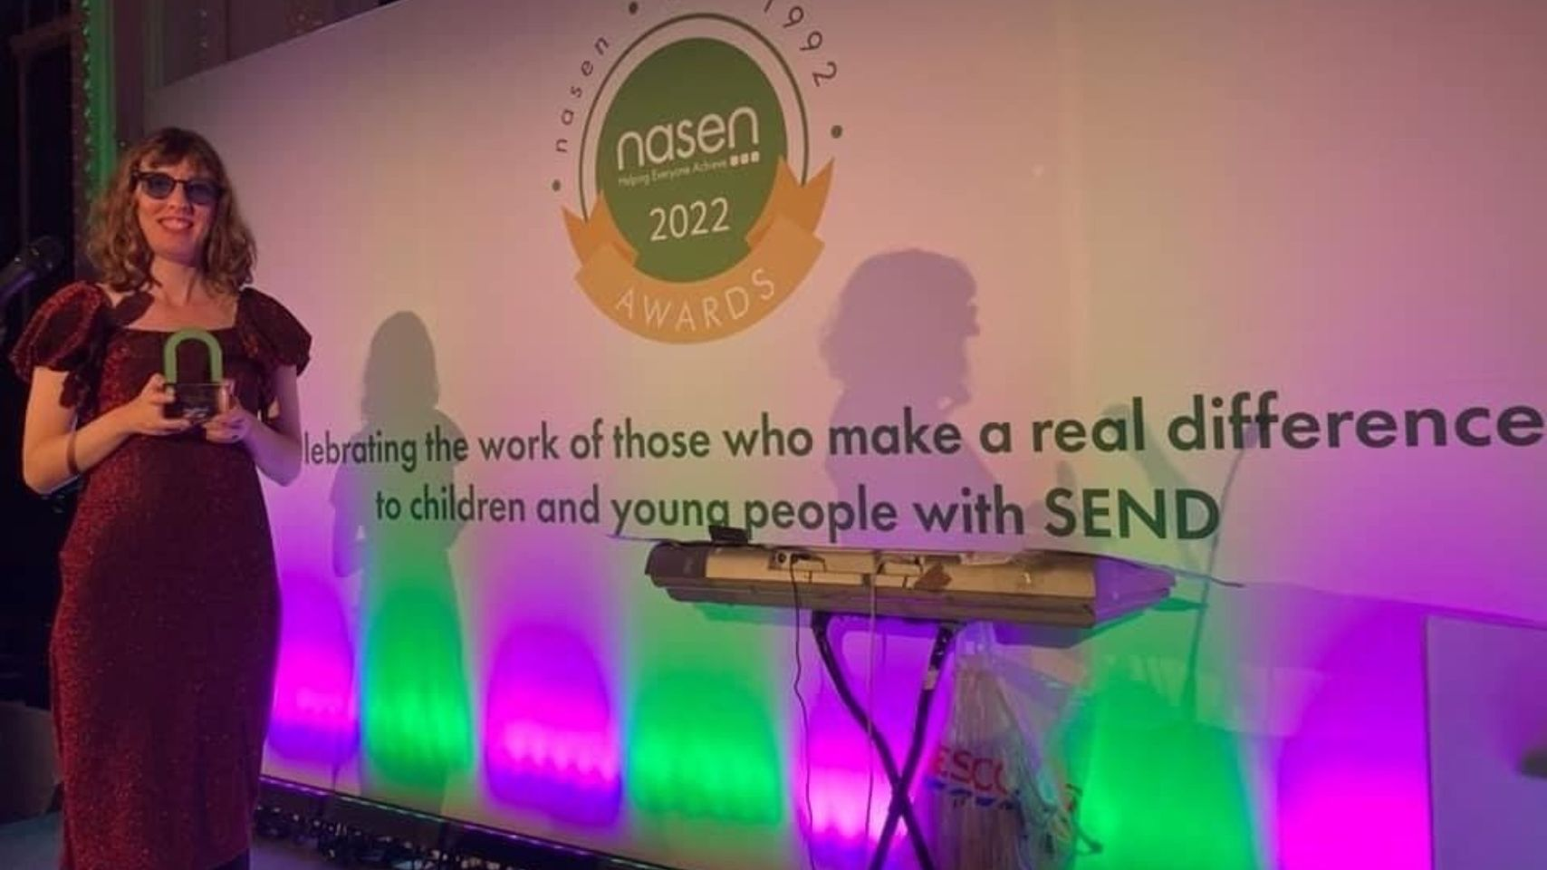

Slide 16
Lincolnshire Parent Carer Forum are building a positive co-productive working model with the Lincolnshire DCO team we have worked collaboratively on projects and shared our respective offers for the benefit of parents and families of children with SEND. There is a good working dialogue operating that allows either party to both support or challenge in ongoing developments.
Sensory Processing Programme - This has been a clear win-win resolution with many parents attracted to the workshops which are very quickly booked by Lincolnshire parents so that they can gain knowledge, develop skills and build their own resilience to work with their own children
For LPCF, the building of parents' self reliance is a key factor in our work and solutions such as this truly resonates without longer term aspirations for parents.
The DCO was also LPCF’s first Question Time subject being videoed answering a range of questions from parents and being grilled for an hour! The video along with the chronological questions log is on the LPCF and we regularly direct parents to the material so that they can see the DCO’s informative responses. This has helped to dispel any myths and rumours about Health services.
There are a number of other outcomes of our joint working including the DCO always representing the NHS at key events helped by LPCF such as our major “Week of SEND” held each January or the recent inclusion of LPCF in the Children and young Peoples Transformation Board plus other new / key strands of Health developments.
LPCF really appreciate our joint working and feel it works well for LPCF, Parent/Carers and Health Services with each benefiting from positive co-production.
Coralie Cross, Chair, LPCF

Slide 17
Liaise – overview of how we work together
LICB and Lincolnshire NHS provider organisations have a with Service Level Agreement with LIAISE which details our responsibilities of how we will support LIAISE key service deliverables. For example:
The DCO is a member of the Liaise Steering Group, we meet three times per year with a focus on supporting the ongoing development of the service and ensuring that we are meeting the national minimum standards
Senior LIAISE Officer is a member of the SEND Health committee, which supports LIAISE to ensure the service is up to date with the latest developments in health, so that the information and advice they give to families is both current and accurate
Providing opportunities for Liaise to deliver training to health professionals to increase their knowledge of SEND law, guidance, local policy, issues and participation. We are now in the second year of delivering an ongoing series of 3 workshops on SEN Support and the Graduated Approach. This also allows us to ensure that health professionals are aware of the service so that they can signpost families to LIAISE for support
LICB provides support to ensure that the service is promoted and advertised within health services, most recently this has included in GP surgeries and Community Pediatricians clinics
Our latest exciting project is working jointly with LICB and the LPCF over the next 12 months to develop a series of bitesize resources in the form of short videos to help families and professionals to understand what is available to support children and young people with Special Educational Needs and Disabilities.

Slide 18
RAG Rated green because…
Strong clinical leadership from the DCO and team with direct line of communication to Executive SRO
Strong integrated commissioning approach between LCC/ICB.
Clear governance structure
Overall approach of all services- strong universal offer, using specialists to train and upskill wider children’s workforce which helps to prevent needs escalating and reduces lots of professional involvement e.g. HML/Sensory Processing / and Community Nursing Team.
Health provision based on needs of individual child
Children’s Integrated Commissioning Team and joint funding and setting of work programme across LCC and ICB
CYP Out of Area Treatment panel
‘Lincolnshire is proactive
in identifying issues and strategic direction and doesn’t wait for
steer from central government or NHSE before responding’.
Notes:
terry

Slide 19
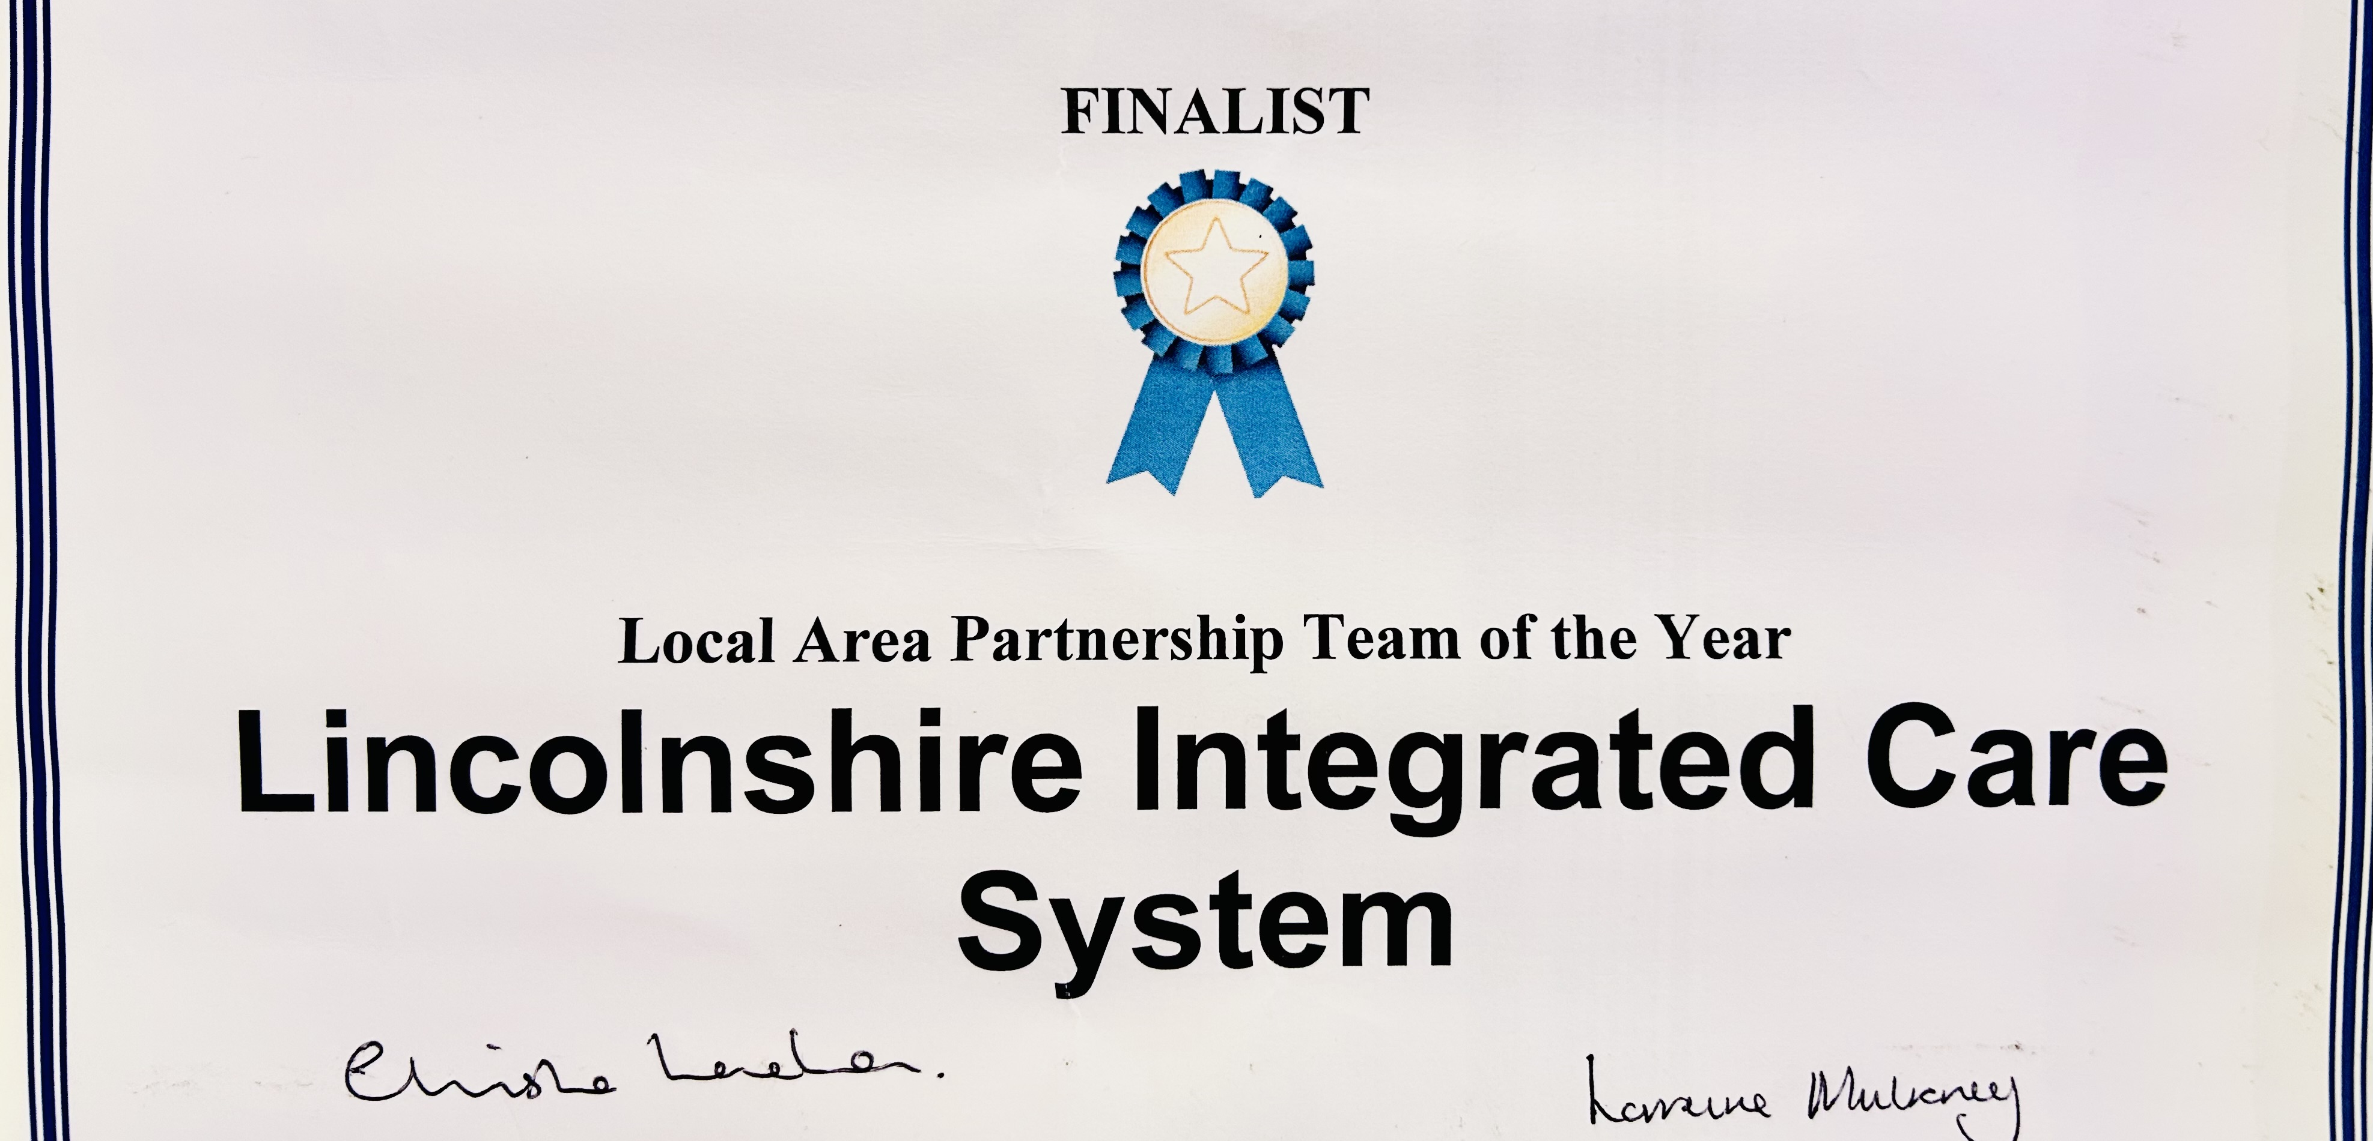
Recent 2024 SEND NHSE award finalists for Partnership working across the ICS

Slide 20
ICB’s wider key areas for development and priorities for CYP/ SEND
CYP Mental Health Transformation
Autism Pathway
Mental Health Support Teams
LMNS & Neonatal Network
Suicide Prevention – CYP
SEND – High Needs & Special Schools
Community Nursing Service review
Children in Care Transformation
Short breaks, CYP with disabilities
Obesity
End of Life Care
Urgent & Emergency Care
SALT

Slide 21
Thankyou

