Slide 1
Lincolnshire’s Virtual Autism Hub
Notes:
Good morning.
My name is Zara Smith and I am the Parent/Carer Lead for Lincolnshire’s Virtual Autism Hub.
I have also been an Early Years SENCo for over 8 years and I am mum to an autisiic adult.
I am here to today to tell you about our fabulous new service, what it is about and how you can contact us for support.

Slide 2
Our Purpose
To enhance the non-clinical community support available to autistic people of all ages and their parent/carers
We are funded by Lincolnshire ICB
Notes:
We are a completely new service, launched in February this year.
We offer non-clinical community support to autistic people of all ages and their parents/carers
This includes:
Those diagnosed autistic
Those currently going through the diagnostic process
Those who identify as autistic but choose not to seek a diagnosis
Our services are additioanl to the statutory requirements.
Use a model of co-production – where we work closely with the local autism community. The autistic community, including parents/carers help to inform our services, for example the steering group that helped set up this service have made it very clear that a diagnosis shouldn’t be needed to access Virtual Autism Hub
Have already supported over 220

Slide 3
Why?
Lack of support available
No support whilst waiting for diagnosis
Little support available post diagnosis
Notes:
This service has been introduced because we know that:
There is a lack of support available to the majority of autistic adults & parent/carers who are not eligible for statutory services
Many people on waiting list for a diagnosis who have still needs and require support
There is little information & advice available after diagnosis aside from a few unfunded, overstretched, volunteer-led support groups
Sometimes the challenges families face escalate and we know that without support they can enter crisis unnecessarily

Slide 4
What it can feel like…
Yes, your child’s autistic. Here’s a leaflet. Now off you go…
Notes:
When parents/ carers do get a diagnosis – we know what it feels like.
Often the only support you receive is a leaflet (if you are lucky!) and you are left to it.
This can be scary, overwhelming and confusing. Where do you go for help? What should you do next? How can you ensure that your child gets the necessary support in school? etc
We also know that there are gaps in the support that is available

Slide 5
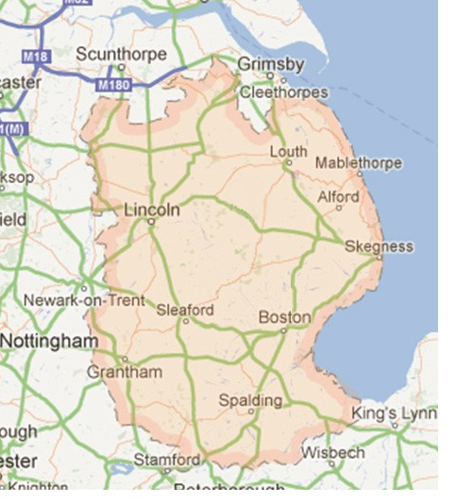
Why a ‘virtual’ hub: why not just open a hub in Lincoln?
Geographically large area
Long journey times
Public transport difficulties
Notes:
Lincolnshire is the 4th largest county in England
With only 1 in 5 of the population live in or around Lincoln
Lincoln isn’t geographically central within the county
This means that:
Transport can be challenging – for example public transport from Holbeach to Lincoln can take several hours and require multiple changes (if you can tolerate public transport which is often difficult or impossible!)
Part of remit is to help support groups grow and establish in their own areas across Lincolnshire – if we are present in one area this could be a barrier to groups setting up
We are looking to offer some ‘Pop-up Hubs’ in the future to allow people to drop in and chat with us face to face
So what does our service offer?

Slide 6
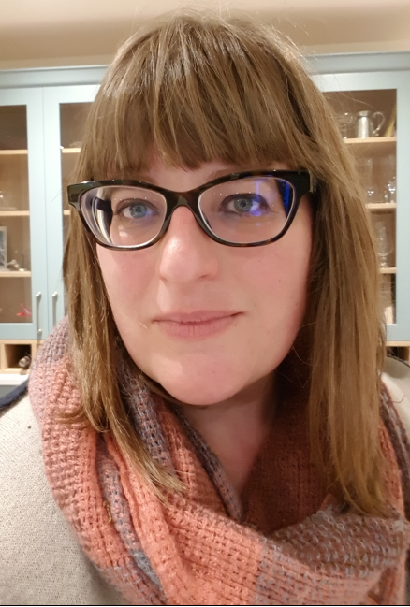
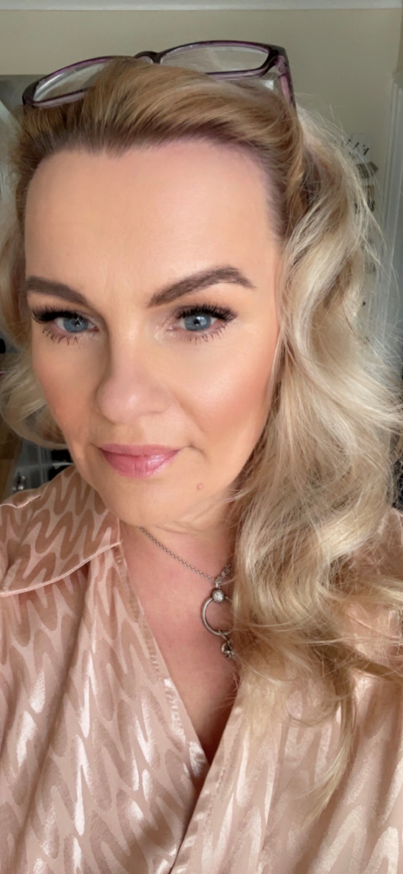
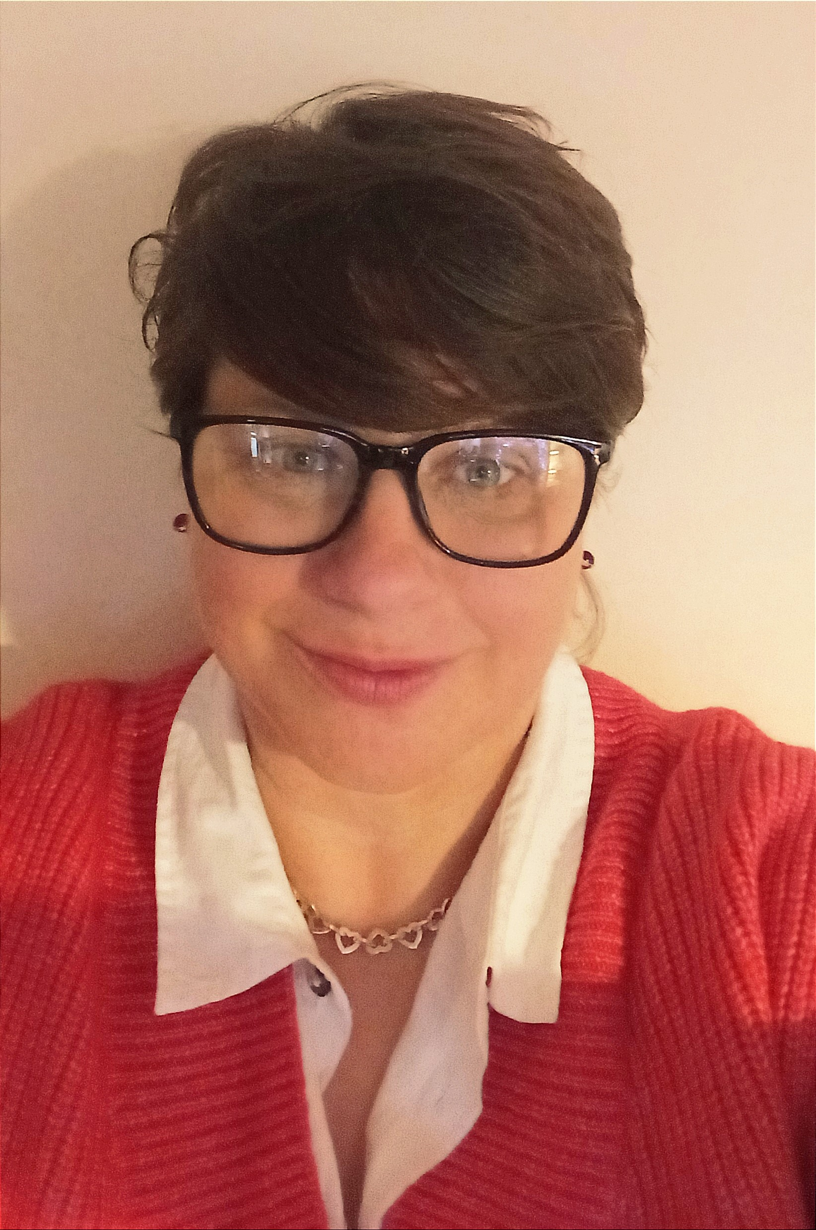
Specialist Autism Navigators
Michelle
Emma
Ingrid
Emma
Notes:
We have four Specialist Autism Navigators who work across Lincolnshire, all of whom have experience either as parents of autistic children, are autistic themselves or have professional experience working in SEND

Slide 7
Navigators Role
To empower parents/carers and autistic adults of all ages to make informed decisions, and access appropriate services
To support by providing them in information, advice and some practical input
Notes:
Signpost to Local and national support groups and services – those specifically for autism and also more generic guidance (DLA and PIP etc)
Information about autism and diagnostic pathways
Practical help e.g. accompany people to initial meetings, assisting with form filling etc
We operate an open door policy - No referral or diagnosis is needed
Step in, step out support as needed. Can return to service with future issues.
We also have three lead roles. Myself as the parent/carer lead, Gareth is the Children and Young person Lead and Tim is the autistic adults lead.
Our role is network and engage with with support organisations & individuals across the county to understand current issues and represent their cohort’s views within the hub’s steering group. Neil is our Service manager

Slide 8
Access to our service
Support on the phone or over video call
Information and guidance via email
Face-to-face support across the county
lpft.virtualautismhublincs@nhs.net
Virtual Autism Hub :: Lincolnshire Partnership NHS Trust (lpft.nhs.uk)
01522 458588
Notes:
If you call the phone service you will be greeted by a message. Please leave a message and one of our navigators will get back to you. They are on duty Monday to Friday from 9am to 5pm.
Alternatively you can email the team with your question or query. This is often beneficial as you can access there response at your convenience.
If you require help and support face to face for example when completed paperwork or attending initial meetings, they can arrange to do this with you at a mutually convenient location. If necessary that can also arrange appointments for weekday evenings or Saturday mornings.
As the service develops we will also be developing our webpage and hope to be adding useful links and guidance.

Slide 9
Grant Scheme for Community Groups
Notes:
First round of funding has been allocated and the groups are starting to dleiver
Will be a further round later this year
We are committed to distributing £100,000 for the next 2 years
Grants for existing & new autism support organisations
Prioritise autism-specific, volunteer-led orgs run by ppl with lived experience
Intensive grant writing support available to organisation led by people with lived experience, as this has previously been a barrier preventing them accessing money
Will fund independent consultants to help groups who need to develop their safeguarding, governance or finances

Slide 10
Grants to run Post-Diagnostic courses
Notes:
Already in place: A post-diagnostic course for autistic adults run by LPFT
‘Let’s Talk about Autism’ run by an autistic professional through LPFT’s Recovery College
Parent/carers have long been requesting post-diagnostic support & info
Funding available to pilot courses across county of post-diagnosis support for parents of CYP based on psycho-education incl: what is autism, sensory issues, communication, emotions and emotional regulation, support from the education system. Also give participants an informal network of peer support
Funding also available for post-diagnostic courses for older CYP themselves
Course may be provided online or in person

Slide 11
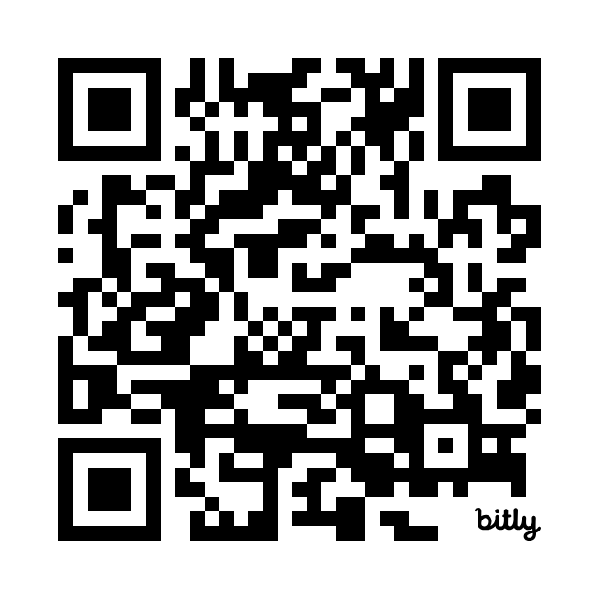
Contact details:
lpft.virtualautismhublincs@nhs.net 01522 458588
phone messages are monitored less frequently than e-mail inbox
Virtual Autism Hub
LPFT
Unit 3, Trust HQ
St George’s Site
Long Leys Road
Lincoln LN1 1FS

