Slide 1
L.E.A.D. Teaching School Hub
Updates and Headlines
‘Working in Partnership, Achieving the Highest Outcomes for All’
Notes:
Welcome

Slide 2
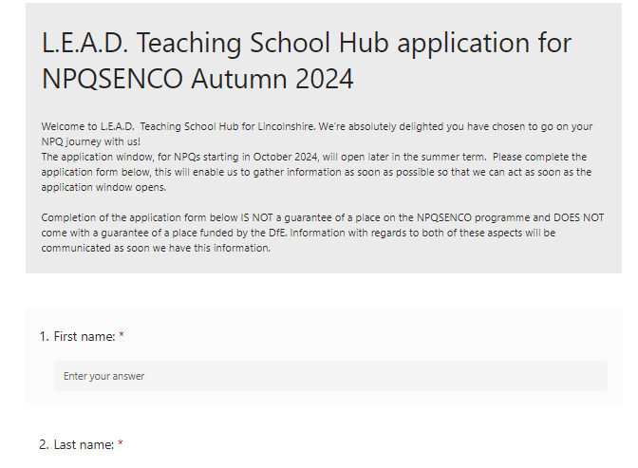
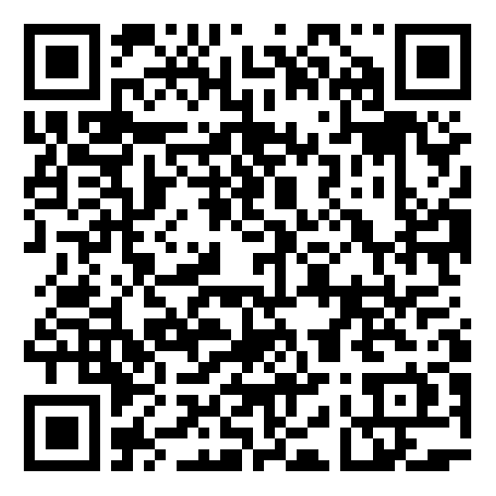
Apply NOW for NPQSENCO

Slide 3
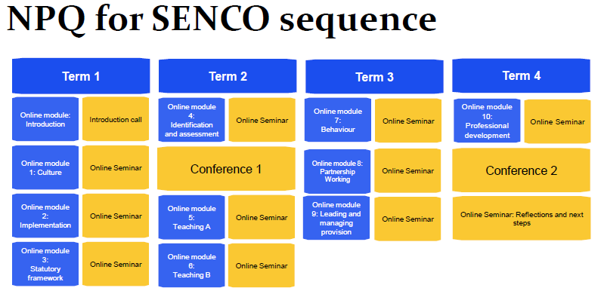
NPQ SENCO sequence
Notes:
In terms of how this spans out across the 18 months – split across 4 terms

Slide 4
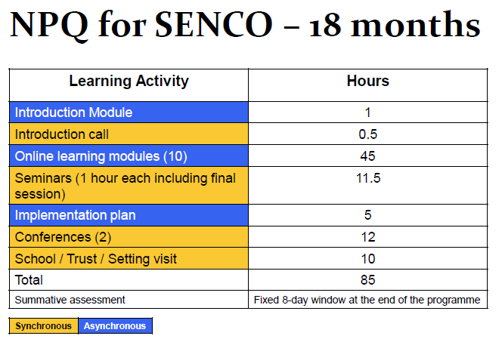
NPQ SENCO commitment
Notes:
The 3-year window to complete the mandatory qualification on taking up a SENCO post will remain following the introduction of the NPQ for SENCOs.
In terms of commitment – time
See the amount of time you will spend on online learning / seminars / attending the two conferences that will take place across the 18 months and then school visits

Slide 5
CPD Preview
NEW for 2024
FREE!!!
Notes:
DfE are looking to reduce the number of children NOT passing the PSC – collating data
To support schools with understanding how those children with SEND can get through the reading gate NEW for 2024
Apply via carrieannenicolson@leadtshub.co.uk

Slide 6
CPD Preview.
Notes:
Alex Quigley – why is it learning fails with some children? What else could contribute to this other than SEND?

Slide 7
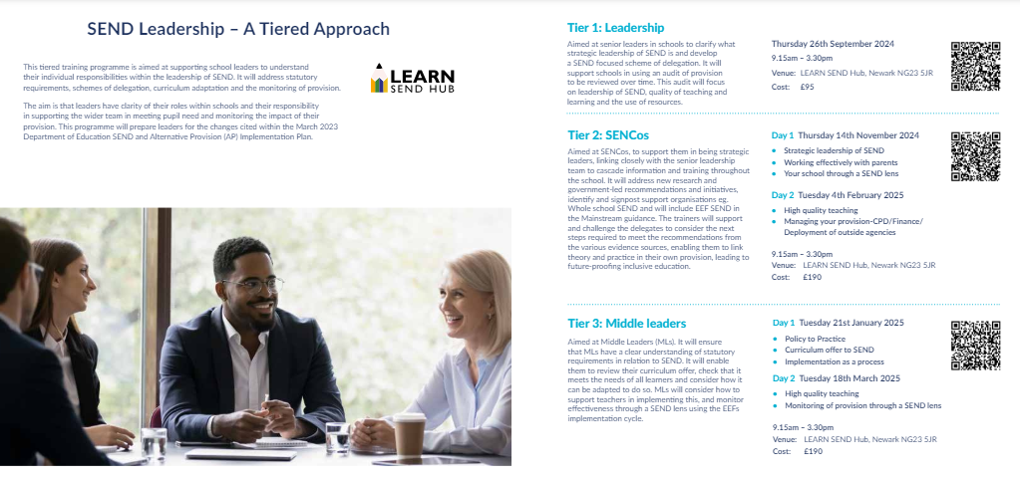
CPD Preview.
Notes:
Back due to popularity

Slide 8
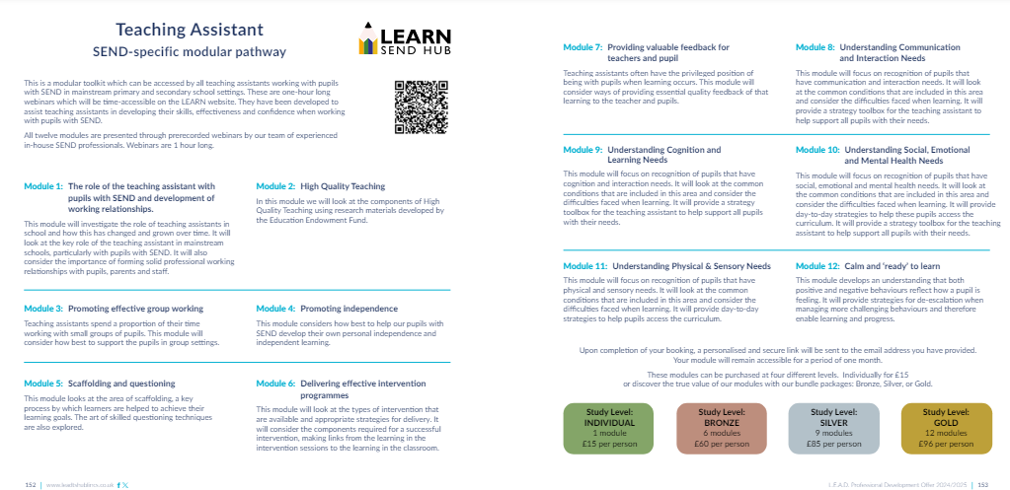
CPD Preview.
Notes:
HTs like this approach – pick and mix – think about the new staff that you have next year – what are their needs / gaps?

Slide 9
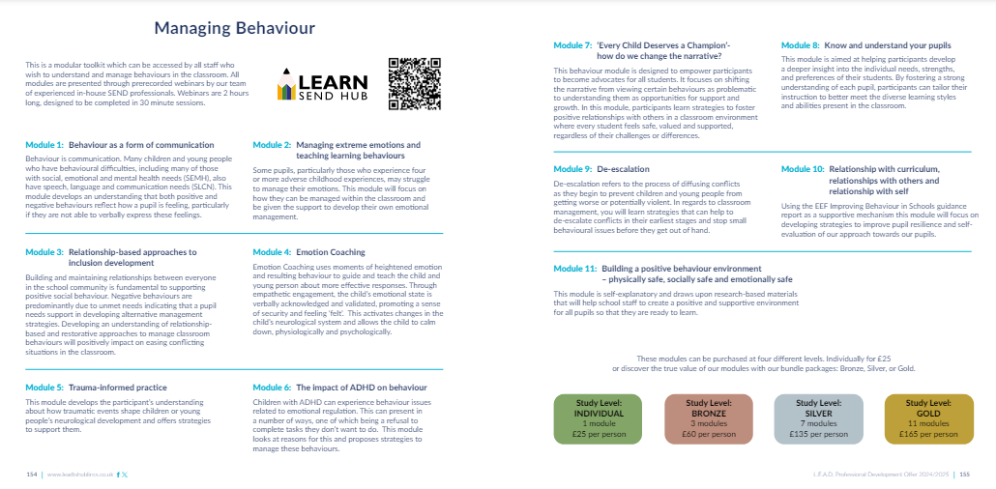
CPD Preview.
Notes:
A lot on behaviour next year – focus of Summer HT briefings – building on from this
Look out for the Behaviour curriculum – S Quinn and the Behaviour programme – Tom Belwood who heads up the B Hub
LEARN also offering Modules – pre recorded webinars – as many or as few as you like from the menu

Slide 10
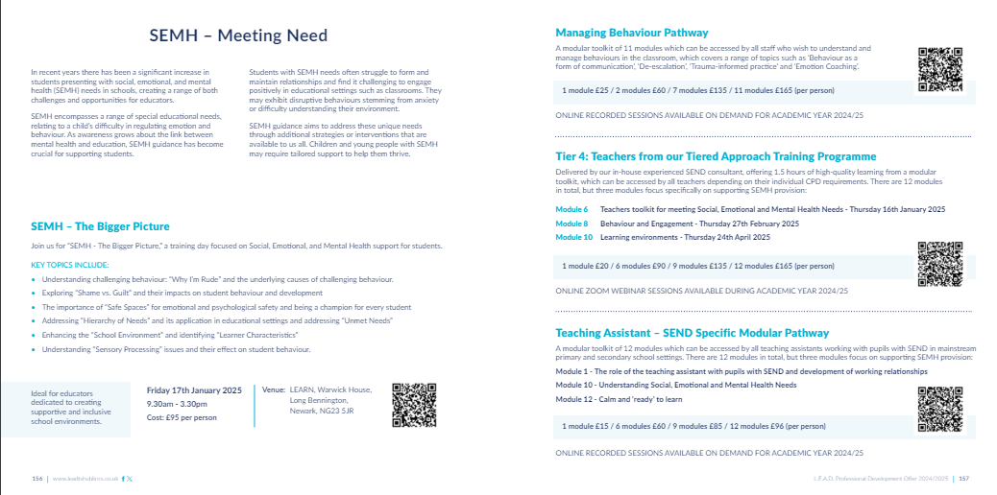
SEMH Preview.
Notes:
Similar approach to SEMH – so complex – enable schools to create their own bespoke offer from all the aspects we have put together

Slide 11
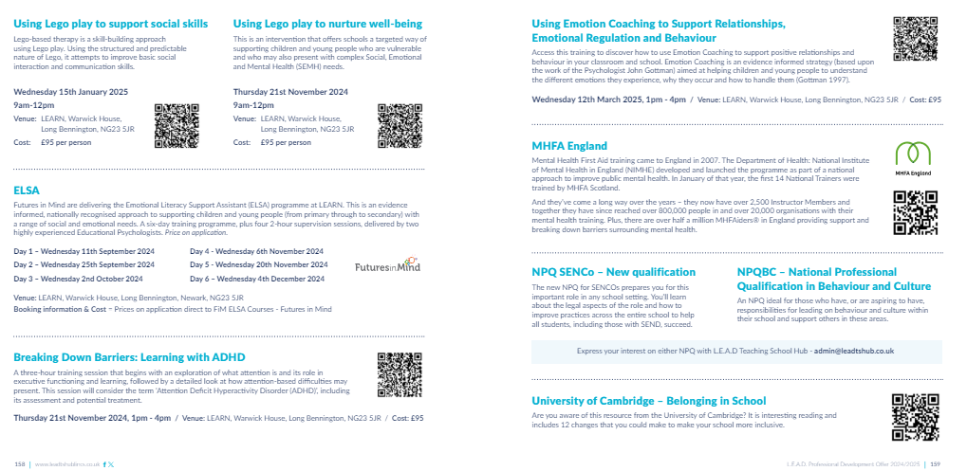
SEMH Preview.

Slide 12
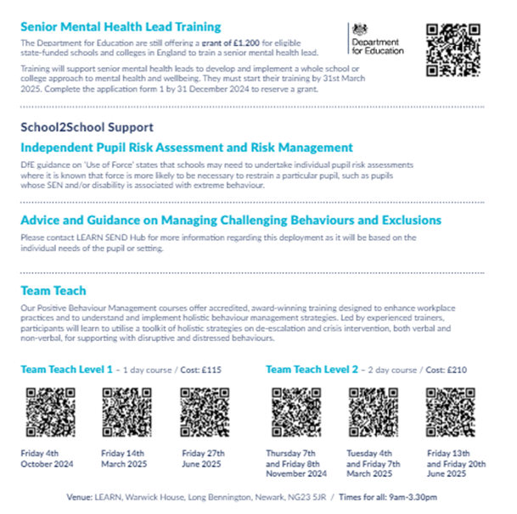
SEMH Preview.

Slide 13
CPD Preview.
Notes:
Adaptive Teaching launched at the Leadership Conference Nov 22nd 2024 – Margaret Mulholland

