Slide 1
Graduated Approach Briefings
July 2024
Notices

Slide 2
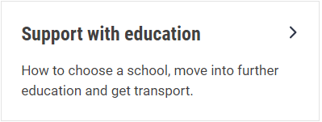
Welcome
To locate information about the Graduated Approach Briefings on the Local Offer, go to: https://professionals.lincolnshire.gov.uk/homepage/54/graduated-approach-briefings
Or on the Home Page, click on: Support with Education
Then scroll down to: Graduated Approach Briefings
Welcome and thank you for joining us for this virtual training session.
Please sign in through the Chat to register your attendance.
As usual, to support everyone to maintain connectivity with so many attendees being here:
Please Mute your microphone and turn off your video when not speaking – we have a large number of participants present today and this may mean that we experience feedback or slowing of the network connection if everybody has their microphone and video on. However, we would like to see you if you ask a question, please, so feel free to switch on both your microphone and video in these instances.
Please note that this meeting, or sections of it, will be being recorded for use on the council’s professionals’ website. If you do not wish to be recorded, you should leave the meeting and watch it back later.
If you would like to ask questions, please use the raise your hand facility or use the chat function in Teams
Please keep discussion in the ‘chat’ relevant – the person presenting may not be able to see your comments but we will have someone monitoring it in order to make sure all questions are answered.

Slide 3
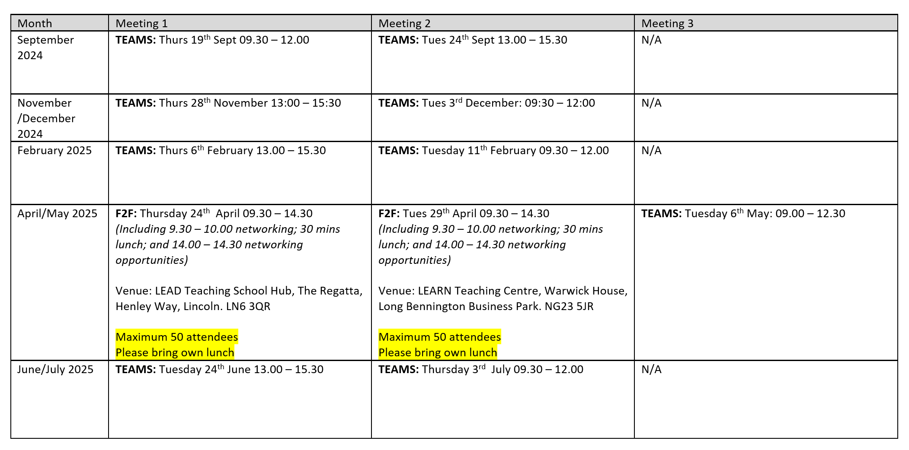
Remember to book your places for each briefing throughout the year on the Local Offer
Graduated approach briefings – Professional resources (lincolnshire.gov.uk)

Slide 4
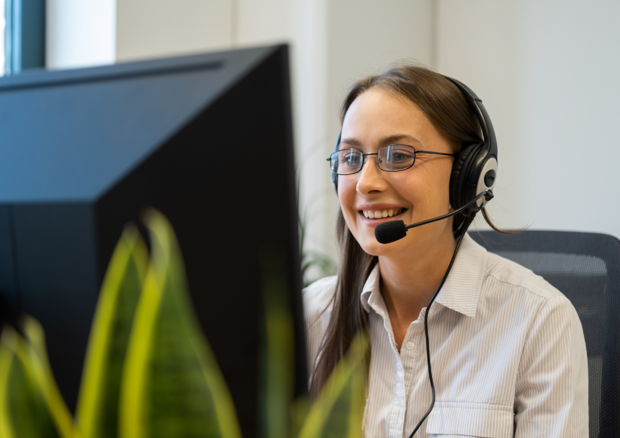
Children’s occupational therapy advice service
Parents, carers and professionals will be able to phone the advice line and speak to a clinician who will be able to offer advice and support children/young people with general fine motor problems and activities of daily living that affect their participation in terms of play, education and leisure.
Who can use the advice line?
The advice line is open for parents and carers across Lincolnshire with a Lincolnshire GP. Please call in on 01522 459848 . We will take your child/young persons details and nature of your concerns. You will then be booked into a designated 20-minute slot, which includes admin time, where an experienced Occupational Therapist will call you at the planned time.
All Lincolnshire health, social care and education professionals can use the line with consent from the child’s parent/carer. You will need to complete our online referral form to ensure we have consent. Once we have received your online referral, we will email you acknowledgement of receipt and ask you to call in on 01522 459848 to book a designated telephone slot.

Slide 5
Children’s occupational therapy advice service
Purpose of advice line:
To discuss the appropriateness of referrals into the service where specialist assessment may be required
To offer reassurance around normal development, red flags and when to refer on for occupational therapy specialist assessment
To sign post to other resources and services
To sign post and give information about LCHS courses
To offer low level advice around fine motor skills, activities of daily living, sensory needs, postural needs, reasonable adaptions to the nursery/classroom and low level equipment needs.
For further information please visit:
Children's Occupational Therapy :: Lincolnshire Children's Therapy Services (lincolnshirechildrenstherapyservices.nhs.uk)

Slide 6
New telephone number for Children’s Therapy Services
There is a new telephone number for Children's Therapy services effective
from 3rd June 2024.
Please call 01522 459848 for Children's Speech and Language, Physiotherapy,
Occupational Therapy and All ages Rapid Response services.

Slide 7
Lincolnshire Virtual School
Training events
Our training offer has been developed to better support settings in promoting educational outcomes for our children in care, children previously in care and children with a social worker. You do not have to have a child in care to attend the training.
The Virtual School had a very informative training session in May, which was recorded with permission from Lincolnshire Psychology Services so that others can access it:
Improving Writing Through Sensory Development and Working effectively with other professionals. This will be available after 15th June here:
Graduated approach briefings – Professional resources (lincolnshire.gov.uk)
Please don’t hesitate to contact us via email: VirtualSchoolTraining@lincolnshire.gov.uk if you
require any further information or advice.
Notes:
Jen

Slide 8
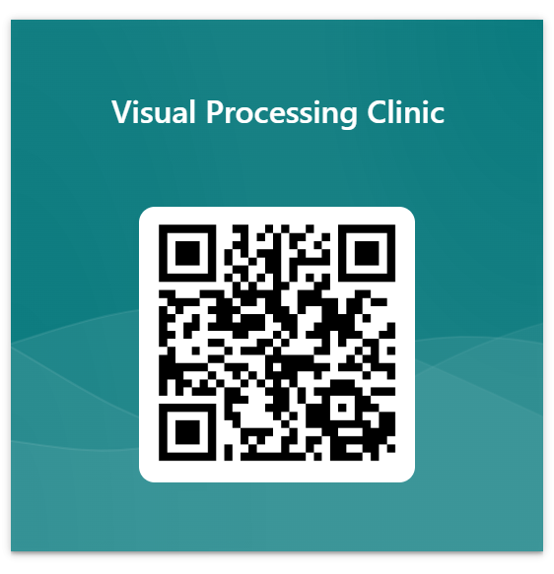
Visual Processing Clinic
Let us know by completing this short form whether you would like them to attend in the Autumn term.
https://forms.office.com/e/x0wTdtFKwU
Reminder: The new Visual Processing Clinic Referral Form was uploaded to the Graduated Approach Briefings page. Please find it in the February 2024 downloads section.

Slide 9
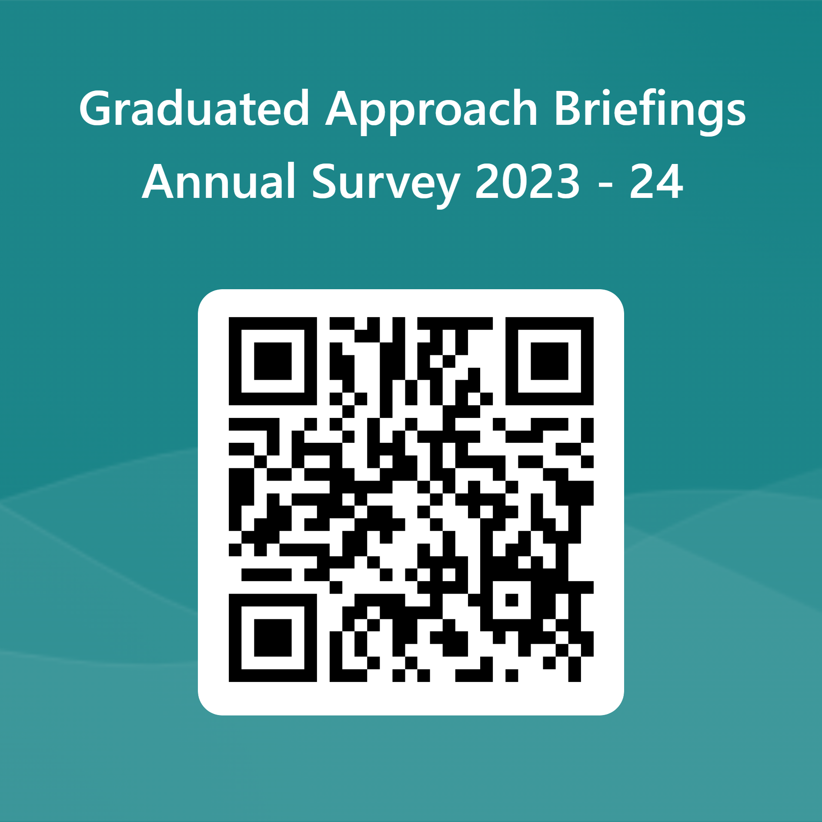
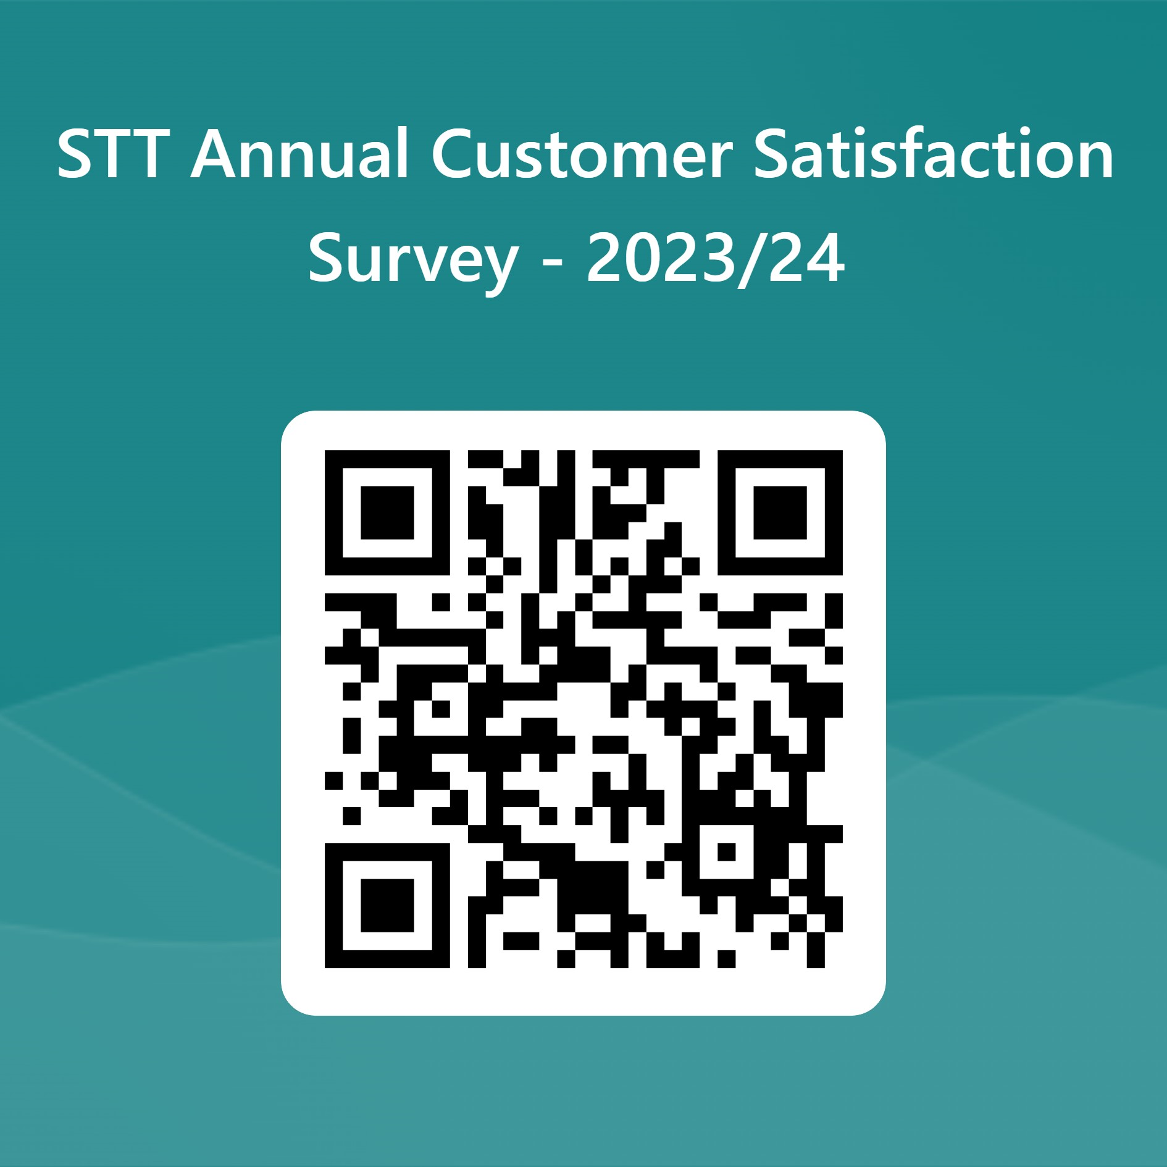
We need your views. Please complete these surveys to help us to help you!

Slide 11
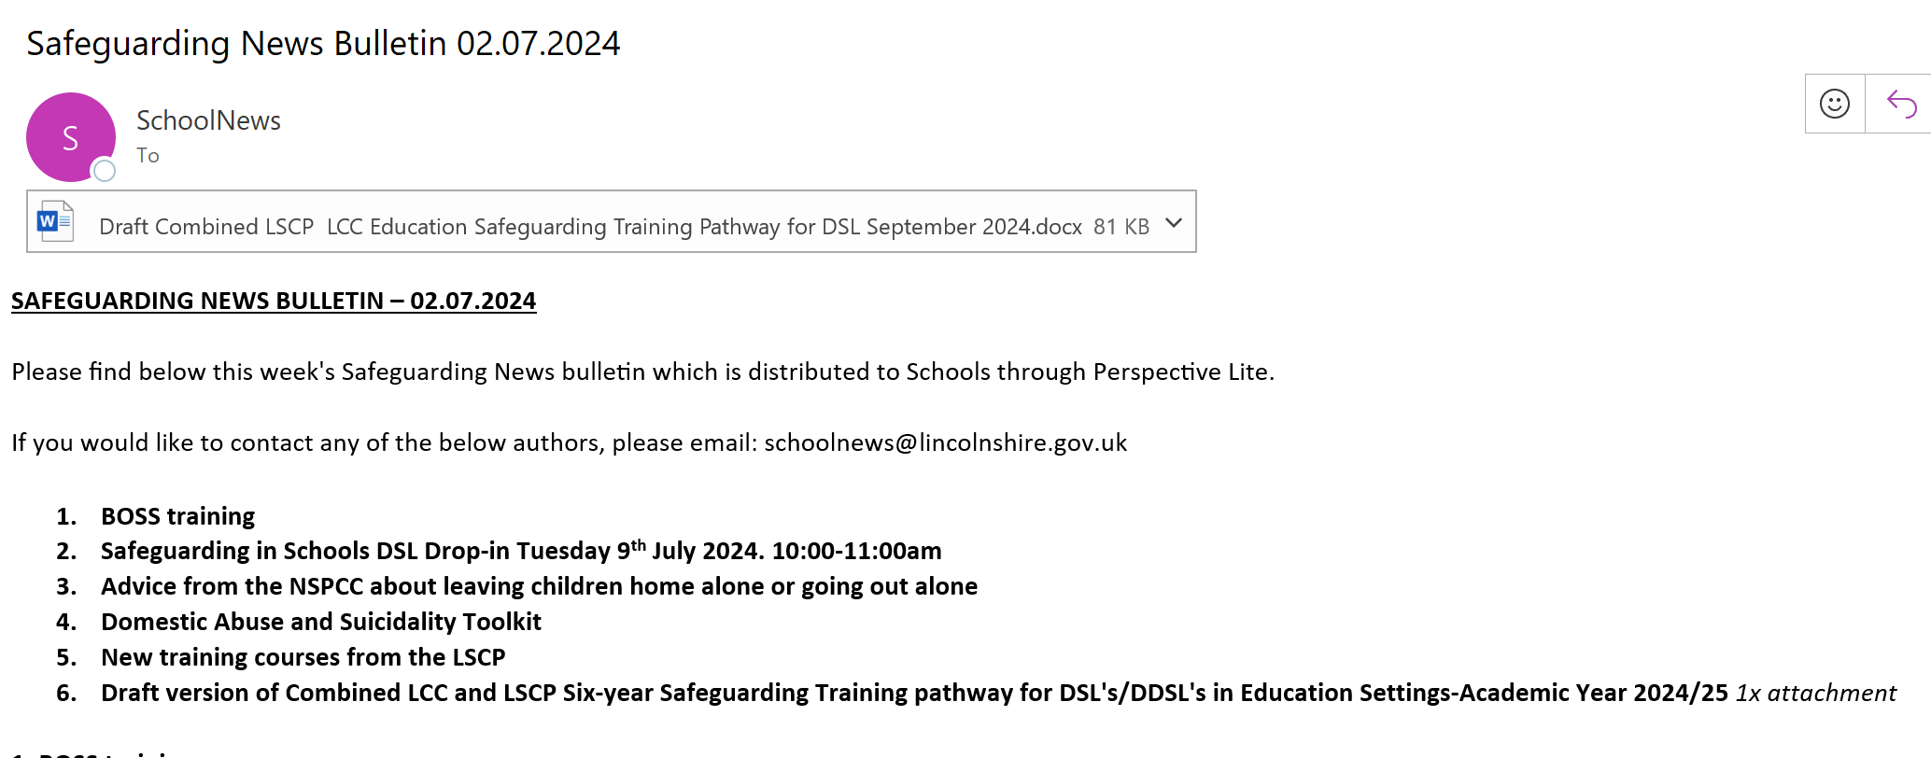
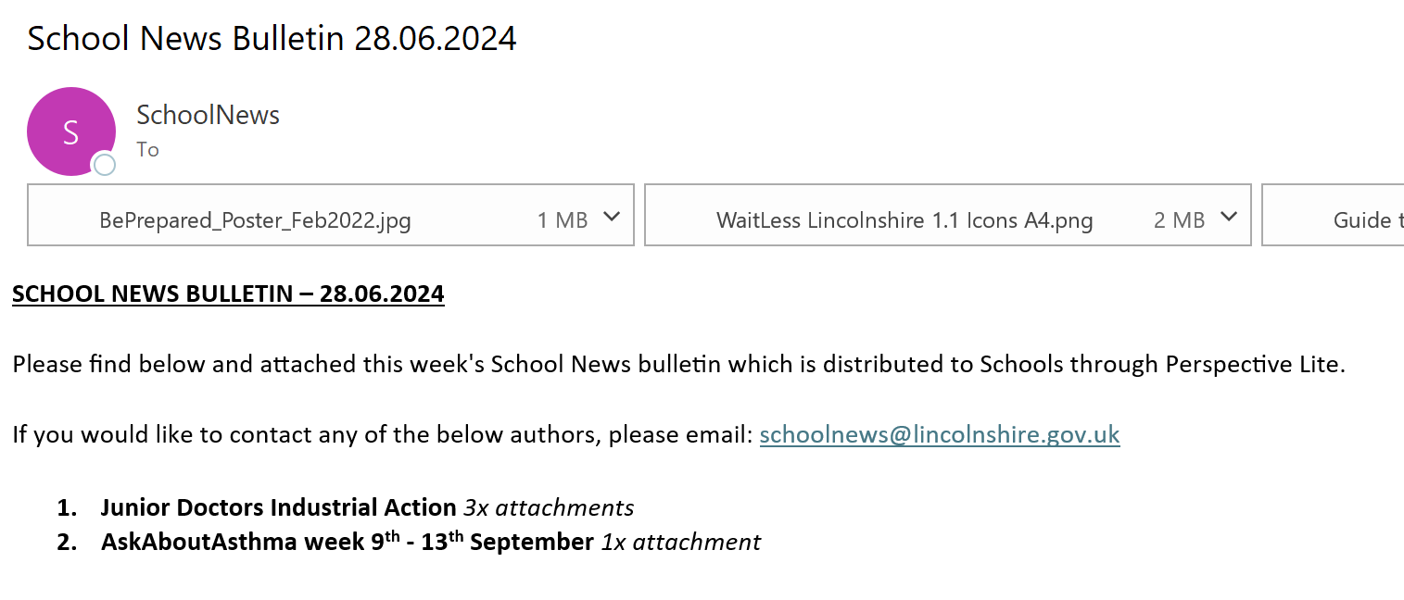
School News Bulletins
Do you access the weekly School News bulletins on Perspective Lite? These come out every Friday and the School News Safeguarding Bulletin comes out every Tuesday.
To get a login, speak to your headteacher as they hold the admin rights for your provision.

Slide 12
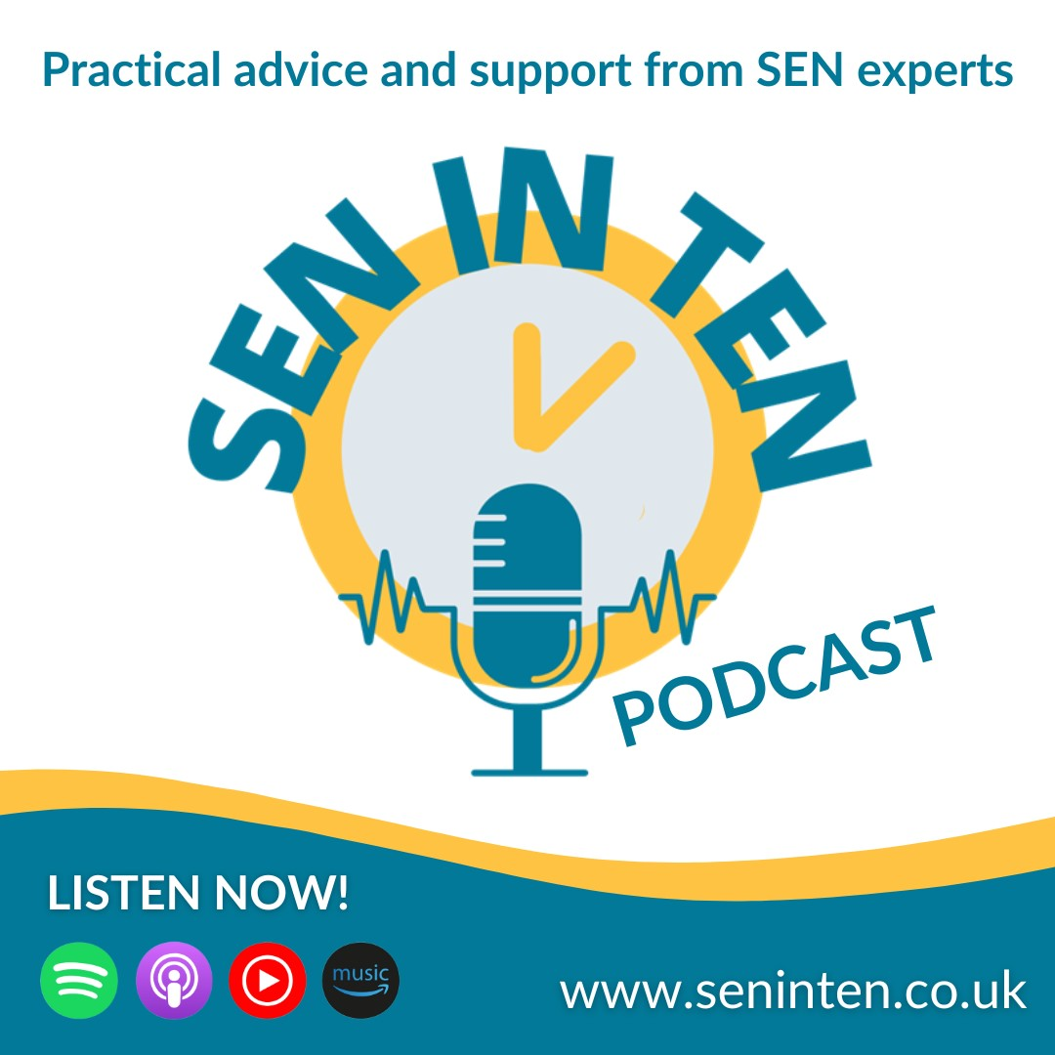
New Podcast

Slide 13
Presentations and Videos will be available from 15th July
Remember to visit the Graduated Approach Briefings page on the Local Offer so that you can view the presentations and videos for this round of briefings and any from the previous academic year.
Graduated approach briefings – Professional resources (lincolnshire.gov.uk)

