Slide 1
Preventing School Avoidance in children with ADHD
Sharon O’Dell

Slide 2
What am I aiming to do?
I want to reduce the prevalence of school avoidance, for children with ADHD, in Lincolnshire and ultimately the whole of the UK
I repeatedly see how strategies used by the adults around children with ADHD often create anxiety and anger, leaving them feeling unwelcome and unsafe in their education setting
I have witnessed that current methods to manage school avoidance in the UK are typically not working for ADHD children; in many cases they exacerbate the situation and numbers are increasing
I am passionate about supporting children with ADHD to meet their potential in life. To do this it is vital to learn from countries who have effective interventions in place to support Children with ADHD to remain in school
I aim to provide understanding and develop affirmative guidance to prevent children with ADHD feeling that they have no choice but to avoid school

Slide 3
How widespread is the problem?
Our world has changed and continues to change, yet there is no pervasive change in the way children with ADHD are supported to stay in school
There is wider acceptance that ADHD is not just about behaviour, yet it continues to be the practice in UK schools to manage through detention, internal isolation, or exclusion
The impact is that children experience various traumas throughout the school day, resulting in them pathologically avoiding school, affecting mental wellbeing
I want to support schools to replace punitive practice with proven restorative interventions to keep children with ADHD in school in a way that does not impede them further but meets their needs and supports them to meet their potential and have a positive school experience

Slide 4
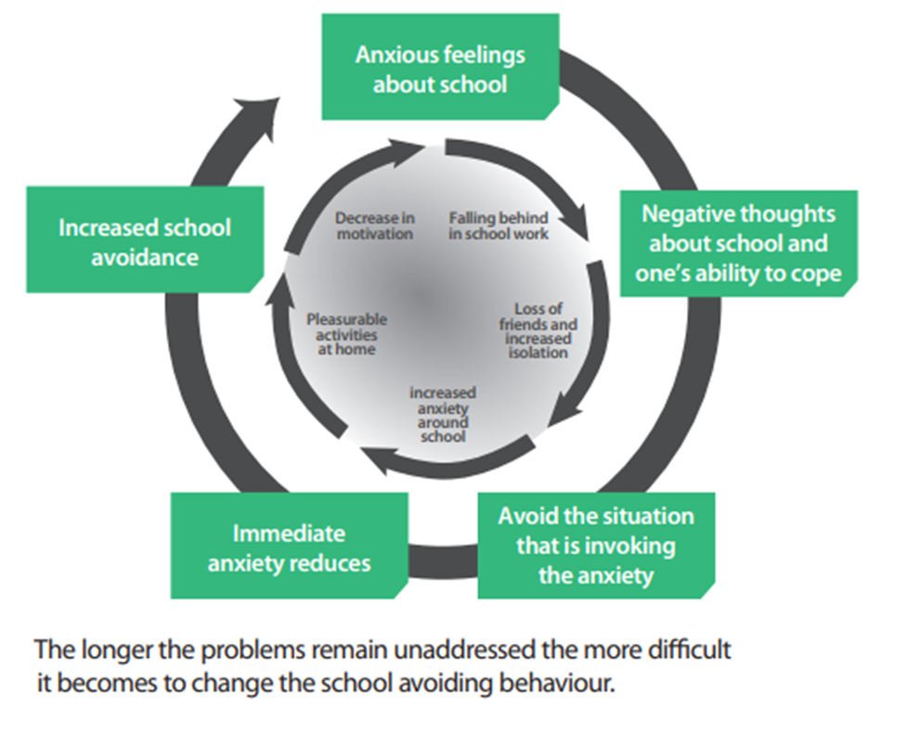
Signs of Emotionally Based School Avoidance
EBSA can be so gradual in onset that it is hard to notice at first
It can begin at any point in a child’s academic journey, but there do seem to be higher rates between periods of transition between school phases, primary to secondary school, changing schools etc

Slide 5
Signs of Emotionally Based School Avoidance
Common signs include:
Stomach aches, headaches and other physical symptoms that have no apparent medical cause.
Asking to stay home for trivial reasons
Withdrawing from social activities
Increased anxiety, panic attacks and/or depression, lower self-esteem and lack of confidence
Becoming extremely agitated, tearful and/or angry when asked about school
Refusing to leave their parents or get out of the car
Patterns in absences, for example, particular days and/or subjects, after weekends and holidays
Expressing a desire to attend classes but is unable to do so
Social isolation and avoidance of classmates or peer group
Confusion or extreme absent-mindedness shown in school

Slide 6
School Avoidance is extremely commonplace in children with ADHD Yet the EBSA pathway is typically not offered to them

Slide 7
What causes school avoidance?
“School refusal occurs when stress exceeds support,
when risks are greater than resilience and when
‘pull’ factors that promote school non-attendance
overcome the ‘push’ factors that encourage attendance” (Thambirajah et al., 2008)
A ‘push’ towards school would be when a child
finds school ‘easy’, can access lessons, learns
well and is academically bright
A ‘pull’ away from school could be that schools
are too noisy, the fear of the unknown and
pressure to succeed academically

Slide 8
So why are children with ADHD regularly excluded from the EBSA pathway?
A school’s response to ADHD tends to be to:
Introduce a more punitive approach
Increase sanctions
Introduce a stricter behaviour policy
This exacerbates the problem and leads to:
More extreme behaviours
Increased school anxiety
Even higher numbers of school avoiders
Missing the signs of inattentive ADHD

Slide 9
Why does the punitive approach not work?
The words punishment and discipline are often used
interchangeably; however, they are not the same:
Punishment is a punitive measure meant to stop a behaviour
Discipline is a teaching process; punishment can be a part of the
discipline process, but to be effective it should be balanced with
recognising and rewarding positive behaviours
The actions of a child with ADHD typically aren’t so much misbehaviours as they are a lack of the skills needed to control and manage symptoms of ADHD
Punishment alone doesn’t generally work for children with ADHD because it is based on the premise that the child willingly did something wrong and the consequence or punishment will prevent the behaviour from occurring again
Typically, the child hasn’t “willfully” misbehaved, he just hasn’t managed ADHD symptoms -- and that could be simply because he doesn’t yet have the skills to do so

Slide 10
Teachers report that:
They are spending more and more time in the classroom managing disruptive behaviour from children with ADHD
The most commonly reported disruptors such as the inability to process instructions, pay attention and control impulses make the classroom a very challenging environment for a child with executive functioning impairments
Some schools still suggest that this is choice behaviour

Slide 11
My research has taken me across Europe and the USA with the following objectives:
Develop a bespoke questionnaire to be completed by ADHD pupils and parents who are currently school avoiding and those who have previously not attended school
1
Gather expert opinions from Educational Innovators in Europe and the USA and collect data from the ADHD pupils they support, their parents and their teachers
2
Codify these opinions into a new framework
3
Write up and test the toolkit
4
Publish the toolkit to inform/be added to existing pathways around the UK to prevent school avoidance of children with ADHD
5

Slide 12
Highlights from my Research in Europe and the USA
Change the Culture of the School
Imperative to look beyond the behaviour
The School curriculum needs to accommodate Executive Function
Stop reliance on punitive measures to manage ADHD

Slide 13
You can help us to support your pupils and families by….
Adding us to your school website
Informing your parents of our services
Sending our brochure to your parents
Sharing our factsheets with your staff

Slide 14
Thank you for listening
Sharon O’Dell
projects@adhdlincs.org
adhdlincs.org
Facebook/adhdlincs
LinkedIn

