Slide 1
L.E.A.D. Teaching School Hub
Updates and Headlines
‘Working in Partnership, Achieving the Highest Outcomes for All’
Notes:
Welcome

Slide 2
Recruiting for Oct 2024 soon
New NPQ SENCO
to start October 2024
Mandatory for SENCOS
Valuable for other leaders/teachers
NPQ Leading Primary Maths
In partnership with the Maths hub and Redhill T S Hub
1
Notes:
5 specialist NPQ programmes available for 2024/25 / 5 leadership NPQ programmes
When these run will be dependent on numbers of applications – we are anticipating only one cohort for some of the programmes – Feb 2025 to make the size of the groups viable so that participants get an excellent experience. Other more popular programmes will have two cohorts Oct 24 and Feb 25

Slide 3
NPQ Updates
For October’s cohort, the DfE will fund up to 10,000 places in total
All state schools will be eligible for fully-funded places on the NPQ in Headship, NPQ for SENCOs, NPQ in Leading Primary Maths and Early Headship Coaching Offer only
For all other NPQs, schools with the highest 50% of pupil premium pupils will be eligible for fully funded places, as well as early years and 16 to 19 educational settings identified as having high disadvantage
Notes:
Funding
EDT leaving the NPQ landscape as a Lead Provider – honouring those that are currently on programmes
Lead provider for NPQLPM – continue in our partnership with the maths hub and Redhill Teaching School Hub and NPQSENCo will be with Teach First
Applications remain closed – will update when these open – ask schools to submit an expression of interest via the LEAD T S Hub website
FUNDING – NPQH/NPQEYL/NPQLPM/NPQSENCo - All schools eligible for funding also includes EHCO – Early Headship Coaching Offer if within first 5 years of Headship and have NPQH or on the programme
Early years leadership NPQ funding
For the early years leadership NPQ, scholarship funding is also available for some early years professionals.
You need to be, or be employed by, one of a:
maintained nursery school in England
pre-school class or nursery that’s part of a maintained school in England
pre-school class or nursery that’s part of an independent school in England providing free early years entitlements places
nursery that is registered on the Ofsted Early Years Register
childminder registered on the Ofsted Early Years Register, or with a registered childminder agency
Earlier this month, the DfE shared with us a list of schools that they anticipate will be eligible for the newly announced scholarship funding
These schools have not been formally confirmed and the list may change if a school’s pupil profile changes. Strongly advise schools to express an interest in the programmes they want to take part in as will first come first served basis as only so many funded places to allocate.

Slide 4
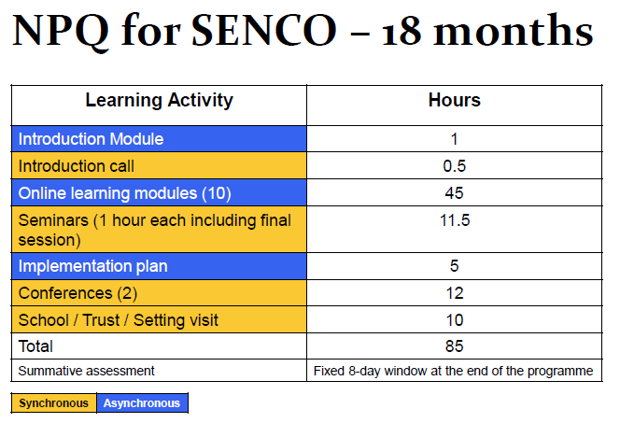
NPQ SENCO
Notes:
The 3-year window to complete the mandatory qualification on taking up a SENCO post will remain following the introduction of the NPQ for SENCOs.
In terms of commitment – time
See the amount of time you will spend on online learning / seminars / attending the two conferences that will take place across the 18 months and then school visits

Slide 5
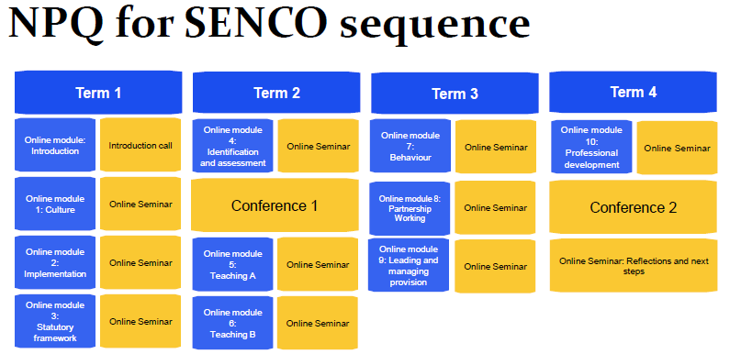
NPQ SENCO
Notes:
In terms of how this spans out across the 18 months – split across 4 terms

Slide 6
Reading Ambition for All:
Teaching children who need the most support, including those with SEND.
Notes:
New programme for September 2024 through the English hub – fully funded.
5 modules across the academic year with Gap tasks
Aim: Improve outcomes for children who need additional support with reading, including those with SEND
Help delegates identify the causes of the attainment gap between pupils with SEND and other under achieving pupil groups.
Modules offer practical advice on how to use the validated SSP programmes successfully by exploring the principles and adaptations to use with the lowest attaining pupils and those with SEND.
Aimed at Reading Lead / SENCO – HT at modules 1 and 4
We are only able to take on 10 - 20 schools so if you are interested get in touch.

Slide 7
LEARN SEND HUB Offer for 24/25
LEARN provides bespoke CPD and school support through a wide range of specialist SEND and mainstream colleagues, some of which is SEND-specific. However, our focus is to ensure that every child receives access to high quality education.
www.learnsendhub.co.uk

Slide 8
SEND Leadership – A Tiered Approach
A tiered training programme aimed at supporting school leaders to understand their individual responsibilities within the leadership of SEND.
Tier 1: Leadership
Aimed at senior leaders in schools to clarify what strategic leadership of SEND is and develop a SEND focused scheme of delegation.
Tier 2: SENCos
Aimed at SENCos, to support them in being strategic leaders, linking closely with the senior leadership team to cascade information and training throughout the school
Tier 3: Middle leaders
Aimed at Middle Leaders to ensure that they have a clear understanding of statutory requirements in relation to SEND.
Tier 4: Teachers
A toolkit of 12 online, live modules which can be accessed by all Teachers depending on their individual CPD requirements.
www.learnsendhub.co.uk

Slide 9
Teaching Assistant – SEND-Specific Modules
Managing behaviour Modules
A toolkit of 12 modules which can be accessed by all teaching assistants working with pupils with SEND in mainstream primary and secondary school settings. Developed to assist teaching assistants in developing their skills, effectiveness and confidence when working with pupils with SEND.
A toolkit of 11 modules which can be accessed by all staff who wish to understand and manage different behaviours in the classroom.
www.learnsendhub.co.uk

Slide 10
Adapted Teaching
Adaptive teaching is a pedagogical approach to education that tailors instruction to meet the individual needs of pupils. It involves continually assessing pupils' progress and adjusting teaching strategies and content accordingly. This two-day programme of professional learning will explore:
Day 1
The context of adaptive teaching and the statutory guidance in which we operate
Adaptive teaching – what it is and what it isn’t
High quality teaching principles
Practical strategies for adaptive teaching focussed on the four broad areas of need
Day 2
The role of assessment in ensuring timely and accurate adaptations
The role of teachers and TAs in curriculum adaptation
Effective communication strategies (for within school and also for working with parents and carers)
Practical strategies for adaptive teaching focussed on the four broad areas of need
www.learnsendhub.co.uk

Slide 11
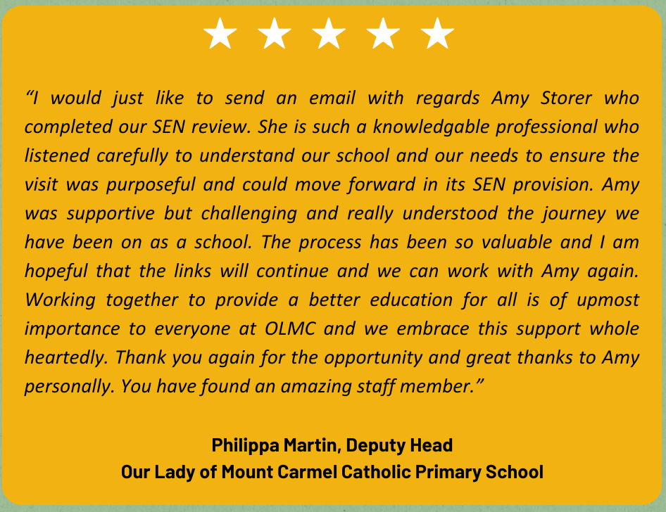
Bespoke School to School Support
Every school is unique, and the support we provide is tailored to meet the specific needs of the school and its staff.
Below are some of the ways in which LEARN can assist:
Providing support for newly appointed SENCos
Supporting existing SENCos
Conducting onsite training for teachers and teaching assistants
Reviewing and refining systems and processes
Conducting a SEND Review
Facilitating discussions to problem-solve and create action plans
Guiding through the EHCP process
Implementing policies into practice
Mapping out continuous professional development opportunities
Tracking EHCP outcomes
www.learnsendhub.co.uk

Slide 12
SEND Workforce Development
Scan the QR code to register for FREE!
7800+
Modules
completed
311
Lincs schools
engaged
99%
Satisfaction
rate
25
Average mins per module
chris.lincoln@learnsendhub.co.uk
Notes:
The SEND Workforce Development project continues to be accessed by staff in schools across Lincolnshire.

Slide 13
SEND Workforce Development
Modules available include:
Induction Tier:
(Now also available to parents)
Types of SEND
Awareness of a Neuro-Typical Child
What is Inclusion?
SEND Code of Practice
Respecting Individuals
Working with Professionals
Tier 1:
Sensory Processing and Integration
Supporting Transitions
Support Interventions
Restorative Practice
Four Areas of Need
Nurture Principles
Personal Care and Dignity
Introduction to Attachment
Introduction to Trauma
Scan the QR code to register for free:
@SENDworkforce
“A very clear and concise toolkit
of strategies. I enjoyed working through the scenarios and the downloadable content”
chris.lincoln@learnsendhub.co.uk
Notes:
All of these modules are live and available to access. Introduction to Trauma has just gone live. A reminder that any member of staff who has an account on the Lincolnshire Safeguarding Children Partnership platform, should be able to see and access all of the modules that have gone live when they sign into the platform. If any staff need support, they can contact us through the QR code and a member of the team will get in touch.

Slide 14
SEND Workforce Development
Parent Flyer
Scan the QR code to register for free:
@SENDworkforce
chris.lincoln@learnsendhub.co.uk
Notes:
Induction Tier modules are available to parents for free. If you would like a flyer about the content that you can send to parents and carers, please contact Chris on the email address at the bottom of the slide. We are really looking to promote this content to as many parents as possible.

Slide 15
SEND Workforce Development
Case Study
Scan the QR code to register for free:
@SENDworkforce
chris.lincoln@learnsendhub.co.uk
Notes:
Case study from an external professional

Slide 16
Notes:
The impact of the modules

Slide 17
SEND Workforce Development
How schools use the modules…
Whole staff training during Inset Days or remotely
Inset Day or remote training for specific staff members such as Teaching Assistants
Part of an induction for new staff members
Specific modules for specific staff. For example, Personal Care and Dignity for staff members who support a young person with toileting
Signposting for staff who wish to explore further CPD
Scan the QR code to register for free:
@SENDworkforce
All of the content remains free to access
chris.lincoln@learnsendhub.co.uk
Notes:
You can pick and choose the modules most relevant to your staff and school. Here are some examples of how schools have used the modules

