Slide 1
Adopting an inclusive approach to teaching and learning in our setting
Notes:
1

Slide 2
How did our journey begin?
Began in 2020, following the OFSTED review regarding children with 1:1s in the corridors with an adult and not accessing the full curriculum, us seeing an increase in SEND needs entering our school, limited spaces for SEND places across the county, it creates a middle ground where children can succeed whilst evidence is gathered for an EHCP and a desire to offer something different for our community.
Carried out a review of the impact of 1:1 teaching assistants and found there was a huge variance depending on confidence and qualifications of the TA. Children often over reliant and TAs struggled to facilitate learning effectively often due to subject knowledge.
Planned a different model following a revolving door approach. Children in year 2-6 who were still accessing a Reception/Y1 curriculum were grouped together for Maths, English and communication and language using a play-based approach in the mornings only.
There were 8 children (half with EHCPs) accessing the provision with one teacher (special school trained) and a TA.
After 4 months we found that significantly more progress was being made in that period of time, than the last year. Children were growing in self-esteem which was resulting in them being more confident and this was seen in non-core lessons with their age-related peers. Some then started moving back into their year group class for Maths and English.
2

Slide 3
4 years on … Where are we now?
From working with local nurseries and our own we knew there was a large influx of children with need coming up (8 children in our 23/24 reception cohort have EHCPs (most with significant needs)
Now have 2 provisions- Atlas (2023) and Everest (2020)
We have 4 curriculums running across our school. Informal, semi formal, formal and mainstream.
Atlas room caters for children with high needs who are working on an informal/semi-formal curriculum using an EYFS approach.
Everest room works on a formal curriculum (Year 1 / 2) is aimed at children who require a slower pace and are significantly behind their academic year group.
3

Slide 4
Atlas
Opened in September 2023.
Staffed with x2 full time TA’s both with experience of SEN needs and x1 full time teacher.
Currently has 10 children from Reception to year 2. All children have an EHCP (most with significant need) or in the process of receiving one. (Next year this will be 12.)
Offer of a pathway curriculum (used in SEN schools)
Children are in a room with minimal stimulation. All equipment is stored and brought out when used.
Day broken into shorter activities, more outdoor continuous provision, regular snack breaks, toileting and nappy changes timetabled into the day to support with toilet training.
Children are more regulated throughout the day.
More thorough handovers with parents due to smaller class size and higher adult ratio.
All children are making small steps of development in communication and interaction.
Able to accept more consults due to the provision we can offer.

Slide 5
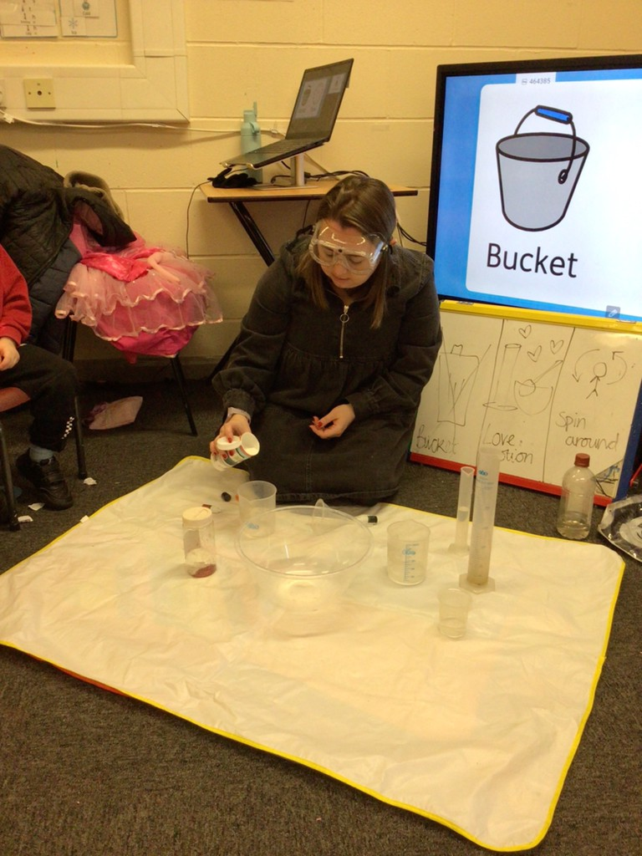
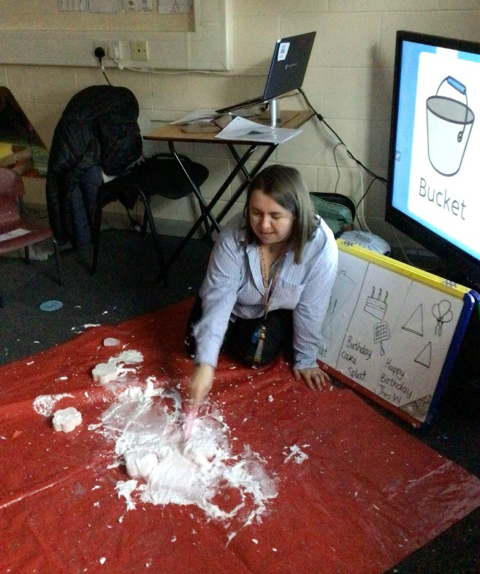
Some useful Gina Davies Bucket Time links…
https://www.bing.com/videos/riverview/relatedvideo?q=gina+davis+bucket+time&mid=0291D053D585533A81A60291D053D585533A81A6&FORM=VIRE
Practical Help with Autism | Gina Davies Autism Centre
Attention Autism stage 1: Attention bucket and comments from Gina Davies (autismspectrumteacher.com)
Bucket-Time-Ideas.pdf (sendat.academy)

Slide 6
SEN Curriculum
Researched and looked at a lot of SEN schools over the country to see what they offer with regards to curriculum and tracking.
Adopted the pathway curriculum alongside a themed curriculum. Try to align as best we can with the EYFS curriculum.
Tracking – we use Tapestry and use the Cherry Tree tracking alongside the WTT AET progression framework.
Planning – use PLIMS developed from a child’s EHC.
Child friendly targets and how to help me guides visible in classroom.

Slide 7
Typical day in the Atlas room
Breakfast
Circle time – songs, days of the week, register
Activity – creative/fine motor
Outdoor provision
Snack
Bucket phonics
Outdoor provision
Lunch
Bucket time
Indoor continuous provision
Tray time (working on individual targets from their PLIMS)
Bucket Maths
Outdoor provision
Sensory time/deep pressure massage
Home time

Slide 8
Challenges
Every day is different – must be highly flexible to manage children's daily needs.
Resources for weekly themed planning.
Higher rates of illness and absence. This impacts children and adults in the room.
Managing physical behaviours – change of room layout, equipment, more physical contact with children.
Tracking and monitoring children.
Future planning for children.

Slide 9
Impact
Children receive an individualised curriculum
Children are making more rapid small steps of progress due to this approach
Children have opportunity to access a wider array of resources. E.g children taught to communicate using Makaton, PECs, electrotonic communication aids.
Bucket time has had a dramatic impact on focus and listening skills (Gina Davis is well worth looking at)
Visual routine and music has helped with developing calm transitions
Lots of CPD for our staff from Gosberton house and other training providers.
9
1 May, 2024

Slide 10
Everest
1 teacher and 12 children from years 2-6
2 children have EHCPs. The rest don’t as not required due to needs being met.
Work on a year 1 and 2 curriculum for the mornings only focussing on Maths and English. Go back to their classrooms in the afternoon for an adapted curriculum.
Use of InPrint in all lessons. This supports reading and writing in lessons.
Colourful semantics

Slide 11
Impact
Rapid progression seen with children with independence skills, reading, writing and number knowledge and function.
Boost in self-confidence.
Less behavioural difficulties – meeting their personal needs more effectively.
Slower pace with lots of repetition of learning.
Children returning to their classroom permanently for core lessons due to progress and significant gaps being filled.
11

Slide 12
Challenges
Planning for children with a variety of strength and weaknesses is time consuming.
Additional resources to support learning.
Coordinating timetables with the child's year group for non-core subjects that are delivered in the morning (PE).
Ensuring there is a clear criteria for children who should be accessing the Everest room.

Slide 13
If you would like to see us in action…
Callum Clay
Headteacher
callum.clay@sleafordchurchlane.lincs.sch.uk
Sophie McCordick
SENDCo
Sophie.mccordick@sleafordchurchlane.lincs.sch.uk
13
1 May, 2024

