Slide 1
SEND Advice Line Lincolnshire (Ask SALL)
Current Team Members
Sharon Drewery
Linda Baldwin
Nicole Amott
Contact:
AskSALL@lincolnshire.gov.uk
Notes:
Sharon – Early Years and ESCO
Linda – Primary and LSS (now STT)
Nicole – Secondary and Specialist

Slide 2
Purpose
To support settings for Children and Young People from 0-25 Years to understand and meet the needs of CYP with SEND, delivering better outcomes and maximising inclusion.
Helping settings to follow the graduated approach to CYP’s needs by providing information, advice and guidance and signposting to services and support.
The SEND Advice Line Lincolnshire (Ask SALL)
Intended Impact
The SALL service is key to efforts to: Ensure children’s needs are understood and met at the earliest point to support better outcomes and inclusion, avoiding the need for specialist provision where possible.
Support Offer
The service will offer settings:
Easy and quick access to an experienced advisor to discuss the individual child/young person, or broader school/setting issue and provide information, advice and guidance (IAG).
Signposting to the Local Offer, SEND inclusion toolkit, the Valuing SEND tool and other services to better understand and meet need.
Where appropriate, a follow up appointment with a relevant Ask SALL team member, or other professional (Educational Psychologist, Early Years Specialist Teacher) can be arranged.
Notes:
Importance of Early Intervention – signposting to relevant agencies. The reason the service was commissioned in the first place.

Slide 3
How can you access support?
The ASK SALL advice line is a professional service offered for SENDCos, SEND managers and other professionals. Our aim is to support settings with early conversations to help guide them through the graduated approach and signpost to next steps and resources to support meeting needs. We offer support to pre-schools all the way through to post 16 education settings.
For quick queries, you can call the dedicated number for the team on: - 01522 553199
- Mon- Fri 9:30 – 16:30
Examples of ‘quick’ queries:
VSEND questions including logging on issues
SEND processes including EHCNAR
Colleagues from out of county looking for the most appropriate contact
Notes:
Expand on types of ‘quick’ queries and explain how we recognise time is precious but an online referral is preferable for individual child enquiries - would allow more in depth conversation and specific direction

Slide 4
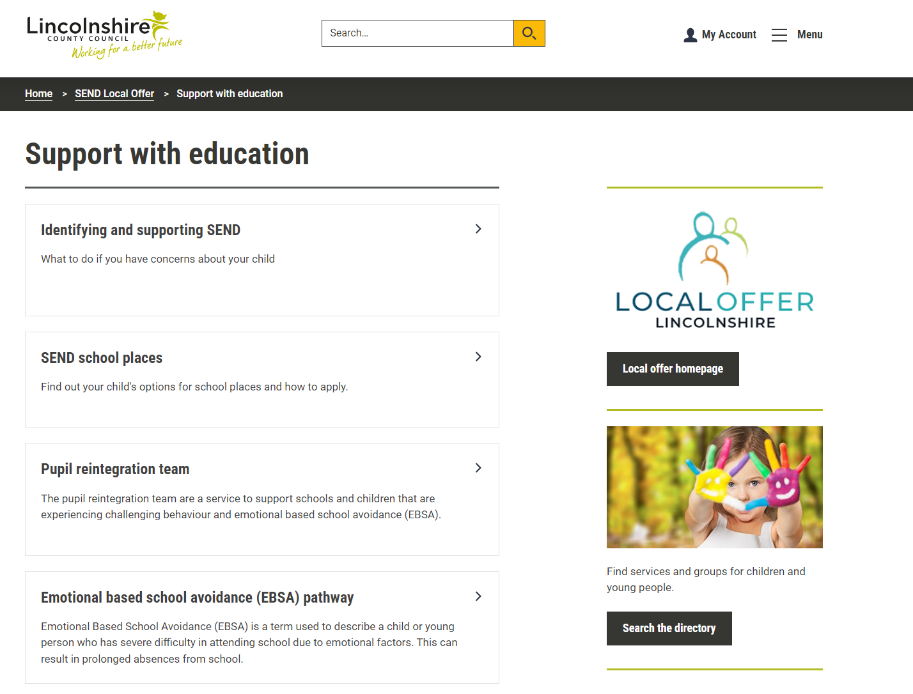
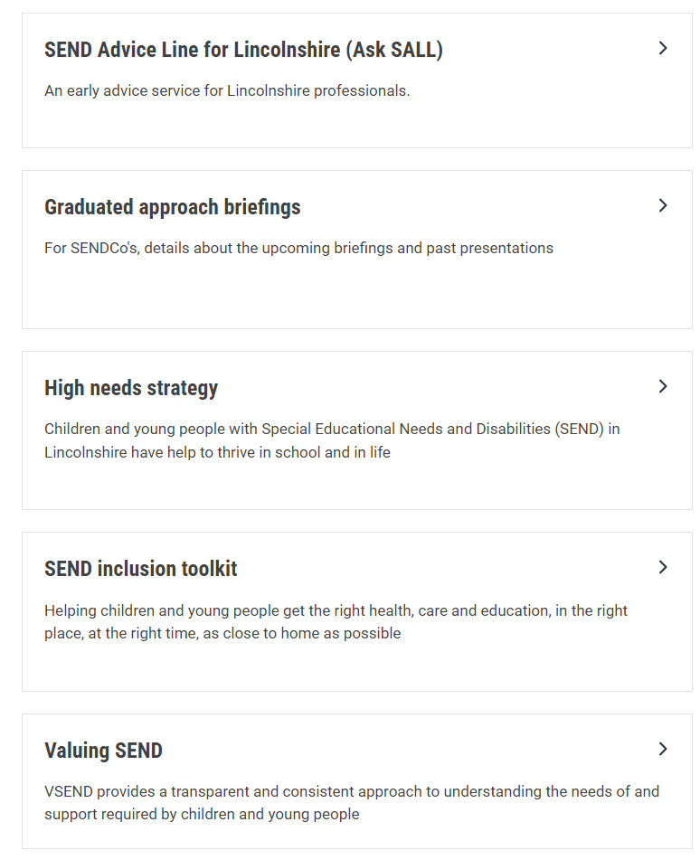
Where can you access the ASKSALL local offer pages?
The AskSALL pages can be found via the ‘Support with Education’ section on the SEND local offer homepage (scroll down to locate)
Notes:
Have disappeared off the ‘quick links’ on local offer page so do need to hunt for us!

Slide 5
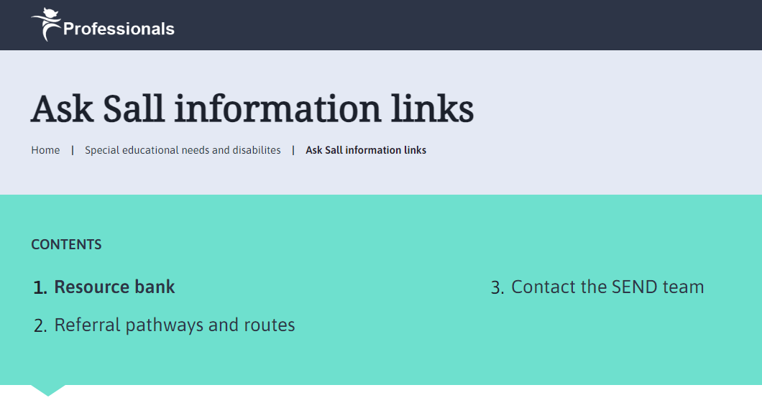
How can you access support?
Our resource bank can be accessed via the ASK SALL pages on the local offer:
Ask Sall information links – Professional resources (lincolnshire.gov.uk)
Here you can find information and links to a range of other services including ESCO, TAC, PRT, STT, WTT to name but a few.
It is here you can also access a link to both the Valuing SEND tool and the SEND Inclusion Toolkit.
Notes:
Expand on what can be found on the first page

Slide 6
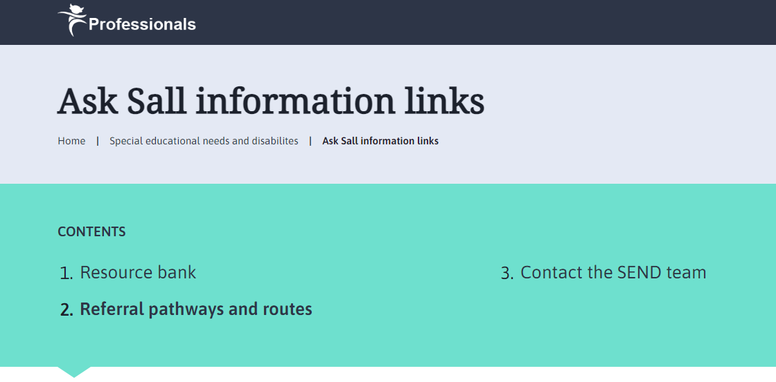
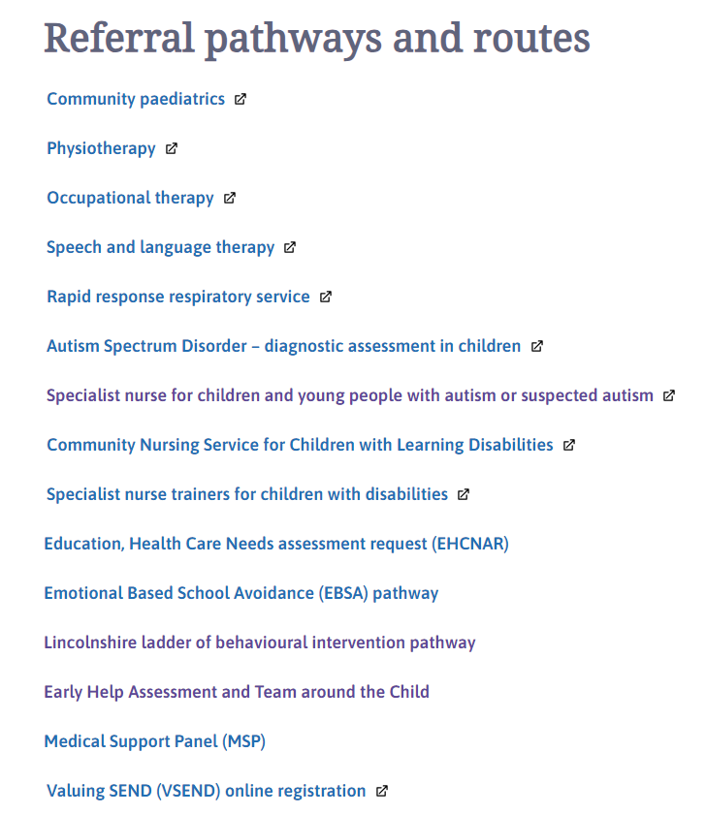
How can you access support?
Referral pathways and routes can also be accessed via the ASK SALL pages on the local offer:
Ask Sall information links – Professional resources (lincolnshire.gov.uk)
Here you can find information and links for referral pathways including Community Paediatrics
Notes:
The reason no referral forms are on there to be downloaded as they change rapidly! Instead, constant review but are reliant on other services to alert us/inform us of this. Use NHS and LCC news/communications to update this regularly

Slide 7
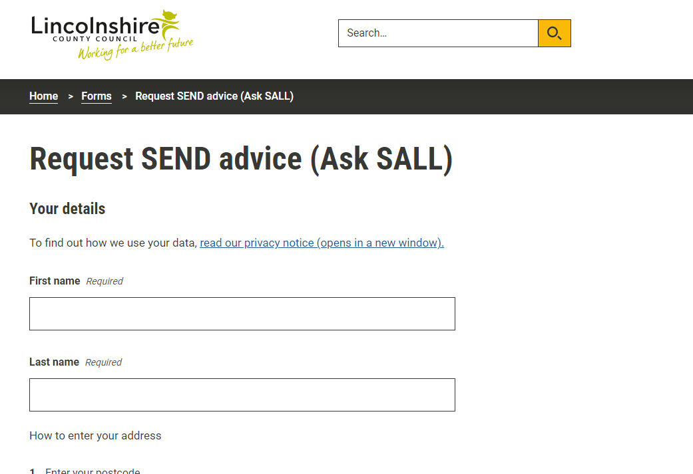
How can you access support?
For more specific information, concerns regarding individual pupils or whole school issues we ask for you to Complete the online form with brief details and reason for your consultation request.
Please consider which staff member knows the child best and would be most suitable to have the consultation with Ask SALL.
Notes:
Page three, scroll to the bottom and there is a link to the online referral

Slide 8
What is the ASKSALL process?
Once the online form is received, the Ask SALL advisors aim to respond to the contact within 48 hours. We endeavor to arrange a convenient time to call back to discuss in more detail; occasionally, a direct email response will suffice.
Are your privacy notices in place to allow you to share individual child's details with us?
Signs of safety
“Telephone conversation between XX (SALL) and XX (staff role). The notes below were recorded during the discussion and reflect the information passed to the SALL advisor by the setting. School advised that they had permission to share the child's details for discussion.”
What are we worried about?
What is working well?
Information Advice and Guidance given
Notes:
Stress the need for privacy notices in place and explain how this enables records to be linked together if access is allowed.

Slide 9
What is the ASKSALL process?
During the consult, an Ask SALL advisor will give you (and other educators/professionals supporting) time to discuss concerns at an individual or whole school level.
We then will email to:
Signpost to resources and links to support meeting a child’s needs
Direct to the most appropriate services for a child’s needs
If appropriate, arrange for further support from an experienced professional such as Educational Psychologist or Early Years Specialist Teacher.
Notes:
Time is precious – we want to be able to support and signpost and not waste time. Sometimes it can be reassurance – Sencos can feel isolated and often option to discuss with someone independent outside of setting can be beneficial

Slide 10
EDUCATIONAL PYSCHOLOGY CONSULT
These are early intervention conversations to unpick further support as part of the GA. At school discretion, parents can be invited to attend these.
They will only be offered after a full consult with SALL and if deemed appropriate/suitable (This would not result in a full EP report)
If needs are more complex and would benefit from observation/assessment then this would be for school to engage an EPS
They are offered at no cost to you in school but do cost the service so if no longer needed PLEASE give notice to cancel

Slide 11
6 week SEND allocation panel information (Education Health Care Needs Assessment Requests)
The Ask SALL advisors also sit in on Wednesday allocation panel meetings.
We do not hold decision making powers but can be asked to confirm/expand on any SALL contact.
Follow up contact and advice following declined Education Health Care Needs Assessment Requests (EHCNAR) is then offered to settings.
“I am contacting you from the SEND Advice Line Lincolnshire to see if there is any further advice, we can offer you for a case that was submitted to the Education Health and Care Needs Assessment Panel (as a parental request). The child’s initials are XX ; screening took place on xx/xx/xx and the decision was made not to proceed with an EHC Needs Assessment. The decision is now available to see on the EHC Hub and reason for decision and advice from panel is:
Please let me know when the most convenient day/time would be for me to give you a call back to discuss this further.”
Notes:
Our other role – messengers not decision makers. But do read hub submissions, discuss good practice as a team to enable other settings. Challenge too – can see the parity and fairness in the panel when discussing individual cases

Slide 12
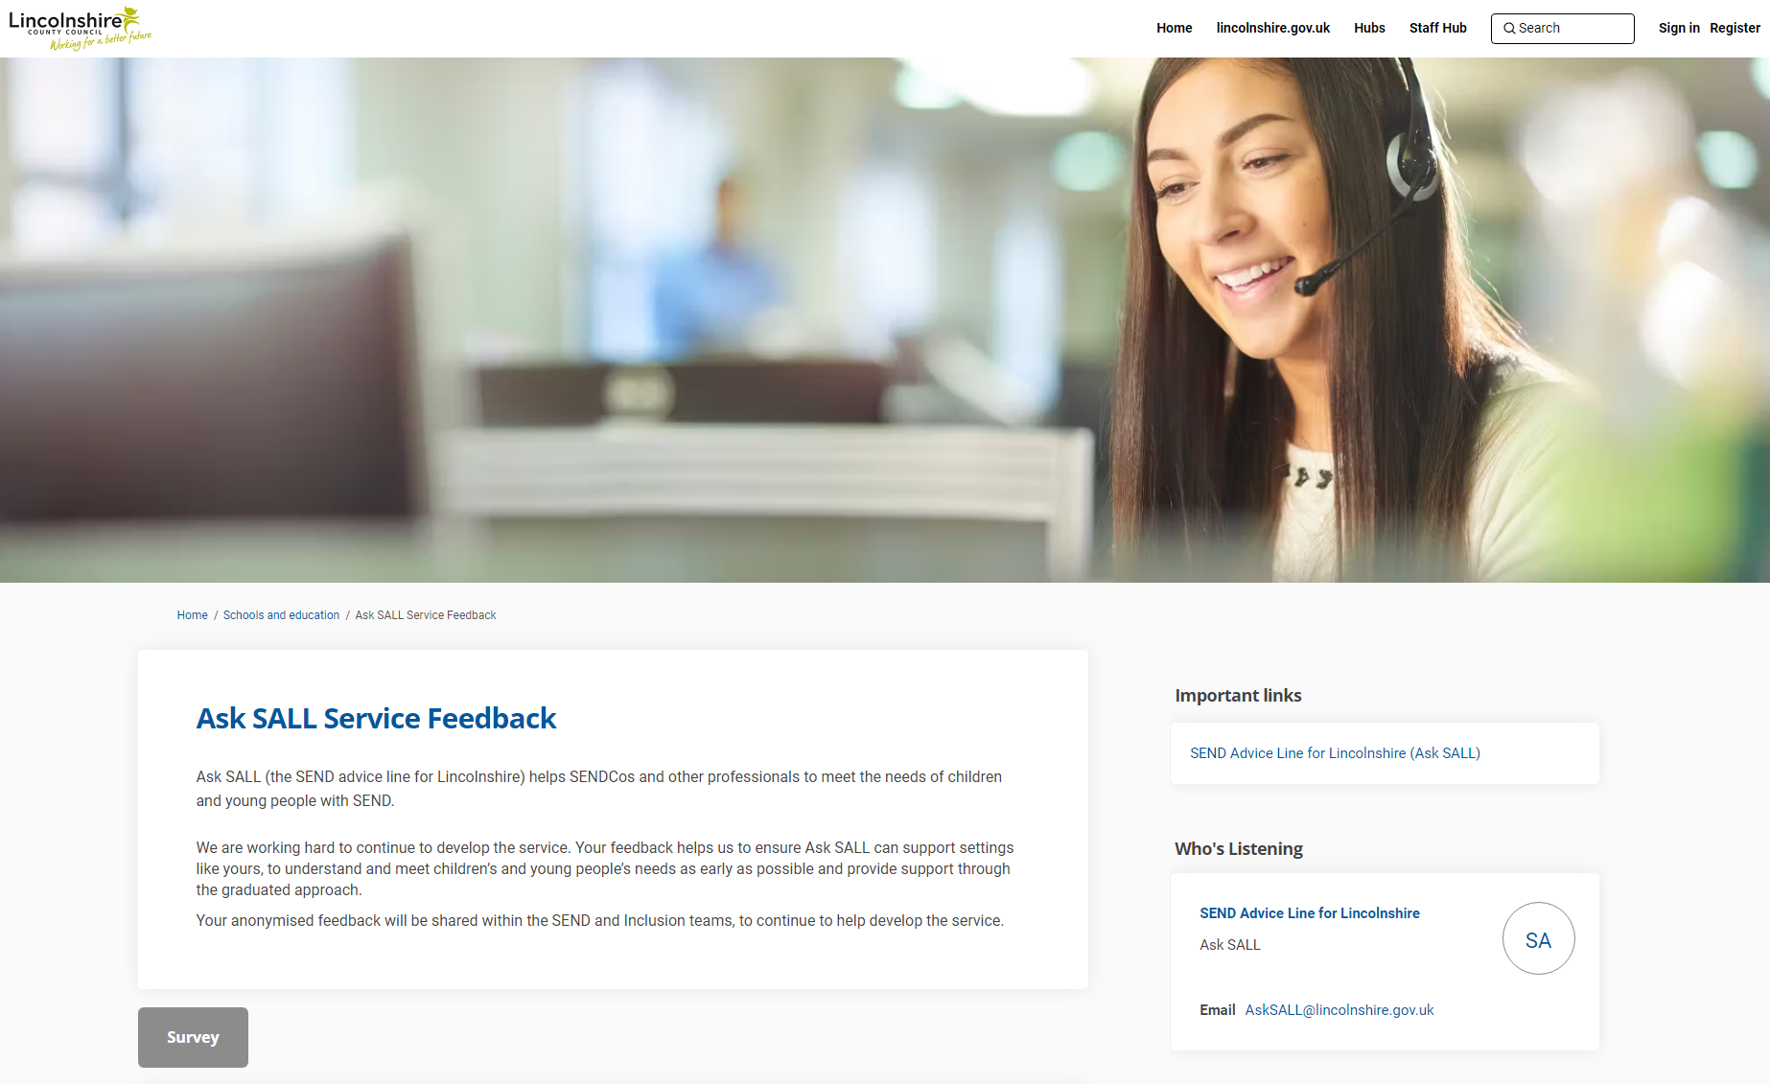
Feedback and Responses
Ask SALL Service Feedback | Let's Talk Lincolnshire
Notes:
This does matter and is important – we value the constructive messages and constantly review our practices

Slide 13
What does AskSALL do well?
‘Advisors are knowledgeable and easy to talk to. It is great being able to discuss matters ideas/support with another individual. A SENCO can often feel as though they have to be the expert on everything. ASK SALL is great for those moments that you are not’
Friendly, knowledgeable and experienced advisors
Quick response times
Option of a telephone call at a time that best suits the SENCo
Listen to concerns and unpick the difficulties being seen through a detailed conversation
Option of a follow up Educational Psychologist consultation if appropriate
Information provided on the pre contact form has been read and advisors are well prepared for the call back.
Signposting to services and resources
Support for SENCos new to the role
Opportunity to talk through support setting have already considered/implemented
Notes:
Examples from the last feedback survey

Slide 14
Areas of Improvement
Points Raised
What We Have Done
Can be extremely busy at times which delays accessing support and advice.
Updated the SALL local offer which means SENCos can find commonly used referral forms, information on most accessed services and are advised to only use the line for quick questions and directed to submit a contact form for a more detailed discussion.
Can be a lengthy wait for Educational Psychologist consultation.
Additional Educational Psychologists have been recruited to support SALL enabling us to offer more consultation slots reducing the waiting time.
Feels like a box ticking exercise sometimes to be able to obtain further support/access referrals (WTT, EBSA cases)
SALL are now able to direct SENCos to the new EBSA pathway which has been updated and offers additional support and resources.
Notes:
We do listen

Slide 15
Feedback We Have Received
“The SALL advisor was very thorough with the advice she gave. She emailed over lots of supporting documents and information within the same day. She understood that as a setting we had already done a lot to support this child, but gave us new ways to extend it further.”
“The SALL advisor was very helpful and professionally precise in terms of support. She was well prepared and aware of the issue and supported my professional clarification around our best practice.”
"I was able to discuss the current situation and ask for advice on next steps, including how to access different external agencies for support. The practitioner was a great listener and gave some really useful advice, then followed this up with all the information I needed in an email with links to services and websites.”
“There is always something - even if small - that we haven't tried and that the ASK SALL consultant gives us to try.”
“ The service is valuable in identifying support that is already in place, evaluating successes and where appropriate trialling new strategies”

Slide 16
Any Questions

