Slide 1
Graduated Approach Briefings
April / May 2024
Notices

Slide 2
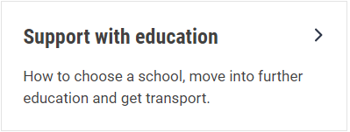
Welcome
To locate information about the Graduated Approach Briefings on the Local Offer, go to: https://professionals.lincolnshire.gov.uk/homepage/54/graduated-approach-briefings
Or on the Home Page, click on: Support with Education
Then scroll down to: Graduated Approach Briefings
Welcome and thank you for joining us for this virtual training session.
Please sign in through the Chat to register your attendance.
As usual, to support everyone to maintain connectivity with so many attendees being here:
Please Mute your microphone and turn off your video when not speaking – we have a large number of participants present today and this may mean that we experience feedback or slowing of the network connection if everybody has their microphone and video on. However, we would like to see you if you ask a question, please, so feel free to switch on both your microphone and video in these instances.
Please note that this meeting, or sections of it, will be being recorded for use on the council’s professionals’ website. If you do not wish to be recorded, you should leave the meeting and watch it back later.
If you would like to ask questions, please use the raise your hand facility or use the chat function in Teams
Please keep discussion in the ‘chat’ relevant – the person presenting may not be able to see your comments but we will have someone monitoring it in order to make sure all questions are answered.

Slide 3
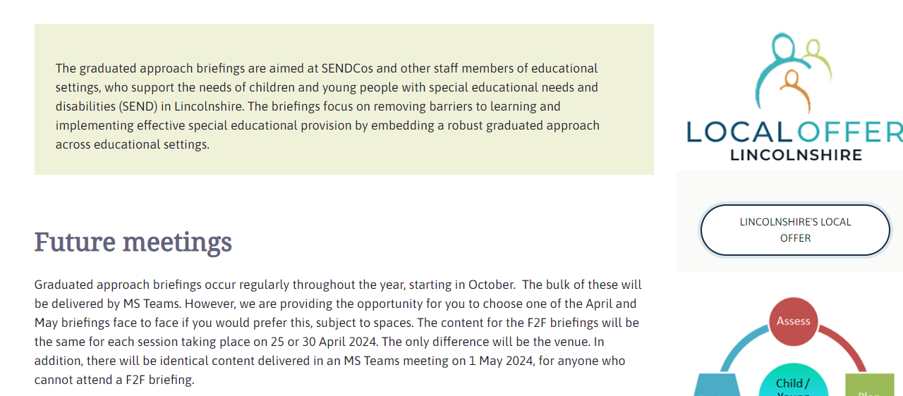
Remember to book your places for each briefing throughout the year on the Local Offer
Graduated approach briefings – Professional resources (lincolnshire.gov.uk)

Slide 4
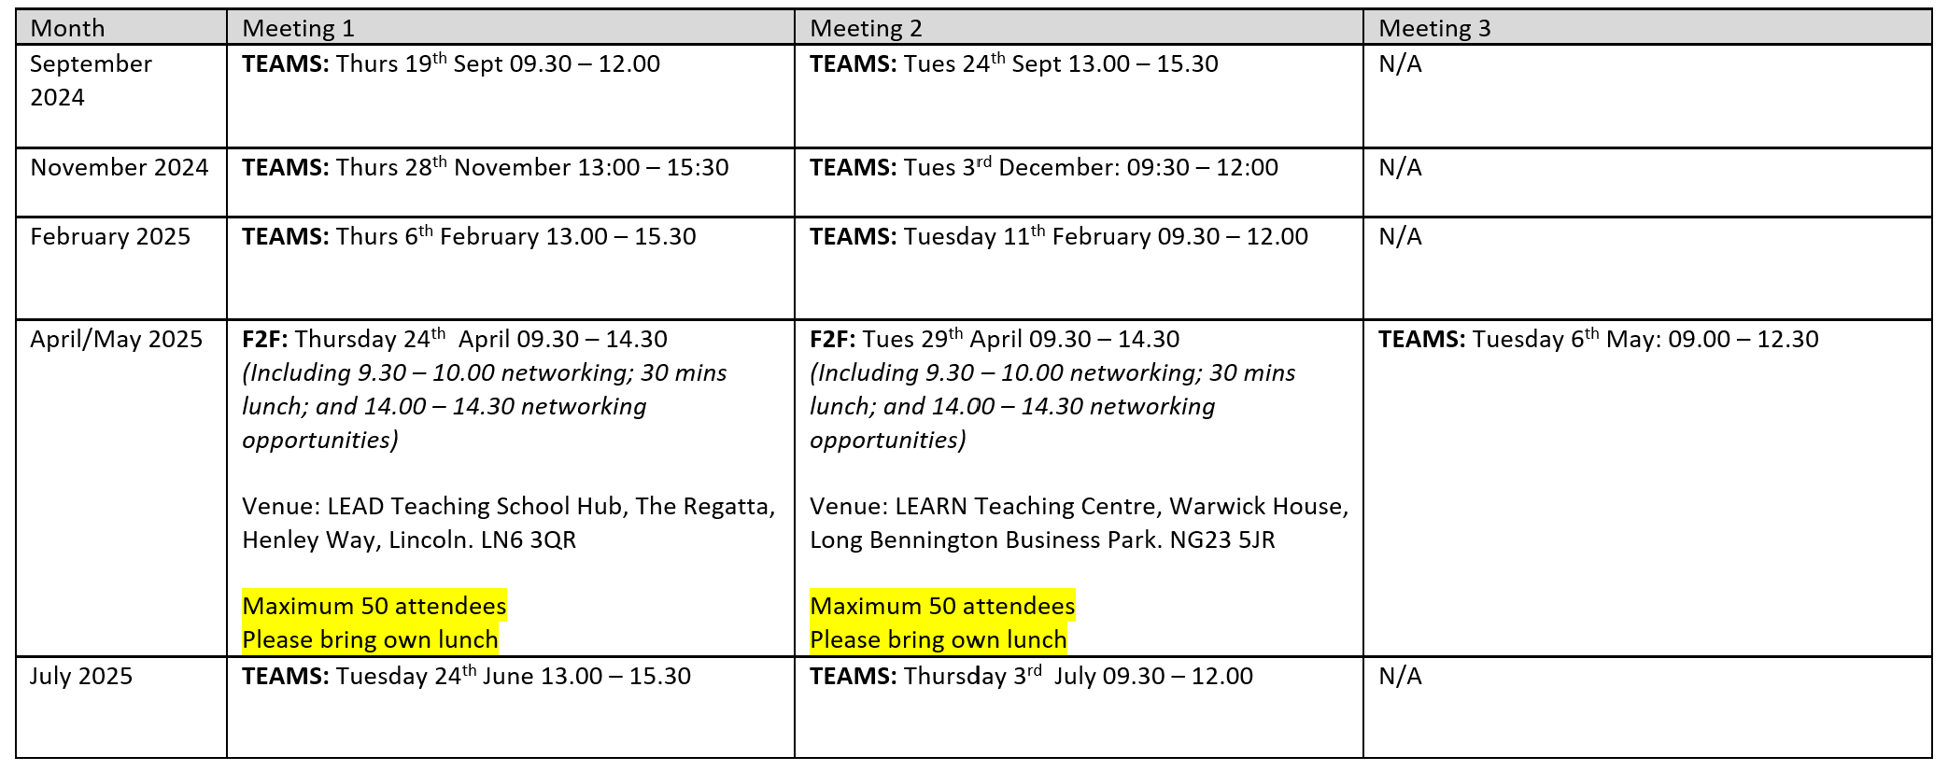
Graduated Approach Briefings for 2024-25
The dates are as follows:
Booking will be available on the Local Offer Support for Education pages shortly: Future briefings – Professional resources (lincolnshire.gov.uk)

Slide 5
Closing date: 6th May.
Please make your questions specific!
Forward notice for July Briefings:
Designated Clinical Officer Q & A session
In the annual survey, a number of themes around Health arose as being areas you wanted training on. Russell Outen-Coe, Designated Clinical Officer, will be coming to our July briefings and will answer prepared questions as part of his session. The following themes have been identified in the survey: ADHD, PDA, Mental Health and FASD. If you have any specific questions around these themes that you would like answering, please follow this link:
https://forms.office.com/e/P9jZUG82yQ
There is a final question asking if you have any other questions not related to these themes – we may not be able to answer them in the July briefings but, if there are enough, we can invite Russell back for another session in the Autumn term.
Only 11 responses so far.

Slide 6
We Are With You – name change to Horizon
As from 1st April 2024, the new Young Persons Service will be known as 'Horizon’.
New 'info' email address lincsyp.info@lincshorizon.co.uk. Our main telephone number remains the same:
0800 304 7021 (for both adult and YP services).
To make a referral to the Young Persons service, this can be done via the Turning Point website, or via our Horizon dedicated website www.lincshorizon.co.uk
The service we deliver to the young people of Lincolnshire remains the same, a free and confidential service to support young people with the issues they may face around drugs and alcohol. Whether it's to cut down, quit, gain control or just to learn more about the risks and effects of taking drugs and alcohol, we're here to advise and guide.

Slide 7
Lincolnshire Safeguarding Children Partnership Website Launch
LSCP (lincolnshirescp.org.uk)
Keep an eye on their social media page Lincolnshire Safeguarding Children Partnership | Facebook for the launch of their Supporting Emotional Wellbeing campaign this summer, developed with the views of children in Lincolnshire.

Slide 8
EHCNA Requests
Please support us to support you by considering the statutory time frames SEND need to work to when you submit an EHCNA request. Any requests submitted after 5th June will be heard in the last week of term or during the summer holidays, meaning that the actual assessments will need to be carried out in the summer holidays too (within 4 – 6 weeks of allocation). Those children will not therefore be seen in school, and you may not be available to provide further information.
Don’t forget to include attainment data too!

Slide 9
Virtual Autism Hub launch
www.lpft.nhs.uk/virtual-autism-hub
Lincolnshire’s Virtual Autism Hub is a new
source of autism support. Our service is for nonclinical autism enquiries. We’re here to empower autistic people and their parents/carers. We will work closely with community groups and service providers.

Slide 10
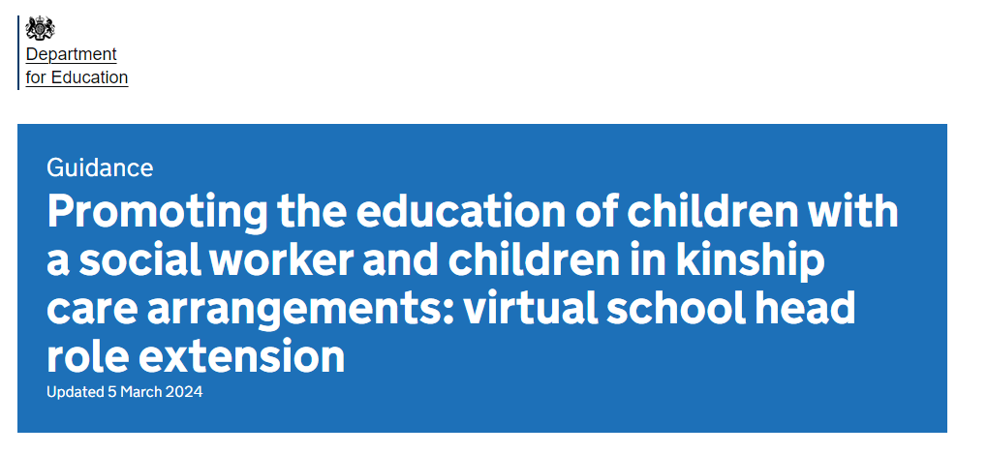
Lincolnshire Virtual School
The Virtual School are delighted to share that our team has been expanding!
From September 2021, DfE non-statutory guidance extended the role of the Virtual Head to promote educational outcomes for children with a social worker (CWSW).
In Lincolnshire’s Virtual School, Krysta Parsons is the Strategic Lead for CWSW and there are now four recently appointed CWSW Education Progress Coordinators spread across the districts:
Lincoln and West Lindsey - Emmie.Gamble@lincolnshire.gov.uk
North Kesteven and South Kesteven - Reece.Breakell@lincolnshire.gov.uk
Boston and South Holland - Lucy.Jewitt@lincolnshire.gov.uk
East Lindsey - Hannah.Darby@lincolnshire.gov.uk
More information on the extension of the Virtual School role can be
found at: Promoting the education of children with a social worker and children in kinship care arrangements: virtual school head role extension - GOV.UK (www.gov.uk)
Notes:
Jen

Slide 11
Lincolnshire Virtual School
Training events
Our training offer has been developed to better support settings in promoting educational outcomes for our children in care, children previously in care and children with a social worker. You do not have to have a child in care to attend the training.
Please use the training booklet to book onto any of the courses.
Summer 2024 Briefings: Improving Writing Through Sensory Development (with the Lincolnshire Psychology Service) and Working effectively with other professionals | Tuesday 21st May 2024 9:30—11.30 or Thursday 23rd May 2024 13:00—15:00
Understanding Dyslexia For Parents, Foster Carers & Schools SDQs – what they are, why we do them, and how to complete them Responsibilities of the Designated Teacher Language Development & Trauma For Parents, Foster Carers & Schools ePEP Training for professionals, parents and carers The role of the Designated Teacher in meeting the needs of children previously in care | Tuesday 4th June 18:30 – 19:30 Thursday 13th June 2024 10:00 – 11:30 Thursday 20th June 2024 10:00 – 11:30 Primary: Tuesday 18th June 2024 10:00 —12:00 Secondary: Tuesday 25th June 2024 12:00 —14:00 Tuesday 25th June 2024 10:00 – 11:30 Thursday 4th July 2024 10:00 – 11:30
Virtual School Conference: Keynote speaker is Paul Dix, author of ‘When the adults change everything changes’ and ‘After the adults change’. Further workshops on the day will enhance the day’s understanding about the impact on children’s learning and support that can be provided. | Friday 12th July - Bishop Grosseteste University
Notes:
Jen

Slide 12
Lincolnshire Virtual School
Training events
Our training offer has been developed to better support settings in promoting educational outcomes for our children in care, children previously in care and children with a social worker. You do not have to have a child in care to attend the training.
Please use the training booklet to find out the dates of these and to book onto any of the courses.
Please don’t hesitate to contact us via email: VirtualSchoolTraining@lincolnshire.gov.uk if you
require any further information or advice.
Additional workshops available include: Introduction to Restorative Practice Restorative Practice - Deep Dive 2-Day course (F2F Lincoln LN6 9BW) Creating Calm - An introduction to mindfulness, supporting emotional regulation, self-care and wellbeing for adults and children Relational Repair - Supporting children to trust others and invest in relationships Introduction to Trauma Awareness (You will need to attend both session 1 and session 2.) A Relationship Based Approach to Inclusion - Policy & Practice Kids Skills Supporting Grief, Loss and Positive Endings
Notes:
Jen

Slide 13
Look out for the Training Brochure
This will be saved with the presentations and videos on the Graduated Approach Briefing pages

Slide 14
Presentations and Videos will be available from 8th May
Remember to visit the Graduated Approach Briefings page on the Local Offer so that you can view the presentations and videos for this round of briefings and any from the previous academic year.
Graduated approach briefings – Professional resources (lincolnshire.gov.uk)

