Slide 1
Emotional Based School Avoidance (EBSA) updates and next steps
Amanda Smith
Pupil Reintegration Officer - South

Slide 2
Emotional Based School Avoidance
Updates and next steps:
“The more healthy relationships a child has, the more likely he will be to recover from trauma and thrive. Relationships are the agents of change, and the most powerful therapy is human love.”
Bruce D. Perry, The Boy Who Was Raised as a Dog

Slide 3
Emotional Based School Avoidance
Updates and next steps:
DFE and NHS England
EBSA toolkit – early intervention and effective whole school systems
Whole school approach
Audit tool
Risk screening tool
EBSA interventions document

Slide 4
Emotional Based School Avoidance
Updates and next steps:
Training updates
EBSA Pathway
Training feedback/ questionnaire
Bitesize sessions for September 2024 – Phases and tools
Observing at Medical Support Panel (MSP)

Slide 5
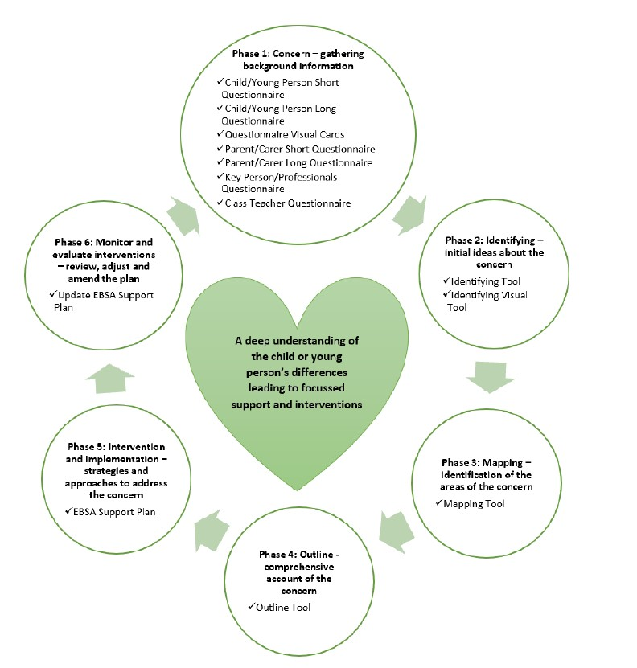
EBSA Tools and Checklist

Slide 6
Other Resources/ Support
EBSA Pathway
https://www.lincolnshire.gov.uk/support-education/emotional-based-school-avoidance-ebsa/4
EBSA Toolkit
https://professionals.lincolnshire.gov.uk/ebsa-pathway/ebsa-toolkit
Whole School Approach tools
https://professionals.lincolnshire.gov.uk/downloads/download/240/ebsa-toolkit

Slide 7
Contact PRT for training/advice/guidance
PRT@lincolnshire.gov.uk

Slide 8
Any Questions

