Slide 1
L.E.A.D. Teaching School Hub
Updates and Headlines
Graduated Approach
‘Working in Partnership, Achieving the Highest Outcomes for All’
Notes:
Welcome

Slide 2
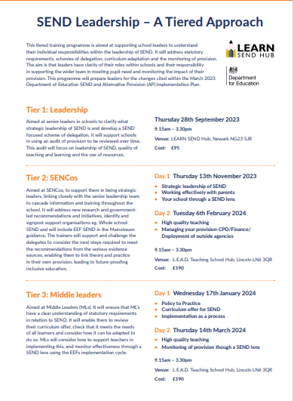
DfE accredited SEND Tiered Approach
Notes:
As you Are all aware we have been busy working with LEARN who are delivering The SEND Tiered Approach this year – This is a 4 tier approach to the leadership of SEND – with sessions for Leaders / SENCOs / Middle Leaders and Teachers

Slide 3
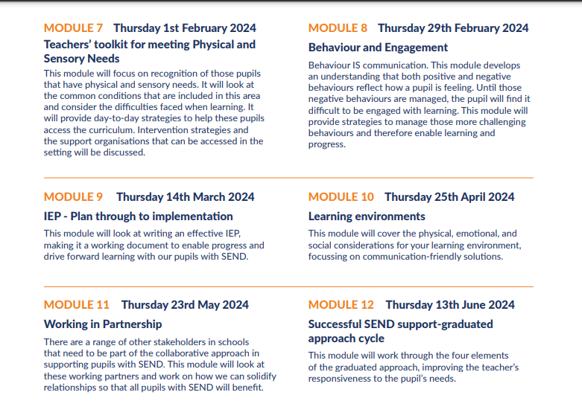
Notes:
We have had requests from schools to buy individual modules – Within Tier 4 for Teachers - these are normally priced at 6 modules for £90 = £15 a session
Individual modules will be charged at £20.

Slide 4
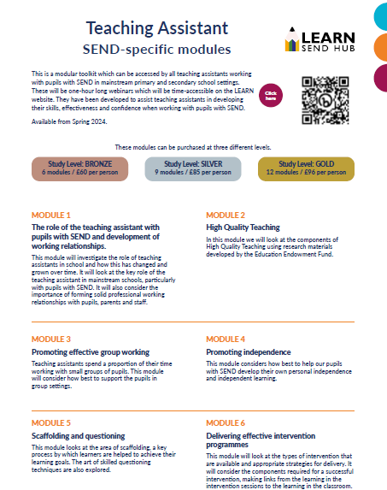
Notes:
Equally the Teaching Assistant modules are available – these are recorded sessions so can be accessed at a time that suits both the school and the member of staff. These have been hugely popular.
Again there is a package available - £60 for 6 modules - £10 a module but these can also be purchased separately at £15 each

Slide 5
Recruiting for Oct 2024 soon
New NPQ SENDCO
to be launched October 2024
Mandatory for SENCOS
Valuable for other leaders/teachers
NPQ Leading Primary Maths
underway from March 2024
In Partnership with Redhill T S Hub and East Midlands Maths Hub
1
Notes:
NPQSEND – Oct 2024
Sign up via following link: https://www.leadtshublincs.co.uk/page/?title=Sign+up+for+an+NPQ&pid=47
ADD LINK TO CHAT

Slide 6
NPQ for SENCos
This NPQ will be the mandatory qualification for SENCOs from September 2024, with teaching beginning in autumn 2024.
The 3-year window to complete the mandatory qualification on taking up a SENCO post will remain following the introduction of the NPQ for SENCOs.
Notes:
Mandatory for SENCOs / Valuable for all

Slide 7
Requirements for SENCos
SENCOs who have already obtained the NASENCO do not need to complete the SENCO NPQ.
From September 2024, all SENCOs and aspiring SENCOs will need to:
take the NPQ if they have not completed or started the NASENCO
complete training within 3 years of appointment – schools and SENCOs must make sure they enrol on training that will meet this requirement
SENCOs appointed before 1 September 2009 are not required to take the NPQ, but will be expected to ensure compliance with the regulations.

Slide 8
Course content
Useful documents:
- NPQ for SENCos Framework
National professional qualification for special educational needs co-ordinators (publishing.service.gov.uk)
- DfE Page with the most up to date information
Special educational needs co-ordinator's national professional qualification - GOV.UK (www.gov.uk)
- Transition from NaSENCO to NPQ for SENCos
Transition to national professional qualification for special educational needs co-ordinators - GOV.UK (www.gov.uk)
school culture
statutory framework
identification of need
teaching
behaviour
leading and managing provision
professional development
implementation

Slide 9
Funding available for Phonics
including Special schools
Notes:
The English Hub are now able to work with Special schools in so far as we are able to fund phonics provision if you are using one of the DfE validated programmes and you have primary aged pupils in your setting – don’t have to be sitting PSC in Yr1
If you are a special school we might be able to support with the purchase of phonics resources linked to an accredited programme
Also remember the FREE support days – specialists can come in to look at book provision / organisation / effective interventions / well matched decoable reading books / school’s approach to early reading. Also @£100 backfill.
Even if confident and teaching with fidelity there are always aspects that we can support with and make those “tweaks” to ensure that all children become fluent readers and eventually fluent writers.

Slide 10
Toolkit for SEND in Early Years
Notes:
https://www.pengreen.org/wp-content/uploads/2024/01/SEND-Toolkit-2024.pdf

Slide 11
SEND Workforce Development
Scan the QR code to register for FREE!
6400+
Modules
completed
299
Lincs schools
engaged
99%
Satisfaction
rate
25
Average mins per module
chris.lincoln@learnsendhub.co.uk
Notes:
The SEND Workforce Development project continues to be accessed by staff in schools across Lincolnshire.
The figures in yellow show what has changed since the last briefing.

Slide 12
SEND Workforce Development
Modules available include:
Induction Tier:
(Now also available to parents)
Types of SEND
Awareness of a Neuro-Typical Child
What is Inclusion?
SEND Code of Practice
Respecting Individuals
Working with Professionals
Tier 1:
Sensory Processing and Integration
Supporting Transitions
Support Interventions
Restorative Practice
Four Areas of Need
Nurture Principles
Personal Care and Dignity
Introduction to Attachment
Trauma
Intensive Interaction
Communication
Scan the QR code to register for free:
@SENDworkforce
“A very clear and concise toolkit
of strategies. I enjoyed working through the scenarios and the downloadable content”
chris.lincoln@learnsendhub.co.uk
Notes:
All of the modules in black are live. The three green modules will be going live soon so keep your eyes peeled for these. A reminder that any member of staff who has an account on the Lincolnshire Safeguarding Children Partnership platform, should be able to see and access all of the modules that have gone live when they sign into the platform. If any staff need support, they can contact us through the QR code and a member of the team will get in touch.
Finally, our first Induction Tier modules have been completed by parents. If you would like a flyer about the content that you can send to parents and carers, please contact Chris on the email address at the bottom of the slide. We are really looking to promote this content to as many parents as possible.

Slide 13
SEND Workforce Development
Scan the QR code to register for free:
@SENDworkforce
chris.lincoln@learnsendhub.co.uk
Notes:
Parent flyer

Slide 14
Whole School SEND Update: Lincolnshire Graduated Approach Briefing: Feb 24

Slide 15
Teacher Handbook: SEND
This handbook has been developed as a resource for teachers to use over time as they embed inclusive practice in their classrooms: it is not intended that it is read cover-to-cover. It has been written for both primary, secondary and specialist colleagues: teaching assistants, teachers, senior leaders and headteachers. The handbook includes whole-school and whole-class approaches as well as subject-specific and condition-specific guidance.
The Humanities sections have now been release.
Teacher Handbook: SEND | Whole School SEND
Notes:
The Teacher Handbook:SEND continuers to be a helpful resource. This has just been updated with chapter five have new subjects added. The humanities subjects have support and content like the previous released sections.

Slide 16
Whole School SEND Professional Development Groups
Our Professional Development Groups offer an unrivalled space for teachers and school and college leaders to provide peer to peer reflection, challenge and support with facilitation from a WSS Regional SEND Lead.
100% of the first cohort of PD Group participants reported that SEND was prioritised within school improvement planning as a result. Current plans for this year's themes include exploration of a number of key areas linked to the SEND and AP Improvement Plan, such as inclusive classroom practice and effective transitions, as well as role specific groups, for example for those new to SEND leadership.
Download the presentation to find out more, and register interest for future cohorts.
Professional Development Groups (dotdigital-pages.com)
School improvement for SEND | Whole School SEND
Notes:
The Whole School SEND professional development groups for the next project year and now open for recruitment. There is a loink to a previous group member at the bottom of the slide so you can get an idea about how these groups work and the experience of a group member.
The link about is a link to the sign up page on the WSS website.

Slide 17
Online Learning
We can now offer two online learning options through our Ambitious About Inclusion modules, and our SEND CPD units, all designed to support your professional development whenever and wherever it suits you.
Ambitious About Inclusion provides a role-specific foundation for all practitioners who are seeking to develop their whole school approach to inclusion at all stages of the learning journey to further education. Ambitious About Inclusion - Online Learning | Whole School SEND
Understanding is further enhanced by the SEND CPD units - a series of 20 minute units that will be released over the next two years, with the first eight units available now. Online CPD Units | Whole School SEND
All online learning is free-to-access for members, thanks to funding from the Department for Education.
Notes:
Whole school SEND offers a range of online learning opportu8nities. The two highlighted hear are
Ambitious About Inclusion provides a role-specific foundation for all practitioners who are seeking to develop their whole school approach to inclusion at all stages of the learning journey to further education, Click the link to go directly to this page on the website.
SEND CPD units - a series of 20 minute units available now If you enjoy the units or want to take your learning further you can sign up for the contextualising sessions once the unit has been completed. Again click the link to take you directly to the page.

