Slide 1
Stay Safe Partnership
Lincolnshire’s Stay Safe Partnership
Preventative Education in Collaboration

Slide 2
Background
Established in 2015. the Stay Safe Partnership was created to ensure every secondary school aged child within Lincolnshire received preventative education to enable them to make informed decisions and keep themselves safe.
Objectives:
To address existing and developing priorities effecting young people.
To deliver preventative education in a more coordinated way.
To ensure consistency in messaging and quality of delivery.
To make the most effective and efficient use of public resources.
The need to engage with a younger audience on relevant safety issues became apparent. Age-appropriate workshops and on-line resources for primary school children and teachers were developed.

Slide 3
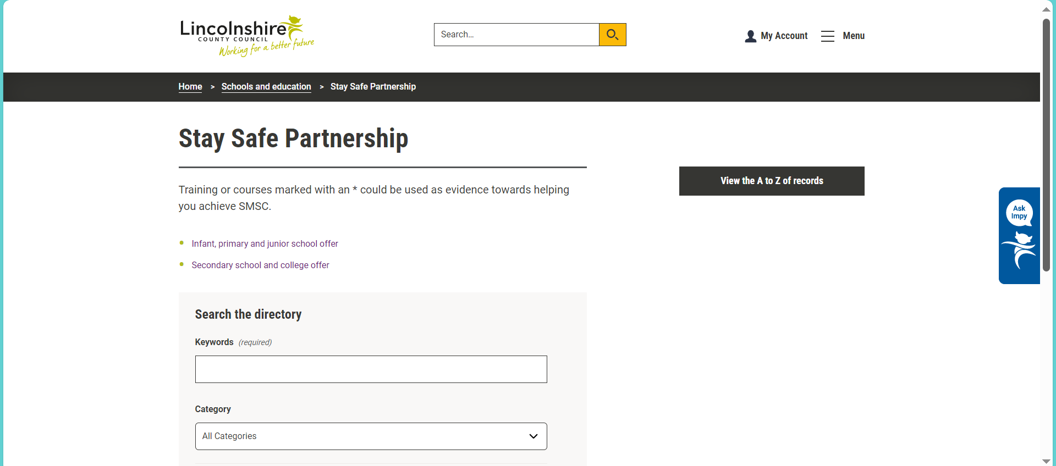
Stay Safe Directory
Serves as a ‘one-stop shop’ resource for schools on preventative education, as well as a single booking system for agencies.
Infant, Primary and Junior School Offer:
71 workshops/resources/training packages available
Secondary School and College Offer:
82 workshops/resources/training packages available
https://www.lincolnshire.gov.uk/directory/16/stay-safe-partnership

Slide 4
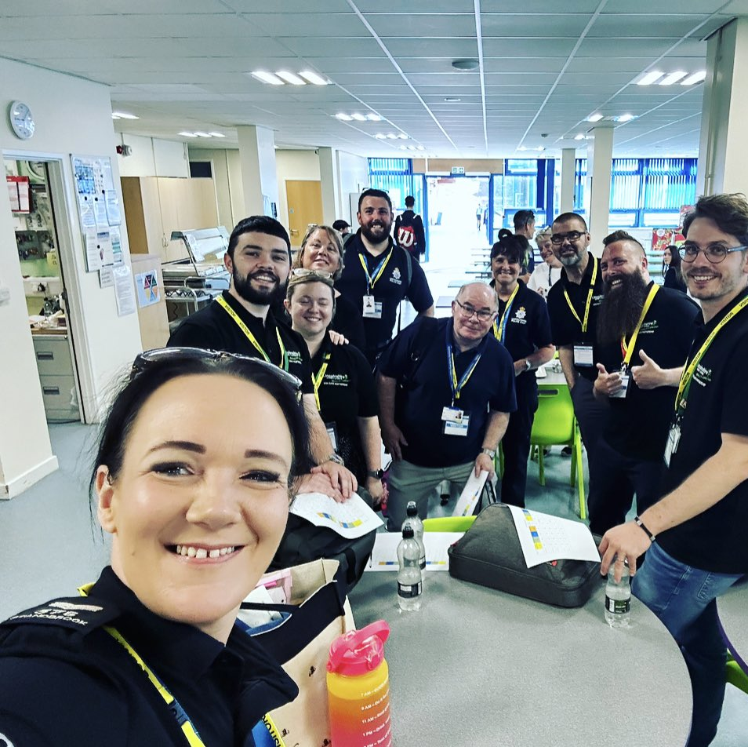
Stay Safe Offer
'Stay Safe' Days
Multi agency workshops delivered on the same day in key safety areas (dependent on year group):
Online safety, Anti-social behaviour, Healthy relationships, Alcohol awareness, Drug awareness, Fire safety, Road safety, County Lines and Knife Crime
Two Stay Safe Days in every academic year, at no cost.
Delivered to 20,978 pupils in 2022/2023
Deconstructed days for Pupil Referral Units, some SEND provisions and colleges.
Individual sessions
Available to Primary and Secondary schools and colleges through the Stay Safe Directory. Sessions range from e-safety to Prevent awareness, modern slavery to mental health and knife crime to hate crime.

Slide 5
One session can leave a lasting impression…
"I liked how it talked about how the topics play out in real life.“ Healthy Relationships Year 9 Student
“I liked how instead of overloading us with information we did a Mario Game and we learnt information along with the game!” Year 7 Student
Qualitative and quantitative data collated to monitor impact thinking and decision-making.
11,868 responses received from Year 7 to 11 students in 2022/23:
97.4% said information would help with their future decisions.
97.7% found information within sessions helpful.
98% found the sessions well presented and explained.
"This was very fun and the information will definitely stick to me and make me think about my safety“ Student
"Each time we have a SSD day it gets better…topics covered are relevant. We have had a significant reduction in the amount of sexting". Teacher
“I have learned so much about the topics. I was unsure about it at the start of the day. After period 1, I was so excited to learn more. I really hope we have another safety day soon. I liked how relaxed everything was and enjoyed it. I loved today and thank you!” Year 7 Student
“That even small things can have a big impact” ASB Year 8 Student

Slide 6
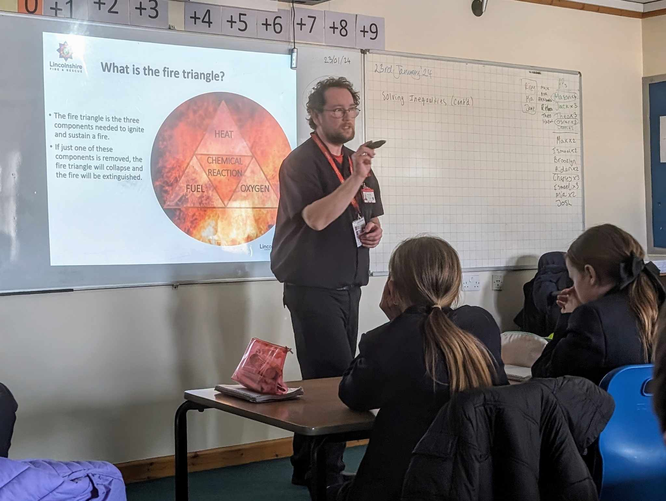
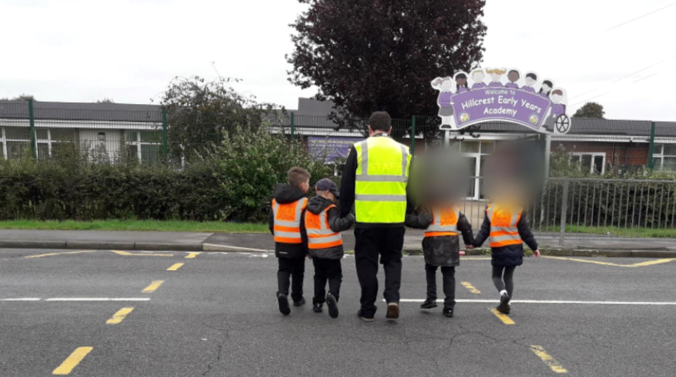
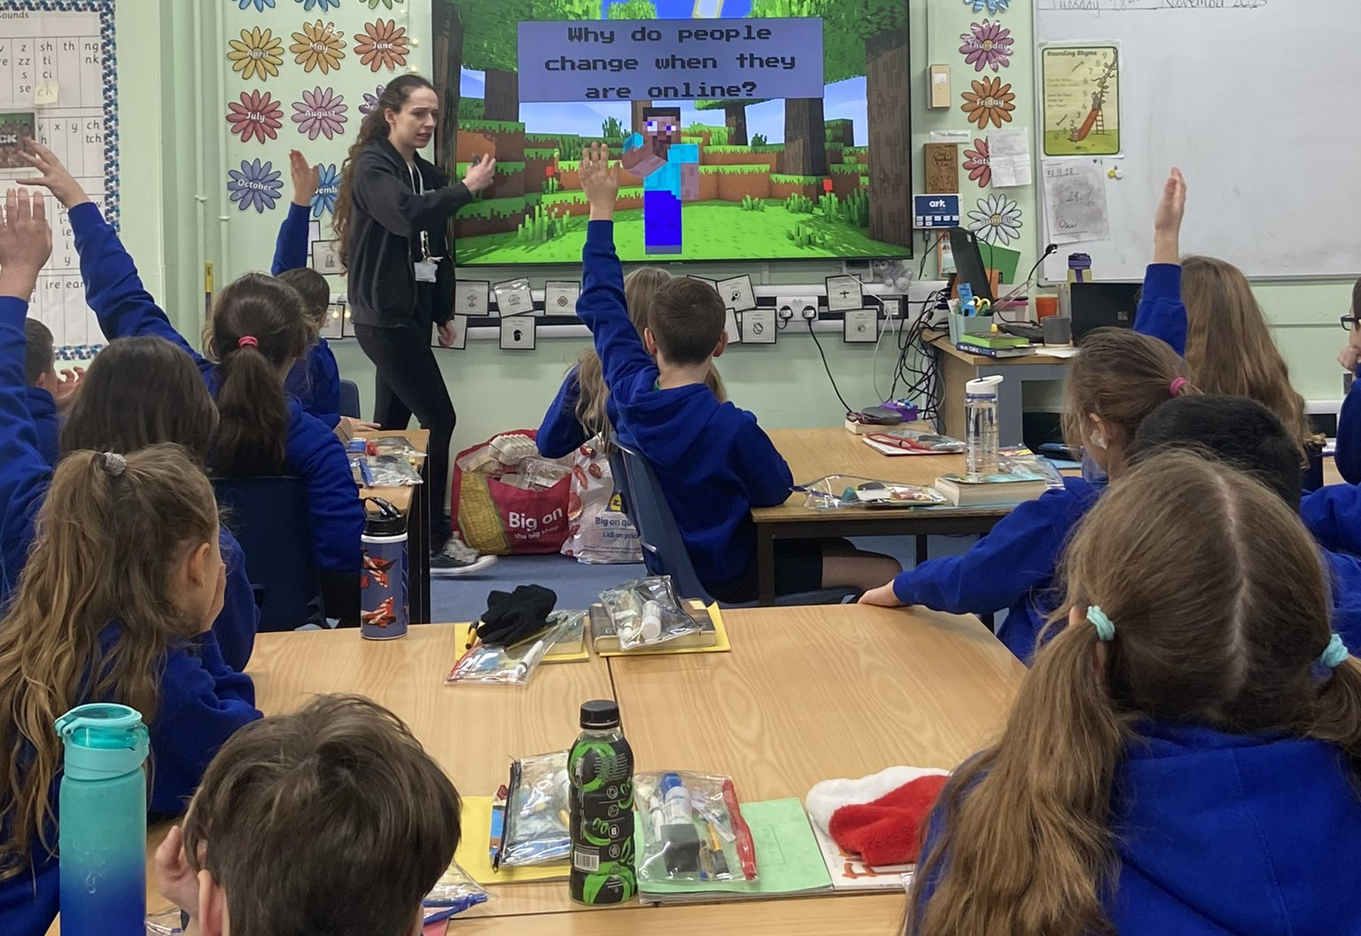
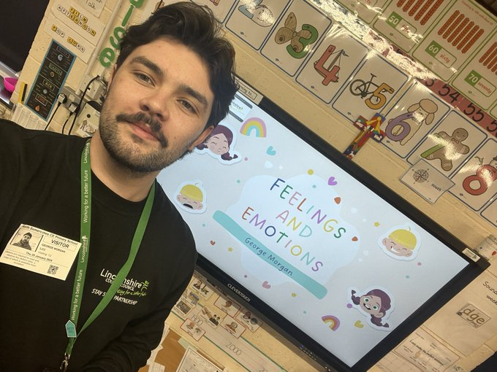
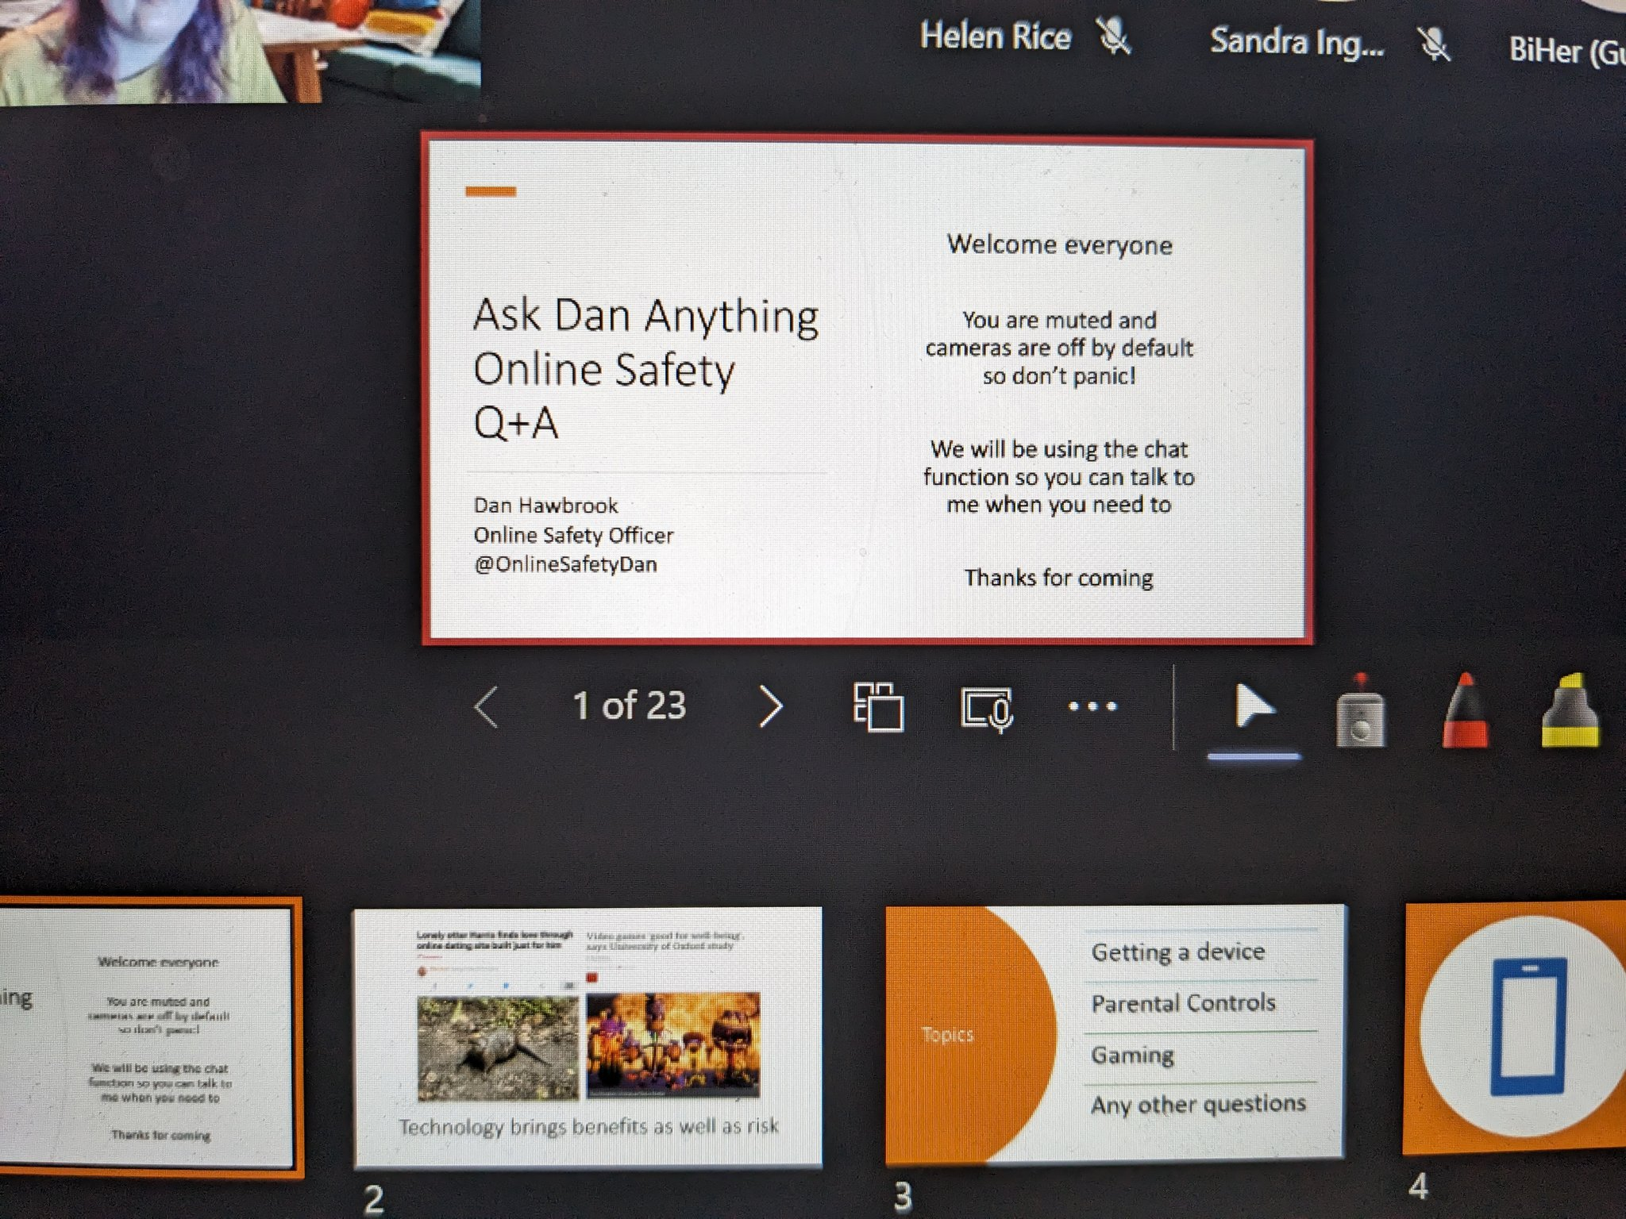
Primary Delivery
Full ‘Online Safety’ curriculum available for Year 2 to College covering critical thinking skills, getting support from trusted adult, grooming techniques, false information, cyberbullying and image sharing.
Domestic Abuse Team deliver Full Year 2 to College curriculum new for 2023/2024. Primary Package aims to embed skills needed to have a healthy relationship, like managing our emotions, negotiating boundaries, conflict management, respectful communication and identity.
Bi-annual online Parent Engagement workshops from both LCC and LDAP.
Road Safety full package teaching road skills, road safety walks, in car safety, helmet safety, JRSO program and transition workshop
Year 2 and Year 6 Fire Safety Workshops from LFR
We Are With You deliver Substance Misuse workshops What’s in the Box to Year 6
Lincs Police have their Mini Police Program and can deliver reactive workshops where there is required need. VAWG coordinator delivering Realities of Pornography to all year 6 students.

Slide 7
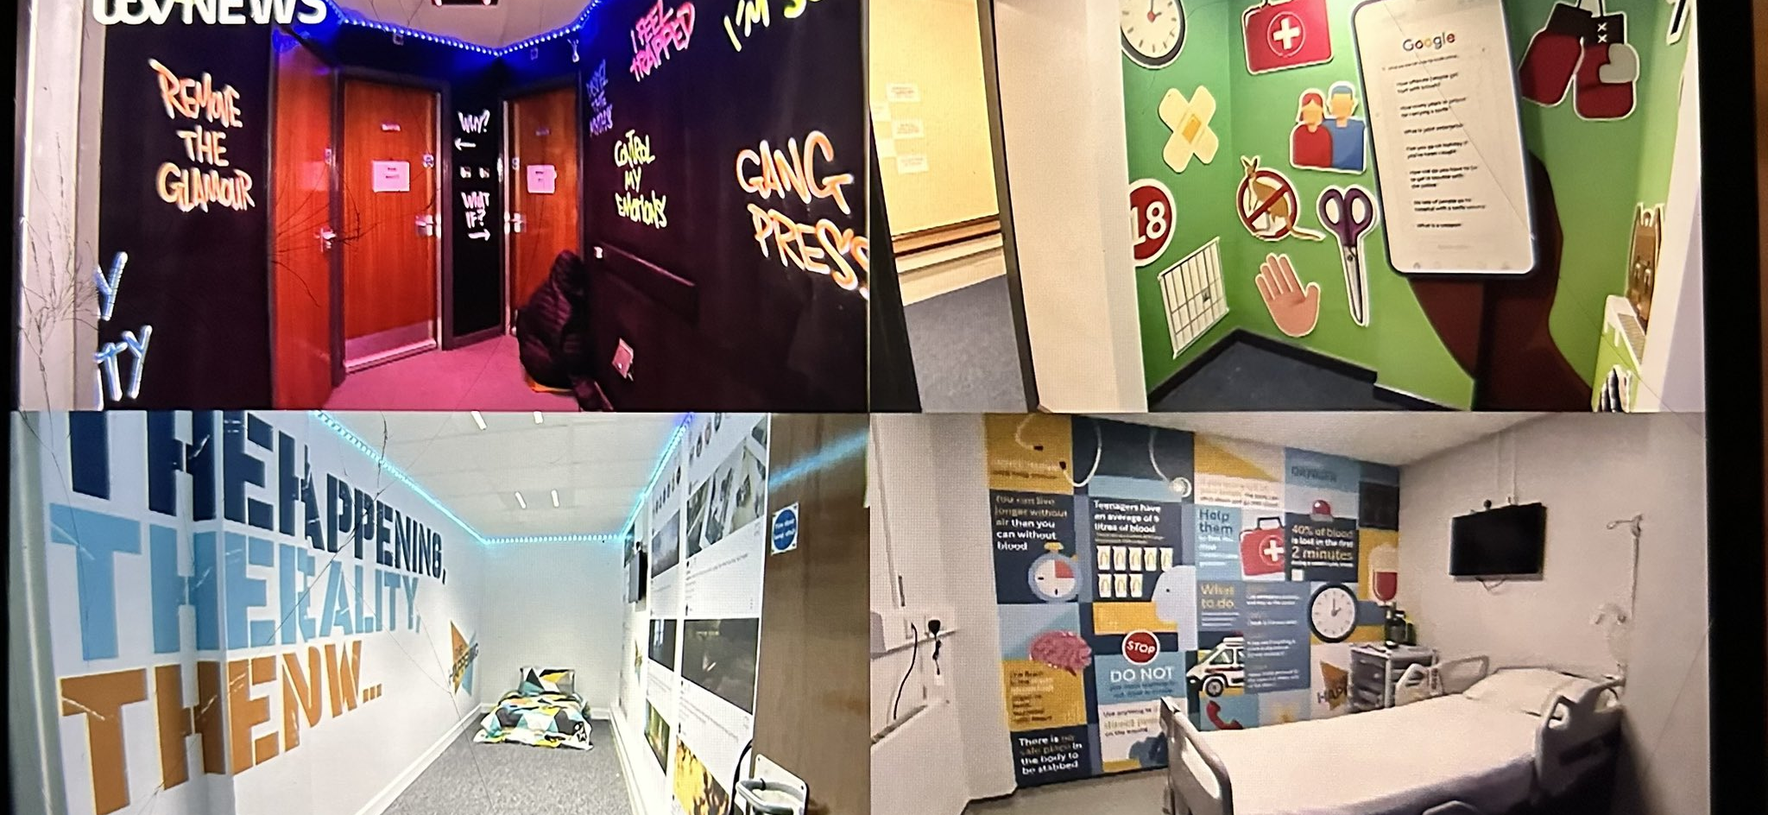
The Happening – Immersive Knife Crime Prevention Experience
Available to book for age 10–18-year-olds.
Located Sleaford Police Station – Schools need to be able to transport students to the centre but once there workshop is free.
Small groups of 6-8 students. 120-minute sessions Ran twice a day on Tuesdays and Thursdays.
12 rooms exploring issues of knife enabled crime. Group discussions, interactive activities and first aid skills.
https://www.lincolnshire.gov.uk/directory-record/74981/knife-crime-intervention-the-happening-years-5-and-6
https://www.lincolnshire.gov.uk/directory-record/74982/knife-crime-intervention-the-happening-key-stages-3-and-4

Slide 8
TRENDING Sessions
Available to book for age 13–18-year-olds.
Must be open to Social Care / Early Help or Futures for Me.
Programs circulate around the County currently running in Lincoln and Grantham. Next 6-week program will run in Skegness and Gainsborough beginning in March/April
Small groups delivered in youth center environment after school 5-7pm. Young person needs to be able to get to the center and be picked up.
Can be referred to the full program or just specific session applicable to their needs. Sessions include Alcohol and drug awareness, malicious communications, health and sleep hygiene, knife crime and ASB.
Referral form needs to be completed and sent to F4MInterventions@lincolnshire.gov.uk

Slide 9
For Information:
Kathryn Smith
Community Safety Strategy Coordinator with lead for Preventative Education
Kathryn.smith@Lincolnshire.gov.uk
@KathrynSmithSSP
@SaferLincs
https://www.facebook.com/saferlincs
Stay Safe Partnership – Lincolnshire County Council

