Slide 1
Lincolnshire’s Virtual Autism Hub

Slide 2
Virtual Autism Hub: Our Purpose
To enhance the non-clinical community support available to autistic people of all ages and their parent/carers.
Our funding comes from Lincolnshire ICB (Integrated Care Board, previously called CCG) whose job is to plan services & allocate the NHS budget i.e. commission services

Slide 3
Our Origins
Lack of support available to the majority of autistic adults & parent/carers who have low-level needs
Lots of people on waiting list of diagnosis, needs might increase while waiting
Little information & advice available after diagnosis aside from a few unfunded, overstretched, volunteer-led support groups
So sometimes problems get worse & family enters crisis unnecessarily
Our services goes beyond statutory requirements
Model co-produced with local autism community e.g. community members gave a strong steer that diagnosis shouldn’t be needed to access Virtual Autism Hub

Slide 4
What it can feel like…
Yes, your child’s autistic. Here’s a leaflet. Now off you go…

Slide 5
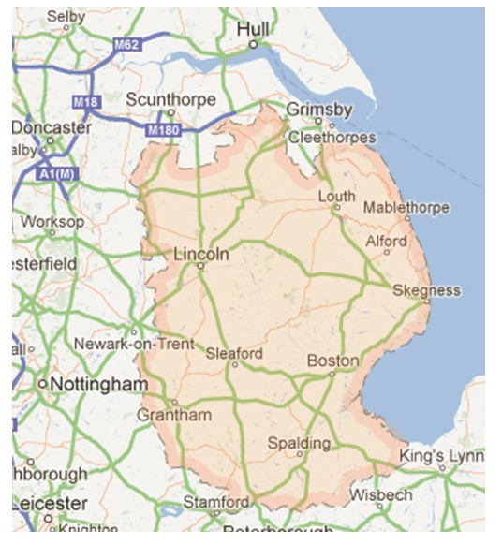
Why a ‘virtual’ hub?
Why not just open a hub building in Lincoln?
The single hub model used by metropolitan areas (Grimsby, Nottingham) is inappropriate
4th largest & most sparsely populated county
Only 1 in 5 live in or around Lincoln
If we had our own hub that would undermine local support groups having or wanting their own base in towns across the county

Slide 6
Our offer: Specialist Autism Navigators
We’re just getting started:
2 whole time equivalents (4 part-time staff)
Several have lived experience as parents and professional experience working in SEND
‘Soft’ opening to enquiries end January 2024

Slide 7
Specialist Navigators: Empowering People
Will provide info & advice about statutory services & voluntary sector support
Practical help e.g. accompany people to initial meetings, assist them to fill in forms
Service for autistic adults & parent/carers of autistics of all ages
Open door policy, no referral needed
Step in, step out support as needed. Can return to service with future issues.

Slide 8
Ways to access support from the Specialist Autism Navigators
Face-to-face support across the county, in a place that suits the person
Support over video calls or on the phone
New website and printed info

Slide 9
Availability
A Specialist Autism Navigator will be on duty Mon-Fri 9am-5pm
Available for appointments if needed weekday evenings & Saturday
Limits to the service
Support for parent/carers & autistic adults only, not professionals
Not a clinical, emergency or crisis service
Can’t ‘case hold’

Slide 10
Contact details:
lpft.virtualautismhublincs@nhs.net
Tel. 01522 458588 (monitored less frequently than our inbox, e-mail is the primary mans for contacting us)
Virtual Autism Hub
LPFT
Unit 3, Trust HQ
St George’s Site
Long Leys Road
Lincoln LN1 1FS

