Slide 1
Graduated Approach Briefings
February 2024
Notices

Slide 2
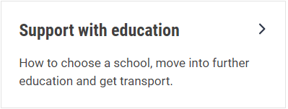
Welcome
To locate information about the Graduated Approach Briefings on the Local Offer, go to: https://professionals.lincolnshire.gov.uk/homepage/54/graduated-approach-briefings
Or on the Home Page, click on: Support with Education
Then scroll down to: Graduated Approach Briefings
Welcome and thank you for joining us for this virtual training session.
Please sign in through the Chat to register your attendance.
As usual, to support everyone to maintain connectivity with so many attendees being here:
Please Mute your microphone and turn off your video when not speaking – we have a large number of participants present today and this may mean that we experience feedback or slowing of the network connection if everybody has their microphone and video on. However, we would like to see you if you ask a question, please, so feel free to switch on both your microphone and video in these instances.
Please note that this meeting, or sections of it, will be being recorded for use on the council’s professionals’ website. If you do not wish to be recorded, you should leave the meeting and watch it back later.
If you would like to ask questions, please use the raise your hand facility or use the chat function in Teams
Please keep discussion in the ‘chat’ relevant – the person presenting may not be able to see your comments but we will have someone monitoring it in order to make sure all questions are answered.

Slide 3
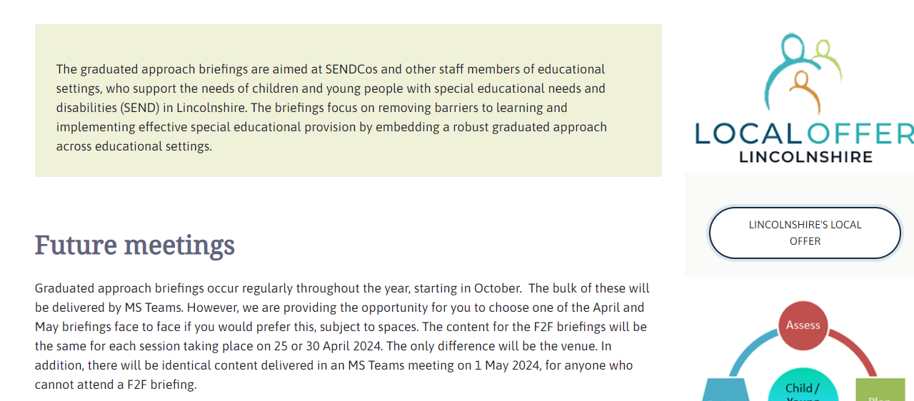
Remember to book your places for each briefing throughout the year on the Local Offer
Graduated approach briefings – Professional resources (lincolnshire.gov.uk)

Slide 4
Lincolnshire Virtual School
Training events
Our training offer has been developed to better support settings in promoting educational outcomes for our children in care, children previously in care and children with a social worker. You do not have to have a child in care to attend the training.
Please use the training booklet to book onto any of the courses.
Please don’t hesitate to contact us via email: VirtualSchoolTraining@lincolnshire.gov.uk if you
require any further information or advice.
Spring 2024 Briefings: Promoting Inclusion, Reducing Exclusion and Planning Effective Transitions | Wednesday 6th March 2024 10:00 – 12:00 or Thursday 14th March 2024 10:00 – 12:00
Governor and Trustees Training: Supporting Children in Care & Previously Looked after Children | Tuesday 23rd April 2024 9:30—11.30
Summer 2024 Briefings: Improving Writing Through Sensory Development (with the Lincolnshire Psychology Service) and Working effectively with other professionals | Tuesday 21st May 2024 9:30—11.30 or Thursday 23rd May 2024 13:00—15:00
Notes:
Jen

Slide 5
Lincolnshire Virtual School
Training events
Our training offer has been developed to better support settings in promoting educational outcomes for our children in care, children previously in care and children with a social worker. You do not have to have a child in care to attend the training.
Please use the training booklet to find out the dates of these and to book onto any of the courses.
Please don’t hesitate to contact us via email: VirtualSchoolTraining@lincolnshire.gov.uk if you
require any further information or advice.
Additional workshops available include: Introduction to Restorative Practice Restorative Practice - Deep Dive 2-Day course (F2F Lincoln LN6 9BW) Creating Calm - An introduction to mindfulness, supporting emotional regulation, self-care and wellbeing for adults and children Relational Repair - Supporting children to trust others and invest in relationships Introduction to Trauma Awareness (You will need to attend both session 1 and session 2.) Introduction to Social Pedagogy A Relationship Based Approach to Inclusion - Policy & Practice Kids Skills Supporting Grief, Loss and Positive Endings
Notes:
Jen

Slide 6
Lincolnshire Virtual School
Children in Care, and those who have experienced early trauma, are more likely to struggle with aspects of their learning, in particular with their language development and executive function skills (Clegg et al., 2019; Yehuda, 2015).
The VS are delighted to continue to commission STT for their core assessments, which includes language and cognitive skills, for our children in care to help inform the use of PP+ spending and to ‘close the gap’ of educational outcomes (Keegan, 2023).
These are at specific points in their school journey:
Up to Year 2 (frequency of reviews dependent on STT recommendations)
Year 4
Year 5 (if new into care)
Year 7
Year 8 (if new into care)
Please note that these assessments are not to replace your school’s Assess Plan Do Review and usual process of identifying needs. If you do have concerns, please continue with your SEND processes and we will ask STT to work around what has already been carried out.
Notes:
Jen

Slide 7
0-19 Service online referral form
The 0-19 service have launched a new online referral form. This form can be completed by parents with children in year 1 and above who would like to request support from the Children’s and Young People’s nurses (CYPN’s) and Children’s Continence Service (CCS).
Professionals will now be requested to complete this online form if they wish to refer to any of our services (Health Visiting, CYPN and CCS).
The form is located on the LCC website on our Children’s health page, it navigates through several questions that ensures it gets sent to the correct team for review and referrers will receive a letter response.
Please find the link below:
https://gbr01.safelinks.protection.outlook.com/?url=https%3A%2F%2Fwww.lincolnshire.gov.uk%2Fhealth-wellbeing%2Fhealth-visitors&data=05%7C02%7CSchoolNews%40lincolnshire.gov.uk%7Cb2f389f0b5154ce4669d08dc12b8dc2a%7Cb4e05b92f8ce46b59b2499ba5c11e5e9%7C0%7C0%7C638405832369641079%7CUnknown%7CTWFpbGZsb3d8eyJWIjoiMC4wLjAwMDAiLCJQIjoiV2luMzIiLCJBTiI6Ik1haWwiLCJXVCI6Mn0%3D%7C3000%7C%7C%7C&sdata=QG40wVs2rSkm2OBZkUZ0Hb43%2F3DVhXzBiSm8opCoZTU%3D&reserved=0

Slide 8
News from the Safeguarding Bulletin:
Neurodiversity Celebration Week- 18th-24th March 2024
Resources are now available for Neurodiversity Celebration Week. You can sign up to join this national event that runs from 18th -24th March and aims to increase understanding and acceptance, support education, and celebrate and value the talents of neurodiverse minds. The resources include a guide pack to help you get involved, a social media pack, activity sheets and posters.
Please visit:
https://gbr01.safelinks.protection.outlook.com/?url=https%3A%2F%2Fwww.neurodiversityweek.com%2Fget-involved-schools&data=05%7C02%7CSchoolNews%40lincolnshire.gov.uk%7C87c1233bc80d4d4e301e08dc296e5c47%7Cb4e05b92f8ce46b59b2499ba5c11e5e9%7C0%7C0%7C638430801161854311%7CUnknown%7CTWFpbGZsb3d8eyJWIjoiMC4wLjAwMDAiLCJQIjoiV2luMzIiLCJBTiI6Ik1haWwiLCJXVCI6Mn0%3D%7C0%7C%7C%7C&sdata=DN4ZLPFU7FosJ%2F4%2FDUAKxDyiyDstGZzs%2BwyMd04O0Ro%3D&reserved=0
Supporting mental health at primary school- new toolkit Three charities from The Coram Group have joined forces to produce a toolkit to help primary schools support children’s mental health and well-being. There are lesson plans, age-appropriate stories, and related activities to help children develop the core skills they need to navigate life and maintain positive mental health habits.
To access the toolkit please visit:
Coram launches free wellbeing toolkit for primary school children - Coram Group : Coram Group

Slide 9
STT Buy Back Closing Date tomorrow!
Tomorrow is the closing date for STT’s buy back. If you haven’t started the Edulincs process yet, please do so as soon as possible in order to guarantee support for next year:
Specialist teaching team - EduLincs – Lincolnshire County Council
Visual Processing Clinic new referral form
This was emailed to you with the agenda. If you didn’t get that email, please ensure that you visit the Graduated Approach Briefings page to download the form from there after 5th March.

Slide 10
Please make your questions specific!
Forward notice for July Briefings:
Designated Clinical Officer Q & A session
In the annual survey, a number of themes around Health arose as being areas you wanted training on. Russell Outen-Coe, Designated Clinical Officer, will be coming to our July briefings and will answer prepared questions as part of his session. The following themes have been identified in the survey: ADHD, PDA, Mental Health and FASD. If you have any specific questions around these themes that you would like answering, please follow this link:
https://forms.office.com/e/P9jZUG82yQ
There is a final question asking if you have any other questions not related to these themes – we may not be able to answer them in the July briefings but, if there are enough, we can invite Russell back for another session in the Autumn term.

Slide 11
Presentations and Videos will be available from 5th March
Remember to visit the Graduated Approach Briefings page on the Local Offer so that you can view the presentations and videos for this round of briefings and any from the previous academic year.
Graduated approach briefings – Professional resources (lincolnshire.gov.uk)

