Slide 1
Early Years Inclusion Training Programme Overview

Slide 2
Who are Dingley’s Promise?
Established 1983 by parents of children with SEND
Three specialist early years settings
Family support & outreach programme
National training programme
Level 3 Certificate in EY Inclusive Practice
Lockdown & EY SEND Partnership
National influencing
Notes:
CATH

Slide 3
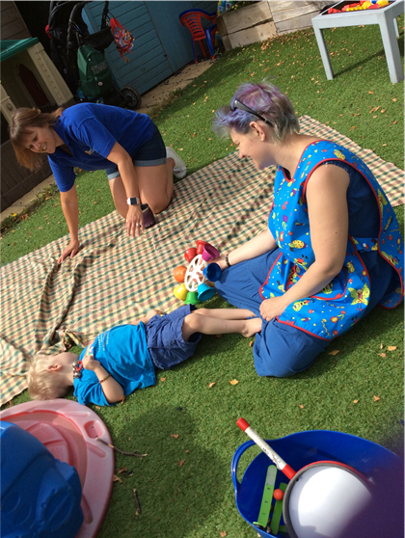
What is the Early Years Inclusion Project?
The aim is to increase the number of young children with SEND accessing early years and childcare places through:
Partnership with Local Authorities
Meaningful Parental Engagement
A National Steering Group
A Comprehensive and Extensive Training Offer
Research shows training and confidence are critical barriers
We want to make a difference and build a movement for greater inclusion in the early years
Notes:
CATH

Slide 4
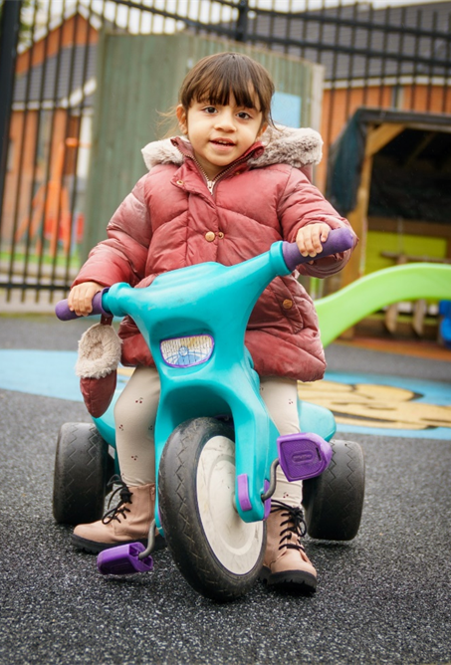
What can we offer you?
Free online training for the whole early year's workforce
10 courses over 5 years including:
Introduction To Early Years Inclusive Practice
Early Years SEND Transitions
Managing Behaviours that Challenge
Having Difficult Conversations with Families
Further 6 courses to be developed
All courses are a mix of workbook, videos and activities
Training can be completed at your own pace
Learning assessed through learners' experiences
rather than a formal assessment.
Notes:
AMANDA

Slide 5
How will it help practitioners/SENCOs and settings?
Practitioners/SENCos
Enhanced knowledge and skills
Increased confidence in the day to day and with families
Hands on experience
Certificate of completion to use in career development
Your setting
Whole setting approach to inclusion – reducing need for 1-1's
Contribute to Ofsted 'Unique child' approach
Better outcomes for children
Improved working with parents
Dingley's Promise Kitemark – Inclusion Friendly Setting
Notes:
CATH?

Slide 6
Transition Training- A Little Taster ..
SEND Code of Practice (6.17) stresses the importance of preventing a widening of the attainment gap between children with SEND and their peers.
A big transition to a new school risks a widening of this gap for multiple reasons.
Lower levels of development especially in social and communication skills needed for coping with change will mean children with SEND have a different starting point- work through transition at a slower pace- be ready to start learning later than other children.
Typically developing children have an intellectual spurt triggered by transition . This cognitive response may be later in children with SEND.

Slide 7
Transition Training … A little Taster..
3 Rs of school readiness for children with SEND
R- Resilience
R- Resourcefulness ( problem solving)
R- Reciprocity- ( being able to be part of a group)
All of this takes a lot of time…… Start Early!
Settings need to work on building resilience, self esteem and independence in all children but particularly those with SEND.

Slide 8
The Importance of Independence…
Being able to do as much for themselves as possible, relieves dependence on adult assistance.
This then facilitates more impromptu casual social opportunities which are otherwise hampered by adult intervention.
Consider how you feel as an adult when you have managed to achieve something by yourself…. Sorted out an IT issue without the need to call the service desk, fixed a washing machine without the need for an engineer……. IT FEELS REALLY GOOD!!! Your self-esteem is sky high, and you feel as if you can do anything..
We want all children to feel like this…..

Slide 9
What will the training give to settings?
An understanding of the impact of transition on the child, the family and the setting.
Improved knowledge of the “why?”
Practical strategies that are simple and achievable.
Improved confidence.. Not only in supporting children into school , but into a setting ..
A can-do attitude and the warmest of welcomes for all families.

Slide 10
What else do you need to know?
Register at https://dingley.org.uk/dingleys-promise-training/early-years-inclusion-programme/
We'll get back to you within 5 working days to confirm next steps
Please allow about 8 hours to complete each course
For queries or support, please contact training@dingley.org.uk
Notes:
AMANDA

Slide 11
Notes:
BOTH

