Slide 1

Local Offer update for the Pupil Re-Integration Team and EBSA
Using Screening Tools as part of the Lincolnshire Ladder of Behavioural Intervention.
Karen Richardson
Inclusion Team Manager

Slide 2
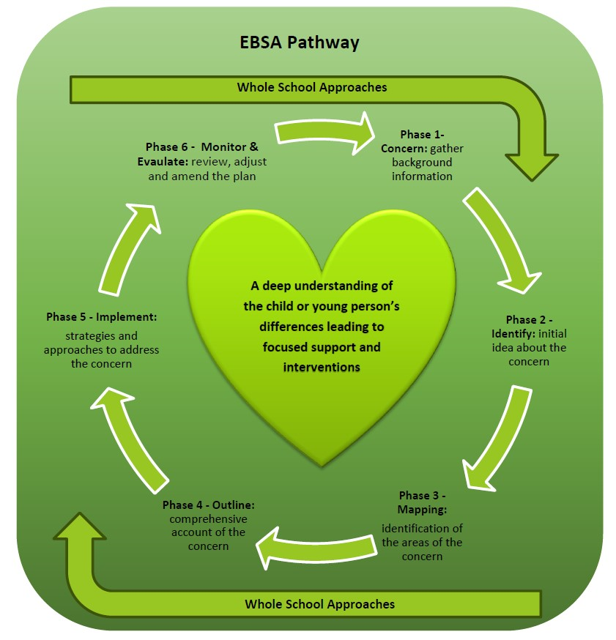
Emotional Based School Avoidance
New Local Offer pages
https://www.lincolnshire.gov.uk/support-education/emotional-based-school-avoidance-ebsa/4

Slide 3
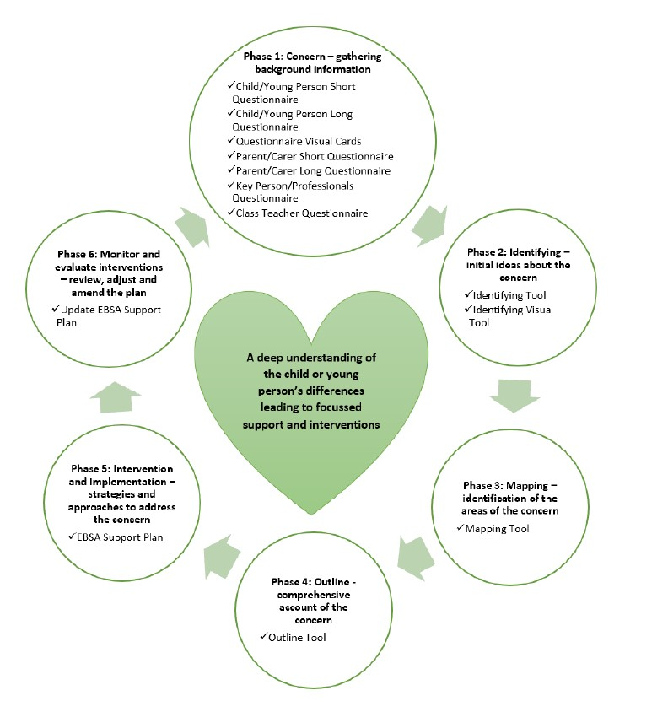
EBSA Tools

Slide 4
Pupil Re-Integration Team
New Local Offer pages
https://www.lincolnshire.gov.uk/support-education/pupil-reintegration-team

Slide 5

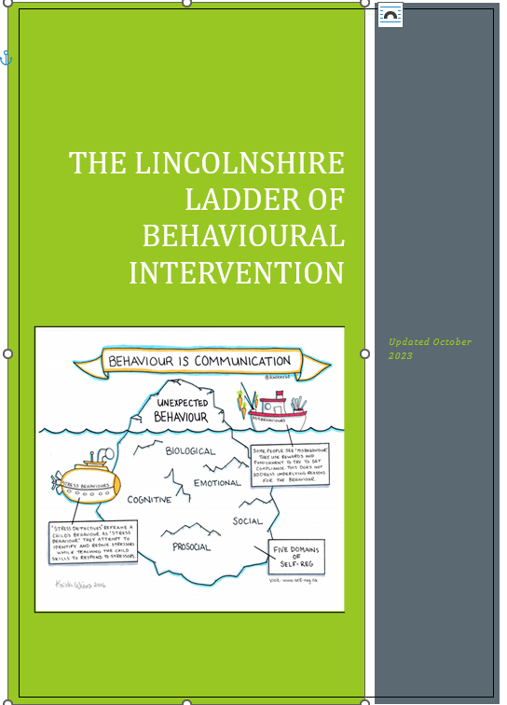
Pupil Re-Integration Team
Other Updates
Other Useful Information
The Stay Safe Directory https://www.lincolnshire.gov.uk/directory/16/stay-safe-partnership It is split into primary and Secondary and has a search function to make things easier.
The Happening is a diversionary programme based at Sleaford Police Station for KS2 – KS5. https://www.lincolnshire.gov.uk/directory-record/74982/knife-crime-intervention-the-happening-key-stages-3-and-4
Parent Training
29th November 2023 – Navigating teenage relationships (Secondary Aged Parents)
6th December 2023 - Ask Dan Anything Online Safety Q+A for Primary Aged Parents
13th December 2023 - Ask Dan Anything Online Safety Q+A for Secondary Aged Parents
The Community Safety Service has a Professional Online Safety Q&A session Lincolnshire Professional online safety Q+A Tickets, Wed 6 Dec 2023 at 10:00 | Eventbrite
SSP@lincolnshire.gov.uk
Updated Ladder now on Perspective Lite
Update on BOSS referrals with the new training requirements

Slide 6

Using Screening Tools as part of the Lincolnshire Ladder of Behavioural Intervention.
Ladder Step One
“A behaviour screening tool such as the Strengths and Difficulties Questionnaire (SDQ) or Boxall Profile should be used to determine any significant behaviour patterns or areas for development.”
They can be used to plan for early intervention, working on specific areas to address concerns before they escalate.
Some examples of resources you could use include:
Why use Screening Tools?

Slide 7
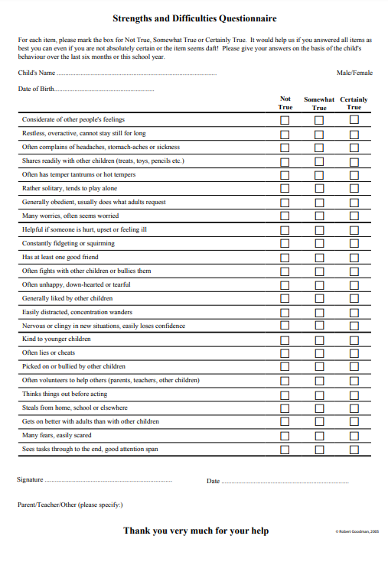
Strengths and Difficulties Questionnaires (SDQ)
“Before and after SDQs can be used to audit everyday practice and to evaluate specific interventions”
“All versions of the SDQ ask about 25 attributes, some positive and others negative. These 25 items are divided between 5 scales:
emotional problems
conduct problems
hyperactivity/inattention
peer relationship problems
prosocial behaviour”
https://www.sdqinfo.org/py/sdqinfo/b3.py?language=Englishqz(UK)

Slide 8
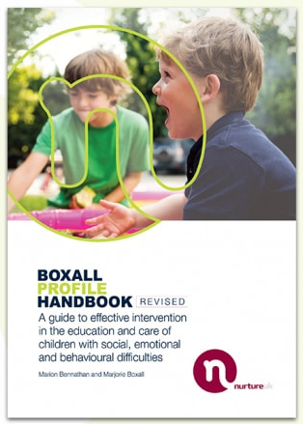
The Boxall Profile
“The Boxall Profile is a resource for helping teachers to understand children’s precise emotional and behavioural difficulties, and for planning effective interventions
and support activities.”
The handbook includes the Profile itself, with guidelines explaining how to use it and interpret the results. It also provides case studies of children in serious difficulties, showing how you can use the Profile to create Individual Education Plans.
https://www.nurtureuk.org/our-charity/

Slide 9
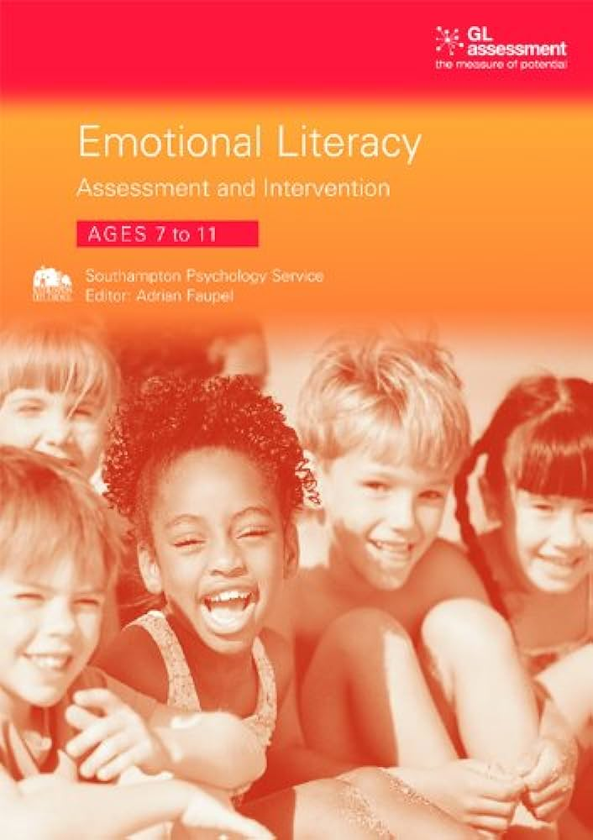
GL Assessment – Emotional Literacy
“Developed by psychologists, this assessment uses stakeholder checklists – for the pupil, parent/carer and teacher – to discover a pupil’s strengths and challenges in five sub-scales of emotional literacy and, where necessary, highlighting areas for intervention:
self-awareness
self-regulation
motivation
empathy
social skills
Scores are provided for each of the sub-scales, as well as an overall emotional literacy score, with information about techniques to help you support pupils’ development, and specific activities to address each of the five sub-scales.”
https://www.gl-assessment.co.uk/assessments/products/emotional-literacy/#product-faqs-tab-0
There are 2 versions ages:
7-11 and 12-16

Slide 10
Ladder Step One
“For all pupils at risk, undertake screening for underlying causes and special needs. A particular focus should be on communication skills because of known link with behaviour. In 2008 Bryan noted that two thirds of young offenders have speech, language and communication difficulties, but in only 5 % of cases were they identified before the offending began. (see Communication Trust's Progression Tools for additional support). It is also recommended that a reading assessment is completed to ascertain the pupil’s reading age.”
It may also be worth noting that:
81% of children with emotional and behavioural disorders have unidentified SLCN (Bercow: Ten Years On, 2018; Hollo et al., 2014). These behavioural difficulties can leave SLCN unidentified as they are often the more overt behaviour and therefore the focus of concern.
UK data reports prevalence of speech, language and communication needs in young offenders to be around 60–70% (Bryan et al., 2015), with international prevalence studies mirroring these statistics (Snow and Powell, 2011). However, studies have shown that only 5–8% of those with measurable SLCN have had these previously identified (Gregory and Bryan, 2011).

Slide 11
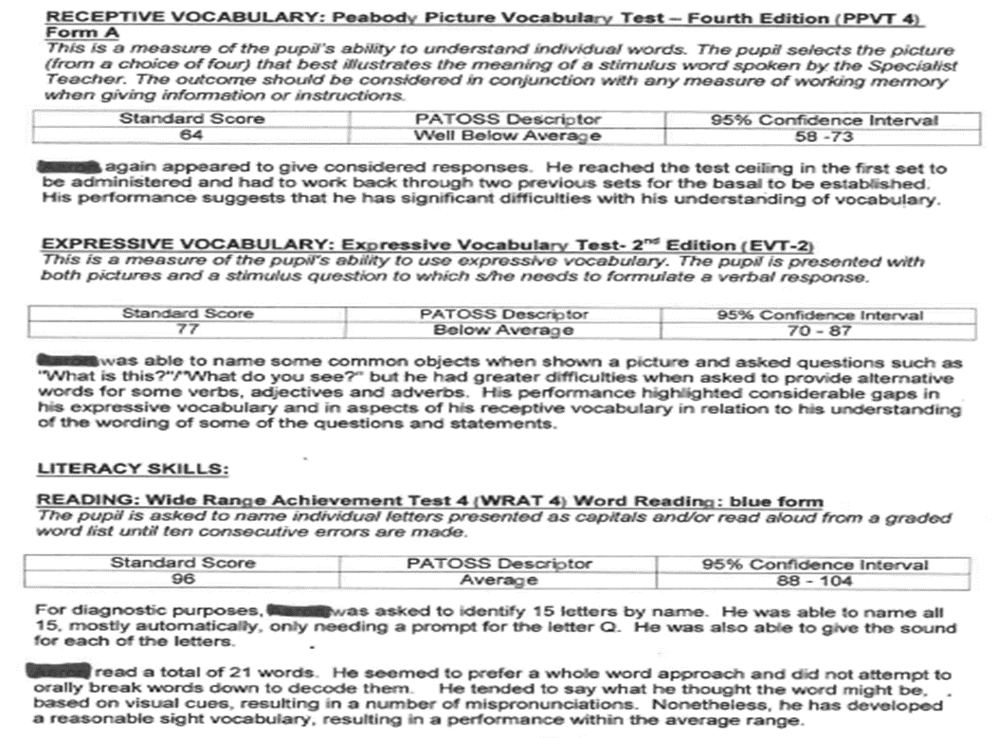
But their reading is at ARE?

Slide 12
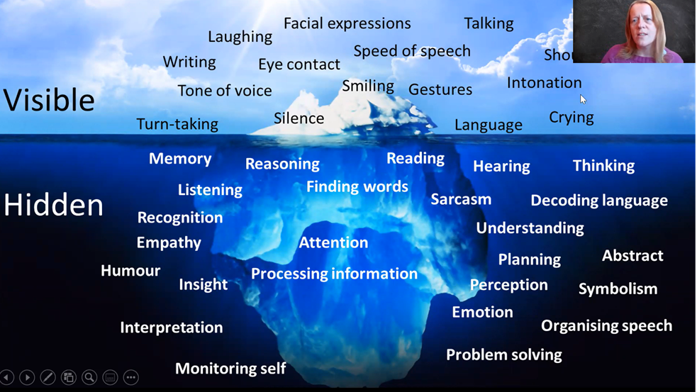

Speech Language and Communication in the Classroom – the Iceberg
What does this look like? What should I look out for?
Shouting
Ref:

Slide 13

Tools for assessing SLCN
The following may be of use when trying to identify and support SLCN:
“Universally Speaking is a series of booklets for anyone who works with children and young people. The booklets show where children should be with their communication skills at any given age.
You can use the booklets to find out whether the children you work with are on the right track, what helps them learn to talk and listen and what to do if you have concerns about any of their communication abilities.”
There are 3 booklets:
Birth to 5
5-11
11-18
There is also a Checklist to help assess needs
These Free resources can all be found here:
https://speechandlanguage.org.uk/talking-point/for-professionals/the-communication-trust/universally-speaking/

Slide 14
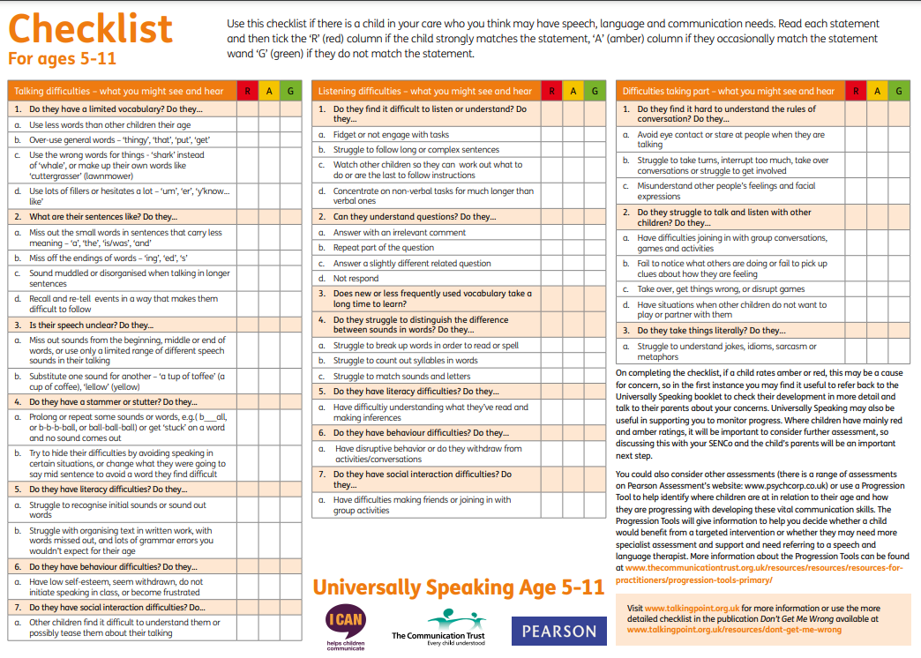
https://speechandlanguage.org.uk/media/3227/us_checklist_update.pdf

Slide 15
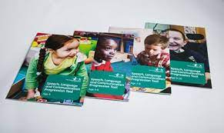
Progression Tools
“Based on the content of Universally Speaking, the Speech, Language and Communication Progression Tools aim to provide a relatively quick way of determining where children are against where they should be for their age and provide more information about how these vital skills are progressing.
The Progression Tools aim to support teaching staff to identify children who may be struggling to develop their speech, language and communication skills. They can also be used to track progression of these skills over time or following interventions.”
Progression Tools Webinar Primary on Vimeo
Progression Tools Webinar Secondary on Vimeo
Other Support from Speech and Language UK and the Communication Trust
https://speechandlanguage.org.uk/information-and-support/

Slide 16

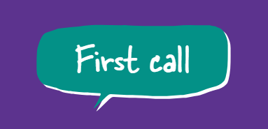
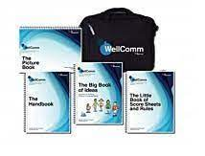

Other Resources/ Support
https://www.hacw.nhs.uk/identifying-slcn/
https://www.lincolnshirechildrenstherapyservices.nhs.uk/our-services/resource-library/first-call
https://www.lincolnshirechildrenstherapyservices.nhs.uk/our-services/resource-library/secondary-first-call
“WellComm helps you to identify pre-school and primary school children who are experiencing barriers to speech and language development so that you can support them early in their education journey.
Available for Early Years and Primary-aged pupils. Both toolkits come with an age-appropriate ‘Big Book of Ideas’ with targeted activities. Activities and strategies can also be shared with parents for use in the home learning environment.”
https://www.gl-assessment.co.uk/assessments/products/wellcomm/
“Provide screening, intervention, staff training and support in a one yearly subscription”
https://speechandlanguage.info/

Slide 17

Any Questions

