Slide 1
L.E.A.D. TSH Graduated Approach
22.11.2023 / 28.11.2023
Working in partnership, achieving the highest outcomes for all’
Notes:
AG

Slide 2
SEND Leadership – A Tiered Approach
Tier 1 - Leadership
Tier 2 - SENCos
Tier 3 – Middle Leaders
Notes:
Introduced the Tiered Approach to SEND Leadership this year
SENCo has started but not too late to sign up if the modules for 6.11.2023 are of interest
Middle Leader – starts in January

Slide 3
SEND Leadership – A Tiered Approach
Notes:
Teacher has started but you can still access the modules that are yet to run.
SEND is an aspect that came up time and time again on the leadership Briefings – make full use of these modules to support staff in your school

Slide 4
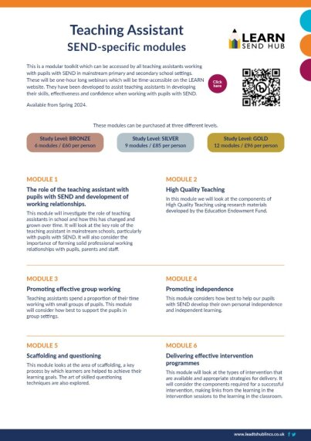
SEND Leadership – Teaching Assistant
6 modules £60 pp
9 modules £85 pp
12 modules £96 pp
Notes:
Teacher has started but you can still access the modules that are yet to run.
SEND is an aspect that came up time and time again on the leadership Briefings – make full use of these modules to support staff in your school

Slide 5
SEND Huh
“So Mary Myatt and I have been interviewing
some remarkable subject leaders about
curriculum development.”
“The challenging conversations that comprise SEND Huh paint an inspiring picture that is hugely hopeful for the future of SEND curriculum provision in our schools.”

Slide 6
Updates since we last met
NPQSEND:
The new NPQ will replace the existing National Award for SEN Coordination (NASENCO) as the mandatory qualification for SENCOs from September 2024.
Only for new SENDCOs.
They must complete this within 3 years of starting the SENCO post.

Slide 7
SEND Workforce Development
Scan the QR code to register for FREE!
5000!
Modules
completed
256
Lincs schools
engaged
99%
Satisfaction
rate
25
Average mins per module
chris.lincoln@learnsendhub.co.uk
Notes:
The SEND Workforce Development project continues to be accessed by staff in schools across Lincolnshire.
The figures in yellow show what has changed since the last briefing. An additional 40 schools have completed modules, taking us to more than
5,000 overall.

Slide 8
Workforce Development
Tier 1 Feedback
Restorative Practice:
‘The module has helped me to be much more child focussed/led with the huge importance of not chasing a sorry’
‘A very clear and concise approach to restorative practice, including the aims, benefits, different strategies and how to manage conversations by using key questions’
‘I learnt about restorative practice and the benefits of using a restorative approach with pupils, as the relationship between you and them is important and encourages respect. The downloadable resource will be very useful to my practice’
Sensory Processing and Integration:
‘I learnt about positive sensory profiling on a deeper level and additional strategies that can support learners such as weighted jackets and sensory circuits’
‘I was unaware of some of the sensory systems and the content will help me use sensory equipment in a better way, underpinned by the correct purpose. It will also help me to to use sensory circuits more effectively with a greater understanding of each stage in supporting sensory systems’
‘I learnt the significance of understanding that every child is different and can respond differently to various things such as sound. It has helped me get a better understanding of what strategies can be used to support those children’
chris.lincoln@learnsendhub.co.uk
Notes:
Feedback is vital for us to inform the next modules.

Slide 9
Workforce Development
Tier 1 Feedback
Support Interventions:
‘The module helped me to think a great deal about interventions and now my processes will be much more logical’
‘I now understand that it is vital that any support interventions are correctly identified, and then supported appropriately with assessments both at the start and the end of the process’
‘I now know how to plan a reliable and effective intervention whilst understanding the key areas/questions to consider when implementing an intervention. It is important to assess with accurate diagnostics and fidelity’
Supporting Transitions:
‘I learnt all about how important it is to do any transitions properly, whether it’s from nursery to primary, secondary to college/working/internships, ensuring that children are at the centre of their plans, their voices are heard and respected. It was good to see all the optional sites of support that are available to children and their families/people working alongside the child’
‘The module will help me to support young people and students to develop, grow and help them on their journey in a safe, professional and happy environment. To prioritise their development and ensure that their voice is heard. To act as a mentor and also an advocate.
‘I liked the toolkit sheets to record the child's voice with pictures and ‘all about me’ sheets. I now understand the importance of having high goals for children with SEND and putting transitional items in place early so that they have better adult outcomes’
chris.lincoln@learnsendhub.co.uk

Slide 10
Workforce Development
Where next?
-Phased roll out of Tier 1 across sectors continues
-One module every 2-3 weeks. Module names to be announced on Twitter the week before
Key Dates this term:
SEND Schools
Mainstream
9th
Oct
Module 5
6th
Nov
Module 6
20th
Nov
Module 7
4th
Dec
Module 8
30th Oct
Induction Tier for parents and carers
18th
Sep
Module 3
2nd
Oct
Module 4
16th
Oct
Module 5
6th
Nov
Module 6
20th
Nov
Module 7
4th
Dec
Module 8
chris.lincoln@learnsendhub.co.uk

Slide 11
SEND Workforce Development
Modules available include:
Induction Tier:
(Now also available to parents)
Types of SEND
Awareness of a Neuro-Typical Child
What is Inclusion?
SEND Code of Practice
Respecting Individuals
Working with Professionals
Tier 1:
(Modules released every 2-3 weeks)
Sensory Processing and Integration
Supporting Transitions
Support Interventions
Restorative Practice
Four Areas of Need
Nurture Principles
Personal Care and Dignity
Introduction to Attachment
Trauma
Intensive Interaction
Communication
Scan the QR code to register for free:
@SENDworkforce
“A very clear and concise toolkit
of strategies. I enjoyed working through the scenarios and the downloadable content”
chris.lincoln@learnsendhub.co.uk
Notes:
Since the last briefing, another three modules have gone live to all schools. These are Four Areas of Need, Personal Care and Dignity and Introduction to Attachment.
A reminder that any member of staff who has an account on the Lincolnshire Safeguarding Children Partnership platform, should be able to see and access all of the modules that have gone live when they sign into the platform. If any staff need support, they can contact us through the QR code and a member of the team will get in touch.
Finally, our first Induction Tier modules have been completed by parents. If you would like a flyer about the content that you can send to parents and carers, please contact Chris on the email address at the bottom of the slide.

