Slide 1
Ensuring that EHCNA Requests are Properly Evidenced.
November 2023
Nicola Carter & Josie Pedersen
Notes:
I have put a link to a form in the chat – if you have observed an allocations panel meeting, please could you complete the survey by clicking on the link in the chat. So, today, we’re looking at ensuring that EHCNA requests are properly evidenced. Before I start, I’d like to provide a little information about the high numbers of requests we are getting coming through at the moment. We split the Allocations Panel when we reach 30 cases due to sheer volume of reading that is required. Just looking back to the start of the summer term in April, we had split panels every week apart from 3, including all through the holidays and, apart from a slight lull in September and early October, split panels have also been the norm going forward to now. It’s therefore really important that you are providing all the information the Panel requires so that we can make the right decision from the start.

Slide 2
Requests for assessment
 | Yes/No | Comments
Has information about the nature, extent and context of the child or young person's SEN been provided?
Is this an Educational Need?
Is there sufficient evidence of the child/young person's academic attainment (or developmental milestones) and rate of progress?
Is there sufficient evidence of action taken by the early years’ provider, school or post-16 institution to meet the child/young person's SEN? Has the setting used all its available resources?
Is there sufficient evidence that where progress (if any) has been made, it has only been the result of much additional intervention and support over and above that which is usually provided?
Has advice been sought from relevant external agencies, followed, and reviewed?
Notes:
Showing section of the decision-making sheet that is completed for each request. Hopefully you can read the questions on the left but if they are a bit small, don’t worry as each one will be detailed on the following slides as I talk about the evidence we need to see. When you put in a request, we expect to be able to answer yes to all of these questions; and if we do, the EHCNA will proceed to an assessment.

Slide 3
Information that must be included
1. Has information about the nature, extent and context of the child or young person's SEN been provided?
Remember to include any medical diagnoses and/or educational diagnoses (SpLD)
State what impact these have on the CYP’s education
Where would this be included in the new Hub?
Important Information About the Child/Young Person
What historical information about the child or young person's Special Educational Needs (SEN) is relevant?
What historical information about the child or young person's health needs is relevant?
Documents - Additional documents provided with this request:
If you have stated that the CYP has a medical diagnosis of, for example, Autism, we need to see the letter
from the Community Paediatrician detailing this. You may wish to number your appendices in the body of
the request and in your file names. For example,
XXX received a diagnosis of Autism in January 2023 from Dr YYY. (See Appendix 1)
And then in the document folder, the file name would be: Appendix 1_Autism diagnosis
Notes:
Looking at the first question we have to answer… You need to outline exactly what it is that is preventing the CYP from accessing their education and detail any diagnoses and the impact of these. We expect to see evidence of diagnoses in the ‘Additional documents provided with this request’ section: It’s really helpful if you name the files you are uploading clearly so that those on Panel can find them easily. I’ve given you an example at the bottom of the screen. The sections in blue font on all of the slides are the titles of the sections I am suggesting it may be helpful to include the information in. When you are considering which documents to attach, please don’t just dump every single document pertaining to the same diagnosis in the attachments. Ideally we need to see the Community Paediatrician letter from when the diagnosis was made as well as the most recent letter, as that helps the EP or ST to write up their reports, but we don’t need to see every single change of medication, for example.

Slide 4
Information that must be included
2. Is this an Educational Need?
State what impact this has on the CYP’s education
Where would this be included in the new Hub?
This will be a common thread running throughout the application. The Panel should be in no doubt that there is an educational need.
Notes:
Looking at the second question we have to answer: It’s important to state the impact on the CYP’s education. Often, we will get applications for CYP with medical needs. In order for an EHCP to be agreed, there has to be clear evidence that the medical need is impacting on the child’s education.

Slide 5
Information that must be included
3. Is there sufficient evidence of the child/young person's academic attainment (or developmental milestones)
and rate of progress?
Where would this be included in the new Hub?
Important Information About the Child/Young Person
What historical information about the child or young person's Special Educational Needs (SEN) is relevant?
OR
Cognition and Learning
What are the child or young person's special educational needs related to learning in this area?
OR
Documents - Additional documents provided with this request:
As a named appendix
Historical Termly Data, (Eg. Autumn, Spring, Summer) including previous educational setting data where available.
Date Assessed | Year Group | Key Stage | TA or SATS Please indicate whether reporting in stages or levels | Spelling Age / Spelling, Grammar & Punctuation Age | Speaking & Listening | Writing | Reading | Maths | Science
Notes:
Looking at the third question we have to answer… This is so important and yet omitted by so many settings because it is not specifically asked for now within the EHC Hub format (even though it is detailed in the notes section). You could develop your own table, or instead of re-inventing the wheel, use the relevant ones from the old request pack. Remember to provide a commentary on what your school results mean because it can be different for every school now and we need to know what that means for the individual CYP. Working Towards the Expected Standard is too vague.

Slide 6
Information that must be included
4. Is there sufficient evidence of action taken by the early years’ provider, school or post-16 institution to meet the child/young person's SEN? Has the setting used all its available resources?
And
5. Is there sufficient evidence that where progress (if any) has been made, it has only been the result of much additional intervention and support over and above that which is usually provided?
Where would this be included in the new Hub?
In each of the broad areas of need sections
What has the current education setting already put into place to support these needs?
What has been the effect of any support or strategies already put into place by the education setting?
OR
Documents - Additional documents provided with this request:
You could upload a separate APDR document along the same lines of the one from the old request pack or
a costed provision map:
Desired Outcomes (Eg. Support Plan Targets, Individual Targets) | Outside Agency | Strategies Implemented | Provision Delivered | Frequency, Duration and by Whom | Start Date – End Date | Actual Outcomes: (Impact made) Met/Partially Met/Not Met
Notes:
Questions 4 & 5 can be answered together… Don’t just think about interventions that you are putting in place as part of your APDR. Evidence what support is going on in the classroom too. If there has been progress, detail what that is and tell us if it is as a result of the additional interventions and whether these are over and above your delegated funding. Try to give us bullet points or a chronology of what you have tried and what impact that has had. You could also upload a separate APDR document along the same lines of the one from the old request pack or a costed provision map

Slide 7
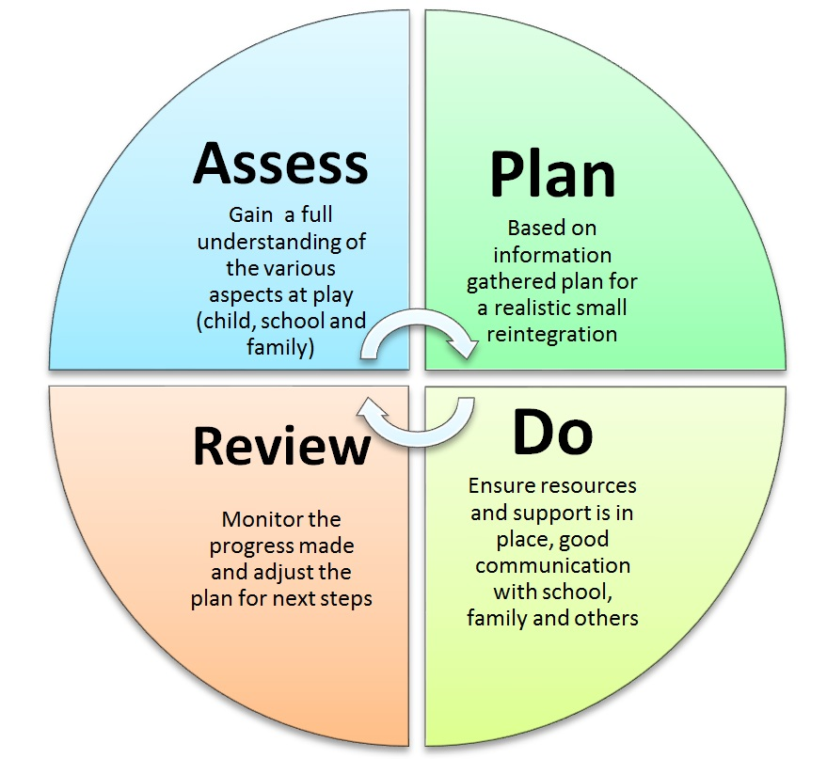
A Graduated Approach to support
Provision map, IEP, decision making
Off the shelf, ST, EP, SEST, SC, MH, Health, etc
Assess | Plan | Do | Review
Name the assessment and date | Decision making and Provision | Allocate and Monitor delivery | Date of review Impact and next step
6 weekly recorded
TA timetabling, observations, lesson planning
2 cycles – first cycle is often “off the shelf” assessments
or SENCO assessment, and second/subsequent cycle(s) specialist
and/or external.
Should flow from EY to primary to secondary.
Notes:
Thinking about the Assess, Plan, Do, Review cycle now… Assess: Think about off the shelf assessments you can use that establish a baseline against which you can measure progress and the impact of any interventions you have in place. Please don’t just upload documents without explaining what the results mean. We see lots of screening tests and Boxall Profiles where there has been no analysis whatsoever and no indication of what was done following the results of the screener to address the difficulties.
Plan: Think about whether the CYP’s IEP or support plan is actually going to give us all the information we need to make a decision on whether you have used all of the resources available to you. Generally, the IEPs we see have been written in a child-friendly way and don’t detail all of the support that is in place. Consider whether a costed provision map or a ‘Day in the life’ document may provide a better example of everything you are doing.
Do: A costed provision map or Day in the Life may double up to provide your evidence of the Do part of the process.
Review: We need to know whether what you have tried has worked. If it hasn’t, we wouldn’t expect to see more of the same in the next cycle.

Slide 8
Information that must be included
6. Has advice been sought from relevant external agencies, followed, and reviewed?
Remember to demonstrate that you have put into place the advice given and subsequently reviewed it.
Have you sought advice from all relevant agencies?
Where would this be included in the new Hub?
Important Information About the Child/Young Person
What historical information about the child or young person's Special Educational Needs (SEN) is relevant?
What historical information about the child or young person's health needs is relevant?
OR
In each of the broad areas of need sections
What has the current education setting already put into place to support these needs?
What has been the effect of any support or strategies already put into place by the education setting?
As recommended by….The impact of this was…
Remember to provide evidence of the advice given in
the additional documents section.
Notes:
Finally, we’re looking to see that you have utilised the wealth of advice that is available to you within Lincolnshire. You would be amazed at how many children with ASD we see coming through the process and there is no WTT involvement and no explanation of why that is the case.

Slide 9
Summary
Remember to provide evidence of:
Attainment levels with explanation
Evidence of an SEN
Assessment lifespan is 6 months to a year – we only want 2 yrs old (max) apart from any original CP diagnosis letters.
The fact you have exhausted all the usual resources of a setting - graduated approach - evidence of cycles of support, including specialists - evidence of impact and quantification

Slide 10
Requests for assessment - Allocations Panel Meetings take place every Wednesday
Joint Assessment Route
A EP only
B1 Specialist Teacher with final approval EP
B2 Specialist Teacher with EP input
C1 Early Years Specialist Teacher with final approval EP
C2 Early Years Specialist Teacher with EP input
D1 ECLIPS, SEST or other lead professional with final approval EP
D2 ECLIPS, SEST or other lead professional with EP input
If you wish to observe an Allocations Panel Meeting, contact: BS_SEND@lincolnshire.gov.uk
Notes:
This slide shows you the assessment routes that can be chosen at the Panel meeting if the decision is a Yes to assess. Just one plea FROM THE Panel members is that we are getting a lot of parental requests through at the moment with no supporting information from school. We would hope that the majority of these are cases that you don’t agree need a Plan because otherwise you would have submitted the information yourself. If that is the case, please don’t ignore the request for additional information but indicate that you are currently meeting the CYP’s needs through the Graduated Response and within the resources available to you as a setting. Attainment levels indicating progress will also be helpful but then the rest can be left blank as we will get the message. If it is the case that you do feel a Plan may be needed but that parents have jumped the gun whilst you are still gathering evidence, it is really important that you indicate this and show the level of need and how you are meeting it. It is very costly for the LA to say no to a parental request due to lack of evidence only to be taken to mediation a short while later and find that there is enough evidence from the school or setting to warrant an assessment.
We welcome anybody who wishes to observe a Panel meeting. You can book a place through BS_SEND. I’m just going to end the presentation next and give opportunity to ask questions but before I do that I have a quick poll for those of you who have already attended a Panel meeting. Stop sharing and load poll.

Slide 11
Any Questions?

Slide 12
Useful information/documents The SEND Code of Practice 2015 https://www.gov.uk/government/uploads/system/uploads/attachment_data/file/398815/SEND_Code_of_Practice_January_2015.pdf The Children and Families ACT/Regulations 2014 http://www.legislation.gov.uk/ukpga/2014/6/pdfs/ukpga_20140006_en.pdf The Disability Discrimination Act 2005 https://www.legislation.gov.uk/ukpga/2005/13/pdfs/ukpga_20050013_en.pdf The Equality Act 2010 https://www.legislation.gov.uk/ukpga/2010/15/pdfs/ukpga_20100015_en.pdf Accessibility Plan Equality Act 2010: Schedule 10, Paragraph 3 and Disability Discrimination (prescribed Times and Periods for Accessibility Strategies and Plans for Schools) (England) Regulations, 2005. SEND Governance Review Guide http://sendgov.co.uk/wp-content/uploads/2018/05/LLS-SEND-Review-Guide-screen.pdf
Notes:
Really helpful documents for their reference

Slide 13
Useful information/documents Reasonable Adjustments for disabled children in school https://www.equalityhumanrights.com/sites/default/files/reasonable_adjustments_for_disabled_pupils1.doc Supporting pupils at school with medical needs https://www.gov.uk/government/uploads/system/uploads/attachment_data/file/638267/supporting-pupils-at-school-with-medical-conditions.pdf Preparing for Adulthood https://www.preparingforadulthood.org.uk SEN: role of the link governor SEN: role of the link governor | The Key for School Governors (thekeysupport.com) Pupils not attending and on Reduced Timetables https://www.lincolnshire.gov.uk/school-attendance/pupil-attendance/4 EHCA/EHCP Locality email addresses , NKSK_SendLocality@lincolnshire.gov.uk –Bex Rawdon, Team Manager LWL_SendLocality@lincolonshire.gov.uk – Michelle White, Team Manager EAL_SendLocality@lincolnshire.gov.uk – Josie Pederson, Team Manager BSH_SendLocality@lincolnshire.gov.uk –Alison Charity, Team Manager
Notes:
Really helpful documents for their reference

