Slide 1
Graduated Approach Briefings
November 2023
Notices

Slide 2
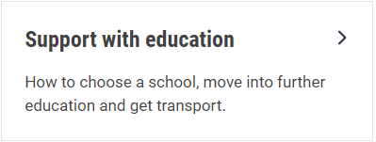
Welcome
To locate information about the Graduated Approach Briefings on the Local Offer, go to: https://professionals.lincolnshire.gov.uk/homepage/54/graduated-approach-briefings
Or on the Home Page, click on: Support with Education
Then scroll down to: Graduated Approach Briefings
Welcome and thank you for joining us for this virtual training session.
Please sign in through the Chat to register your attendance.
As usual, to support everyone to maintain connectivity with so many attendees being here:
Please Mute your microphone and turn off your video when not speaking – we have a large number of participants present today and this may mean that we experience feedback or slowing of the network connection if everybody has their microphone and video on. However, we would like to see you if you ask a question, please, so feel free to switch on both your microphone and video in these instances.
Please note that this meeting, or sections of it, will be being recorded for use on the council’s professionals’ website. If you do not wish to be recorded, you should leave the meeting and watch it back later.
If you would like to ask questions, please use the raise your hand facility or use the chat function in Teams
Please keep discussion in the ‘chat’ relevant – the person presenting may not be able to see your comments but we will have someone monitoring it in order to make sure all questions are answered.

Slide 3
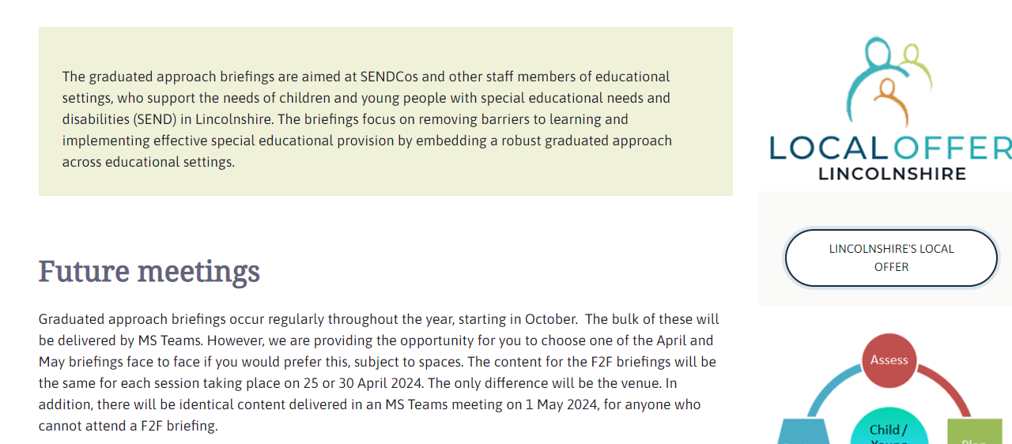
Remember to book your places for each briefing throughout the year on the Local Offer
Graduated approach briefings – Professional resources (lincolnshire.gov.uk)

Slide 4
Lincolnshire Children's Hearing Services Working Group
Children’s Hearing Services Working Groups (CHSWGs) are groups of parents and professionals who work with deaf children and young people. They meet regularly to help improve health, education and social care services for deaf children, young people and their families.
The Lincolnshire CHSWG meets 3 times a year and works on an action plan that has a number of priorities for our local area. Representatives have the opportunity to share their views, feedback on any progress made, raise issues that are affecting deaf children and young people, and provide the voice of parents.
We are looking for a SENCo Representative to support the work of this group. If you are interested, please contact: Nicola.Carter@lincolnshire.gov.uk

Slide 5
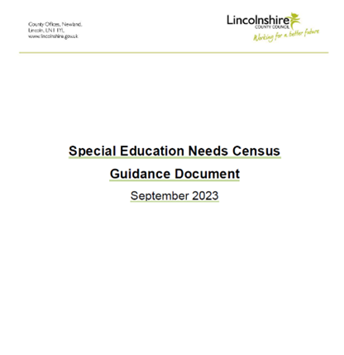
SEN Census Guidance Document and FAQ Document
Following on from the October briefings, both of these documents have now been released through School News. If you haven’t seen them, they will be added to the Local Offer here following our briefings this month: Graduated approach briefings – Professional resources (lincolnshire.gov.uk)

Slide 6
Lincolnshire Virtual School
Training events
Our training offer has been developed to better support settings in promoting educational outcomes for our children in care, children previously in care and children with a social worker. You do not have to have a child in care to attend the training.
Between now and the next SEND Graduated Briefings we have the following free sessions on offer:
Skills Needed for GCSE Maths for carers and CiC: 6th December 2023 18:30 – 19:30 please signpost foster carers to this
Skills Needed for GCSE English for carers and CiC: 12th December 2023 18:30 – 19:30 please signpost foster carers to this
Supporting Grief, Loss and Positive Endings – 4th December 12:00 – 14:00 or 11th January 19:00 – 21:00
Introduction to Trauma awareness (2 parts to attend) – 6th and 13th December 19:00 – 21:00
Sleep Workshop Supporting Sleep, Nightmares and Night Terrors – 15th December 10:00 – 12:00
Find out about the Caring2Learn Schools Toolkit– 9th January 10:00 – 12:00
A Relationship Based Approach to Inclusion - Policy & Practice – 16th January 10:00 – 12:00
SDQs – what they are, why we use them and how to complete them–17th January 13:00 – 14:30
Please use the training booklet to book onto any of the courses.
Please don’t hesitate to contact us via email: VirtualSchoolTraining@lincolnshire.gov.uk
if you require any further information or advice.

Slide 7
Please signpost students and parents to this free training being delivered by the Dyslexia Outreach Team.

Slide 8
Presentations and Videos will be available from 5th December
Remember to visit the Graduated Approach Briefings page on the Local Offer so that you can view the presentations and videos for this round of briefings and any from the previous academic year.
Graduated approach briefings – Professional resources (lincolnshire.gov.uk)

