Slide 1
Introduction to SEND Leadership- A Tiered Approach
www.learnsendhub.co.uk

Slide 2
New Venue
YMCA Lincolnshire,
The Showroom, Tritton Road,
Lincoln, LN6 7QY
Tier 2: SENCos
Aimed at SENCos, to support them in being strategic leaders, linking closely with the senior leadership team to cascade information and training throughout the school. It will address new research and government-led recommendations and initiatives, identify and signpost support organisations e.g. Whole school SEND and will include EEF SEND in the Mainstream guidance. The trainers will support and challenge the delegates to consider the next steps required to meet the recommendations from the various evidence sources, enabling them to link theory and practice in their own provision, leading to future-proofing inclusive education.
More details on P23 of the LEARN SEND Hub brochure.
www.learnsendhub.co.uk

Slide 3
Tier 3: Middle leaders
Aimed at Middle Leaders (MLs). It will ensure that MLs have a clear understanding of statutory requirements in relation to SEND. It will enable them to review their curriculum offer, check that it meets the needs of all learners and consider how it can be adapted to do so. MLs will consider how to support teachers in implementing this, and monitor effectiveness through a SEND lens using the EEFs implementation cycle.
More details on P23 of the LEARN SEND Hub brochure.
www.learnsendhub.co.uk

Slide 4
Tier 4: Teachers
This is a modular toolkit which can be accessed by all Teachers depending on their individual CPD
requirements. The twelve modules complement the ECT and NPQ packages by providing practical
guidance, They will address research and common themes affecting learners and schools within the
County. Each session will be held as a series of webinars 1.5 hrs in length.
Module
High Quality Teaching - the Inclusive Teacher
Working with support staff
Scaffolding
Teachers toolkit for meeting Cognition and Learning Needs
Teachers toolkit for meeting Communication and Interaction needs
Teachers toolkit for meeting Social, Emotional and Mental Health Needs
Teachers toolkit for meeting Physical and Sensory Needs
Behaviour and Engagement
IEP - Plan through to implementation
Learning environments
Working in Partnership
Successful SEND support-graduated approach cycle
More details on P24 & 25 of the
LEARN SEND Hub brochure.
www.learnsendhub.co.uk

Slide 5
TEACHING ASSISTANT– SEND-SPECIFIC MODULES
This is a modular toolkit which can be accessed by all teaching assistants working with pupils with SEND in mainstream primary and secondary school settings. These will be one-hour long webinars which will be time-accessible on the LEARN website. They have been developed to assist teaching assistants in developing their skills, effectiveness and confidence when working with pupils with SEND. Available from Spring 2024.
Module
The role of the teaching assistant with pupils with SEND and development of working relationships.
High Quality Teaching
Promoting effective group working
Promoting independence
Scaffolding and questioning
Delivering effective intervention programmes
Providing valuable feedback for teachers and pupil
Understanding Communication and Interaction needs
Understanding Cognition and Learning needs
Understanding Social, Emotional and Mental Health Needs
Understanding Physical and Sensory Needs
Calm and ‘ready’ to learn
More details on P26 & 27 of the
LEARN SEND Hub brochure.
www.learnsendhub.co.uk

Slide 6
SEND Workforce Development
Scan the QR code to register for FREE!
4000+
Modules
completed
216
Lincs schools
engaged
99%
Satisfaction
rate
25
Average mins per module
chris.lincoln@learnsendhub.co.uk
Notes:
Induction Tier has been available for SEND schools since December 2022 and for mainstream schools since March 2023.
Tier 1 then went live before the Summer holidays with modules being rolled out on a phased basis every 2-3 weeks.
Any member of Lincolnshire school staff should be able to access the modules on their LSCP profile. However, if you aren’t sure where to go or can’t see the modules, scan the QR code to get in touch with our team.

Slide 7
Workforce Development
Tier 1 Feedback
Restorative Practice:
‘The module has helped me to be much more child focussed/led with the huge importance of not chasing a sorry’
‘A very clear and concise approach to restorative practice, including the aims, benefits, different strategies and how to manage conversations by using key questions’
‘I learnt about restorative practice and the benefits of using a restorative approach with pupils, as the relationship between you and them is important and encourages respect. The downloadable resource will be very useful to my practice’
Sensory Processing and Integration:
‘I learnt about positive sensory profiling on a deeper level and additional strategies that can support learners such as weighted jackets and sensory circuits’
‘I was unaware of some of the sensory systems and the content will help me use sensory equipment in a better way, underpinned by the correct purpose. It will also help me to to use sensory circuits more effectively with a greater understanding of each stage in supporting sensory systems’
‘I learnt the significance of understanding that every child is different and can respond differently to various things such as sound. It has helped me get a better understanding of what strategies can be used to support those children’
chris.lincoln@learnsendhub.co.uk
Notes:
Feedback is vital for us to inform the next modules.

Slide 8
Workforce Development
Tier 1 Feedback
Support Interventions:
‘The module helped me to think a great deal about interventions and now my processes will be much more logical’
‘I now understand that it is vital that any support interventions are correctly identified, and then supported appropriately with assessments both at the start and the end of the process’
‘I now know how to plan a reliable and effective intervention whilst understanding the key areas/questions to consider when implementing an intervention. It is important to assess with accurate diagnostics and fidelity’
Supporting Transitions:
‘I learnt all about how important it is to do any transitions properly, whether it’s from nursery to primary, secondary to college/working/internships, ensuring that children are at the centre of their plans, their voices are heard and respected. It was good to see all the optional sites of support that are available to children and their families/people working alongside the child’
‘The module will help me to support young people and students to develop, grow and help them on their journey in a safe, professional and happy environment. To prioritise their development and ensure that their voice is heard. To act as a mentor and also an advocate.
‘I liked the toolkit sheets to record the child's voice with pictures and ‘all about me’ sheets. I now understand the importance of having high goals for children with SEND and putting transitional items in place early so that they have better adult outcomes’
chris.lincoln@learnsendhub.co.uk

Slide 9
Workforce Development
Where next?
-Phased roll out of Tier 1 across sectors continues
-One module every 2-3 weeks. Module names to be announced on Twitter the week before
Key Dates this term:
SEND Schools
Mainstream
9th
Oct
Module 5
6th
Nov
Module 6
20th
Nov
Module 7
4th
Dec
Module 8
30th Oct
Induction Tier for parents and carers
18th
Sep
Module 3
2nd
Oct
Module 4
16th
Oct
Module 5
6th
Nov
Module 6
20th
Nov
Module 7
4th
Dec
Module 8
chris.lincoln@learnsendhub.co.uk

Slide 10
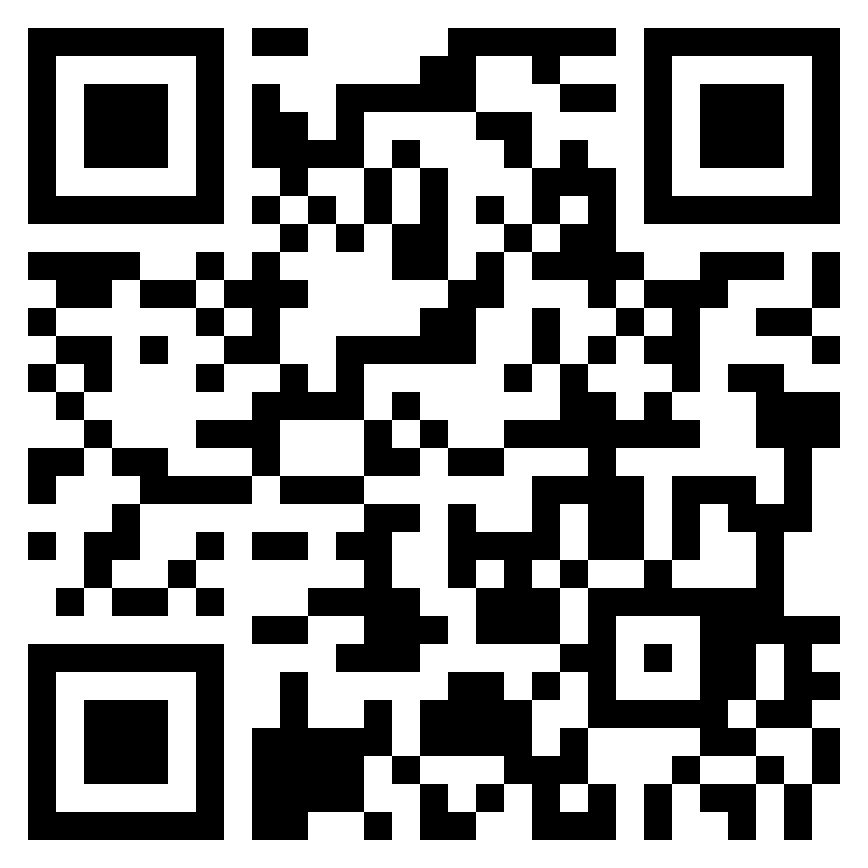
SEND Workforce Development
Modules available include:
Induction Tier:
(Now also available to parents)
Types of SEND
Awareness of a Neuro-Typical Child
What is Inclusion?
SEND Code of Practice
Respecting Individuals
Working with Professionals
Tier 1:
(Modules released every 2-3 weeks)
Sensory Processing and Integration
Supporting Transitions
Support Interventions
Restorative Practice
Four Areas of Need
Nurture Principles
Personal Care and Dignity
Introduction to Attachment
Trauma
Intensive Interaction
Communication
Scan the QR code to follow us on Twitter:
@SENDworkforce
“A very clear and concise toolkit
of strategies. I enjoyed working through the scenarios and the downloadable content”
chris.lincoln@learnsendhub.co.uk
Notes:
Parents and carers will be able to access the Induction Tier modules from 30th October. Contact Chris on the email address at the bottom of the slide to access a flyer that can be sent to parents and carers with more information.

Slide 11
WSS Updates Autumn 23-24

Slide 12
UNIVERSAL SEND SERVICES EVENTS CALENDAR
2023
VIEW EVENTS ONLINE: https://www.wholeschoolsend.org.uk/events
Join us for our FREE hour-long discussions on a range of themes related to inclusive practice. Hosted by Regional SEND Leaders with specialist guests from our partner organisations.
ASK SPECIALIST ADVICE – NETWORK WITH COLLEAGUES – SHARE EXPERIENCES
Autumn
Wednesday 1 November
16:00 – 17:00
Thursday 2 November
16:00 – 17:00
Understanding behaviour as communication – Secondary / FE
An introduction to speech, language and communication needs – Secondary / FE
Book now!
Book now!
Tuesday 7 November
16:00 – 17:00
Tuesday 14 November
16:00 – 17:00
Supporting the development of speech, language and communication skills - Primary
Identifying and supporting speech, language and communication needs – Primary
Book now!
Book now!
NOV
Wednesday 15 November
16:00 – 17:00
Tuesday 21 November
16:00 – 17:00
Understanding behaviour as communication - Primary
Supporting the development of speech, language and communication skills – Secondary / FE
Book now!
Book now!
Tuesday 28 November
16:00 – 17:00
Featuring specialists from:
Creating a learning environment that supports speech, language and communication – Secondary / FE
Book now!
Hosted by
Part of Universal SEND Services: an ambitious 3-year programme, funded until 2025 by the Department for Education, and delivered by nasen through the Whole School SEND consortium, in strategic partnership with the Education and Training Foundation, and the Autism Education Trust. It aims to develop the education workforce to identify and meet the needs of all children and young people effectively.

Slide 13
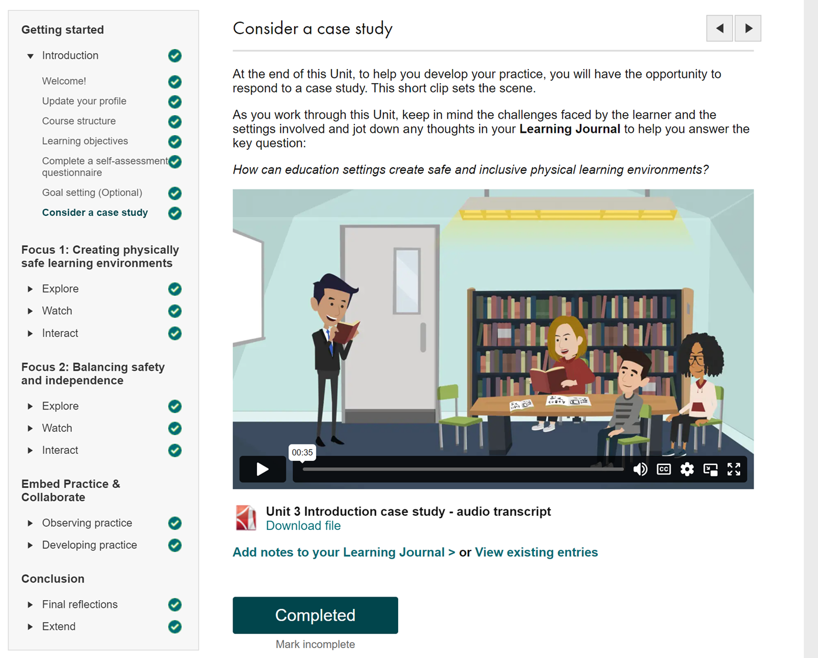
Universal SEND Services programme: Online SEND CPD units
20 free to access e-learning units
20 minutes to complete a unit
Each unit addresses one of the most commonly observed barriers to learning
Applicable to all ages, stages and area of need
Suitable for teachers / tutors and support staff in schools and FE settings
www.wholeschoolsend.org.uk/page/online-cpd-units
Notes:
AW
3
Developed by ERG, YPAG, trialled and reviewed by school and college practitioners
Over 1000 people have used already – 100% satisfaction, 99% report improvement in confidence in identifying and meeting needs, 99% report they will incorporate learning into daily practice, 97% report they will share learning to impact provision across setting

Slide 14
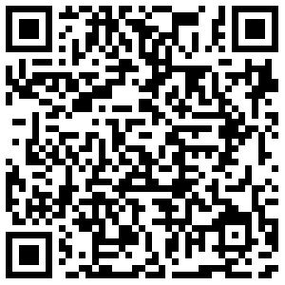
Universal SEND Services Online SEND CPD units
Register for updates about new units:
Notes:
AW
2

Slide 15
Universal SEND Services programme: Live online discussions
Informal, interactive online meetings
Led by WSS regional leads, ETF Centres for Excellence, and subject specialists
Chance to share experiences and seek advice
Tailored to Primary or Secondary / FE settings
Support contextualisation and application of learning from our online SEND CPD units (although there’s no obligation to have completed the units)
Opportunity to network with colleagues from across the country
“It has been wonderful to be able to share experiences and approaches with people from different settings. Very enriching.”
Notes:
AW
3
Booking for sessions linked with first 3 units is available for Summer Term
Booking for other units launched alongside the units themselves

Slide 16
Universal SEND Services programme: Webinars and webinar recordings
Four live webinars each year, responding to the needs of the sector
Access to recordings of all previous webinars
Led by WSS National Coordinators, Regional Leads, external subject specialists
Previous USS webinars include:
Ensuring accurate identification of SEN
Supporting reflection on SEND using Ofsted framework
Ensuring an ambitious and accessible curriculum for learners with SEND
Meeting increasing SEMH needs within mainstream settings
“Amazing session.
Thoroughly practical and in a relaxed, supporting manner.
Many thanks.”
Notes:
AW
3
Booking for sessions linked with first 3 units is available for Summer Term
Booking for other units launched alongside the units themselves

Slide 17
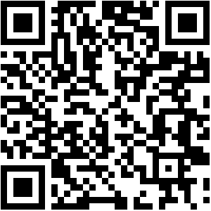
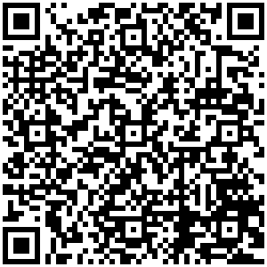
Universal SEND Services programme: Live online discussions, webinars and webinar recordings
Book for live discussions and webinars:
“Breakout rooms were useful. Conversations were insightful and provided lots of ideas to use.”
Online Discussion Participant
“Delivered in a way that was real and made easy to understand. I will use this as CPD for my team.”
Live Webinar Delegate
View past webinar recordings:
“Excellent session – very motivating. I’ll share the recording across my trust. Thank you.”
Live Webinar Delegate
www.wholeschoolsend.org.uk/events
Notes:
AW
2

